Slide 1


Barriers to Involving and Engaging Parents and Families
For Scotland’s learners with Scotland’s educators

Slide 2
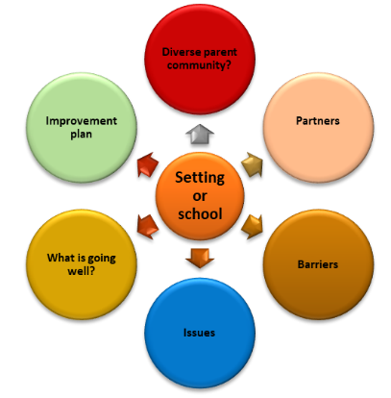
Self-Evaluation Exercise
Purpose - To consider the diverse parent community in your catchment area through a self-evaluation exercise
See Section 3 of the Engaging parents and families: A toolkit for practitioners
https://education.gov.scot/resources/engaging-parents-and-families-a-toolkit-for-practitioners/
For Scotland’s learners with Scotland’s educators

Slide 3
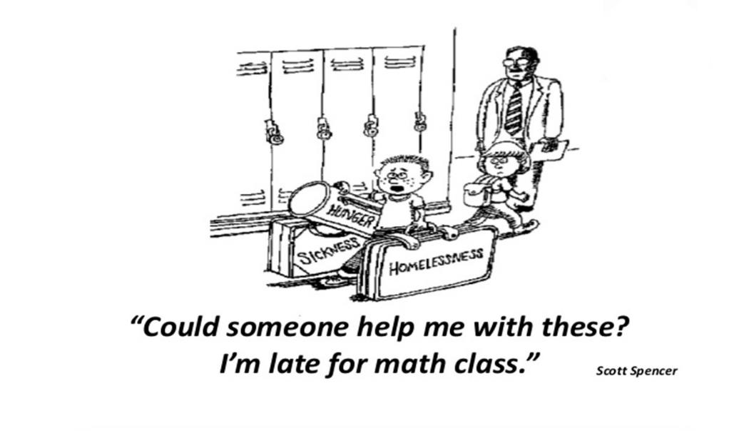
cartoon
For Scotland’s learners with Scotland’s educators

Slide 4
Comparisons - Barriers to involving and engaging parents and families
Research
Uninvolved
Reluctant to participate
Hard to reach
Apathetic and indifferent to child's education
Do not care about child's education
Responsibility placed on parents when no participation
Access to capital affects ability to act and participate
Despite educational theory on the importance of involving / engaging parents, practice lingers behind
Future rests on teacher training and professional learning
Parents feel unable to engage with child's learning
Setting or school factors
Educators and practitioners
Time
Staffing
Cover
Private space to make calls
Making connections
Skills, competencies, standards, building blocks are required
Little or no professional learning
Unaware of the importance of involving/engaging parents
Beliefs, unconscious bias
Attitudes
Personal anxieties over engaging with parents and families
Lack of strategies
Not equipped to work with parents and families
Parents and families
No opportunities or not aware
Bereavement
Digital devices / data poverty
Balancing work / learning at home
Mental health
Anxieties, feeling disconnected from setting/school
Own or child's Additional Support Needs
Time, cost
Other children
Confidence
Language barriers
Literacy / numeracies issues
Previous negative experiences
Financial stress
Household stress
Shared parenting
Social isolation
Age
Caring responsibilities
For Scotland’s learners with Scotland’s educators

Slide 5
Barriers to engaging parents timeline (2011-2022)
2011
Individual parent and family factors
Parent-teacher factors
2017
Time, childcare, transport, knowledge, information, awareness, motivation, working patterns, English as additional language, negative experiences, perceptions, gender
Socio-economic, poverty, social inclusion, additional support needs, disabilities, parenting skills, shared parenting, mental health issues, substance misuse, offending
2017
Parents feel unable to engage with children’s learning
Child factors
Societal factors
Information and support, effective strategies, community and family based interventions
2019
2020-2022
Less opportunities to build relationships and get involved in wider life of setting / school
Caring for younger children
Not aware of opportunities
Cost
Language barriers
Feelings of ‘failing’ children
Bereavement
Digital poverty
Balancing work/learning at home
Less opportunities to access support
Changing timescales and restrictions
Mental health and wellbeing
Frustration
Anxieties
Self-isolation/shielding
Communication
Transitions
Inconsistencies
Feelings of being disconnected from setting / school
Additional support needs
Not allowed in setting/school
Work commitments
No opportunities
Lack of confidence
(Hornby and Lafaele - 2011)
(Scottish Executive - 2005 - Updated by Education Scotland in 2017)
(Centre for Research on Families and Relationships - 2017)
Parental Involvement / Engagement census - 2019
COVID-19 Barriers – 2020-22
For Scotland’s learners with Scotland’s educators

Slide 6
Local authority PIE Census data
Practitioners should insert information on their local authority’s PIE Census data. For example, this could include data on the following:
Comparative number of responses between surveys e.g. 2019 compared to 2022
Barriers:
what is preventing parents from getting involved and engaged e.g. work commitments, no opportunities
by age or SIMD
by sector e.g. primary, secondary
by ethnicity
Learning at Home:
Data on schools providing parents with information they need to support their child's learning at home.
Family Learning:
Percentage of schools making parents aware of Family Learning opportunities
Percentage of parents that have taken part in Family Learning opportunities

Slide 7
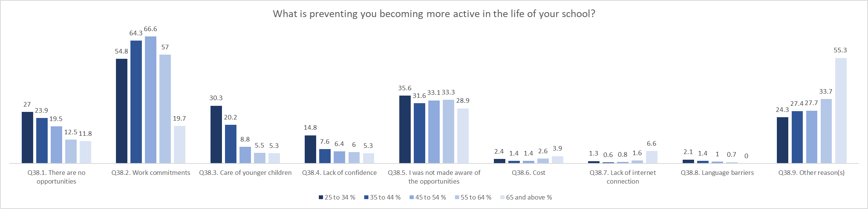
National Parental Involvement and Engagement Census 2022
https://www.gov.scot/publications/parental-involvement-and-engagement-census-scotland-2021-22/pages/parental-involvement-and-engagement/

