Slide 1

Notes:
This is a front cover page and can only be used at the beginning of a PowerPoint presentation once. Do not add anything else to this screen if it is being used.

Slide 2

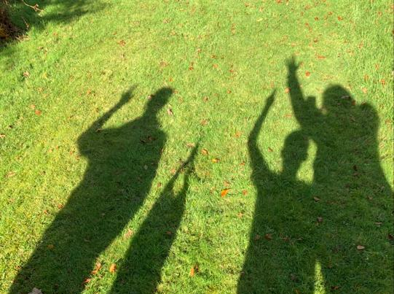
Engaging Families in Learning
A thematic inspection of family learning

Slide 3
Scope of the thematic
Inspectors visited 41 schools, early learning and childcare and CLD settings
January and February 2020
We spoke to:
474 parents and carers | 292 children and young people
429 staff | 191 partners
For Scotland's learners, with Scotland's educators
Notes:
This is an internal page in blue and can be duplicated to create additional pages. Always keep the heading and footer as shown. Use the corresponding blue internal and back pages if you are using this page.

Slide 4
Definition of family learning
‘Family Learning encourages family members to learn together as and within a family, with a focus on intergenerational learning. Family learning activities can also be specifically designed to enable parents to learn how to support their children’s learning. ‘Family learning is a powerful method of engagement and learning which can foster positive attitudes towards life-long learning, promote socio-economic resilience and challenge educational disadvantage’.
(Family Learning Network, 2016)
For Scotland's learners, with Scotland's educators
Notes:
This is an internal page in blue and can be duplicated to create additional pages. Always keep the heading and footer as shown. Use the corresponding blue internal and back pages if you are using this page.

Slide 6
Two high level questions
How are families engaged in family learning activities?
How are families benefiting from family learning activities?
For Scotland's learners, with Scotland's educators
Notes:
This is an internal page in blue and can be duplicated to create additional pages. Always keep the heading and footer as shown. Use the corresponding blue internal and back pages if you are using this page.

Slide 7
What did we find? – Strengths
Most schools and ELC settings where family learning is taking place are building and sustaining positive relationships with parents. This is key to the success of family learning activities and programmes. | Family learning in schools is starting to improve outcomes in terms of attainment and achievement. Families facing challenges are learning new skills to help them address issues in their lives. | Children and young people have increased confidence, self-esteem and engagement in their learning as a result of parental engagement and family learning. | A few adults engaged in family learning are gaining qualifications, progressing to volunteering and in a few cases employment.
For Scotland's learners, with Scotland's educators
Notes:
This is an internal page in blue and can be duplicated to create additional pages. Always keep the heading and footer as shown. Use the corresponding blue internal and back pages if you are using this page.

Slide 8
What did we find? – Areas for improvement
Developing a stronger understanding of the key features of family learning would help schools, ELC settings and their partners to set out clearer aims and outcomes. | There is scope for schools, ELC settings and their partners to work together in a more coordinated way to help them achieve their shared objectives. | Partners need now to establish robust arrangements that enable them to report on the impacts of family learning, and to celebrate and disseminate highly-effective practice. | The sustainability of family learning needs to be considered as part of planning activities and programmes. | Progression routes for adult learners needs to be more integral to family learning activities and programmes. Effective partnership working can help to strengthen this.
For Scotland's learners, with Scotland's educators
Notes:
This is an internal page in blue and can be duplicated to create additional pages. Always keep the heading and footer as shown. Use the corresponding blue internal and back pages if you are using this page.

Slide 9
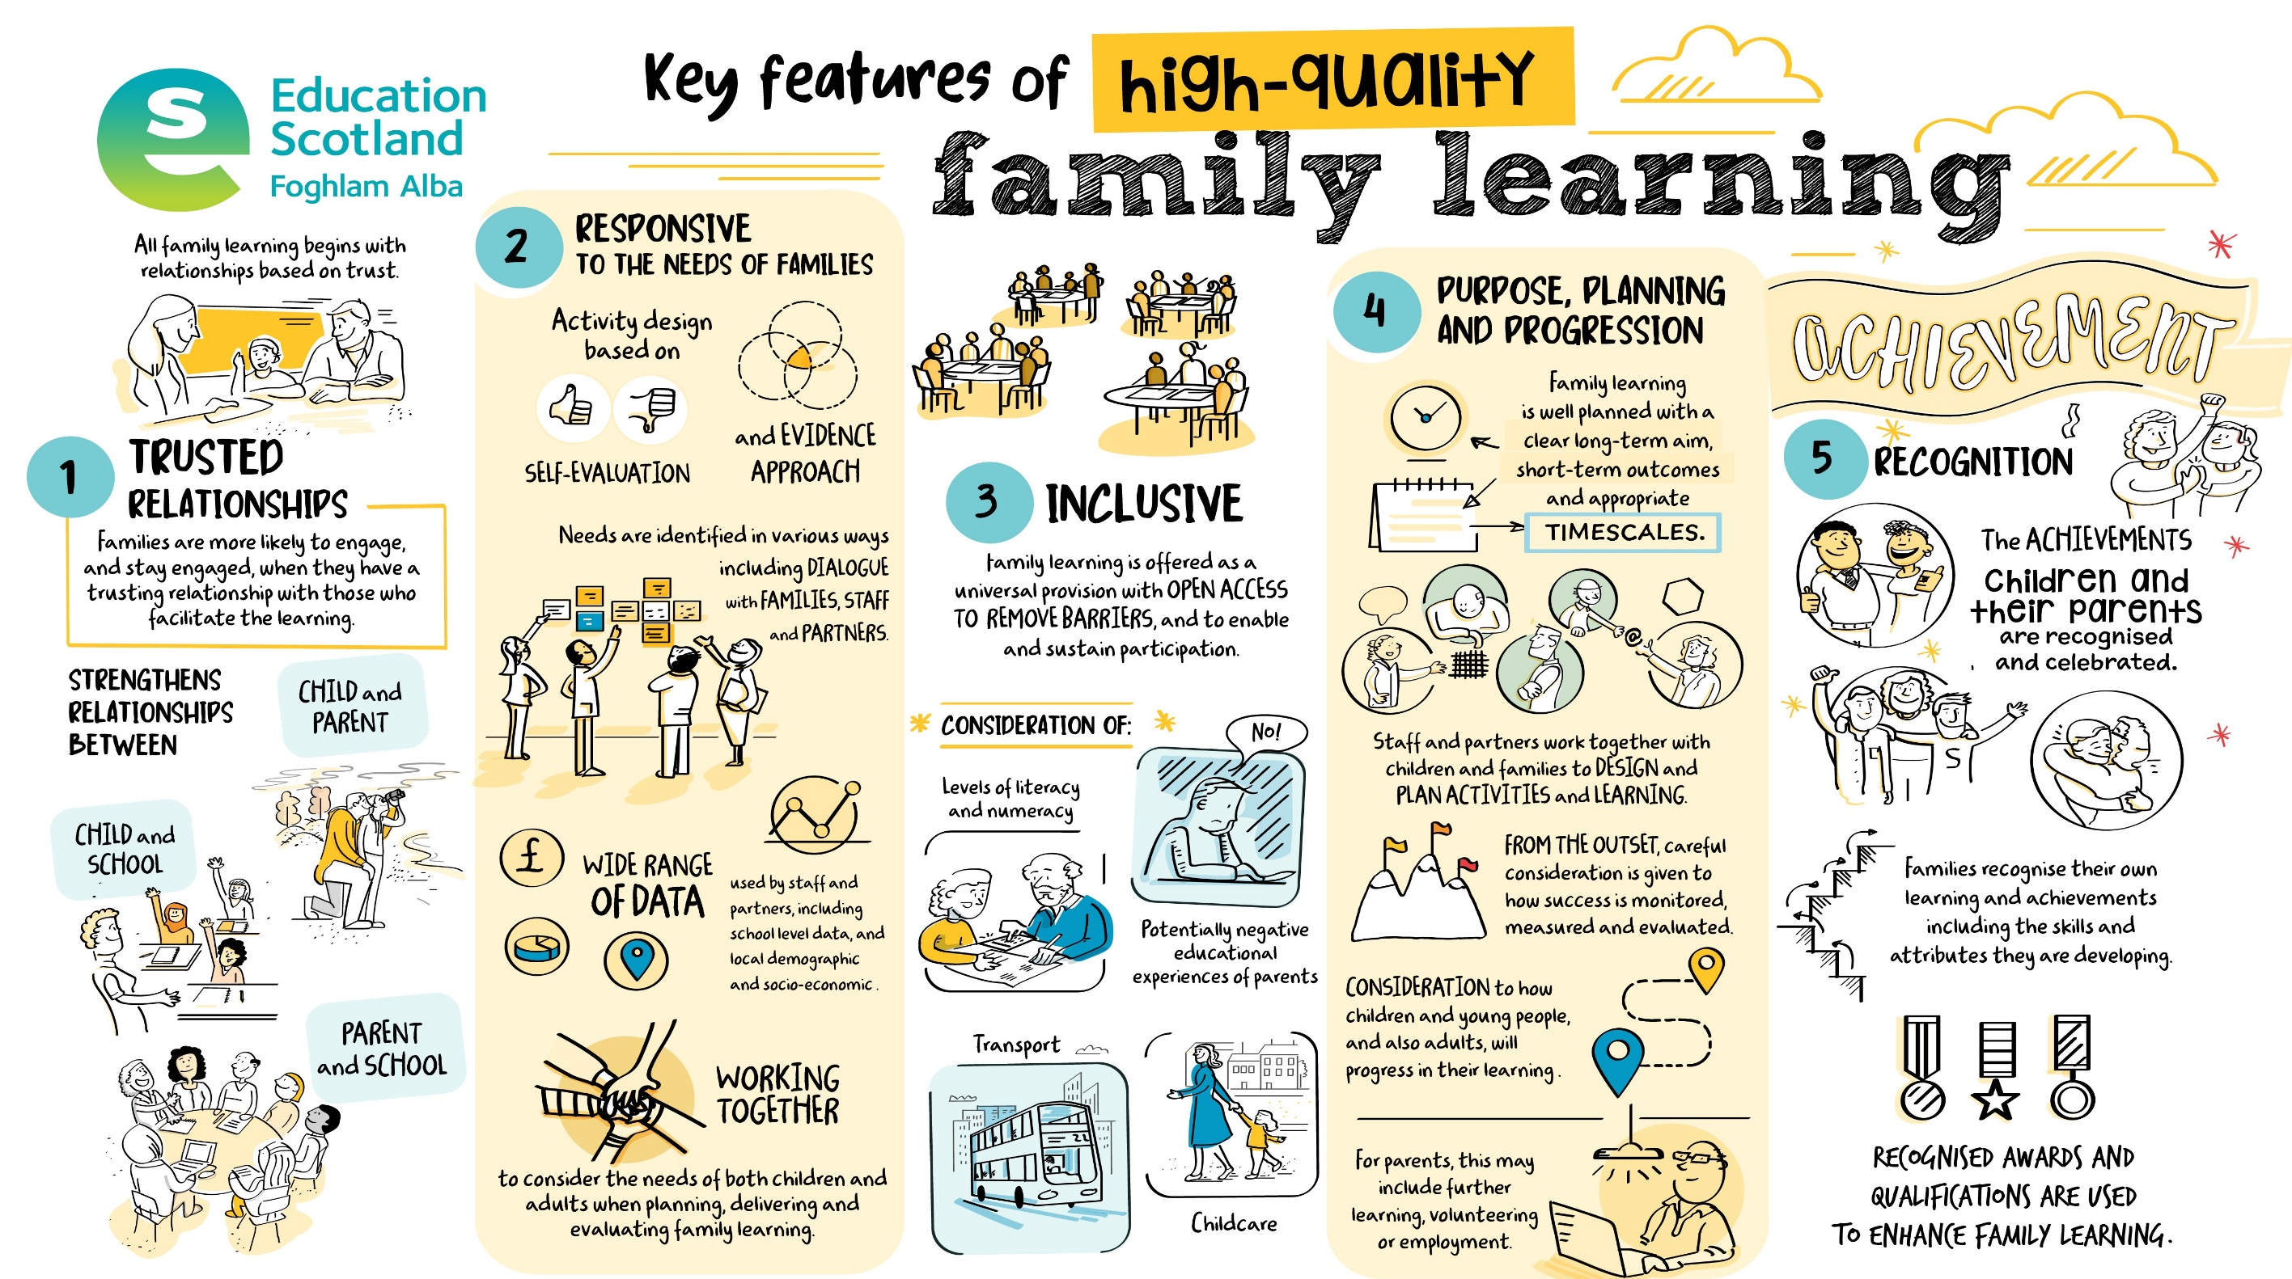

Slide 10
Questions for discussion
How can we work together with parents and children to plan family learning that takes account of the impact of the pandemic on families and communities?
How can we adapt our engagement with families whilst ensuring that everyone is safe?
How will our future work with families help us to meet the needs of those most disadvantaged by Covid-19?
For Scotland's learners, with Scotland's educators
Notes:
This is an internal page in blue and can be duplicated to create additional pages. Always keep the heading and footer as shown. Use the corresponding blue internal and back pages if you are using this page.

Slide 11


Education Scotland
Denholm House
Almondvale Business Park
Almondvale Way
Livingston EH54 6GA
T: +44 (0)131 244 4330
E: enquiries@educationscotland.gov.scot
www.education.gov.scot
For Scotland's learners, with Scotland's educators
Notes:
This is a back cover page in blue. You may edit the address if needed only. It can only be once and at the end of the PowerPoint presentation. Use the corresponding blue internal and back pages if you are using this page.

