Slide 1

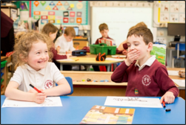
Learning at Home
For Scotland’s learners with Scotland’s educators

Slide 2
Scottish Schools (Parental Involvement) Act 2006
The Act recognises the vital role that parents play in children’s learning and development.
Duties within the PI Act:
Parents should receive information and support to help develop their child’s learning at home and in the community.
Learning at home should be included in the Local Authority’s Parental Involvement Strategy.
Parental Involvement Act 2006
and Statutory Guidance
Learning at
Home
Home / School partnership
Parental representation
For Scotland’s learners with Scotland’s educators

Slide 3
Review of the impact of the Parental Involvement Act 2006 (NPFS, 2017)
There was confusion and a general lack of understanding among parents and staff about the difference between homework and the concept of learning at home.
Further work is required on the learning at home strand of the Parental Involvement Act (2006).
Headteachers identified learning at home as an area for further development.
Clarification is needed on the definition of learning at home.
For Scotland’s learners with Scotland’s educators

Slide 4
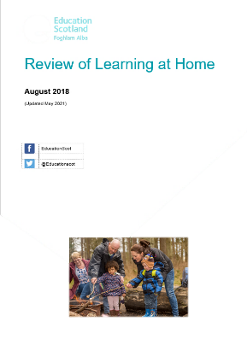
Review of Learning at Home
https://education.gov.scot/resources/review-of-learning-at-home/
For Scotland’s learners with Scotland’s educators

Slide 5

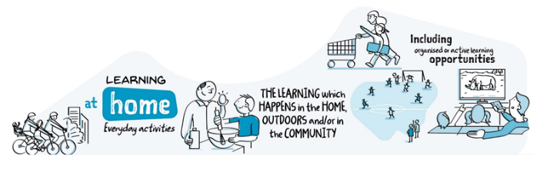
What is Learning at Home?
Parents have a vital role in a child’s learning and development throughout their lives. Early learning and childcare settings, schools and communities can also play a key part in recognising, developing and resourcing this.
‘Learning at home is the learning which happens in the home, outdoors or in the community. It can take place through everyday activities that families already do and can overlap with aspects of organised or active learning activities’
(Scottish Parental Involvement Officers Network, 2018).
For Scotland’s learners with Scotland’s educators

Slide 6
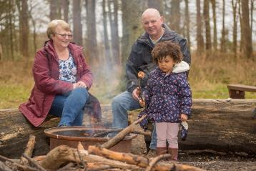
Why is Learning at Home important?
Research has shown that around 80% of the difference in how well children do at school is dependent on what happens outside the school gates.
(Rasbash et al 2010; Save the Children 2013)
Learning at home is crucial for children to learn and develop. Research shows that learning at home can have significant immediate and longer-term impacts on children in different ways:
a child’s early learning
later achievements
nurture
resilience
wellbeing
social mobility
skills for life
For Scotland’s learners with Scotland’s educators

Slide 7
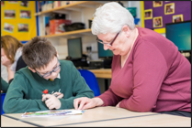
Why is Learning at Home important (Cont.)?
In Scotland children spend approximately 15% of their waking hours in school, which leaves 85% spent at home and in the community, with huge potential for learning.
OECD Report 2014
For Scotland’s learners with Scotland’s educators

Slide 8
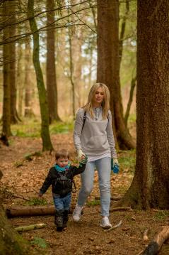
How can Learning at Home happen?
A range of events including:
play, leisure activities, fun events, sports, trips, cultural or volunteering experiences.
It can also happen through:
curriculum related activities, homework, reading and sharing books.
For Scotland’s learners with Scotland’s educators

Slide 9
What do we mean by the home learning environment?
Combination of everything in a home
Time that a child spends out and about which affects their learning and development - including:
  having space and time to learn
  toys, books, outings
  people who provide the love, security, encouragement, conversation and positive role models to help a child to thrive
A good home learning environment encourages children and young people to have positive attitudes to learning, to be curious, creative and to have confidence in themselves.
https://education.gov.scot/parentzone/learning-at-home/home-learning-environment/
For Scotland’s learners with Scotland’s educators

Slide 10
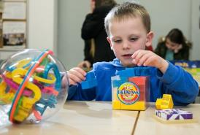
Why is the home learning environment important?
Research shows that when parents and carers engage in their children’s learning, and when children and young people live in a supportive home learning environment, it improves their attainment and achievement
(2024 National Improvement Framework and Improvement Plan, 2023).
For Scotland’s learners with Scotland’s educators

Slide 11

Home learning activities - Growing up in Scotland Study
Children from less advantaged households are less likely to experience a wide range of ‘home learning’ activities than children from more advantaged households.
Children who experience a wide range of activities like being read to, singing nursery rhymes and drawing, from an early age score higher in cognitive ability tests at age 3 than children with less experience of these activities.
Parenting and children’s activities in the early years can make a difference to children’s outcomes.
The influence of home learning environment was over and above that of standard measures of family socio-demographic factors such as parental education, socio-economic status and income.
(Melhuish, 2010)
For Scotland’s learners with Scotland’s educators

Slide 12
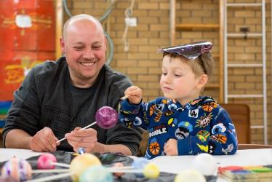
Discussion
What does learning at home look like in your setting/school?
For Scotland’s learners with Scotland’s educators

Slide 13
Examples of Learning at Home (including Homework activities)
Learning at Home
Learning at home / homework activities: Family challenges/challenge cards, adventures with Teddy, board games, shopping, lego building, STEM challenge, pick and mix homework, sacrament preparation, model making, newsletter, powerpoints on favourite/interesting things, cake decorating – taking photographs, 100 things to do before you’re 13 | Sharing learning: Nurture groups, Maths recovery lessons (with children), child led workshops, outdoor learning, stay and play, open afternoons, homework fun challenges, P1 home learning reading block, class assemblies, careers day, talk time homework, shared learning exercises (Art/IT – practical)
Families learning together: Family learning events or homework club, PEEP / bookbug, parental reading programme, photography club, outdoor learning, cooking, crafts, work with fathers | Others: Reviewed reading policies, review and planner, tracking achievements, personal learning planning, target setting, GIRFEC review meetings
Helping parents: ESOL, L@H guidance – leaflets, parent packs, workshops, videos, cafes, home-link worker, parent mail/text messages, homework clubs, notes of intended learning | Communication methods: Show my homework, website, twitter app, homework app, Glow, RM Easimaths, leaflets
For Scotland’s learners with Scotland’s educators

Slide 14
Examples of Learning at Home (including Homework activities)
Learning at Home
Learning at home / homework activities: Home learning bags, building on achievements from home, homework tasks with family members, Ted’s adventures at home, home-link initiatives, STEM, travelling dolls, lending library | Sharing learning: Class reward system, home-school sharing of achievements, child led workshops – informative learning opportunities provided by teachers
Families learning together: Family homework group Parent-child homework club | Others: Parents encouraged to support learning through parents meetings, work with school to address issues, target setting in user friendly language
Helping parents: Stay and play sessions, parental workshops, open days, special events, planned support for parents on supporting reading at home, written materials on what child is learning, information booklet on supporting at home | Communication methods: Online learning journals, daily conversations, interactive online resources, blog, learning profiles, home-school diaries, text messages, noticeboards, photographs
For Scotland’s learners with Scotland’s educators

Slide 15
Research – Learning at Home
Topics emerging in research discourses on effective Learning at Home covers the following themes:
Positive parenting experiences
Parent-child relationships
Stimulating home learning environment
Educational activities
Parenting styles
Child development
Homework / effectiveness of homework – primary / secondary
Supporting parents to help their children learn at home
Staff training/development – building the capacity of practitioners
For Scotland’s learners with Scotland’s educators

Slide 16
Examples of Resources available on
Parentzone Scotland
For Scotland’s learners with Scotland’s educators

Slide 17


Web link
https://education.gov.scot/parentzone/
For Scotland’s learners with Scotland’s educators

Slide 18








Family Learning Resources on Parentzone Scotland
Meet the ‘I am a’ characters
Babble
and
Dabble
Multiplying Milli
And
Dividing Dec
Virtual Veronica
and
Coding Christopher
Mike
And
Eiliyah
For Scotland’s learners with Scotland’s educators

Slide 19
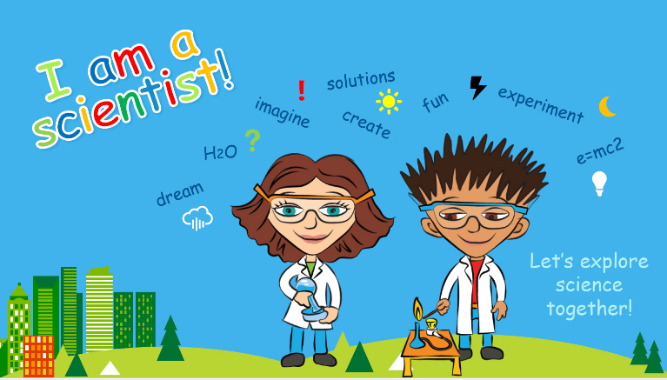


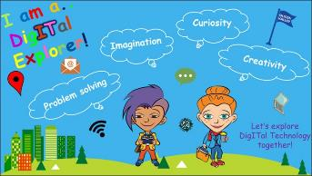
Family Learning Resources on Parentzone Scotland
https://education.gov.scot/parentzone/learning-at-home/supporting-science-at-home/
For Scotland’s learners with Scotland’s educators

Slide 20
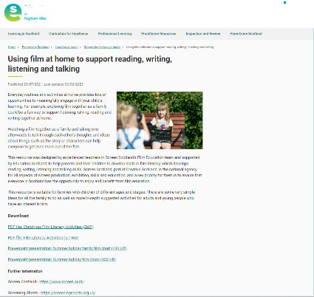
Supporting Literacy at Home
https://education.gov.scot/parentzone/learning-at-home/supporting-literacy-at-home/
For Scotland’s learners with Scotland’s educators

Slide 21
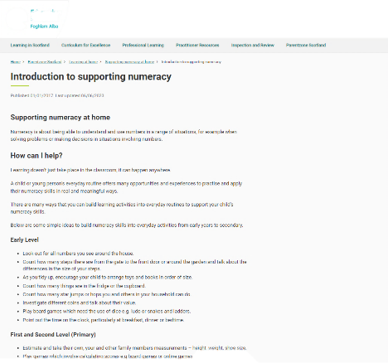
Supporting Numeracy at Home
https://education.gov.scot/parentzone/learning-at-home/supporting-numeracy/
For Scotland’s learners with Scotland’s educators

Slide 22
quote
Enjoy the little things because one day you will look back and realise, they were the big things…..
‘It’s all the little things that make it work….’ (Headteacher)
For Scotland’s learners with Scotland’s educators

