Slide 1

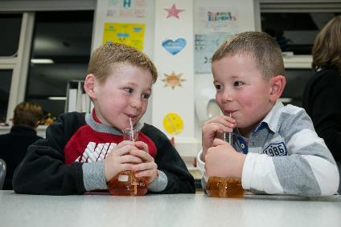
Benefits of Involving and Engaging Parents and Families
For Scotland’s learners with Scotland’s educators

Slide 2
Valuing parent, family and school relationships (Cont.)
‘Parent involvement is valuable in that it contributes to the building of trust and relationships between parents and educators.
Parent engagement in teaching and learning is a critical factor in a child’s academic success and overall well-being. It is a vital component of a child’s educational journey, and it can take on various forms, adapting to the specific needs and dynamics of families. Every parent can and does support their children’s education in various ways. It is important to note that differing outcomes are achieved, depending on where they place their energy’.
(Pushor, D. ‘Revisiting parent engagement in present times’)
For Scotland’s learners with Scotland’s educators

Slide 3
Valuing parent, family and school relationships (Cont.)
‘When educators and families collaborate as partners, they create important opportunities for children to develop social, emotional, and academic competencies. The reason for educators and families to co-operate, co-ordinate, and collaborate is to enhance learning opportunities, educational progress, and school success’.
(Edwards, P.A., Peltier, M.R. and Porter L. (2023), ‘Collaborating to Promote Family Literacy In: Caspe, M. Hernandes, R. ‘Family and Community Partnerships’. Charlotte NC. Information Age Publishing Inc. pp101
For Scotland’s learners with Scotland’s educators

Slide 4
Valuing parent, family and school relationships
The review found that the most effective way of helping low-income children to achieve their ambitions was not by focusing on aspirations; it was focusing on some of the key objectives of family learning: engaging parents in their children's learning, engaging parents in their own learning, and providing a range of support for children. Interventions that helped parents feel more confident and competent at being involved with their children's learning produced better outcomes, as did those that helped parents better understand how the education system works and how they can work with teachers and schools to help their children reach their full potential.
Carpentieri, J.D. (2012), ‘Family learning: a review of the research literature’ - https://learningandwork.org.uk/wp-content/uploads/2020/05/Family-learning-A-review-of-the-research-literature.pdf
For Scotland’s learners with Scotland’s educators

Slide 5
Benefits for parents and families
Their children do better when they are involved
They are better supported to help and encourage their children's learning and development
They have more information about their children's education
Parents can support each other through peer mentoring which can have an impact on reducing isolation and build their confidence and skills
Parents get reassurance that their children are receiving a good education
https://education.gov.scot/resources/engaging-parents-and-families-a-toolkit-for-practitioners/
For Scotland’s learners with Scotland’s educators

Slide 6
Benefits for children and young people
It is easier for children and young people to learn when they get encouragement at home
They will attain and achieve more when their parents are involved
Children and young people get access to more activities in and out of settings when there are more adults to help
Any concerns in the setting or school can be addressed more easily when parents and settings/schools work together
They are happy when their parents are enjoying events in the setting or school
https://education.gov.scot/resources/engaging-parents-and-families-a-toolkit-for-practitioners/
For Scotland’s learners with Scotland’s educators

Slide 7
Benefits for ELC settings and schools
Parents bring skills and cultural diversity which can enhance children’s learning
Parents contribute their time, so together parents and practitioners are able to do more activities with children and young people than practitioners can do on their own
Children and young people’s attainment and behaviour improve
Parents have ideas about how the ELC setting or school can best support their children
Practitioners have people with whom they can talk over ideas and get help when developing plans for the ELC setting or school
Parents can contribute to improvement planning and an enhanced curriculum
https://education.gov.scot/resources/engaging-parents-and-families-a-toolkit-for-practitioners/
For Scotland’s learners with Scotland’s educators

Slide 8
Benefits for the local authority
The local authority can draw on the ideas and experience of parents to influence future strategic developments
The local authority can benefit from feedback provided by parents on how effective its policies and education provisions are working in practice
Local authorities can benefit from parental participation in implementing and reviewing local policies
https://education.gov.scot/resources/engaging-parents-and-families-a-toolkit-for-practitioners/
For Scotland’s learners with Scotland’s educators

Slide 9
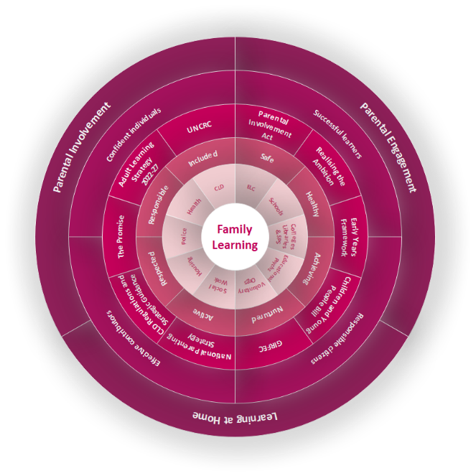

Benefits of Family Learning
Positive impact on parents’ literacy, numeracy, communication, self-confidence and efficacy (Swain, Brooks & Bosley, 2014).
The course helped people gain self-esteem and self-confidence which in turn helped parents communicate better with their children and teachers at school. Every person interviewed now takes part in either parent councils or school activities.
Dr K Stelfox, P Bain, S Foreman (2017)
Research on the value of FL to parents shows that opportunities to experience success in learning
enables parents to change their literacy, numeracy and communication practices as well as improving
their self-confidence and efficacy
Gale Macleod & Lyn Tett (2019)
Family Learning programmes increase the employability of parents/carers whilst also equipping them to support their children’s learning and development. (2016)
The idea that parents need to be literate and that through the intergenerational transfer of skills and attitudes, the parents' education can influence the subsequent educational achievement of their children, is a foundational belief of contemporary family learning programmes.
(Sticht, ‘Towards a Multiple Life Cycles Education Policy’, 2007)
Children become more confident about their learning capacities which in turn leads them to persist in the face of challenges (Horne & Haggart, 2004);
This study provides evidence that after attending family literacy sessions children improve their literacy skills and there are positive changes in the home literacy environment (2016)
Family-centred literacy programmes, however, show that there are immediate benefits as well as a longer-term impact for both children and adults (Brooks et al, 2008; Carpentieri et al, 2011; Hayes, 2006; Tuckett, 2004).
For Scotland’s learners with Scotland’s educators

