Slide 1

Embedding Community Resilience
Network Day 3
For Scotland’s learners, with Scotland’s educators
Notes:
This is a front cover page and can only be used once. Use the corresponding blue internal and back pages if you are using this page. You may add a title and a subtitle if needed only. Do not add anything else or move elements around.

Slide 2
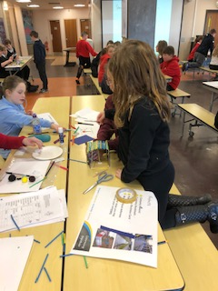
Embedding Community Resilience

Slide 3
General Aims
Embed community resilience as an exciting and relevant context for learning for Scottish schools which supports curriculum areas such as social studies, health and wellbeing, technologies, science, global citizenship, sustainability, rights education, developing the young workforce and outdoor learning through interdisciplinary learning within Curriculum for Excellence.
Through partnership working develop opportunities for learners to participate in and contribute to real-life, relevant community resilience activities locally and nationally.
Create opportunities for children, young people, their parents and schools to connect more fully to their communities and to participate in local decision-making and activities in relation to community resilience.

Slide 4
General Aims (continued)
To enable learners to become more resilient individuals and to develop their skills in managing risks and to empower them to keep themselves and others safe.
To enable children, young people, their parents and communities to understand the importance of community resilience in mitigating the impact of emergency situations and to reassure them that the Government, emergency services and others are at work to keep them safe.
Enable learners to develop the attributes, capabilities, motivation and skills required for them to contribute effectively to make their community more resilient.
Work in partnership with local education authorities to encourage schools to use community resilience and flooding issues as exciting contexts for learning within the curriculum.

Slide 5
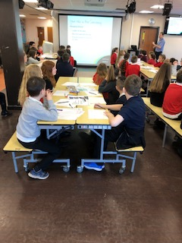
Business in a Box

Slide 6
Day 3 Aims
Throw the dice
Learning Pathway journey to date.
Ali Hynd – Mintlaw Academy Case Study
Paired Reading
Assessment and Moderation – sharing Practice and Moderation Discussion of Planning for Assessment and Levelling Assessment piece
Back to the Beginning – Visual Curriculum

Slide 7
Voice on the table
Starting with the person who has travelled the farthest –rotate clockwise – introduce yourselves
Share your
Name
School and Role
Drawing upon your own personal resilience journey share 1 thing you have learned about yourself.
(1 minute each)

Slide 8
Updates
English Speaking Union – Debating Package
3 draft documents – Es and Os x2 and Benchmarks
National Events?
Next Meeting – possibility of Funding Partners attending
May and September - Work on How Good is our Community Resilience?

Slide 9
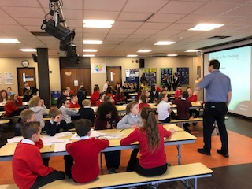
P6 Transition Day

Slide 10
Learning Pathways
You have 5 to 10 minutes each to talk about your Learning Pathway journey to date.

Slide 11
Throw the Dice
Take it in turns to through the dice and share your experiences.
Referring back to your Learning pathway - Tell others about
1= A Community Resilience challenge you have overcome.
2= A Community Resilience Success
3= A successful Community Resilience partnership
4= A positive Community Resilience Impact
5= Something you need to improve
6= Something you need to throw out.

Slide 12
Mintlaw Academy
Ali Hynd – Community Resilience Case Study

Slide 13
Paired Reading
Person no. 1 reads the marked passage
Person no. 2 shares his or her understanding of text
Both discuss and agree on main points and note them down.
Person no. 2 reads the marked passage
Person no. 1 shares his or her understanding of text
Both discuss and agree on main points and note them down.

Slide 14
Assessment and Moderation
Think Pair Share Compare
Benchmark/Es and Os Focus
The Learning Focus for Assessment and how it was assessed.
How did the pupil (s) achieve?
Which stage of learning does the assessment portray and what should the feedback be ?

Slide 15
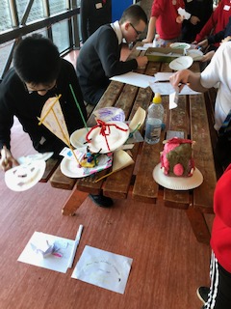
Selling Products

Slide 16
Back to the Beginning
You have drawn up your visual pathways.
Some of you have a Community Resilience Wall
How accessible/ understandable is your Community Resilience Curriculum?

Slide 17
Rotating Carousel
School Logo/Picture/Symbol – Words, pictures, touch, sounds?
Vision and Values – How can they be displayed?
Drivers? E.g. Outdoor Learning, Nurture etc.
National Improvement Framework - How does Community Resilience contribute to improvements?

Slide 18
Next Steps
Work on your own school’s Community Resilience Visual display – whether it is electronic, on a wall or for your school handbook.
Add this to your visual pathway
Continue to embed Community Resilience and record your progress.

Slide 19
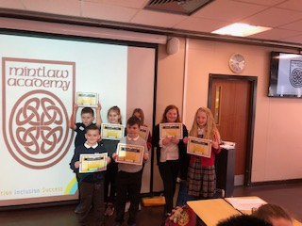
The winning team

