Slide 1

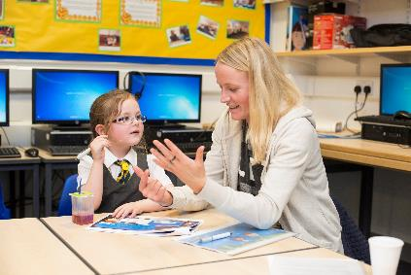
Workforce Development
For Scotland’s learners with Scotland’s educators

Slide 2

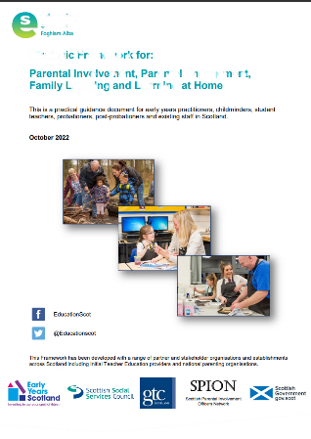
Spotlight on..
Strategic Framework for: Parental Involvement, Parental Engagement, Family Learning and Learning at Home
https://education.gov.scot/resources/strategic-framework-for-parental-involvement/
Notes:
Key messages
This Strategic Framework is for practitioners and educators who work with parents and families and/or who are involved in delivering training to the workforce.
Improving outcomes for learners, parents and families remains a key priority across Scotland’s political and educational landscape.
There is an ongoing need to ensure that the workforce has the appropriate values, competencies, skills, knowledge, experience and qualifications to work effectively with learners, parents and families.
The Strategic Framework provides a structure within which all stakeholders can engage in and deliver professional learning on parental involvement, parental engagement, family learning and learning at home. There is a need for practitioners who support the qualification and professional learning of early years practitioners, childminders and teachers on: parental involvement, parental engagement, family learning and learning at home, to review their offer and ensure it aligns with the Strategic Framework​.

Slide 3
Workforce Development
Equipping the workforce and ensuring they have access to, and are signposted towards professional learning opportunities, resources, case studies, research and current examples of good practice is vital.
It is also important to ensure that staff have the required competencies, skills and values needed to work with parents and families to support their child’s and their own learning journey.
Developing the workforce can be challenging during ever changing complex economic and financial circumstances but it is crucial to building trusting relationships.
For Scotland’s learners with Scotland’s educators

Slide 4
Workforce Development
National Occupational Standards (NOS) describe what a person needs to do, know and understand in order to carry out a particular job or task in a consistent way and to a nationally recognised level of competence.
Suite of NOSs which has been agreed across the four nations of the UK. Qualifications in Scotland are underpinned by the National Occupational Standards.
The National Occupational Standards for Work with Parents apply to work with parents across the four nations of the UK. They were developed in consultation with the sector and were originally approved by the United Kingdom (UK) Regulatory bodies (QCA, SQA, ACCAC and QCA NI) in 2005. The Standards were reviewed during 2010 and the updated version was approved by the UK regulatory body UKCES in January 2011.
Information on the Work with Parents National Occupational Standards is available here.
For Scotland’s learners with Scotland’s educators

Slide 5
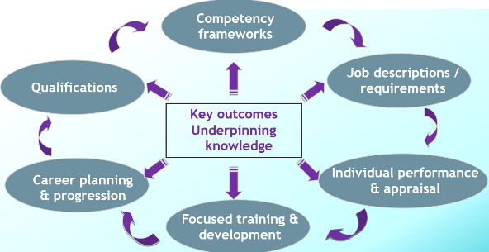
Family Learning National Occupational Standards Refresh 2023
A National Occupational Standard describes what an individual needs to do, know, and understand in order to competently carry out a particular job or function.
Potential uses of NOS:
For Scotland’s learners with Scotland’s educators

Slide 6
How can we capitalise on Parental Engagement to drive improvements?
It is ‘valuable to look beyond these immediate concerns to what may be possible for education on the other side of the COVID-19 pandemic….now is the time to chart a vision for how education can emerge stronger from this global crisis than ever before and propose a path for capitalising on education’s newfound support’ (Brookings, 2020).
‘…the availability of child-oriented books at home and the engagement of parents can play an important mitigation role for continued learning, in particular in the most disadvantaged areas’ (Unicef, 2020).
‘Using existing thought patterns severely restricts the options for change people consider’ (Langley et al, 2009).
For Scotland’s learners with Scotland’s educators

Slide 7
How can we capitalise on Family Learning to drive improvements?
Evidence that schools who had embedded family learning programmes pre lockdown had greater parental and family involvement in learning. Schools engaging with families and communities during COVID | IOE - Faculty of Education and Society - UCL – University College London
Family Learning programmes increase the employability of parents/carers whilst also equipping them to support their children’s learning and development. (2016) Learning and Work Institute
Family-centred literacy programmes, however, show that there are immediate benefits as well as a longer-term impact for both children and adults. (Brooks et al, 2008; Carpentieri et al, 2011; Hayes, 2006; Tuckett, 2004)
For Scotland’s learners with Scotland’s educators

Slide 8


National Parenting Organisations
https://www.npfs.org.uk/
https://connect.scot/
BEMIS Scotland Children in Scotland Comann nam Parant Connect Early Years Scotland Enquire Families Outside Fathers Network Scotland Forces Children’s Education/ADES National Parent Forum of Scotland Parent Network Scotland Parenting Across Scotland Peeple | Respectme Royal Caledonian Education Trust Save the Children Scottish Book Trust Scottish Catholic Education Service Scottish Parental Involvement Officers Network Scottish Qualifications Authority Scottish Traveller Education Programme Shared Parenting Skills Development Scotland STEP (formerly Scottish Traveller Education Programme)
For Scotland’s learners with Scotland’s educators

