Slide 1
Centering Diverse Learners and Critical Knowledges in a Re-Imagined Scottish Curriculum
Allison Skerrett, Ph.D.
The University of Texas at Austin

Slide 2
Where we’re headed…
Framing the Educational Moment
Learners and their Social Landscape
Key Considerations for Curriculum Change
Reflections
Notes:
Colleagues at Education Scotland: Jim Fanning, Ollie Bray, Graeme Wallace, and Andy Creamer
Colleagues in the International Council of Education Advisers

Slide 3
The Current Moment in Scottish Education
It’s our Future – Independent Review of Qualifications and Assessment
Hayward Review of Qualifications and Assessment – June 2023
Learning for Sustainability: Action Plan 2023 to 2030
"Target 2030: A movement for people, planet and prosperity" - June 2023
Mental Health and Wellbeing Strategy June 2023
Fit for the Future: Developing a Post-School Learning System to Fuel Economic Transformation
Withers Report - Skills Delivery Landscape Review – June 2023
All Learners in Scotland Matter, National Discussion on Education – May 2023

Slide 4
Learners and their Social Landscape
Increasing racial, ethnocultural and linguistic diversity amidst ongoing racialized and other inequities
A ”post”-pandemic world that has affected learners
Transnational learners and communities
An increasingly digitized world

Slide 5
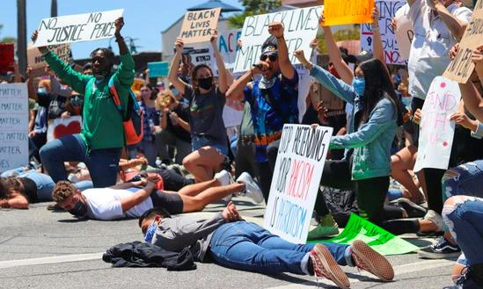
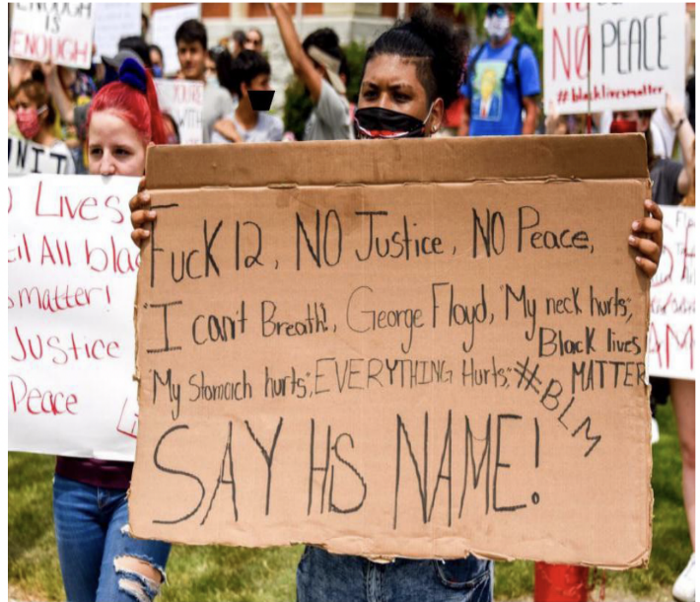
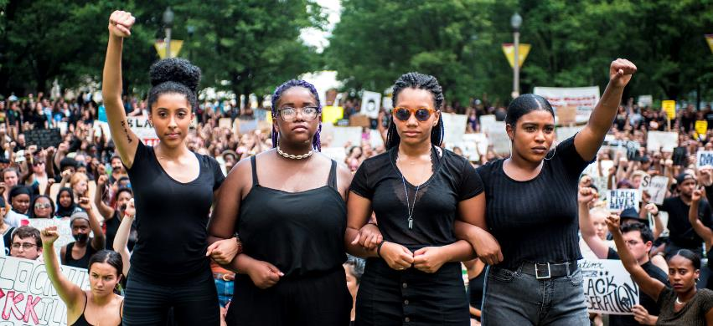
Growing Racial Diversity amidst Intensified Racial Injustices

Slide 6
Covid 19

Slide 7
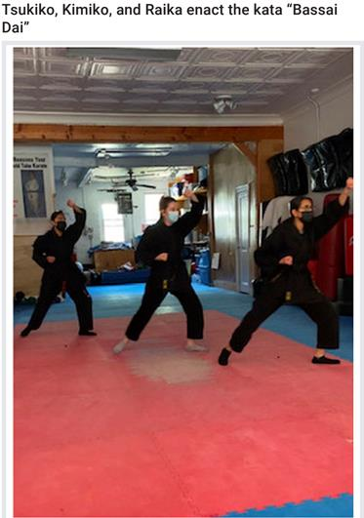
Youth Agency and Resilience
Across the globe, students have been away from schools and their teachers, but literacy learning has continued” (Chamberlain et al., 2020)
Preparing healthy meals for themselves;
Creating safe outdoor convenings with friends;
Taking on new, or rediscovering old, physical exercise activities (e.g., Schaefer, 2022; J. Turner, In Press)
Engaging The Arts (Chamberlain et al., 2020; Curwood & Scott, 2022; Moore & Paris, 2021)
Activism for Black lives (Curwood & Scott, 2022; Turner, In Press)

Slide 8
Transnational Learners and Communities
One in eight international migrants is a child; refugee children are 5 times more likely to be out of school; 36.5 million displaced children worldwide (UNICEF, 2022)

Slide 9
An Increasingly Digitized Social World
In 2018, 95% of teens reported having access to a smartphone, and 45% reported being online “almost constantly”. YouTube, Instagram, and Snapchat are the most popular platforms (Pew, 2018).
45% of young people around the world report using social media or online news sites to stay informed about current events. However they are less trusting of the information they find than are adults with only 17% of youth saying they trust social media sites (Gallup, 2021; UNICEF, 2021).

Slide 10
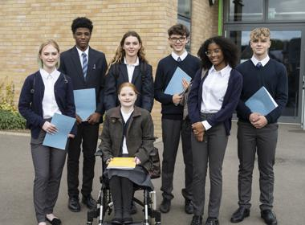
Who are Scottish Learners Today
Notes:
Successful learners
Confident individuals
Responsible citizens
Effective contributors

Slide 11
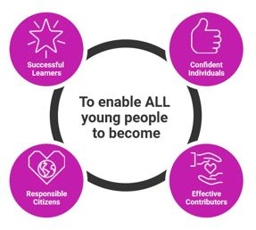
Curriculum Purposes, Principles and Practices
Aims and Goals that include the Personal, Social, Local, National and Global Communities
Curated and Cared For By Learners, Families, Communities, Educators, and Leaders
Guided by Principles of Justice, Respect, and Love
Practices that Position Learners, Families, and Communities as Assets and Agents and Build and Sustain Antiracist, Culturally Sustaining, Place-based and other Justice-oriented Pedagogies
Takes a Critical Perspective on Disciplinary Knowledge
Notes:
Successful Learners Confident individuals Responsible citizens Effective contributors

Slide 12
Key Knowledges for the Curriculum
Critical Disciplinary Literacy Knowledge
Identity as a literate person in and out of school
Racial literacy knowledge
Transnational knowledges

Slide 13
Critical Disciplinary Literacy Knowledge
Knowledge as a social construction and that can thus be (re)constructed for curriculum, teaching, and learning (Lavia, 2006; Love, 2019; Muhammad, 2020; Moje, 1999; Shohat, 1992)
Who created this knowledge?
Who was it created for and for what purposes?
How has this knowledge been used to advance justice or to oppress individuals and groups?
Whose identities and perspectives are represented, valued, marginalized, or absent?
What culturally-informed ways of knowing, understanding, believing, and communicating are present, valued, missing, or marginalized?
How does it (re)construct the beauty, joy, contributions, and full humanity of marginalized people and groups?

Slide 14
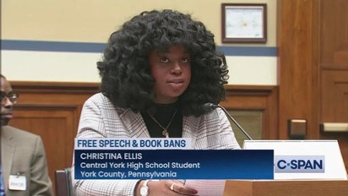
Critical Disciplinary Literacy Knowledge continued…
BIPOC students reported that when books featuring their experiences are banned they are made to feel that their very “existences are controversial” (Dallacqua, 2022, p. 135)
“...being able to talk about border issues or…racism or…the Holocaust allows you to be able to share that with your community and…claim that side of yourself, which you otherwise might not be able to do with…Shakespeare” (Dallacqua, 2022, p. 136)

Slide 15
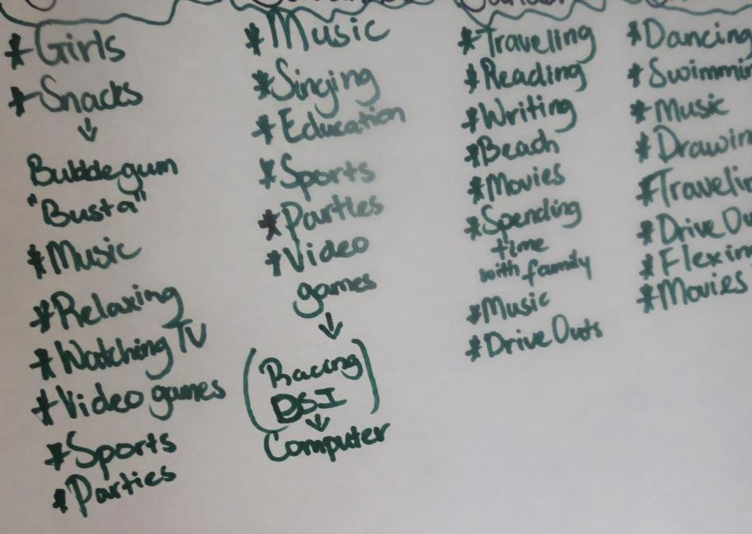
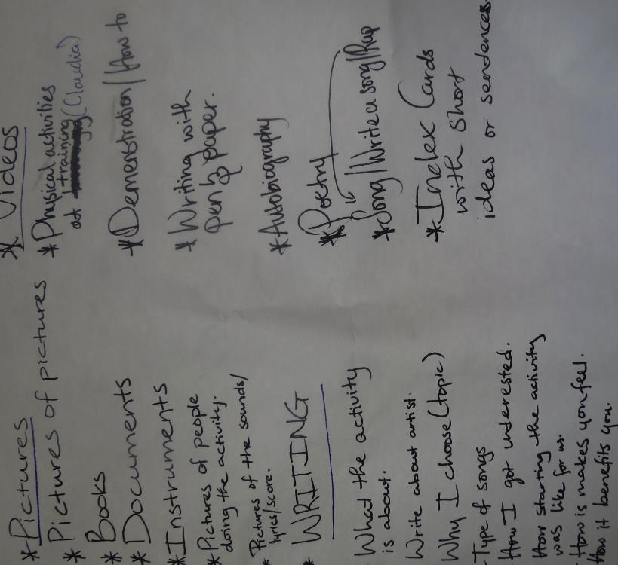
Identities as Literate People
Expanded Definition of Literacy
Notes:
Identities matter in educating for social justice (Skerrett & Smagorinsky, 2022).
Examining multiple and intersecting identities
Identities in relation to local and global communities and for being in classroom community
Identities as they intersect with power, privilege, and oppression
The creation of justice-oriented classroom communities sets the stage for students and teachers to engage in new forms of learning and action that constitute a justice-focused, relevant literacy education.

Slide 16
Racial Literacy Knowledge
Racial Literacy:
includes the knowledge, skills, and awareness needed to talk thoughtfully about race and racism and learning a racial vocabulary that includes terms like race, racism, prejudice, ally, and upstander (Sesame Street in Communities (n. d.)
emphasizes the relation between racism and power
is a lens through which to explore legal and educational practices
maintains the centrality of race while spotlighting and interrogating the “dynamic interplay” (Guinier, 2004, p. 113 among race, gender, class, place, and other demographic variables (cf. Bell, 1992).
is an interactive process in which the constructs of race and racism function as tools of diagnosis, feedback, and assessment.
fosters interpretation of racism in complex and multifaceted ways, including the psychological, social, emotional, interpersonal, and structural dimensions (Guinier, 2004; Rogers & Mosely, 2008).

Slide 17
Racial Literacy
Racial Literacy for Teachers (Sealey-Ruiz, 2020, 2022; Skerrett, 2011; Skerrett & Smagorinsky, 2022)
Who am I in terms of my racial(ized) and cultural identities, and who am I not? How do these identities intersect with my professional identity as a Language Arts teacher and shape my beliefs, values, and practices in my classroom and other contexts?” (Skerrett & Smagorinsky, 2022)
Teachers’ racial literacy shapes their curricular practices (Grinage, 2019; Sealey-Ruiz, 2020; Skerrett, 2011, Skerrett & Smagorinsky, 2022)

Slide 18
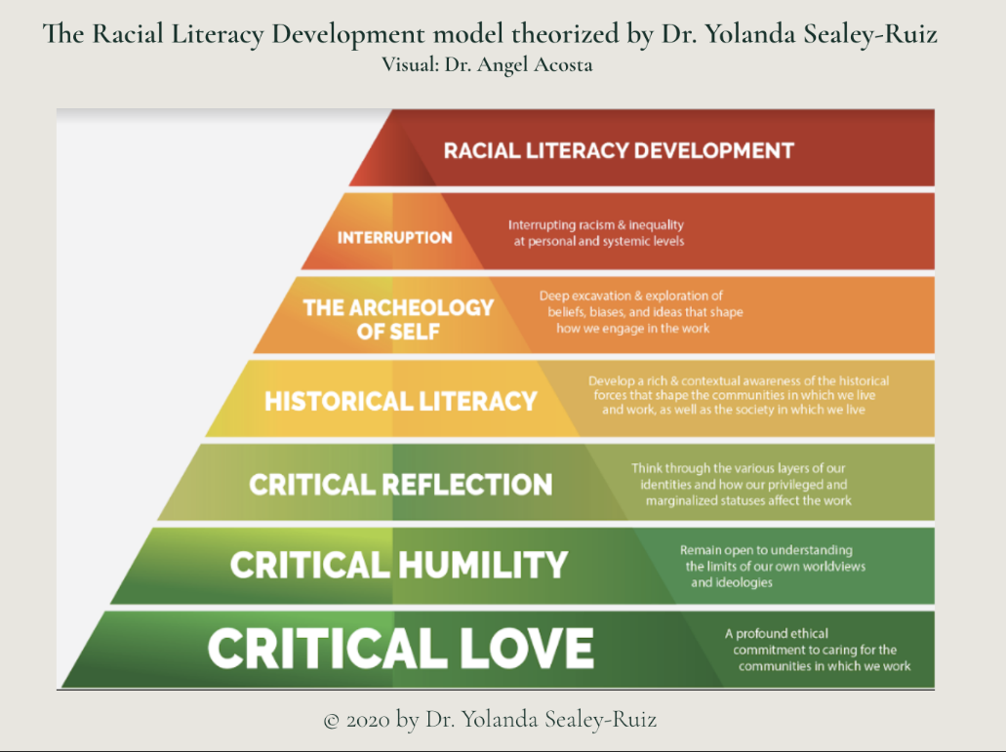
Racial Literacy Development
Archaeology of Self (Sealey-Ruiz, 2022)
Archaeology of Self involves the self-exploration, probing, and understanding of where issues of race and racism live within. It requires that teachers personalize race and recognize how it influences their pedagogy. Archaeology of Self helps teachers understand that their beliefs about students and their community dictate how much or little they will invest in them. If teachers believe that a child belongs to a group of people who cannot achieve, they will treat that child as though they are “at risk” and not see their promise (p. 24).

Slide 19
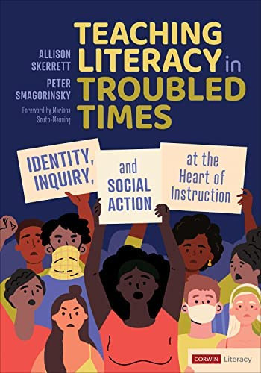
Racial Literacy in practice
In Skerrett & Smagorinsky (2022), we outline an approach in which teachers become familiar with ideas related to racial literacy and learn about how to use and apply their racial literacy to understand better how race functions in their own lives, in schools (its curriculum, structures, policy, and practices), and in society and societal institutions

Slide 20
Racial Literacy continued

Slide 21
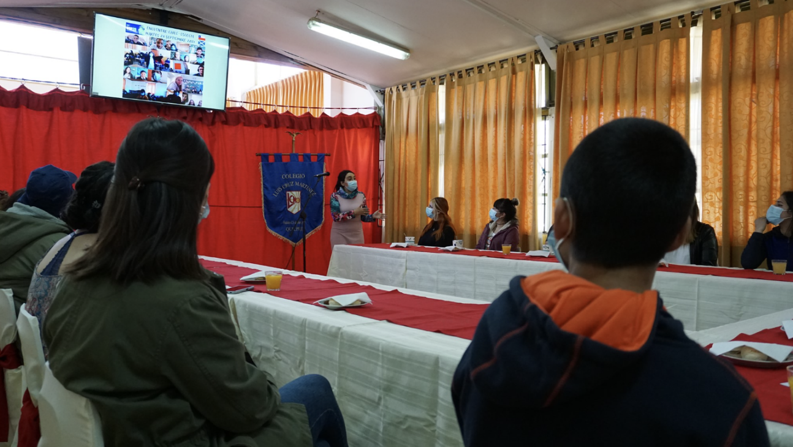
Racial Literacy in Scotland
Anti-Racism in Education Programme,
Antiracist curriculum principles for children, young people, teachers and leaders
Notes:
Anti-racism in Education Programme

Slide 22
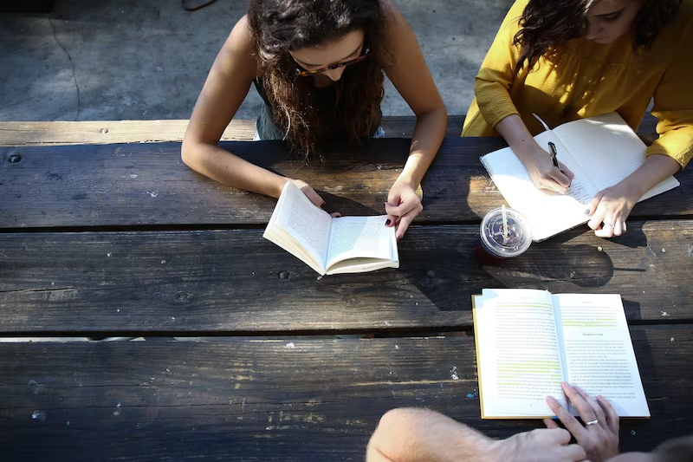
Reflecting on Racial Literacy
Notes:
How have you encountered the concept of racial literacy in your professional and/or personal life? How are you thinking at this moment about racial literacy as a form of curricular knowledge for teaching and learning.

Slide 23
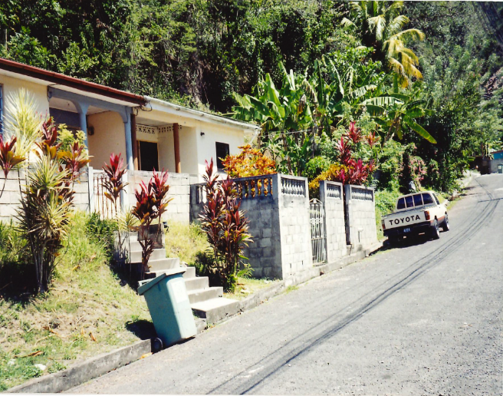
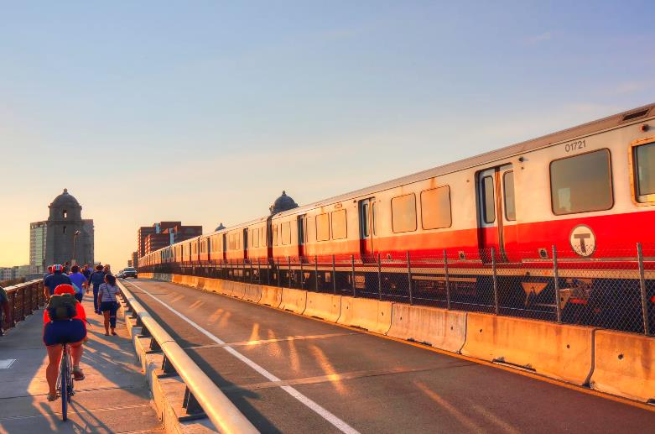
Transnational Knowledges
Personal/familial
Social
Economic
Political
Educational
The phenomenon wherein people, through a mix of necessity and choice, live their lives across two or more nation states (Levitt, 2001). Transnational people develop and sustain multiple inter-national ties.

Slide 24
Transnational Youth
Transnational youths participate actively: physically, psychosocially, and/or virtually in a globalized world through hybrid language and literacy practices
Lam & Warriner, 2012; Lam & Christiansen, 2022; Skerrett, 2015, 2018; Stornaiuolo et al., 2017)

Slide 25
Transnational Learners and Communities 2
One in eight international migrants is a child; refugee children are 5 times more likely to be out of school; 36.5 million displaced children worldwide (UNICEF, 2022)

Slide 26
Transnational Learners
Transnational children and youths develop valuable assets from living transnationally such as intercultural world knowledge and perspectives, multilingual repertoires, and transliteracy practices (de los Rios, 2018; Lam & Rosario-Ramos, 2009; Lam & Christiansen, 2022). These resources can be leveraged for learning in schools (Kwon, 2022; Skerrett, 2015, 2020).
Some transnational youth also face the challenge of interrupted schooling, and attending school across national systems that are different in language, curricular, cultural, and other practices resulting in uneven/poor academic achievement and push-out from school (Coe et al., 2011; Skerrett, 2015; Zuniga & Hamann, 2009)

Slide 27
A Transnationally-Inclusive Approach to Literacy Education
Based in a longitudinal qualitative study of the literacy lives and educational experiences of transnational youths who live across the Caribbean, Europe, India, Mexico, Canada and the US.
Notes:
Read from identity and biography in book—ESL teachers in Canada and my own teaching experiences

Slide 28
A Transnationally-Inclusive Approach to Literacy Education 2
A stance of inquiry into and appreciation of students’ literate lives. Teachers acquire knowledge about students’ social and educational experiences in one or more countries, and students’ language and literacy practices in outside-school contexts spanning local and transnational settings.
Teachers as curriculum innovators. Teachers use their knowledge of students to design curriculum and instruction that responds to students’ local and transnational educational histories, academic strengths, and learning needs.
Curriculum and instruction that consistently emphasize reading, writing, and critical thinking skills, which are useful across global educational and social contexts.
Documentation and sharing of students’ academic development and ongoing needs with other educational partners, to promote appropriate inter- and cross-national academic supports for students.

Slide 29
Peace corps India
Notes:
Ms. Mary Grady of Boston Public Schools, Massachusetts, USA leads her students in investigating their transnational identities with a focus on social justice

Slide 30
Culture: what is typical of the country

Slide 31
Composing with Transnationalism: “Dad & Me”

Slide 32
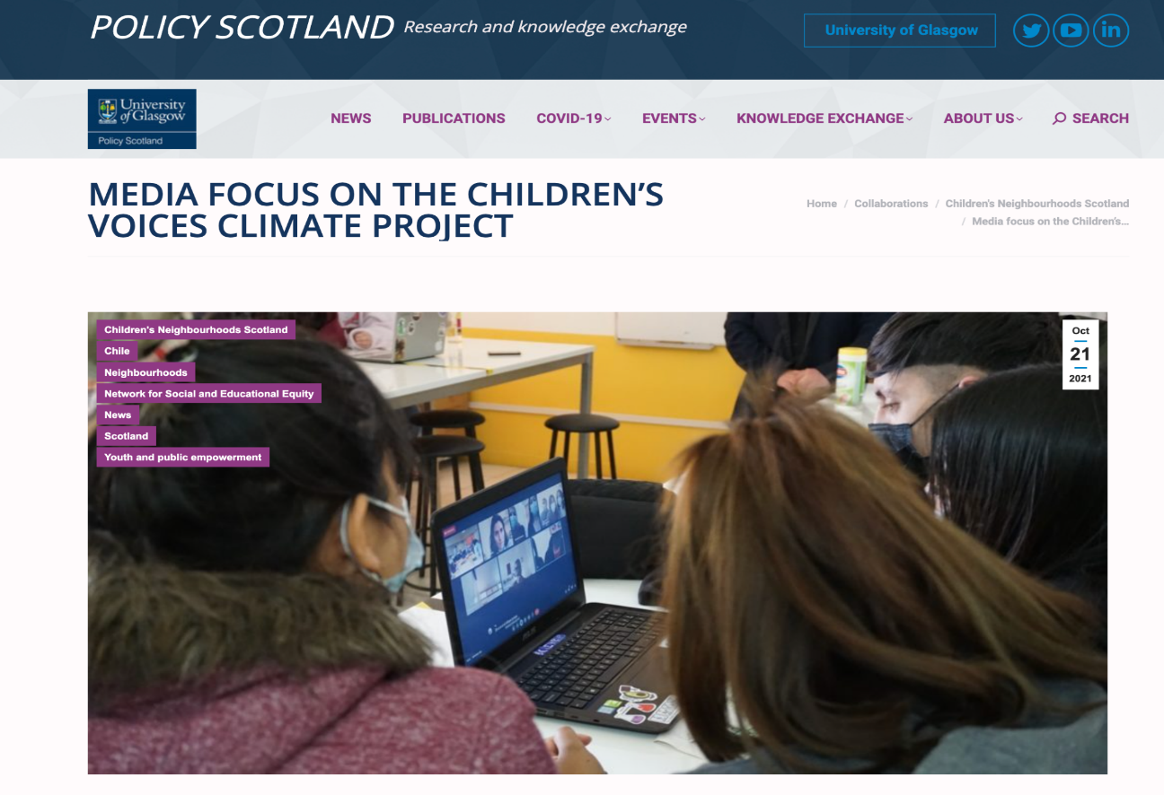
Transnational Learning in Scotland
Notes:
Network for Social and Educational Equity housed at the University of Glasgow. This project involved a collaboration between learners in Scotland and Chile investigating climate change at local and global levels. Thanks to Dr. Chris Chapman of University of Glasgow for sharing about this work with me.

Slide 33
Unique benefits of a transnationally-inclusive approach to English/Literacy Education
Understandings and appreciation of how transnational students and their repertoires comprise part of the diverse and valuable resources for teaching and learning available in classrooms
Greater knowledge and capabilities pertaining to using and strengthening languages, literacies, and sociocultural knowledge to participate productively in and across transnational literacy contexts, including schools
A more comprehensive knowledge base related to the educational, cultural, political, and other aspects of different nations, or particular regions within them, to which transnational students have ties
Identities of global citizenship that include expertise and capacities to identify, care about, critically analyze, and develop potential solutions to social justice concerns of all people and all nations
Notes:
For teachers and students

Slide 34
Reflecting on Transnational Students

Slide 35
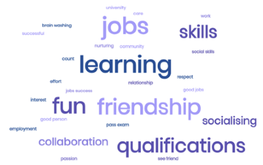
Reflections and Discussion
Notes:
Recent Paper prepared for Education Scotland by the Notosh Group (Augst, 2022). Reflects on the continued relevance of the 4 Capacities that drive CfE
School matters because it allows us to gain social skills and make
friends.
A school is a safe place for many people.
School matters to me because it is setting you up for life.
I go to school to be active and have a better understanding of things.
School matters to people around the world so they can learn, achieve
their dream, work hard for the job they want, and get the stuff they
need.
So I can live a good life.
If everybody gets a good education, they can do great things and
change the world.
I think school matters to my parents because they want me to try my
hardest to achieve my future dreams and be happy.

Slide 36
To Learn More…
Dr. Allison Skerrett, PhD(askerrett) - Latest Links (linktr.ee)
Notes:
qr code!!

