Slide 1

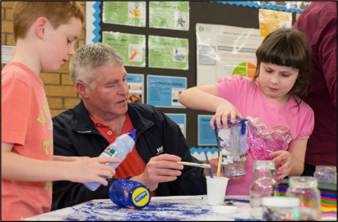
Gathering Data and
Measuring Progress
For Scotland’s learners with Scotland’s educators

Slide 2
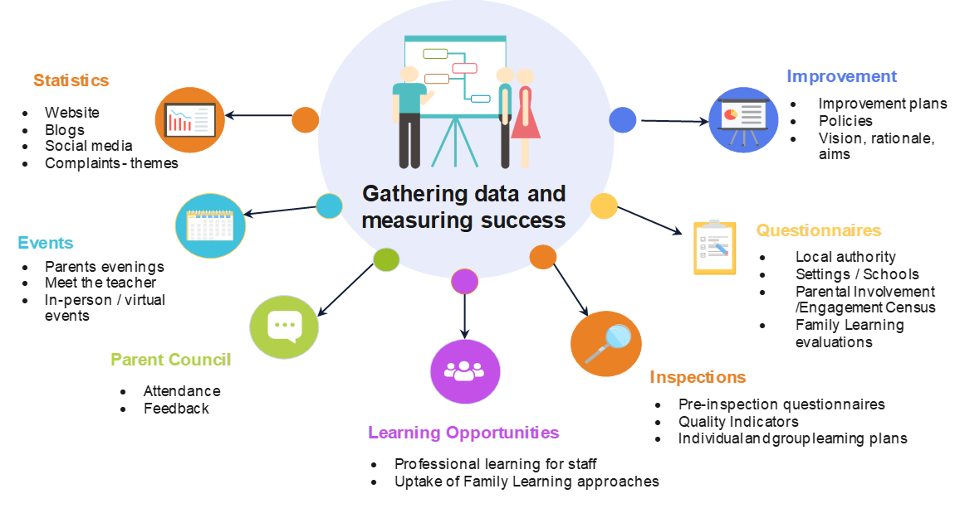
Gathering data and measuring success
For Scotland’s learners with Scotland’s educators
Notes:
Local authorities, educators and practitioners should continue to gather robust data which will support their planning and delivery processes and identify areas for improvement. This slide shows some of the ways in which data can be gathered and used to measure success. This is not an exhaustive list but a helpful guide to support you in your role of working with parents and families. Reference should always be made to the ‘How Good is Our...’ frameworks to support your self-evaluation journey.

Slide 3
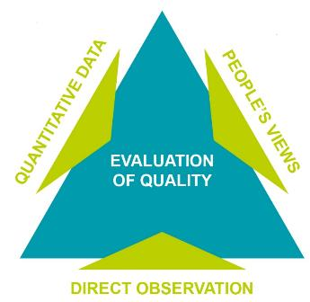
Data Sources
Quantitative Examples
Health data, literacy assessment data, standardised assessments, baseline assessments, teacher’s professional judgments
People’s views
Staff, pupils, parents, partners, stakeholders, community
Direct observation
Learning – outdoors, in a workplace, at college, during excursions, residential experiences
Further information:
How Good is our School 4 - https://education.gov.scot/improvement/self-evaluation/HGIOS4
For Scotland’s learners with Scotland’s educators

Slide 4
Data sources (Cont.)
Benefits
Identifies trends across the school for particular cohorts of pupils, and better determines whether socio-economic factors are influencing attainment and achievement.
Supports the introduction of well-judged initiatives to best meet needs of children and families.
Helps identify priorities to improve outcomes for children and families.
For Scotland’s learners with Scotland’s educators

Slide 5
Data sources (Cont.)
Collating data
The range of available intelligence and data
Data about prior learning and achievements from out with the setting/school
A wide range of assessment data and other information
Data on the attainment of children with additional support needs
Streamlined approach to recording data
Collate all information pertaining to children’s progress to inform discussions about children’s progress over time.
Monitor impact of strategies and evidence of impact on children and families
Data should be in an easily accessible format for parents/parent councils involved in improvement planning.
For Scotland’s learners with Scotland’s educators

Slide 6
Data sources (Cont.)
Analysis of data
Training and development to enhance staff’s skills in analysing and interpreting a range of data.
Data analysis being skills focused to ensure that the additional interventions are the most appropriate.
The wide range of data should be used to identify trends and patterns in attainment, for example in gender.
Interrogate data, identify gaps in children’s learning and at what stages pace begins to slow.
For Scotland’s learners with Scotland’s educators

Slide 7
Data sources (Cont.)
Track and monitor whether socio-economic factors are impacting upon children’s progress with their learning.
Confidence in using professional judgement and robust moderation processes to ensure attainment data is robust and to evaluate progress against national standards.
Data related to children’s wider achievements.
Robust monitoring of the data to track achievements systematically and encourage all children to participate in wider activities.
For Scotland’s learners with Scotland’s educators

Slide 8
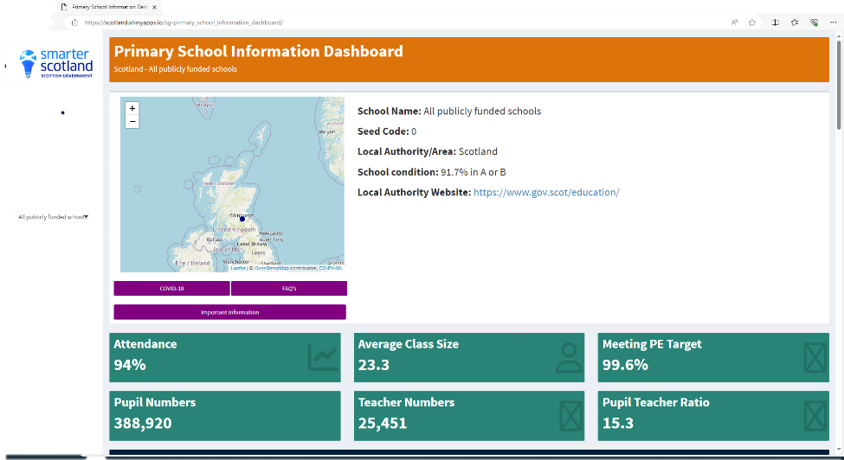
School Information Dashboard
https://education.gov.scot/parentzone/my-school/school-information-dashboard/
Notes:
Local authorities, educators and practitioners should continue to gather robust data which will support their planning and delivery processes and identify areas for improvement. This slide shows some of the ways in which data can be gathered and used to measure success. This is not an exhaustive list but a helpful guide to support you in your role of working with parents and families. Reference should always be made to the ‘How Good is Our...’ frameworks to support your self-evaluation journey.

