Slide 1
Inclusion. An overview
Inclusion Wellbeing & Equalities Professional Learning Framework
Essential for All
@ESInclusionTeam
For Scotland's learners, with Scotland's educators
Do luchd-ionnsachaidh na h-Alba, le luchd-foghlaim Alba
Notes:
Purpose of these Slides
Read title​
This professional learning is pitched at an informed level and suitable for anyone working with children and young people in an educational context.
How to use the slides:
To be used to facilitate professional learning in a group or whole-setting, or as a self-directed learning activity as an individual.
General Guidance
There is a requirement to cover all the slides.
Please do not change the provided slides.
Facilitators are welcome to add slides or activities relevant to your own setting, to support discussion and exploration of the topic. Facilitators will know their participants’ needs best.
Anyone who works in an educational setting can be a facilitator and use these slides.
It is important to establish a safe space which encourages respect and honesty to ensure that everyone is able to participate.

Slide 2
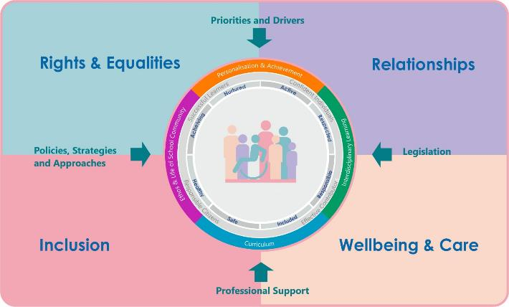
Interconnectivity
Notes:
All of the professional learning in the Framework fits into one of these four themes. The four themes are interconnected and interdependent.​
This activity interconnects with all four themes

Slide 3
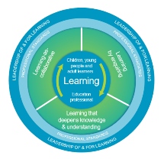
How to use this resource
These slides can be used to facilitate professional learning in a group or
whole-setting, or as a self-directed learning activity as an individual.
Facilitation notes are included at the bottom of each slide.
Please do not remove or change any of the slides included.
Facilitators are welcome to add slides or activities relevant to your own setting, to support discussion and exploration of the topic. Facilitators will know their participants’ needs best.
Anyone who works in an educational setting can be a facilitator and use these slides.
For reflection or discussion activities, it is important to establish a safe space which encourages respect and honesty to ensure that everyone is able to participate.
Notes:
Option to skip slide as these are instructions for facilitators only. No need to read to audience.

Slide 4
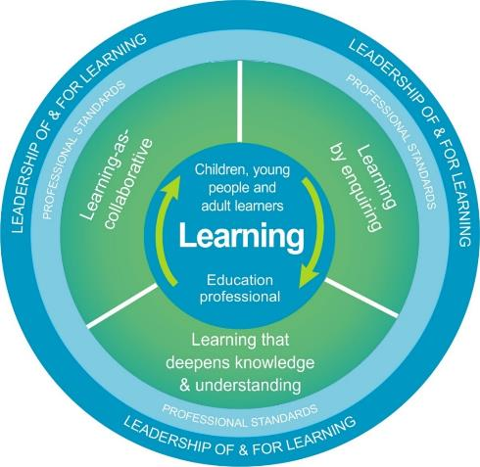
National Model for Professional Learning
This professional learning resource will support you to deepen your knowledge and understanding.
You will have the opportunity to consider how to take this learning forward on your own and with others.
The National Model of Professional Learning (education.gov.scot)
Notes:
This professional learning forms part of the national model for professional learning and is designed to help you gain more knowledge and have a deeper understanding of inclusion, wellbeing and equalities​​
On completion of this professional learning, you will be asked to consider what your next steps will be​​.
Please take some time to consider the reflection questions at the end

Slide 5
Welcome
Pause for Thought…
This session aims to
Provide an overview of inclusion in Scottish Education
Support your next steps in developing a deeper understanding of inclusion.
Notes:
Link activity to national model

Slide 6
Inclusion
Why?

Slide 7
Scottish Context for Inclusion, Equality and Equity
Scottish education is based on the belief that education is a human right and that all children and young people should be supported to reach their fullest potential.
Scotland’s education system is designed to be an inclusive one for all children and young people in Scottish schools, with or without additional support needs.

Slide 8
Scottish Context for Inclusion
‘Inclusion is the cornerstone to help us achieve equity and excellence in education for all of our children and young people.’
Scottish Government : Consultation on the Presumption of Mainstreaming 2019
Children’s rights and entitlements are fundamental to Scotland’s approach to inclusive education. It is supported by the legislative framework and key policy drivers

Slide 9
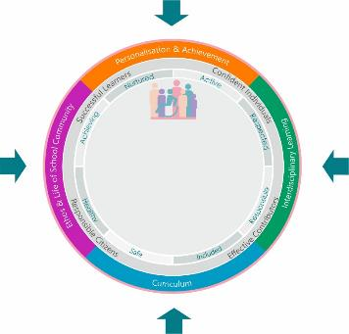
Scottish Context for Inclusion, Equality and Equity – Overview
Achievement, Attainment, Curriculum, Empowerment, Equity, Outcomes
Priorities and Drivers
Inclusive ELC/schools
Positive Relationships
Safeguarding
The GIRFEC approach
DYW
Additional Support
Accessibility
Equality
Inclusion
Learner Voice and Participation
Rights
Policies and
Guidance
Supporting All Learners:
Experiences
Achievements
Attainment
Outcomes
Legislation
Professional Support
Education Scotland
Professional Organisations and Standards
UNIONS

Slide 10
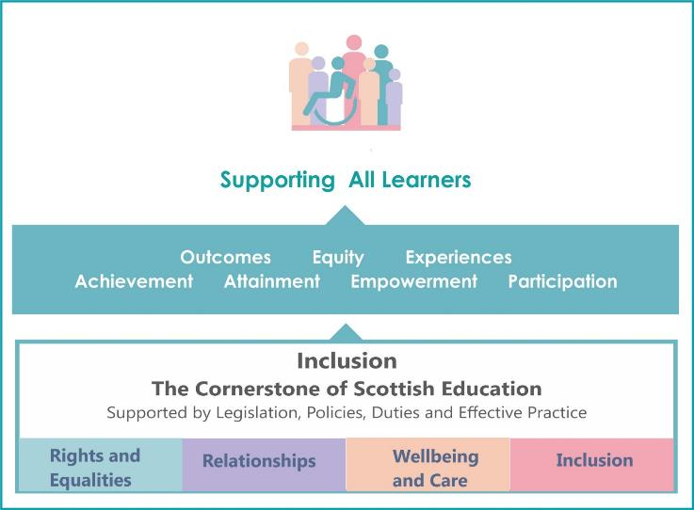
Inclusion Supports all Learners
Notes:
Notes
Inclusion is the cornerstone to help us achieve equity and excellence in education for all of our children and young people.’
Scottish Government : Consultation on the Presumption of Mainstreaming 2019

Slide 11
Inclusion
There are a number of explanations or definitions of inclusion.
Below is a definition from How Good is our school?4
‘Inclusions means taking positive action and intervening in order to enable achievement for all by building and fulfilling the potential of every child, young person and adult’.

Slide 12
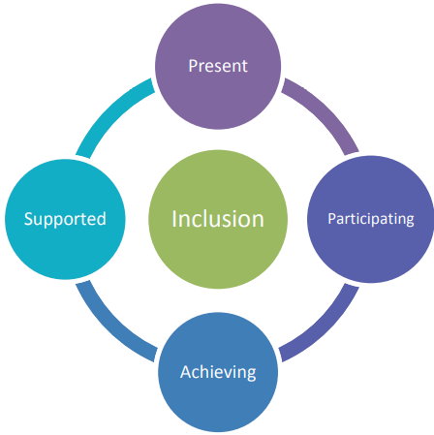
The Four Pillars of Inclusion
To be included all children and young people need to be and feel:
Present
Participating
Achieving
Supported.

Slide 13
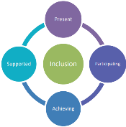
Inclusion - Present
All children and young people should learn in environments which best meet their needs
All children and young people should be fully engaged in the life of their school, through the inclusive ethos, culture and values of the school
All children and young people should receive a fulltime education including flexible approaches to meet their needs

Slide 14
Inclusion - Participating
Key expectations:
All children and young people should have their voices heard in decisions about their education. Including decisions on where they learn
All children and young people will have the opportunity to participate and engage as fully as possible in all aspects of school or early learning and childcare life, including trips and extracurricular activity
All children and young people should be enabled and supported to participate in their learning
Children and young people with additional support needs, who are aged 12-15, also have extended rights within the ASL framework to use rights on their own behalf to affect decisions made about them

Slide 15
Inclusion - Achieving
Key expectations:
All children and young people should be achieving to their full potential
All children and young people should have access to a varied curriculum tailored to meet their needs

Slide 16
Inclusion – Supported
Key expectations:
All children and young people should benefit from the ethos and culture of the school, inclusive learning and teaching practices and relationships
All children and young people should be given the right help, at the right time, from the right people, to support their wellbeing in the right place
All children and young people should be supported to participate in all parts of school life
All children and young people should be supported to overcome barriers to learning and achieve their full potential

Slide 17
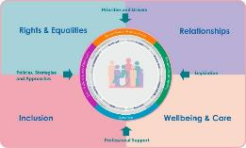
Inclusion
Curriculum for Excellence was design to be an inclusive curriculum for every child and young person, including those who require additional support.
Inclusion is an entitlement for all children and young people and all educators have a professional duty to support inclusion. Within the Inclusion Wellbeing and Equalities professional learning framework are a range of professional learning opportunities that aim to support all educators.

Slide 18
Reflection
From what you have learned so far, think about:
How has this made you feel?
What has this made you think about?
What one action would you like to take forward?
How can you link what you plan to do with others in your setting?
How you will know that this learning has made a difference?
Notes:
Facilitation notes:
You can do this in groups...
Encourage educators to take this forward in an enquiry
Consider impact of the actions / learning

Slide 19
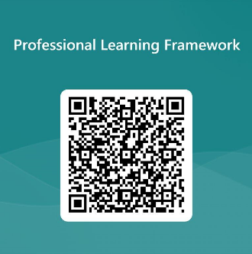
We value your feedback
From now until March 2024 we will be taking feedback on these resources so that we can make changes in advance of a formal launch of the Professional Learning Framework in June 2024
Your feedback could help us improve this resource
Please complete this short form, using the link or QR code, to let us know what you thought of it and any suggestions you have on how it could be improved
LINK: https://forms.office.com/e/b5PCpJJJ3P

Slide 20
For Scotland's learners, with Scotland's educators
Do luchd-ionnsachaidh na h-Alba, le luchd-foghlaim Alba
Education Scotland
Denholm House
Almondvale Business Park
Almondvale Way
Livingston EH54 6GA
T +44 (0)131 244 5000
E enquiries@educationscotland.gsi.gov.uk

