Slide 1
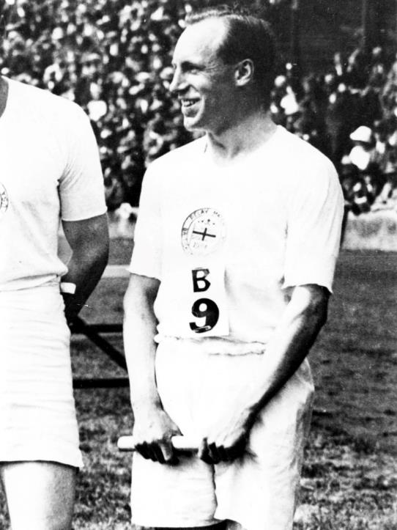
Eric Liddell Assembly
A legend. A legacy. A lifetime of inspiration.

Slide 2
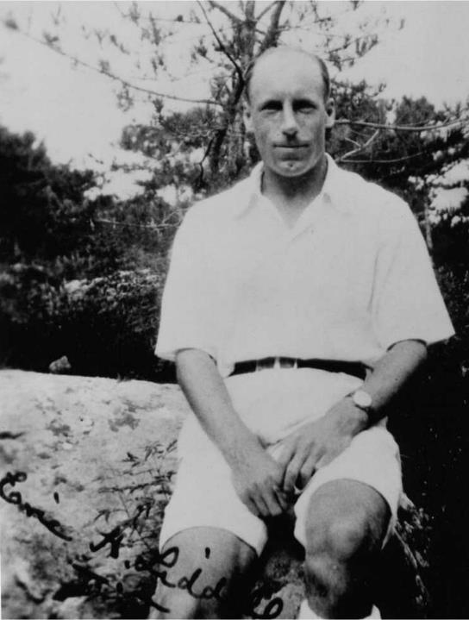
Eric Liddell 100,
why now?
A legend. A legacy. A lifetime of inspiration.

Slide 3
Paris Olympics 1924
400 metres gold medal
200 metres bronze medal
100 years on Paris 2024
Remembering Eric Liddell’s achievements and legacy
Compassion, Passion, Integrity

Slide 4
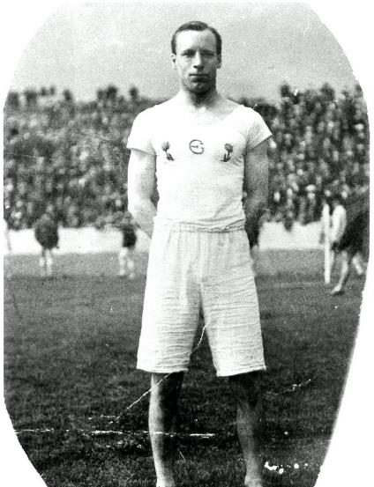
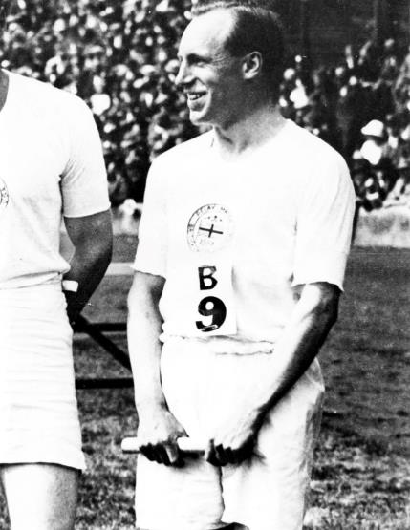
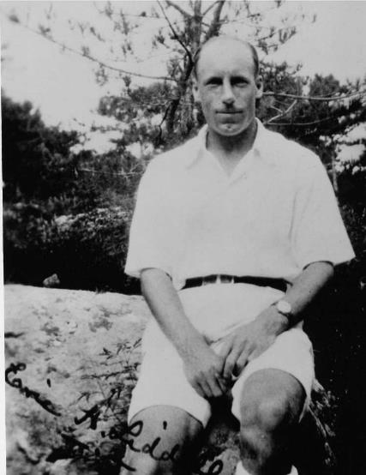
Photos of Eric Liddell

Slide 5
History of Eric Lidell
History of Eric Liddell
Watch this video about Eric Liddell 100
ericliddell.org/wp-content/uploads/2023/03/EL100-Educational-Film-2023.mp4

Slide 6
Legacy of Eric Liddell
Legacy of Eric Liddell
Passion – tackle all of your challenges with enthusiasm, dedication, optimism and self belief
Compassion – conduct yourself with humility, selflessness, respect, care for others and self care
Integrity – Behave with discretion, loyalty, self sacrifice and be principled

Slide 7
Thank you

