Slide 1



Realising the ambition: Being Me
Suggested challenge questions to guide practice
For Scotland's learners, with Scotland's educators
Notes:
This is a front cover page and can only be used once. Use the corresponding green internal and back pages if you are using this page. You may add a title and a subtitle if needed only. Do not add anything else or move elements around.

Slide 2
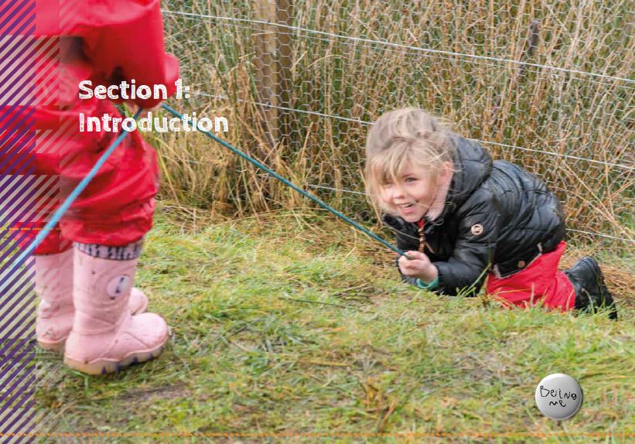
Realising the ambition: Being Me
Suggested challenge questions to guide practice
Section 1
How does the current policy landscape impact:
the policy and practice in your own setting?
your own thinking and practice?
how your setting develops the confidence and knowledge of those working to deliver the service
your ability to speak confidently about the changes happening across the sector and how that will make a difference to children and families ?
For Scotland's learners, with Scotland's educators
Notes:
This is an internal page in green and can be duplicated to create additional pages. Always keep the heading and footer as shown. Use the corresponding green front and back pages if you are using this page.

Slide 3
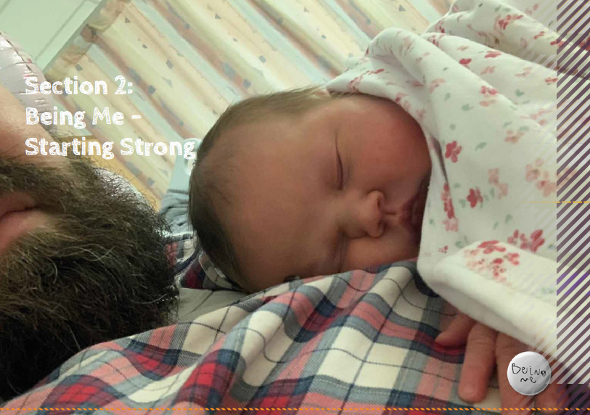
Realising the ambition: Being Me
Suggested challenge questions to guide practice
Section 2 – part 1
To understand how a child develops we discuss three aspects of a developing child, me as an individual , me and my environment and my surrounding culture.
Reflect back on these, what changes can you make immediately, tomorrow, next week and next month to improve the interactions, experiences and spaces for children in your setting ?
Note down what you discuss and ensure that individually and with others you revisit these to make a positive change for children.
For Scotland's learners, with Scotland's educators
Notes:
This is an internal page in green and can be duplicated to create additional pages. Always keep the heading and footer as shown. Use the corresponding green front and back pages if you are using this page.

Slide 4
Realising the ambition: Being Me
Suggested challenge questions to guide practice
Section 2 – part 2
The descriptions of being a baby , toddler and young child may be familiar to you. However think about these questions:
If you have a good relationship with babies in your care, how could you make it even better ? Do you really know how to interpret what a baby is trying to communicate to you and what could you do to make your response even stronger?
Think of a situation where a toddler is showing frustration and is unhappy. What could you do to help resolve the situation?
Taking account of a young child’s interests and need to revisit a learning experiences which is absorbing and interesting requires flexibility. For instance, are you tied by routines and times during the session? How do you accommodate these needs of children?
For Scotland's learners, with Scotland's educators
Notes:
This is an internal page in green and can be duplicated to create additional pages. Always keep the heading and footer as shown. Use the corresponding green front and back pages if you are using this page.

Slide 5
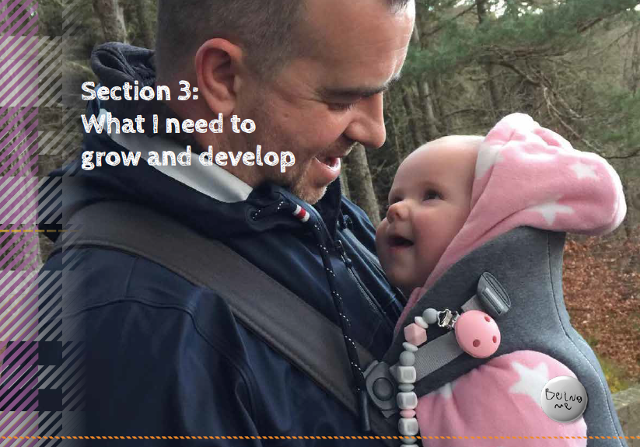
Realising the ambition: Being Me
Suggested challenge questions to guide practice
Section 3 - Part 1
Using the illustration of a mind–minded approach to responsive and intentional planning what are the immediate changes you need to make to your current planning format?
List the actions you need to do and put them into practice. At first revisit the actions frequently. Through quick daily discussion decide what’s working well and what needs to be taken account of next.
Gradually you should find a changing and improving learning situation which reinforces positive learning and development.
Consider how you can involve/share this with parents/carers.
For Scotland's learners, with Scotland's educators
Notes:
This is an internal page in green and can be duplicated to create additional pages. Always keep the heading and footer as shown. Use the corresponding green front and back pages if you are using this page.

Slide 6
Realising the ambition: Being Me
Suggested challenge questions to guide practice
Section 3 - Part 2
GIRFEC
How do you provide opportunities for children to talk about their feelings and needs?
What changes to practice in your situation do you need to make to ensure that children are well supported ?
What are the areas of GIRFEC you feel that you make a positive contribution and which are the ones where you and others need a bit more support?
Do you know how to access this ? If not, this needs to be a priority for you to find out.
For Scotland's learners, with Scotland's educators
Notes:
This is an internal page in green and can be duplicated to create additional pages. Always keep the heading and footer as shown. Use the corresponding green front and back pages if you are using this page.

Slide 7
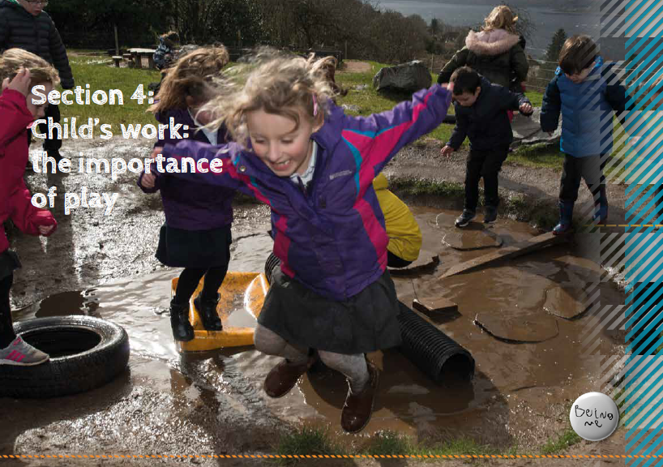
Realising the ambition: Being Me
Suggested challenge questions to guide practice
Section 4
Following your reading of section 4 it will be useful to spend time on creating your own rationale for play pedagogy as described in the text . Think in particular about the interactions, experiences and spaces which define your setting.
Think about what you want to change and the choices you provide. Who decides ?
What is the balance of child initiated, adult initiated and adult directed play in your setting?
How can this be adapted to ensure better experiences for children.?
For Scotland's learners, with Scotland's educators
Notes:
This is an internal page in green and can be duplicated to create additional pages. Always keep the heading and footer as shown. Use the corresponding green front and back pages if you are using this page.

Slide 8
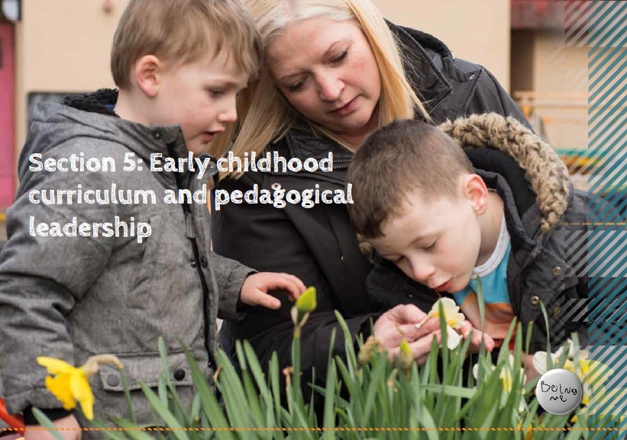
Realising the ambition: Being Me
Suggested challenge questions to guide practice
Section 5
Discuss your understanding of pedagogy with others. What does a collective, shared understanding look like in your context?
What do you think are the key aspects of being a leader of learning in your setting?
Critically reflect on your outdoor learning provision ? Is it well used? What can you do to enhance this? What are the values of outdoor learning you can use in your play rationale?
Do the same for promoting curiosity, creativity and inquiry. What can you do to improve what you already have?
For Scotland's learners, with Scotland's educators
Notes:
This is an internal page in green and can be duplicated to create additional pages. Always keep the heading and footer as shown. Use the corresponding green front and back pages if you are using this page.

Slide 9
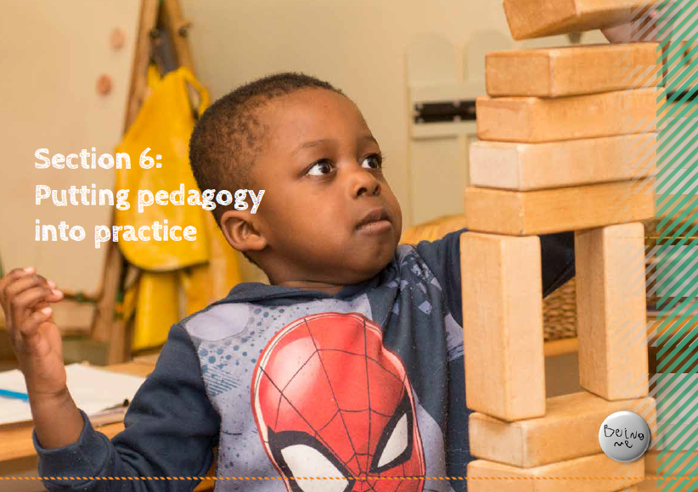
Realising the ambition: Being Me
Suggested challenge questions to guide practice
Section 6
Putting pedagogy into practice.
What changes are you going to make to practice in your setting to promote the concepts and ideas of the overarching themes outlined in this section ?
You’ll need to reflect on all the areas and decide which one to start with but over time you would need to look at all areas.
Remember to put the child at the centre of any changes and keep to the forefront the idea of the child “Being Me”.
For Scotland's learners, with Scotland's educators
Notes:
This is an internal page in green and can be duplicated to create additional pages. Always keep the heading and footer as shown. Use the corresponding green front and back pages if you are using this page.

Slide 10
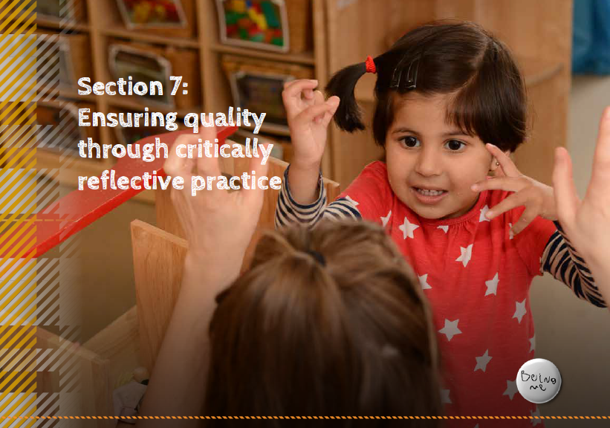
Realising the ambition: Being Me
Suggested challenge questions to guide practice
Section 7 – Part 1
Young children are a discriminating group of learners.
Discuss what does “quality” mean for children?
How do you know and understand where children are in the process of learning ?
Describe what quality practice should look like. Which areas are you happy with and then decide what changes you need to make?
For Scotland's learners, with Scotland's educators
Notes:
This is an internal page in green and can be duplicated to create additional pages. Always keep the heading and footer as shown. Use the corresponding green front and back pages if you are using this page.

Slide 11
Realising the ambition: Being Me
Suggested challenge questions to guide practice
Section 7 – Part 2
Young children are a discriminating group of learners.
Try to use the ideas in section 7.3 to improve self –evaluation within your setting. Make sure you note down the process as you go on.
What changes do you think you could make tomorrow or next week to bring about some improvements?
Discuss the opportunities you have to improve your knowledge and skills with a colleague. What would you really see as a priority for you ?
For Scotland's learners, with Scotland's educators
Notes:
This is an internal page in green and can be duplicated to create additional pages. Always keep the heading and footer as shown. Use the corresponding green front and back pages if you are using this page.

Slide 12
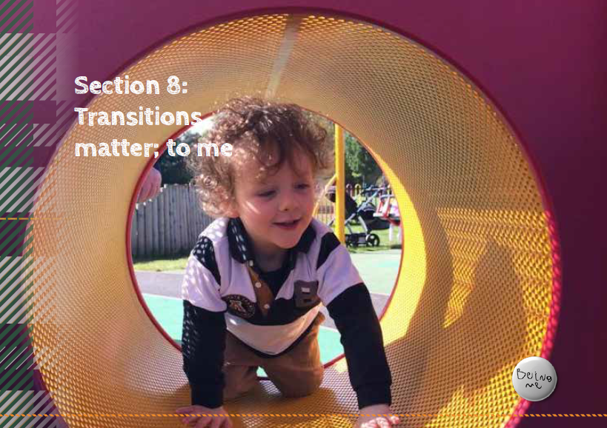
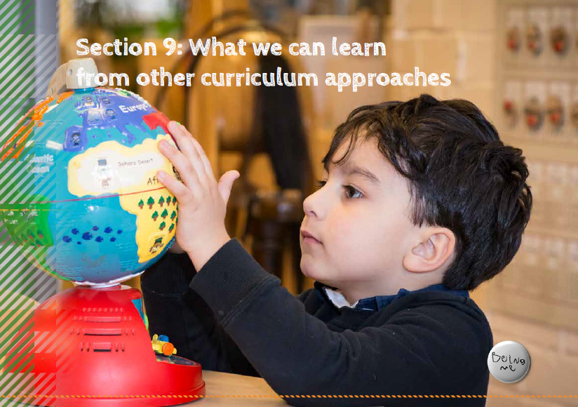
Realising the ambition: Being Me
Suggested challenge questions to guide practice
Sections 8 and 9 contain points for reflection within the text.
For Scotland's learners, with Scotland's educators
Notes:
This is an internal page in green and can be duplicated to create additional pages. Always keep the heading and footer as shown. Use the corresponding green front and back pages if you are using this page.

Slide 13
Education Scotland
Denholm House
Almondvale Business Park
Almondvale Way
Livingston EH54 6GA
T +44 (0)131 244 5000
E enquiries@educationscotland.gsi.gov.uk
For Scotland's learners, with Scotland's educators
Notes:
This is a back cover page in green. You may edit the address if needed only. It can only be once and at the end of the PowerPoint presentation. Use the corresponding green front and internal pages if you are using this page.

