Slide 1
Inclusion Wellbeing & Equalities Professional Learning Framework
The Scottish Education Context Essential for All
@ESInclusionTeam
For Scotland's learners, with Scotland's educators
Do luchd-ionnsachaidh na h-Alba, le luchd-foghlaim Alba
Notes:
Purpose of these Slides
Read title​
This professional learning is pitched at an informed level and suitable for anyone working with children and young people in an educational context.
How to use the slides:
To be used to facilitate professional learning in a group or whole-setting, or as a self-directed learning activity as an individual.
General Guidance
There is a requirement to cover all the slides.
Please do not change the provided slides.
Facilitators are welcome to add slides or activities relevant to your own setting, to support discussion and exploration of the topic. Facilitators will know their participants’ needs best.
Anyone who works in an educational setting can be a facilitator and use these slides.
It is important to establish a safe space which encourages respect and honesty to ensure that everyone is able to participate.

Slide 2
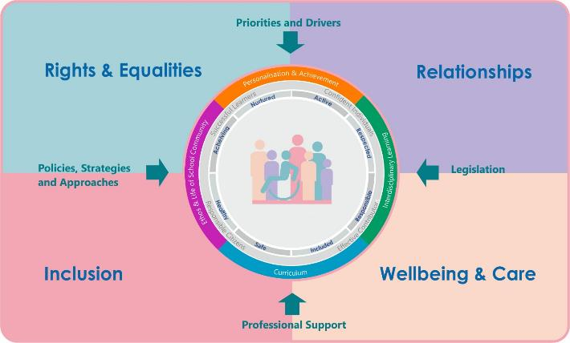
Interconnectivity
Notes:
All of the professional learning in the Framework fits into one of these four themes. The four themes are interconnected and interdependent.​
This activity interconnects with all four themes and forms part of the professional learning that is Essential for All.

Slide 3
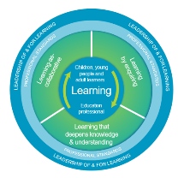
How to use this resource
These slides can be used to facilitate professional learning in a group or
whole-setting, or as a self-directed learning activity as an individual.
Facilitation notes are included at the bottom of each slide.
Please do not remove or change any of the slides included.
Facilitators are welcome to add slides or activities relevant to your own setting, to support discussion and exploration of the topic. Facilitators will know their participants’ needs best.
Anyone who works in an educational setting can be a facilitator and use these slides.
For reflection or discussion activities, it is important to establish a safe space which encourages respect and honesty to ensure that everyone is able to participate.
Notes:
Option to skip slide as these are instructions for facilitators only. No need to read to audience.

Slide 4
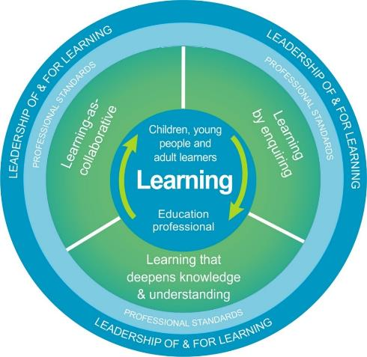
National Model for Professional Learning
This professional learning resource will support you to deepen your knowledge and understanding.
You will have the opportunity to consider how to take this learning forward on your own and with others.
The National Model of Professional Learning (education.gov.scot)
Notes:
This professional learning forms part of the national model for professional learning and is designed to help you gain more knowledge and have a deeper understanding of inclusion, wellbeing and equalities​​
On completion of this professional learning, you will be asked to consider what your next steps will be​​.
Please take some time to consider the reflection questions at the end

Slide 5
Welcome
Pause for Thought…
This session aims to
Provide an overview the inclusive Scottish education context fro children and young people.
Support your next steps in developing a deeper understanding of inclusion, wellbeing, equalities and equity.
Notes:
Link activity to national model

Slide 6
Scottish Context for Inclusion, Equality and Equity
Scottish education is based on the belief that education is a human right and that all children and young people should be supported to reach their fullest potential.
Scotland’s education system is designed to be an inclusive one for all children and young people in Scottish schools, with or without additional support needs.
Children’s rights and entitlements are fundamental to Scotland’s approach to inclusive education. It is supported by the legislative framework and key policy drivers

Slide 7
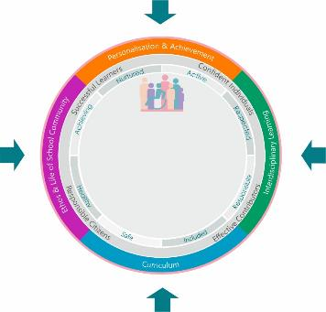
Scottish Context for Inclusion, Wellbeing Equality and Equity
Achievement, Attainment, Curriculum, Empowerment, Equity, Outcomes
Priorities and Drivers
Inclusive ELC/schools
Positive Relationships
Safeguarding
The GIRFEC approach
DYW
Additional Support
Accessibility
Equality
Inclusion
Learner Voice and Participation
Rights
Policies and
Guidance
Supporting All Learners:
Experiences
Achievements
Attainment
Outcomes
Legislation
Professional Support
Education Scotland
Professional Organisations and Standards
UNIONS
Notes:
This slide provides an overview of the Scottish context . Supporting learners and inclusion is central to all that is outlined.

Slide 8
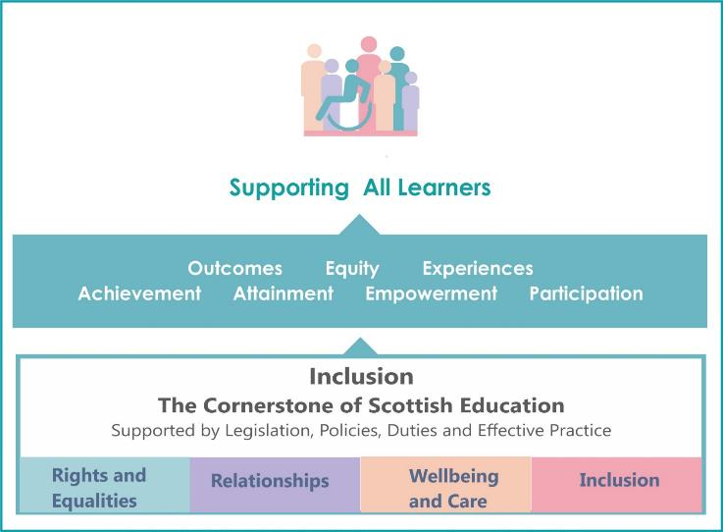
Inclusion Supports all Learners
Notes:
Notes
Inclusion is the cornerstone to help us achieve equity and excellence in education for all of our children and young people.’
Scottish Government : Consultation on the Presumption of Mainstreaming 2019

Slide 9
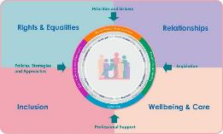
Inclusion
Curriculum for Excellence was design to be an inclusive curriculum for every child and young person, including those who require additional support.
Inclusion and receiving appropriate support is an entitlement for all children and young people in Scotland. Within the Inclusion Wellbeing and Equalities Professional Learning framework there are a range of professional learning opportunities that aim to help all local authorities , establishments and educators develop and improve inclusive practice.

Slide 10
Reflection
From what you have learned so far, think about:
How has this made you feel?
What has this made you think about?
What one action would you like to take forward?
How can you link what you plan to do with others in your setting?
How you will know that this learning has made a difference?
Notes:
Facilitation notes:
You can do this in groups...
Encourage educators to take this forward in an enquiry
Consider impact of the actions / learning

Slide 11
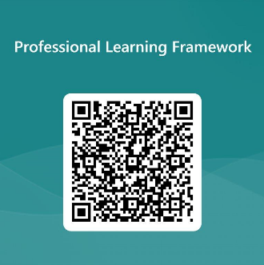
We value your feedback
From now until March 2024 we will be taking feedback on these resources so that we can make changes in advance of a formal launch of the Professional Learning Framework in June 2024
Your feedback could help us improve this resource
Please complete this short form, using the link or QR code, to let us know what you thought of it and any suggestions you have on how it could be improved
LINK: https://forms.office.com/e/b5PCpJJJ3P

Slide 12
For Scotland's learners, with Scotland's educators
Do luchd-ionnsachaidh na h-Alba, le luchd-foghlaim Alba
Education Scotland
Denholm House
Almondvale Business Park
Almondvale Way
Livingston EH54 6GA
T +44 (0)131 244 5000
E enquiries@educationscotland.gsi.gov.uk

