Slide 1

Prevent and Safeguarding
context

Slide 2
CONTEST strategy
The UK Counter-Terrorism (CONTEST) Strategy has been developed to tackle known threats. Prevent is one of four sub-strategies included within the overall Strategy:
Pursue: to stop terrorist attacks;
Prevent: to stop people becoming terrorists or supporting terrorism;
Protect: to strengthen our protection against a terrorist attack;
Prepare: to mitigate the impact of a terrorist attack.

Slide 3
Prevent strategy
‘Prevent’ is about safeguarding people from being drawn into terrorism and ensuring that they are given appropriate advice and support.
Educational establishments have a duty to prevent learners from being drawn towards terrorism , and to respond quickly and effectively to support those who may be at risk of radicalisation.

Slide 4
‘Scottish approach to safeguarding’
‘The aim is to support the development of children and young people’s knowledge, skills and resilience to keep themselves safe and protect themselves and to develop an understanding of the world so that they can respond to a range of issues and potential risky situations arising throughout their lives.’
Notes:
Scotland’s overarching focus on ethos, values, tolerance and respect is central to the delivery of CfE, to safeguarding and protecting learners and to the implementation of Getting it right for every child. (GIRFEC)

Slide 5
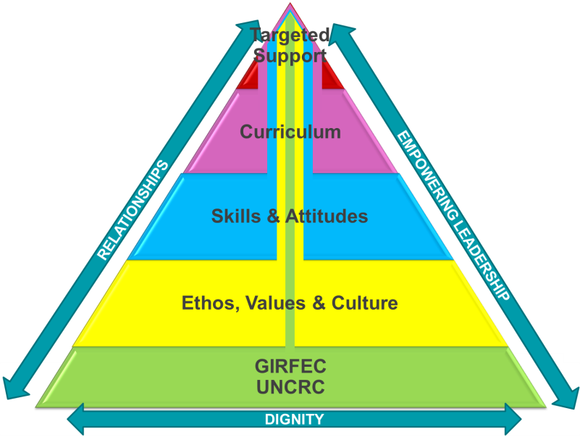
SAFEGUARDING THROUGH:
Rooted in Human rights and GIRFEC
Wellbeing and partnership working
Curriculum:
Positive and supportive relationships
Learning and teaching
Curriculum areas
Personal support
Leadership
Notes:
It is important that safeguarding underpins the ethos and values in an establishment to ensure that learners build their personal resilience and are supported and safe.

Slide 6

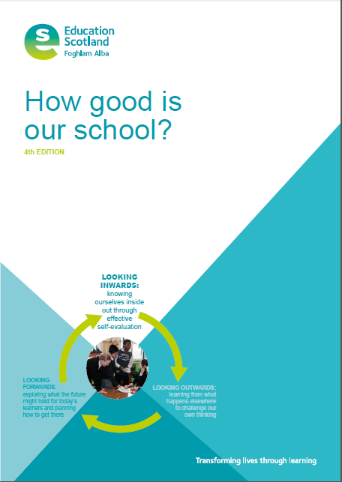
Themes
Arrangements for safeguarding, including
child protection
Arrangements to ensure wellbeing
National guidance and legislation
Notes:
This HGIOS4 indicator focuses on the wide range of duties required of all staff and partners to ensure that all children and young people are safe, well cared for and enabled to flourish.

Slide 7
Establishments with effective safeguarding practices
Protect and support the rights, dignity and wellbeing of all pupils;
Equip learners with the knowledge, skills and ability to think for themselves;
Inform learners where and how they can access relevant support;
Enable learners to challenge and debate within a supportive ethos;
Provide opportunities to learn about different cultures and faiths, and gain an understanding of shared values.

