Slide 1

Community Resilience
Network Day 4
For Scotland’s learners, with Scotland’s educators
Notes:
This is a front cover page and can only be used once. Use the corresponding blue internal and back pages if you are using this page. You may add a title and a subtitle if needed only. Do not add anything else or move elements around.

Slide 2
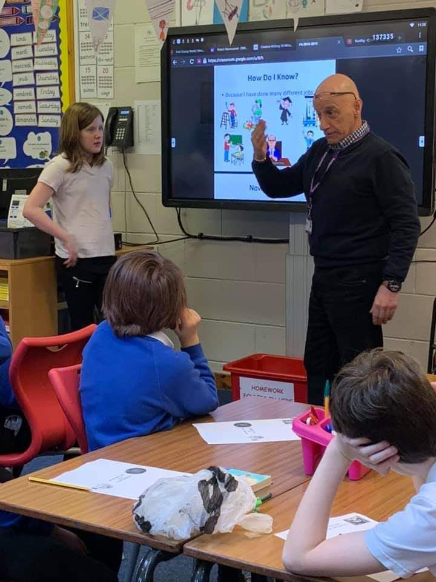
World of Work Week

Slide 3
General Aims
Embed community resilience as an exciting and relevant context for learning for Scottish schools which supports curriculum areas such as social studies, health and wellbeing, technologies, science, global citizenship, sustainability, rights education, developing the young workforce and outdoor learning through interdisciplinary learning within Curriculum for Excellence.
Through partnership working develop opportunities for learners to participate in and contribute to real-life, relevant community resilience activities locally and nationally.
Create opportunities for children, young people, their parents and schools to connect more fully to their communities and to participate in local decision-making and activities in relation to community resilience.

Slide 4
General Aims (continued)
To enable learners to become more resilient individuals and to develop their skills in managing risks and to empower them to keep themselves and others safe.
To enable children, young people, their parents and communities to understand the importance of community resilience in mitigating the impact of emergency situations and to reassure them that the Government, emergency services and others are at work to keep them safe.
Enable learners to develop the attributes, capabilities, motivation and skills required for them to contribute effectively to make their community more resilient.
Work in partnership with local education authorities to encourage schools to use community resilience and flooding issues as exciting contexts for learning within the curriculum.

Slide 5
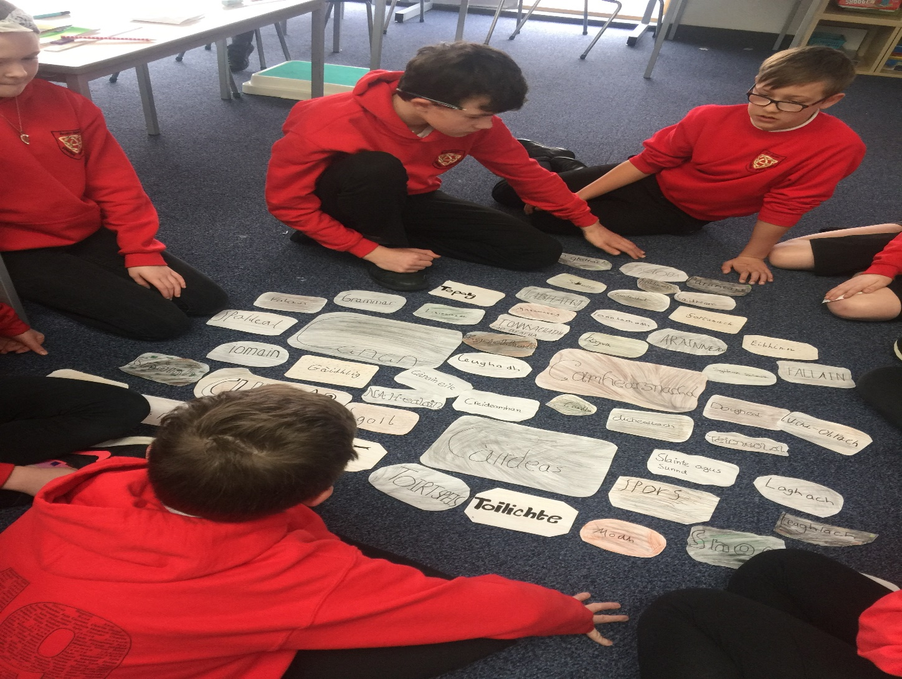
Embedding Community Resilience

Slide 6
Day 4 Aims
Morning –
Supporting the Standards and Quality Report and School Improvement Planning Process through….
Community Resilience - Quality Indicators and Coaching Wheels - Self Evaluation
Rotating Carousel - Strengths, Challenges, What would I have done differently and Next steps?
Also
Alison Ward – ICE
Paired reading – CLPL (depending on time)

Slide 7
Day 4 Aims
Afternoon
Updating “Funding Partners” of progress
Group Formation
Team Building – Resilience Quote
Round Robin – sharing the resilience journey

Slide 8
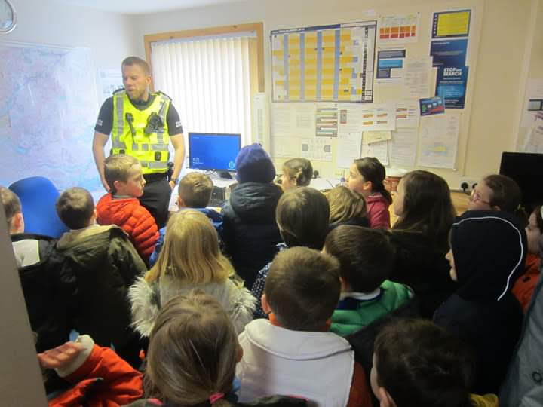
World of Work Week

Slide 9
Community Resilience Self Evaluation
Choose 2 Quality Indicators relevant to your Community Resilience Challenge/focus.
Use the Coaching Wheel to support your Self Evaluation
As you answer the questions in the coaching wheel, consider….
What difference/impact has been made?
How do you know (evidence)?
(20-30 minutes)

Slide 10
Think Pair Share
As a leader – leading the Community Resilience change journey
Are you where you want to be on the journey?
Why / why not?

Slide 11
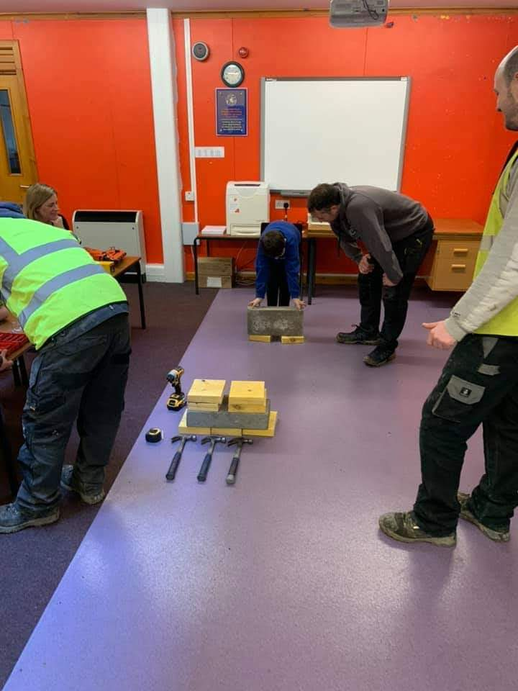
World of Work Week

Slide 12
Alison Ward
ICE
https://ice.org.uk/about-ice/near-you/uk/scotland/education

Slide 13
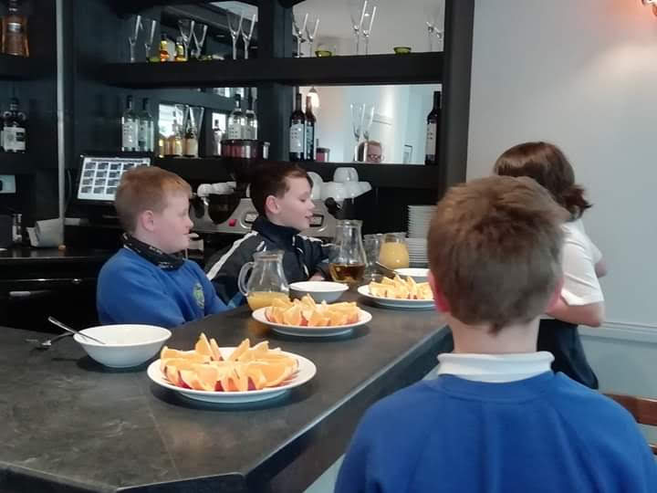
World of Work Week

Slide 14
Rotating Carousel
Referring back to the questions we asked in September, how far we have travelled and where we are now
(Where are we now? How do we plan to get there? How will we know? Where do we want to be in…?)
Consider
Strengths
Challenges,
What would I have done differently ?
Next steps

Slide 15
Getting to know you.
Look at your statement
Do you agree with what it says?
Why / Why not?
Meet and greet your fellow attendees.
Share your statement and your thoughts.

Slide 16
Team Formation
You are now going to form teams of 4
Please ensure that you have a
Red
Blue
Orange
Green
Statement in each team.

Slide 17
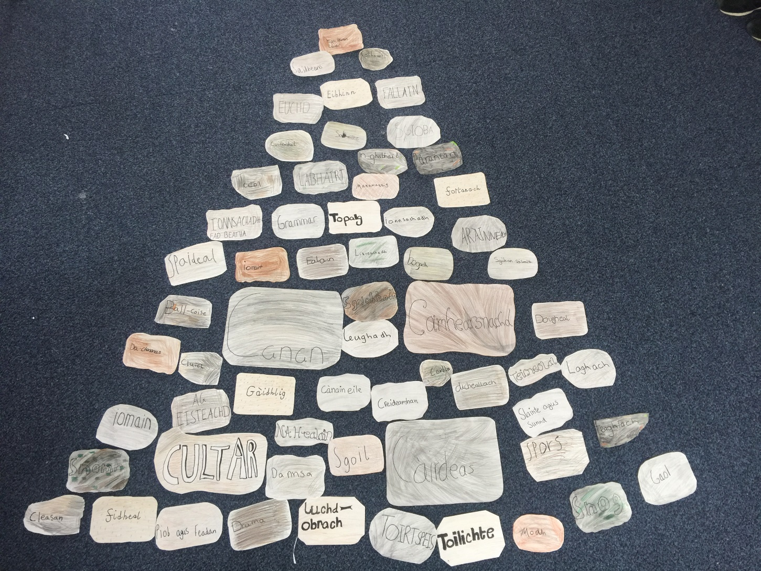
Càrn

Slide 18
Team Building
Using the inspiration from your statements and your thoughts on resilience….
You have 10 minutes to create a team Community Resilience Cocktail.

Slide 19
Round Robin
Introduce and share your
School/learning centre
Resilience focus / challenge
What you have been doing
What the children and community have gained from the embedding Community Resilience journey.

Slide 20
Next Steps
Update the Community Resilience Pathways sheet and forward to Alison MacLennan
Update Standards and Qualities Report and School Improvement Plan
Seek permission from parents for using photographs for promoting Community Resilience.

Slide 21
Conclusion
Useful resources
https://education.gov.scot/improvement/learning-resources/engaging-parents-and-families-a-toolkit-for-practitioners

Slide 22
See You Next Time.

Slide 23
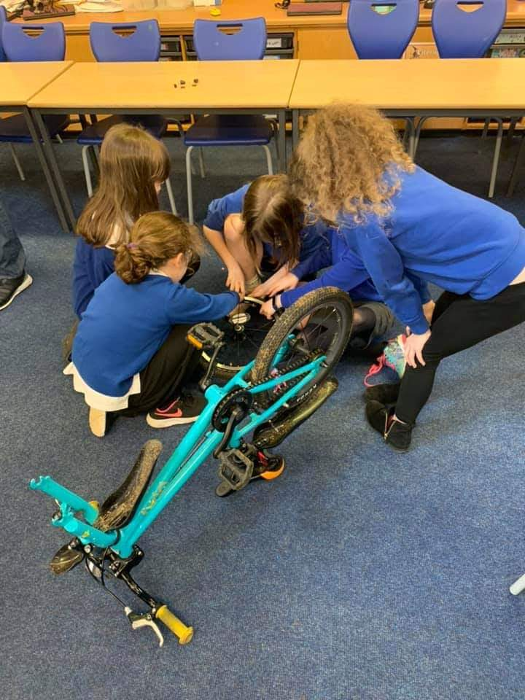
World of Work Week

