Slide 1

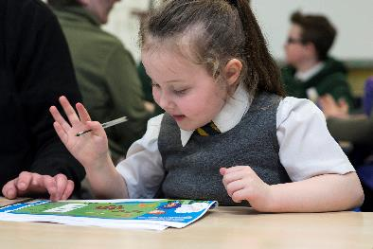
Back to Basics
For Scotland’s learners with Scotland’s educators

Slide 2
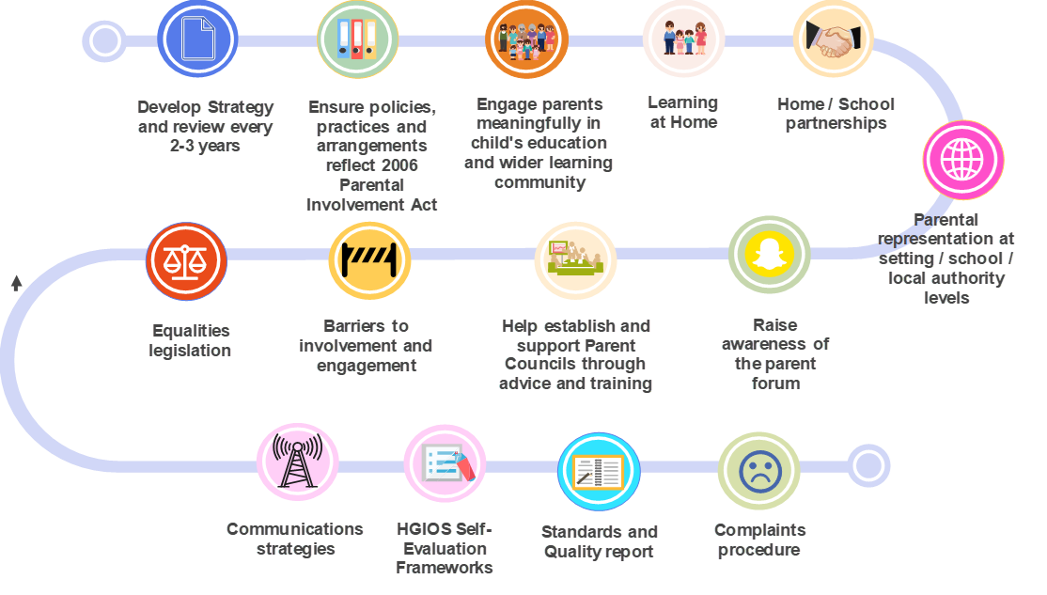
Back to Basics - Legislative
For Scotland’s learners with Scotland’s educators
Notes:
The approaches to involving and engaging parents in their children’s and their own learning requires to be regularly reviewed and adapted to ensure they meet the individual needs of families taking account of different demographics. Communications and relationships based on trust, mutual respect and collaboration are, and will continue to remain an important lever of change and improvement which lies at the heart of all our work with children and families. Having the voice of parents represented will not only influence these approaches and communication methods, it will also help to re-shape the future direction of engaging parents and families in their child’s and their own learning.
There is a need to provide the right support, conditions and opportunities to help parents feel empowered to engage in their child’s and their own learning. Recognising and reducing barriers and/or previous negative or false beliefs, attitudes or mindsets which are preventing parents from engaging in their child’s and their own learning require to be a key focus for local parental involvement and engagement strategies.

Slide 3
Back to Basics - Current
For Scotland’s learners with Scotland’s educators

Slide 4
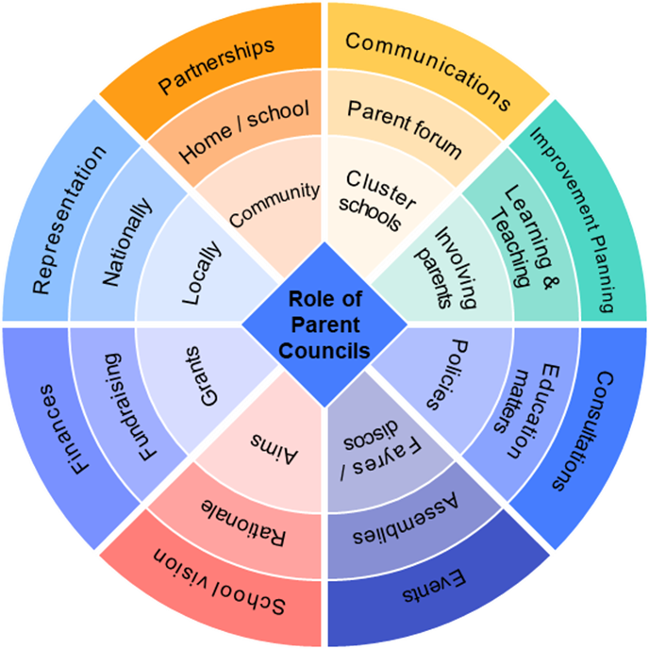
Opportunities to engage parents
For Scotland’s learners with Scotland’s educators

