Slide 1
Writing

Slide 2
Writing
When we assess writing, we are assessing the following:
Tools for writing
Organising and using information
Creating texts
Notes:
Creating texts = The ability to write for a range of purposes and audiences selecting appropriate genre, form, structure and style

Slide 3
Writing in English
Personal essay
Write about a personal experience, including detailed descriptions of your thoughts and feelings
Write about yourself
Discursive/informative essay
Interdisciplinary topic with art
Research and provide information on sweatshops
Imaginative/descriptive writing
Critical essays
Expressing ideas about a text in a clear way

Slide 4
Writing in all subjects
Reports
Projects
Newspaper articles
Evaluations of performance/work
Short responses to understanding questions
Notes:
Examples of writing tasks which would be completed in other subjects – these also require a good level of technical skills

Slide 5
Tools for writing
using knowledge of technical aspects to help my writing communicate effectively within and beyond my place of learning.
The skills included are as follows:
Spelling
Punctuation
Accurately structuring different types of sentences
Editing work to ensure it communicates meaning clearly at first reading
Using the correct layout
Notes:
focus for all year groups and all subjects to ensure the quality of writing improves

Slide 6
CORRECTION CODE
Code (in margin) How it appears Explanation
sp spelling error
P O (incorrect) or ^ (missing) punctuation error
exp ~~~~~~~~~~~~~ poor expression
C O caps (missing or inappropriate)
np // new paragraph
λ λ content missing
[…..] […..] not relevant
rep rep repetition
SE serious error
* * one star
* ** two star
! ! wish
Notes:
On display in every classroom in the school
Used by all departments
Copy available in the information pack

Slide 7
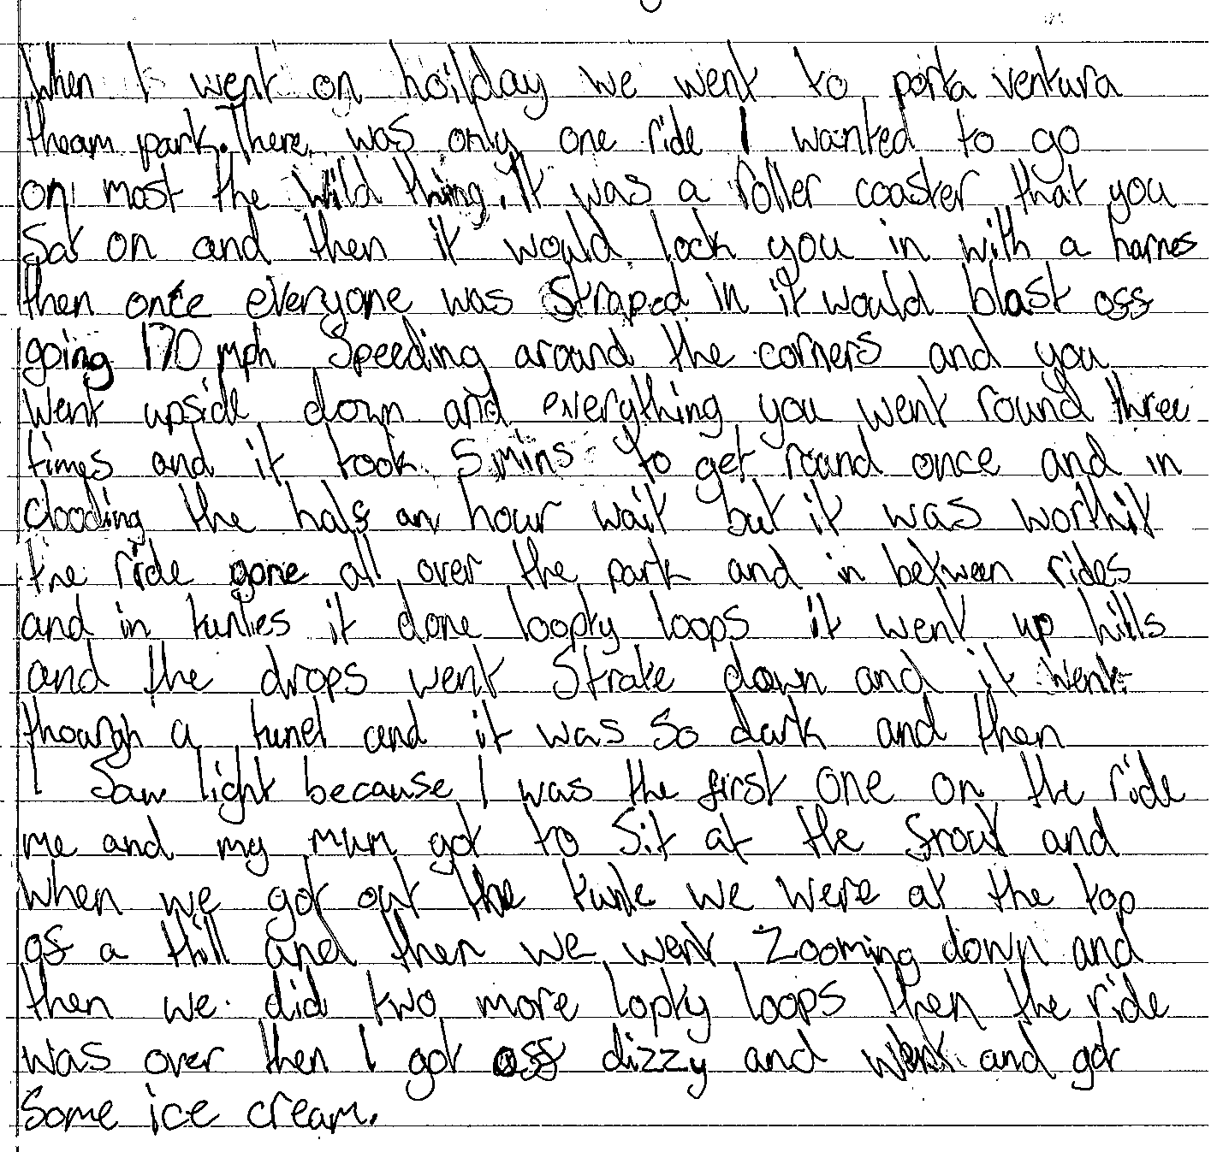
Sample paragraph – no markings
Find example – EB?
Notes:
S1 piece of work (from a previous year group)
This was the whole essay
Read over individually – what issues do you notice? Give parents a few minutes to look over, no need to answer out.

Slide 8
Sample paragraph – no markings
Find example – EB?
Notes:
This slide identifies some of the technical issues with this piece:
many spelling errors
missing capital letters
missing punctuation (full stops)
Long sentences joined together using “and” too often
poor expression at points
no paragraphs
This piece wasn’t edited – had the pupil proofread, they could have fixed some of these issues

Slide 9
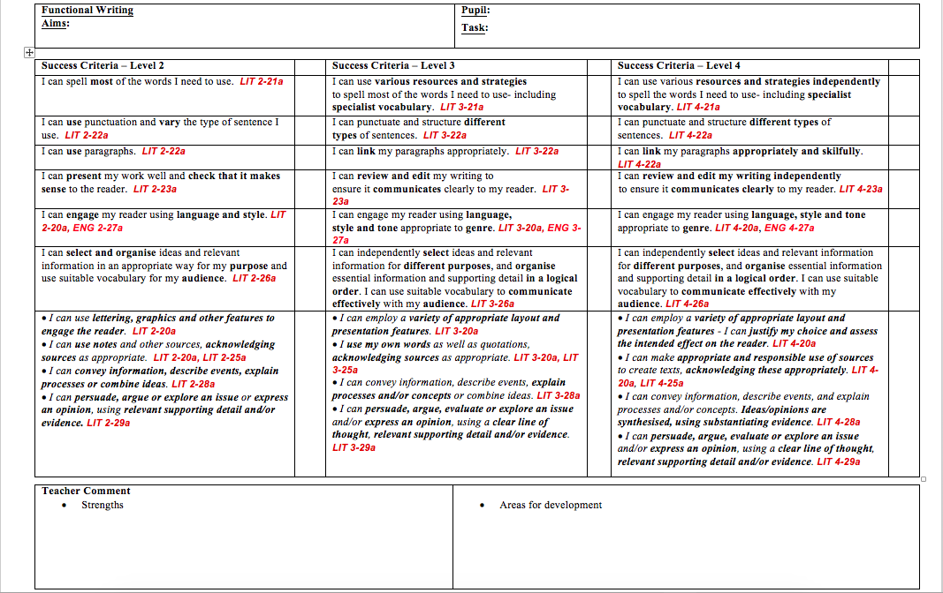
Marking Criteria
Notes:
Copy of this in information pack
Used by staff across the school - shows general literacy skills required for functional writing

Slide 10
Sample Work – Level 2
one reason that many people blame the media for negative Body Image is the use of Photoshop and airbrushing has encresed by 550% In Recent years. This is the medias fault because the photo shop and airbrush alot of photo’s.
Notes:
Reasons for level 2:
poor use of capital letters – missed out when needed and used in inappropriate places
weak spelling of basic words
poor use of punctuation (misused apostrophes)
lack of sense in first sentence
not much content

Slide 11
Sample Work – Level 3
Photoshopping or ‘airbrushing’ is a large part of people being negative feelings about their body. Photshopping is when a special computer adds things that are not there or takes things away. Magazine editors admit that 9 out of 10 photos published are photoshopped. This could drop teenage kid’s confidence severally. We could resolve this by publishing natural images of models in magazines instead of editing them.
Notes:
What most S1s should be aiming for this
mostly technically accurate (some errors - e.g. misused apostrophes)
clear meaning in sentences
could do more to improve – as seen in next example

Slide 12
Sample Work – Level 4
When it comes to looking in magazines such as ‘Hello’ or ‘Ok’, I feel that not enough people take into consideration that the photos they look at could have been severely edited through photoshop. The models and celebrities they use are absolutely perfect as they are – why would they hire them otherwise? The definition of photoshopping is “digitally altering a photograph.” Photoshopping can be used to slim waists, make muscles appear more enhanced, brighten/dull colours and erase imperfections. In most magazines, the publishers do not notify the readers that the models have indeed been photoshopped, sometimes beyond recognition. As a result, people (especially young women) are prone to thinking they need to change their bodies to look like these “perfect” models. I feel that if in any sort of advertisement, it should be made clear that photoshopping has been used to help get rid of these unrealistic expectations of body size.
Notes:
more complex sentence structure – wider variety
sophisticated vocabulary
variety of punctuation correctly used
more in-depth content

Slide 13
How you can help
Encouraging your child to proofread and edit all of their own written work (can also be done aloud to help check punctuation and sense)
Regularly checking jotters from a variety of subjects for basic skills
Encouraging use of dictionary for spelling and/or unfamiliar words
Encouraging regular reading at home
Appropriate level of challenge
Allows for vocabulary building

