Slide 1
Numeracy in Science

Slide 2
BGE Science Programme
Level 3 benchmarks (with extension into level 4)
Biology
Microscopes
Cells (Plants, Animals, Specialised cells)
Micro-organisms and their uses
Biology
Body systems
Technology applications in Health
Inheritance & DNA
Chemistry
Atoms and molecules
Chemical Reactions
Chemistry
Acid and Alkalis and neutralisation
Elements and compounds
Periodic Table
Physics
Energy sources and changes
Forces Contact and Non-contact
Sound Waves Frequency and Loudness
Physics
Light – Reflection, refraction and EM waves
Electricity - Charge and circuits
Notes:
I will be looking to review our own policy in line with the recommendations.

Slide 3
Science Numeracy
Measuring, using units and converting units
(Time, Volume, Mass, temperature, length)
Averages
Rounding from measurements
Bar graphs (Drawing, analysing, making conclusions, predicting)
Line graphs (Scales, plotting points, analysing)
Pie Charts
Percentages
Ratio
Algebra (using formula W = m x g V = IR)
Notes:
I will be looking to review our own policy in line with the recommendations.

Slide 4
Nat 5 Biology 2017
B

Slide 5
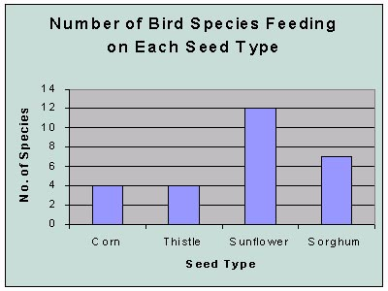
S1 Science bar graphs
Bar graphs
The different values go along the bottom X axis
The numbers go up the side Y axis
Label the axes
Make your scales go up in
even amounts – Start at 0
What does this graph tell you ??

Slide 6
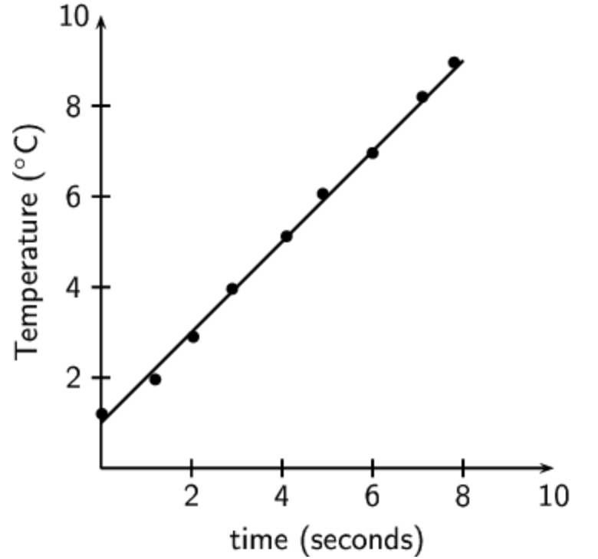
S1 Science line graphs
Line graphs
What did you change?
Independent variable
These numbers go along the bottom X axis
What did you measure?
Dependent variable
These numbers go up the side Y axis
Label the axes
Make your scales go up in even amounts – Start at 0
What does this graph tell you ??
0

Slide 7
S1 Science line graph

Slide 8
Investigations
S2 Maths Week
Resistance Investigation
 | Measured Resistance |  |  | Average Resistance
 | Attempt 1 | Attempt 2 | Attempt 3
Aim
Labelled diagram of
experiment
Conclusion
Notes:
I will be looking to review our own policy in line with the recommendations.

Slide 9
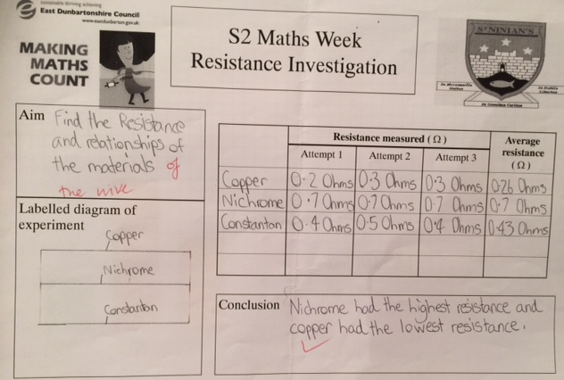

Slide 10
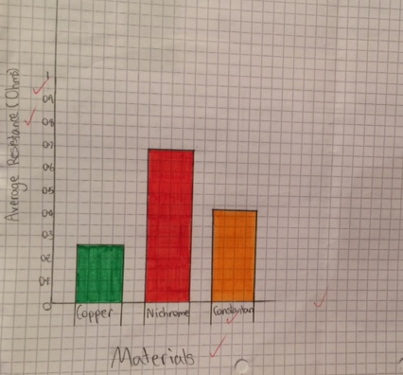

Slide 11
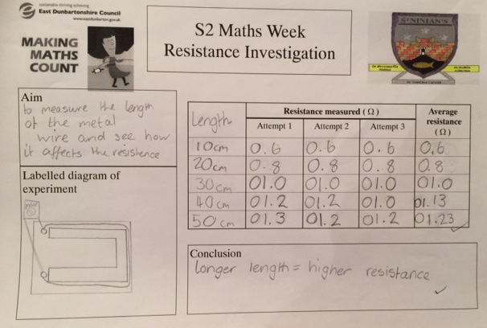

Slide 12
