Slide 1

DYW – overview
Focus Session
Klaus Mayer, Education Scotland
August 2017

Slide 2
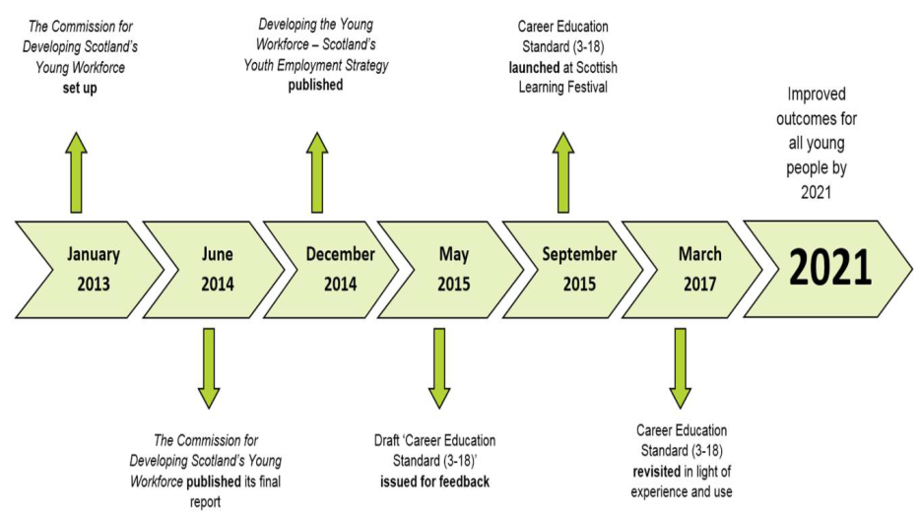
Notes:
This is a timeline line shows the implementation stages of the DYW Youth Employment strategy and the Career Education Standard (CES). There will be a review on the implementation of the CES in March 2017. The overarching aim of the programme is to see a reduction in youth unemployment by 40% in 2021.
& Year programme outline:
In year one, opportunities to learn more about developing the young workforce (DYW), explain what it means from early years through to the end of secondary education and look at what is already happening in practice. Testing out new approaches via the Scottish Funding Council's 'early adopter' activity on school/ college partnerships and on Skills Development Scotland's foundation apprenticeship pathfinders. Initial communication and engagement with young people and parents on the range of routes into employment which are open to young people at school and college.
In year two, more opportunities in place for young people to undertake learning which connects more directly to employment, for example, through school/college partnerships. We will evaluate early activity through foundation apprenticeship pathfinder activity and consider how successful programmes can be expanded further. Engagement with learners, teachers and practitioners to change perceptions of the value of work related learning and qualifications.
In year three, more schools will be delivering a broader range of qualifications for young people from S4 - S6 in partnership with colleges and other providers. Schools will have more partnerships with employers to inform curriculum design and delivery and provide work related learning experiences. With the support of careers professionals, teachers and other practitioners, young people and parents will be more informed about routes into work, careers planning and employment opportunities.
In year four, school and college staff and other practitioners across Scotland will be supported to have a greater understanding of the world of work and routes into work to improve young people's learning. More schools will offer a fuller range of vocational qualifications, in partnership with colleges and other training providers. Pilot activity around foundation apprenticeships will continue to be evaluated with successful activity rolled out. All schools will have employers fully involved in informing curriculum planning and delivery and providing work related learning experiences.
In years five and six, as the programme matures and the new provision becomes established, visible and valued, there will be an expansion of year four activity to cover the majority of secondary schools and other learning settings in Scotland.
In year seven, there will be evidence of increased employer satisfaction, more young people completing vocational qualifications, more achieving qualifications at a higher level, more young people in all secondary schools in Scotland progressing to college, training, university and employment.

Slide 3
DYW – Delivery: 2017/18
In year three:
more schools will be delivering a broader range of qualifications for young people from S4 - S6 in partnership with colleges and other providers.
Schools will have more partnerships with employers to inform curriculum design and delivery and provide work related learning experiences.
With the support of careers professionals, teachers and other practitioners, young people and parents will be more informed about routes into work, careers planning and employment opportunities.
Notes:
This is a timeline line shows the implementation stages of the DYW Youth Employment strategy and the Career Education Standard (CES). There will be a review on the implementation of the CES in March 2017. The overarching aim of the programme is to see a reduction in youth unemployment by 40% in 2021.
& Year programme outline:
In year one, opportunities to learn more about developing the young workforce (DYW), explain what it means from early years through to the end of secondary education and look at what is already happening in practice. Testing out new approaches via the Scottish Funding Council's 'early adopter' activity on school/ college partnerships and on Skills Development Scotland's foundation apprenticeship pathfinders. Initial communication and engagement with young people and parents on the range of routes into employment which are open to young people at school and college.
In year two, more opportunities in place for young people to undertake learning which connects more directly to employment, for example, through school/college partnerships. We will evaluate early activity through foundation apprenticeship pathfinder activity and consider how successful programmes can be expanded further. Engagement with learners, teachers and practitioners to change perceptions of the value of work related learning and qualifications.
In year three, more schools will be delivering a broader range of qualifications for young people from S4 - S6 in partnership with colleges and other providers. Schools will have more partnerships with employers to inform curriculum design and delivery and provide work related learning experiences. With the support of careers professionals, teachers and other practitioners, young people and parents will be more informed about routes into work, careers planning and employment opportunities.
In year four, school and college staff and other practitioners across Scotland will be supported to have a greater understanding of the world of work and routes into work to improve young people's learning. More schools will offer a fuller range of vocational qualifications, in partnership with colleges and other training providers. Pilot activity around foundation apprenticeships will continue to be evaluated with successful activity rolled out. All schools will have employers fully involved in informing curriculum planning and delivery and providing work related learning experiences.
In years five and six, as the programme matures and the new provision becomes established, visible and valued, there will be an expansion of year four activity to cover the majority of secondary schools and other learning settings in Scotland.
In year seven, there will be evidence of increased employer satisfaction, more young people completing vocational qualifications, more achieving qualifications at a higher level, more young people in all secondary schools in Scotland progressing to college, training, university and employment.

Slide 4
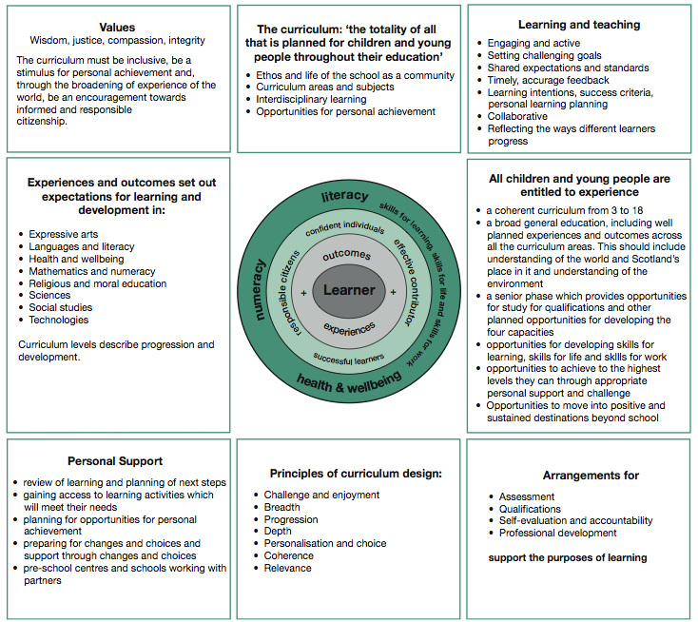
Six entitlements for all learners:
Entitlement 4:
Opportunities for developing skills for learning, skills for life and skills for work
Entitlement 6:
Opportunities to move into positive and sustained destinations beyond school
Notes:
The entitlements for learners set out within CfE express a clear vision around skills development and learner pathways/ positive sustained destinations – core components of DYW.

Slide 5

Overall goal:
By 2021 reduce the level of youth unemployment by 40%!
(excluding those in full-time education)
2017: 9%
2014: 19%
Notes:
The latest youth unemployment figures represent a 50%+ drop of those young people not in work.

Slide 6

2040 Vision:
Responding to the speed of change
Notes:
https://youtu.be/ITJUQre19Mg

Slide 7


Notes:
Skills development is core to preparing children and young people for the world of work. This is in line with the latest research (see Scotland’s Skills 2030 (https://www.ippr.org/publications/scotland-skills-2030 ) and demands by employers for a skilled workforce (CBI survey: https://blogs.glowscotland.org.uk/glowblogs/eslb/2016/08/15/cbis-latest-survey-reveals-an-increasing-demand-for-a-skilled-workforce/ ).
Task: In one of your recent inputs – what skills did your learners develop as a result of your support?
Which of these where skills for work/ employability skills?
Exemplification: Larbert High School – Skills Framework (https://blogs.glowscotland.org.uk/glowblogs/eslb/2017/07/13/dyw-interesting-practice-larbert-high-school-developing-young-peoples-skills-across-all-aspects-of-learning/)

Slide 8

Skills for Learning, Life and Work –
Building the Curriculum 4
Key messages
Skills development is essential
Entitlement from 3 - 18
Embedded in CfE
Skills development:
Numeracy
Literacy
Skills for health and wellbeing
Thinking skills
Skills for enterprise and employability (eg. career management skills, leadership, working with others etc. )
Notes:
BtC 4 focuses exclusively on the development of skills and makes references enterprise and employability skills (see page 13f)

Slide 9

Scotland Skills 2030
By 2030:
78% of the working population will still be of working age by 2030
46% of jobs are at high risk of automation.
On-going political and economic uncertainty
The world of work will look very different. People will:
  Work longer
  Have multiple jobs, employers and careers
  Require higher level skills and digital capabilities
Key recommendation 4: Career pathways co designed by employers and learners.
Notes:
https://www.ippr.org/publications/scotland-skills-2030

Slide 10
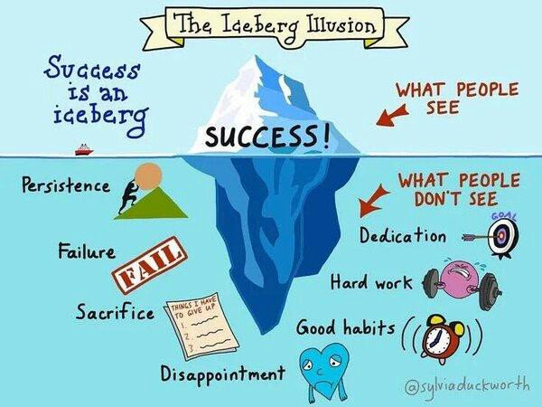
How about attributes and dispositions?
Resilience
Determination
Dedication
Hard work
Enthusiasm
Confidence
Self awareness
Honesty
Respect for others
Entrepreneurial mind-set
Optimism
Creativity
Global awareness
etc.
Notes:
Employers regard attributes, attitudes and dispositions as equally important to the development of knowledge and skills. Particular knowledge is transient and can be passed on and developed in a work context.

Slide 11
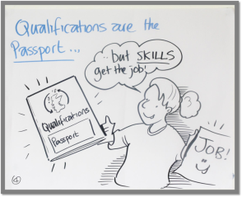
CBI – Education and Skills Survey 2016
What business are looking for:
Attitude (89%)
Aptitude (66%)
Qualifications (52%)
What business identify as deficiencies:
Quality of work experiences (56%)
Communication skills (50%)
Analytical skills (50%)
Self-management skills (48%)
Notes:
There is a false perception amongst young people of what employers are looking for. Most young people think that qualifications are top of the priority list.

Slide 12
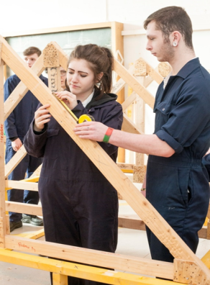
Businesses focus on skills
Employers don’t just value what
people know,
they value what they can do!

Slide 13
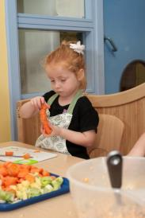
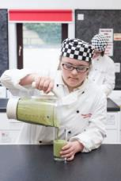
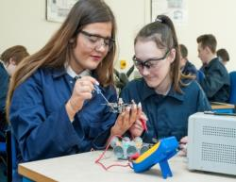
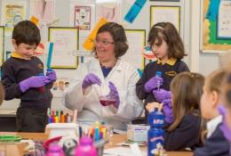
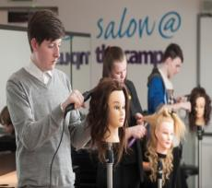


DYW 2017: Where are we now?
Notes:
Progress has been made over the last 3+ years to implement career education across all stages of education from 3 – 18. Building on the foundations of CfE and its emphasis on skills as well as the world of work, many contextualised learning opportunities have been incorporated into the curriculum planning from early years into the senor phase. A renewed focus is on gender balance particularly in STEM subjects as well as equality and inclusion. More diverse pathways are now on offer in the senior phase to support the career aspirations of all learners, including apprenticeships and college options.

Slide 14
Some key developments to date:
New standards and guidance documents published
Senior staff resources in place
22 DYW Regional Groups established across college regions in Scotland
Extended career service (CIAG) offer by SDS
Development of diverse learner pathways (academic and vocational)
Increased parental engagement around future pathways
Innovative approaches to curriculum design (learner centric)
As a result learners are now already better prepared to enter the world of work (BBC News).
……

Slide 15
Developing the Young Workforce Aims
All young people have the opportunity to engage in purposeful and directly work-related learning while at school
All young people have a wider range of choices available to them and are supported to make the most appropriate choices for their futures
A climate where all young people, their parents, teachers and practitioners value - and demand - a range of routes into good jobs and careers, whether that is through our universities, colleges, apprenticeships or training provision
An increase in the uptake of vocational qualifications available to those in the senior phase, year on year from 2015
An increase in the quality and number of strategic partnerships between local authorities, schools and colleges to widen the offer to young people in the senior phase (2015-16)
All secondary schools will have active partnerships with regional colleges (2018-19)

Slide 16



Career Education Standard 3-18
Aims
Children and young people should:
  learn earlier about the world of work
  be better prepared to enter and sustain employment
Recognise key influencers & shared responsibility
Describe and clarify complementary roles
Inform planning and describe success
Notes:
The Career Education Standard 3-18 outlines the key entitlements for children and young people as well as the expectations placed on teachers/practitioners, parents/carers, employers, and SDS. It also provides a planning structure/tool (see ‘I can’ statements in the Appendix) and should form the stating point of any DYW development work.

Slide 17

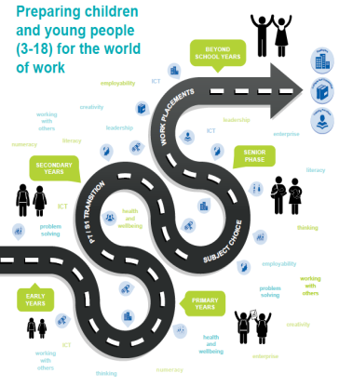
Career Education Standard (3-18)
Notes:
This has been developed with key partners in direct response to the recommendation from Education Working For All that children receive careers guidance earlier. It builds on advice and guidance in Curriculum for Excellence and in particular Building the Curriculum 4: skills for learning, skills for life and skills for work. The standard sets out:
entitlements for children and young people (3-18); and expectations of key partners to support the implementation of the standard.
The standard, when implemented, aims to better prepare children and young people for the world of work.
Download from www.education.gov.scot

Slide 18
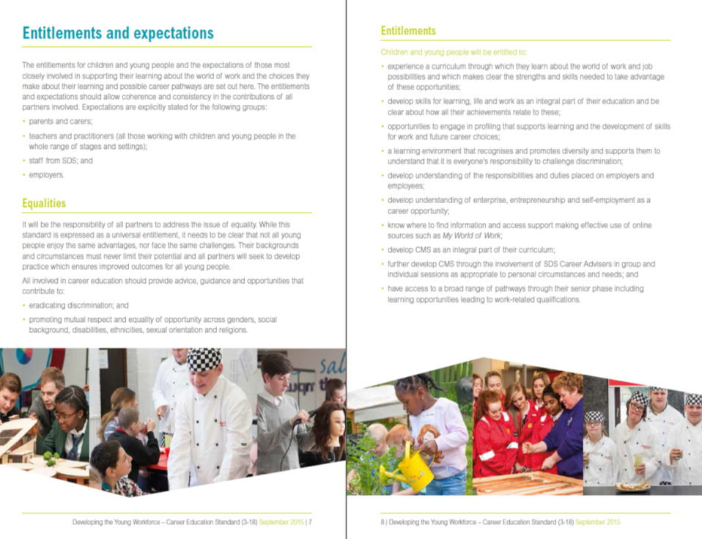
Entitlements for all learners
Teachers
SDS
Parents
Employers
Notes:
The document sets out the standard expressed within the entitlements and expectations. To realise the standard, partnership working is key.

Slide 19
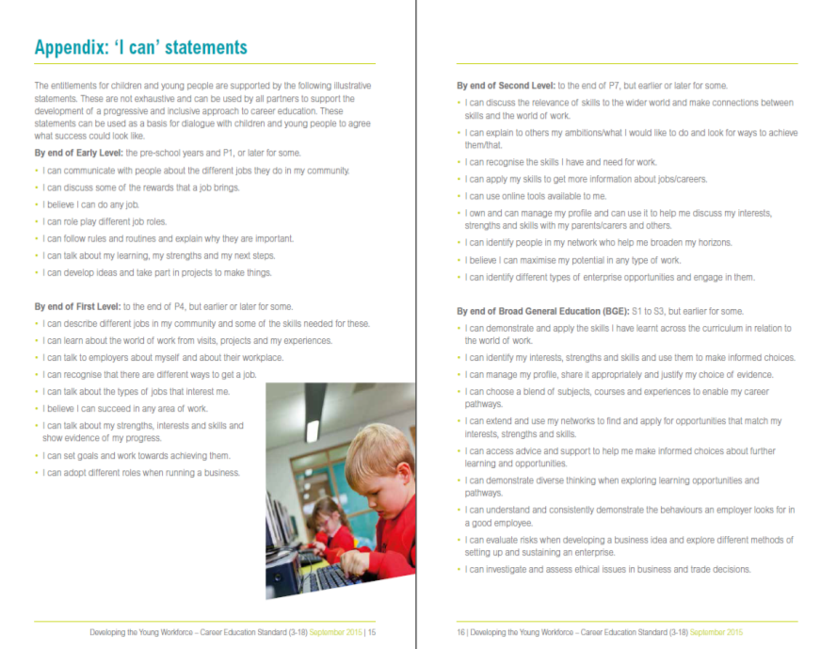

Inform planning
Describe success
Support self evaluation and profiling
Notes:
The illustrative ‘I can’ statements in the Appendix of the CES 3-18

Slide 20
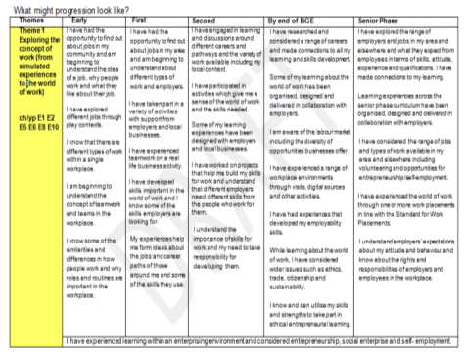
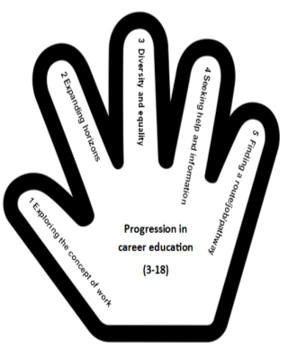
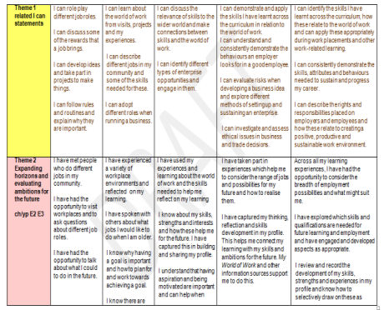
Exemplification tool
Notes:
The Exemplification tool outlines what the implementation of the ‘I can’ statements may look like in context across all levels of the curriculum.
Access the exemplification tool here: https://blogs.glowscotland.org.uk/glowblogs/eslb/2016/12/01/career-education-standard-3-18-exemplification-tool-offers-a-helping-hand/

Slide 21

There’s more than one path to success
“... there is a widespread belief that studying for a degree will lead to a well-paid job and fulfilling professional career and whilst in many cases this is true it isn’t always the case”.
Great Expectations, City and Guilds 2015

Slide 22
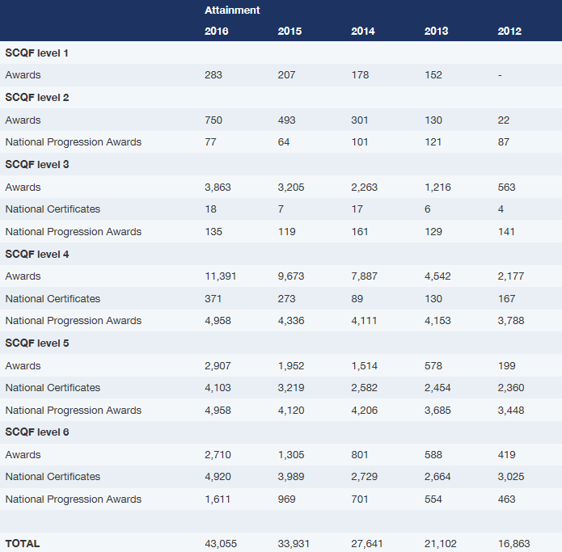
SQA qualifications
SQA Awards, National Certificates, National Progression Awards are up by %17.
(- doubled since 2013!)
Note: 23,779 Skills for Work awards in 2017
43055 33931 27641 21 102
Notes:
There has been a significant increase in work-related qualifications over the last years. The emphasis on career education and the development of employability skills including an extended provision for work-based learning opportunities may partially account for this increase. There has been a slight decrease in 2017 to 41483 (~3.5%). Also Skills for Work awards have risen to 23,779 (from 21,904 in 2016) . This equates to over 65000 work/skills related qualifications, about 10% of all qualifications issued.
More information on the SQA website here: http://www.sqa.org.uk/sqa/80699.html

Slide 23
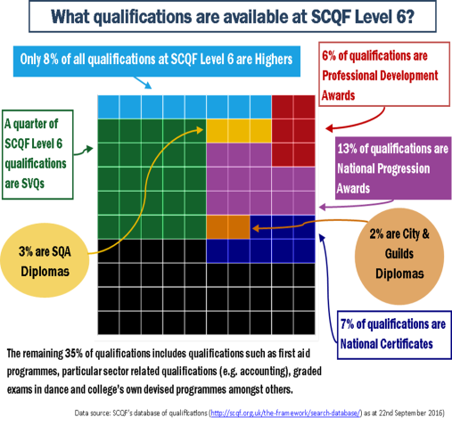
SCQF data
More than 11,000 qualifications and learning programmes recognised on SCQF
84% of qualifications at SCQF Level 6 are not Highers
Notes:
A wide range of other youth work awards and accredited vocational learner pathways are increasingly recognised and valued by employers along side academic qualifications.

Slide 24

The Apprenticeship family
The development of Work Based Learning pathways provides:
Complementary and alternative pathways to existing academic and vocational pathways
Spanning the Scottish Credit and Qualification Framework (SCQF):
  SCQF 6 – Foundation Apprenticeships
  SCQF 5-7 – Modern Apprenticeships
  SCQF 8/10/11 – Graduate Level Apprenticeships
Notes:
The apprenticeship WBL pathway spans the SCQF Framework from levels 5 up to 11
Graduate level apprenticeships are a new work based learning opportunity and a new and alternative apprenticeship route into degree level study.

Slide 25

Foundation Apprenticeships
For senior phase pupils S5-S6
Work-based learning typically over 2 years
Delivery partnerships with schools, colleges, training providers and employers
Work based learning at SCQF Level 6
Deliver elements of a Modern Apprenticeship
Provide industry recognised qualifications
Offer multiple progression pathways – into work including fast-track entry to a related MA, into a GLA, FE or HE
Notes:
And now for a quick update on Foundation Apprenticeships. So what are they? They are :
An exciting new work based learning qualification for young people in the senior phase of secondary school – they are one of a young persons choices within their senior phase curriculum and they are taken alongside other school subjects
They are designed to provide a high quality work based learning experience for young people and deliver a combination of the Knowledge, skills and competence that is needed for career progression in key industries before leaving school
They are developed and delivered in partnerships between education and employers shaped and supported by SDS – young people undertaking a foundation apprenticeship spend part of their time in school, in college and in the workplace
They are based on successful MA frameworks designed by industry – they provide learning that is directly relevant to getting a job – and they ensure the work readiness of young people earlier by enabling them to complete elements of a Modern Apprenticeship while still at school.
Foundation apprenticeships are designed to benefit young people and the economy by expanding the range of progression opportunities and pathways for young people to choose from when leaving school to pursue their future career
On completion of a foundation apprenticeship young people are better prepared and have the skills and experience to go :
Directly into a job
For accelerated progression on to a related Modern Apprenticeship as they will already have completed the foundation elements while still at school
For progression on to a graduate level apprenticeship
or to continue on to further learning at University or College

Slide 26
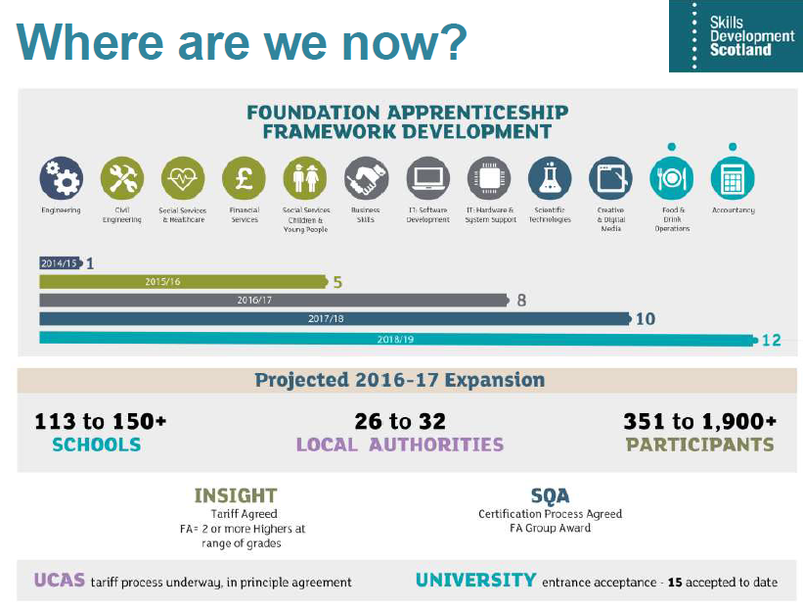
Foundation Apprenticeships
Notes:
Foundation Apprenticeships qualifications are accepted as entry qualifications (Higher equivalent) by an increasing number of universities.

Slide 27
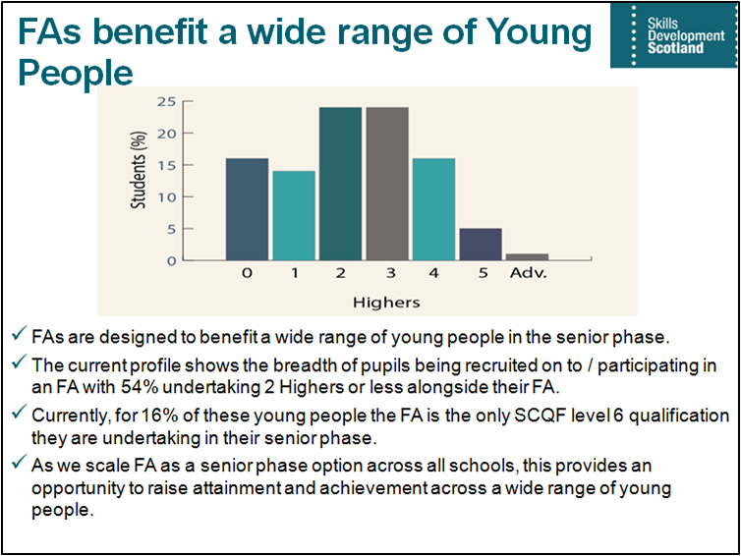

Slide 28
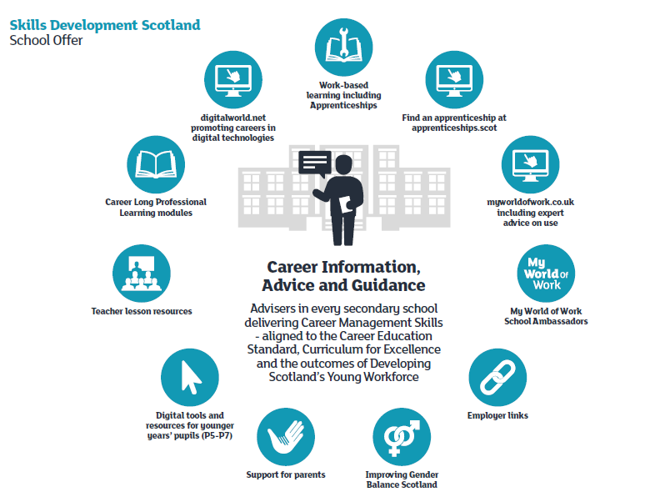
Notes:
Overview of the extended CIAG offer for schools from P5 – S6 delivered by Skills Development Scotland.

Slide 29
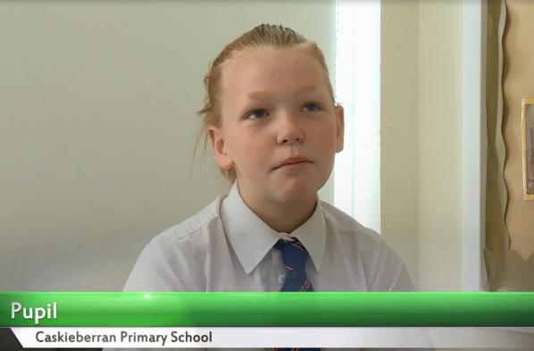
Interesting Practice: Learner voice
Career Education at Caskieberran Primary School, Fife:
https://www.youtube.com/watch?v=OUKWrcfyLbQ
Notes:
In this clip the learner explains her role in a cluster careers event planned, organised and implemented by the pupils in form of an enterprise initiative. The learning, increase in confidence and development of skills through this initiative is evident in the testimony.

Slide 30

Interesting Practice: Community Café, Shetland, Head Teacher perspective
https://www.youtube.com/watch?v=ED8dTBzUMgU
Notes:
In this clip the Head teacher outlines how this initiative was conceived, the wider planning involved and the links to the DYW/skills agenda in the school. It also highlights the benefits of the project in engaging with the wider community.

Slide 31
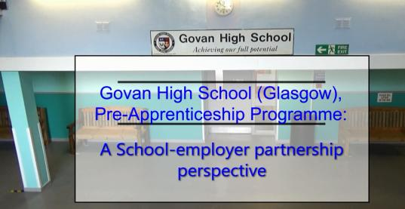
Interesting Practice: Pre-Apprenticeship Programme, Govan High School
https://www.youtube.com/watch?v=U4pViP8zn30
Notes:
This clip features the local employer input to the pre-apprenticeship programme at Govan High. It highlights the opportunities, challenges and benefit to young people at all levels of education.

Slide 32
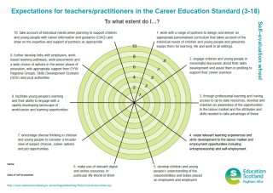
Where are you know?
Reflection:
Use the self-evaluation wheel (see Learning Resource 1) to reflect on the expectations on teachers and practitioners:
To what extent do you contribute to and support the realisation of the expectations?
Which areas could be developed further as part of your work with schools/ LAs?
Notes:
The self-evaluation wheel can be found in the ‘Learning Resource 1: Introduction to the Career Education Standard’ (page 9): https://education.gov.scot/improvement/Pages/dyw23-career-education-standard-learning-resources.aspx.
It is also available as a separate download under the above link.

Slide 33
Does the CES 3-18 feature on your improvement plan for 2017/18?
(including collective Local Authority responses)
Notes:
1. Direct survey responses by schools/establishments:
Primary / EY/ Nursery Schools (236): Yes = 120 (51%) / No = 116 (49%)
Secondary Schools (100): Yes = 68 (68%)/ No = 32 (32%)
Overall: Yes = 188 (56%) / No (or not anymore) = 148 (44%)
2. Adjusted figures which include collective local authority response saying all schools (should) have DYW on their improvement planning for 2017/18:
(Fife (P 140 / Sec 20), Glasgow City (P 152 / Sec 39), Orkney Islands (P 21 / Sec 5), Shetland Islands (P 29 / Sec 7) and South Ayrshire (P 42 / Sec 9); All together: Primaries: 384; Secondaries: 80); In bracket are the number of primary and secondary schools within the respective local authority
Primary / EY/Nursery Schools (~ 500): Yes = 504 (81%) / No = 116 (19%)
Secondary Schools (~ 180): Yes = 148 (82%) / No = 32 (18%)
3. Overall (all school taken together): Yes = 652 (82%) / No = 148 (19%)

Slide 34




National Priorities: Making connections
GIRFEC / 16+ / MCMC / Opportunities for All
Notes:
It is important to be aware of the DYW links across relevant national priorities. DYW is explicitly referred to in all of the latest delivery plans and improvement materials released for education.

Slide 35

3.3 CREATIVITY AND EMPLOYABILITY
Theme 4: Increasing employability skills
How Good is our School 4?
Features of highly effective practice:
The school audits practice using the entitlements and expectations in the Career Education Standard.
Young people experience rich work-based learning. This enables them to make informed career choices.
There are clear expectations for young people, employers, schools, local authority, parents and carers before, during and after work placements.
Challenge questions:
How well are we working with learners, parents and carers, employers, colleges and other partners to develop an effective approach to careers education which supports them into sustained positive destinations?
How knowledgeable and up-to-date is our school team about career and employability prospects?
Notes:
This Quality Indicator relates directly to the DYW agenda. However it is not core to inspection.

Slide 36

HGIOS 4
Core Quality Indicators:
1.3 Leadership of Change
2.3 Learning, Teaching and Assessment
3.2 Raising Attainment and Achievement
3.1 Ensuring Wellbeing, Equality and Inclusion
Permeating themes:
Learning pathways, particular senior phase provision
Development and promotion of partnerships
Recognition of wider achievement
Supporting transition and progression towards positive sustained destinations
Notes:
DYW inspection advice notes have been issued to identify and analyse evidence of the implementation of DYW across learning and teaching.

Slide 37

Benchmarks: References to DYW/skills
Core briefing states:
“Skills development is integrated into the Benchmarks to support greater shared understanding. An understanding of skills and how well they are developing will enable learners to make links between their current learning and their future career options and employment.
Some benchmarks make explicit reference to the world of work and employability skills (eg. Sciences).

Slide 38

National Improvement Framework
Our Priorities
Improvement in attainment, specifically in reading, writing and numeracy
Closing the attainment gap between the most and least disadvantaged children
Improvement in children and young people’s health and wellbeing
Improvement in employability skills and sustained, positive school leaver destinations for all young people
Notes:
Excellence and equity

Slide 39

targeted improvement activity in literacy, numeracy and health and wellbeing
support and complement the broader range of initiatives and programmes to ensure that all of Scotland’s children and young people reach their full potential
Notes:
There is a direct correlation between contextualised learning around careers and future pathways and the attainment of learners. DYW offers rich learning experiences that allows children and young people make connections with the world of work and develop skills in a real life setting. Schools that have embraced tis agenda with learners have seen an increase in attainment (see Craigroyston Community High School, https://education.gov.scot/improvement/Pages/dyw35-helping-young-people-realise-their-aspirations.aspx ) . Other related benefits are increased pupil participation, higher attendance rates and a decrease in exclusions.

Slide 40
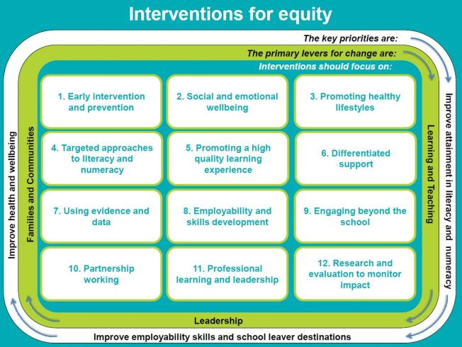
Interventions for Equity
Notes:
Improving employability and school leaver destinations frames the whole agenda. Central to this is also ‘employability and skills development’, ‘partnership working’ (eg. with employers, parents etc.) and ‘engaging beyond the school’, all aspects DYW meaningfully contribute towards.

Slide 41

National Deliver Plan for Scottish Education
DYW Priority:
Improving the breadth of opportunities available to children and young people to experience high-quality work-related learning and develop their skills for work throughout and beyond their education through the implementation of Developing the Young Workforce - or youth employment strategy.
Notes:
DYW is explicitly mentioned in the introduction (see page 2) (http://www.gov.scot/Topics/Education/Schools/DeliveryPlanforScottishEducation )

Slide 42
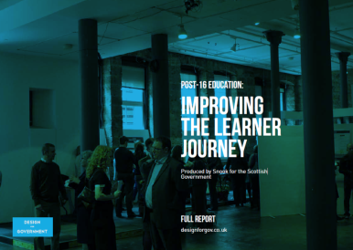
Delivery Plan: Learner Journey review
The top line ambition is to develop a learning system which makes it as straightforward and efficient as possible for young people to develop capacities and skills for learning, life and work and ultimately to secure sustained employment.
Notes:
This new Scottish Government priority is to review the progression of learner pathways for young people from 15 – 24.

Slide 43
Delivery Plan: Learner Journey review
The review will cover five main themes:
Learning choice, careers and application;
Access;
Provisions;
Transitions and progression;
Funding.

Slide 44
GTC – standard: DYW connections
Developing, implementing and evaluating the DYW programme can be referenced against GTC standards eg.:
Professional CLPL Action:
Educational context and current debates in policy, education…
Learning for sustainability.
Leadership and Management:
Leadership mobilises, enables and supports other to develop and follow through on strategies for achieving change.
Management is the operational implementation and maintenance of the practices and systems required to achieve this change.

Slide 45
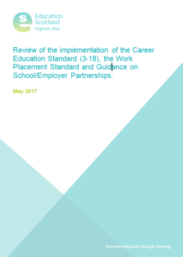

Inspection and Reviews
Notes:
More resources will be added to create a suite of CLPL materials to support professional development around CES as the programme expands.

Slide 46

Career Education Standard 3-18
Implementation review
Majority of practitioners aware of the CES 3-18 but .... varies according to their level of involvement with DYW
Whilst practitioners are increasingly engaged in the delivery of DYW this is not always fully aligned with the CES.
Where local authorities have adopted a pro-active approach in coordinating the implementation there is a higher degree of awareness and realisation of the standards and guidance in schools.
The overall pace of implementation has to increase.
“Most practitioners indicated that they incorporated learning about the world of work in their learning and teaching. This was not always obvious to learners.”

Slide 47
Inspection analysis
Where schools are successful in relation to the implementation of DYW the following features are evident:
Effective partnership working (eg. with parents, local business, colleges, Skills, Development Scotland, Chamber of Commerce, the local community)
Strong leadership
DYW firmly rooted in school’s vision, values and aims
Notes:
The overarching picture gives the broad picture of assessing progress & achievement, and the key points that are relevant to all curricular areas.

Slide 48
Inspection analysis – improvements:
Further work needs to be done to support schools:
Implement the Career Education Standards (3 – 18) and the Work Placement Standards (particularly in early years and primary)
Use DYW as a key driver when reviewing school vision, values and aims
Ensure skills for learning, life and work and creativity encompass, and are central to the whole curriculum
Increase the range of work-based learning opportunities provided
Extend the use of partnership working
Ensure learners can articulate the skills they are developing and their relevance to learning, life and work
Develop effective tracking systems
Notes:
The overarching picture gives the broad picture of assessing progress & achievement, and the key points that are relevant to all curricular areas.

Slide 49

CIAG Reviews
“In most schools, the development of CMS is not yet incorporated sufficiently within the wider school curriculum. Overall, subject teachers are not sufficiently aware of CMS or the requirements of the career education standard (CES).” Mar 2017
“Overall, young people in secondary schools do not have sufficient opportunity to develop and apply their CMS within the broader school curriculum.” Mar 2017
“Overall, subject teachers in schools are not sufficiently aware of the Career Education Standard (CES) and how to develop CMS with all young people. In some schools, CES is not yet incorporated within the wider school curriculum.” Apr 2017

Slide 50
What next?
In the light of the CES 3-18 Implementation review we collaborate with local authorities to develop tailored support.
Working group to consider guidance on profiling in relation to DYW.
Further develop STEM National Strategy to publication by autumn.
RAiSE project now gaining momentum
Gender balance (resources on NIH) and equalities remain key priorities.
Collate and disseminate exemplification to support CES implementation
Notes:
Key areas of development in 2017/18

Slide 51
What next?
Learning pathways - Senior phase design: Resource is now published in the National Improvement Hub:
  a self-evaluation tool
  approaches to support collaborative curriculum design and planning
  case studies of interesting practice
Capacity building:
  Professional Learning Reference Group to consider professional standards and leadership qualifications
  Collaboration with SCEL on ‘Excellence into Headship’ framework
  DYW strategic leads network – quarterly meetings
  Increase collaboration of DYW leads and DYW Regional Groups
Notes:
Key areas of development in 2017/18
Learning

Slide 52

Planning ahead – some thoughts:
Work strategically – leadership matters
Make the Career Education Standard 3-18 central to your planning
Make DYW an approach, not a project
Put children and young peoples’ aspirations at the centre (entitlements!)
Build on existing structures and experiences
Develop your partnerships
‘Double dividend’ wherever possible
Consider data, research and your context and…
..stay calm: Don’t do more, do things differently!

Slide 53

Where are you going next?
Leadership
Reflection:
What are the challenges you face moving forward?
What opportunities can you identify in developing the DYW agenda further?
Action points?
Double Dividend
Data & Context
CES 3-18
Partnership
Entitlements
Notes:
Excellence and equity

Slide 54




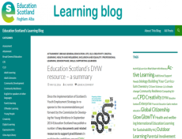




DYW resources and support

Slide 55
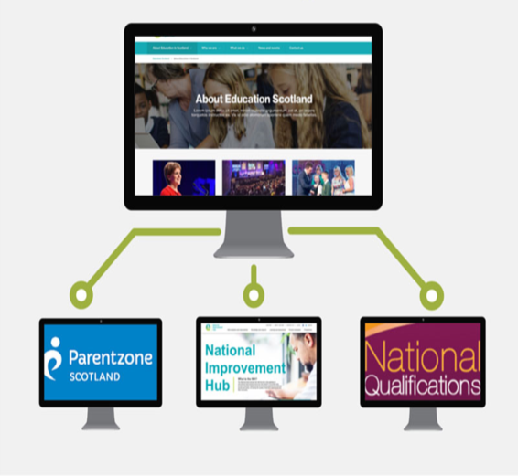
New Education Scotland corporate website: www.education.gov.scot

Slide 56
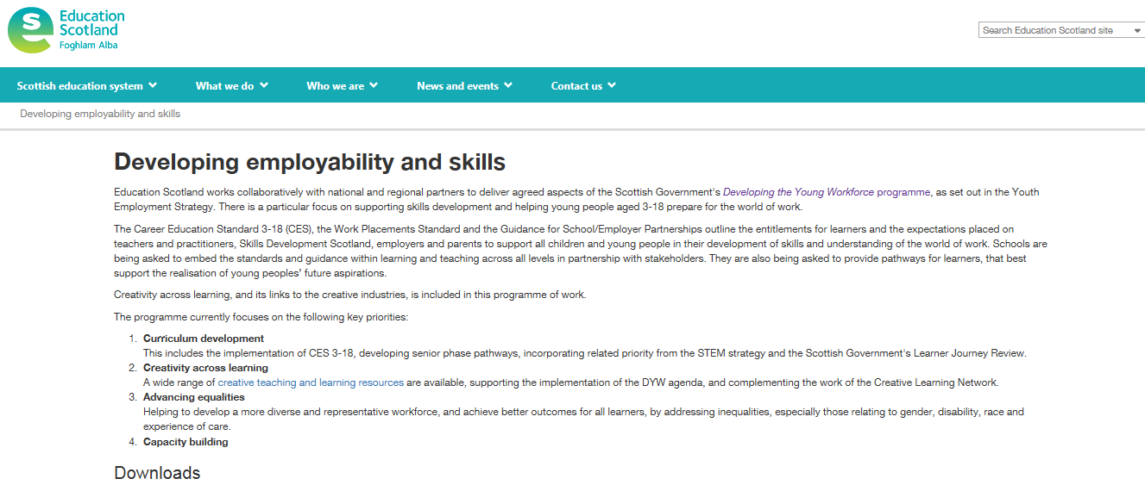
Education Scotland Website
All related policy documents can be accessed on the on the ‘Developing employability and skills’.
Notes:
The 13 Interesting Practice (IP) exemplars feature DYW related activities from Dumfries & Galloway to the Shetland Islands and include contributions from early years/primary and secondary sectors as well as colleges and local authorities. Each IP contains a summary sheet with core information on the topic (about 300 words only!) and a wide range of supporting materials including over 30 video contributions from learners, teachers, senior managers and college lecturers.
More exemplars will be added as the DYW programme expands.

Slide 57
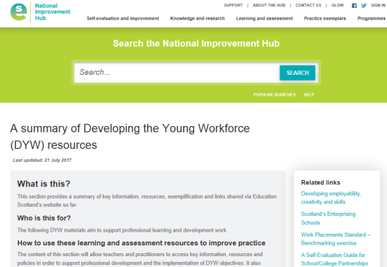
National Improvement Hub: DYW Summary
Key documents, resources and interesting practice examples are collated on the National Improvement Hub on the DYW-summary page.
Notes:
The 13 Interesting Practice (IP) exemplars feature DYW related activities from Dumfries & Galloway to the Shetland Islands and include contributions from early years/primary and secondary sectors as well as colleges and local authorities. Each IP contains a summary sheet with core information on the topic (about 300 words only!) and a wide range of supporting materials including over 30 video contributions from learners, teachers, senior managers and college lecturers.
More exemplars will be added as the DYW programme expands.
There are also a wide range of resources and toolkits available to support your implementation of DYW including an overview of the whole DYW programme offer its lifetime (2014 – 2021). The page also includes links to our Learning Blog, DYW Flyer and e-bulletins.

Slide 58

Career Education Standard 3 – 18: Learning Resources
LR 1: Introduction to the Career Education Standard (3-18) –This resource aims to help teachers and practitioners to become familiar with the new standard.
LR 2: Introduction to Labour Market Information
This resource provides an introduction to the concept of using labour market information within learning.
LR 3: Introduction to Career Management Skills This resource introduces the Career Management Framework for Scotland and explores the skills young people need to develop across the curriculum.
LR 4: Introduction to My World of Work
This resource provides an overview of My World of Work and how practitioners can make the best use of it to link learning to careers.
Notes:
More resources will be added to create a suite of CLPL materials to support professional development around CES as the programme expands.
Under development:
Learning Resource 5: Enterprise in Education
Learning Resource 6: Creativity and Employability

Slide 59

Skill blog
https://blogs.glowscotland.org.uk/glowblogs/eslb/2016/05/10/education-scotlands-dyw-resource-a-summary/

Slide 60

DYW e-bulletin
http://www.educationscotland.gov.uk/newsandevents/emailupdates/index.asp

Slide 61




Developing Employability and Skills
edsskills@educationscotland.gsi.gov.uk
        Yammer Professional Learning Community (PLC)
        Developing our young workforce https://www.yammer.com/yammer.glowscotland.org.uk/#/threads/inGroup?type=in_group&feedId=8228932
Twitter
@Esskills

