Slide 1

Developing Employability and Skills - Profiling
Kingussie High School Approach

Slide 2
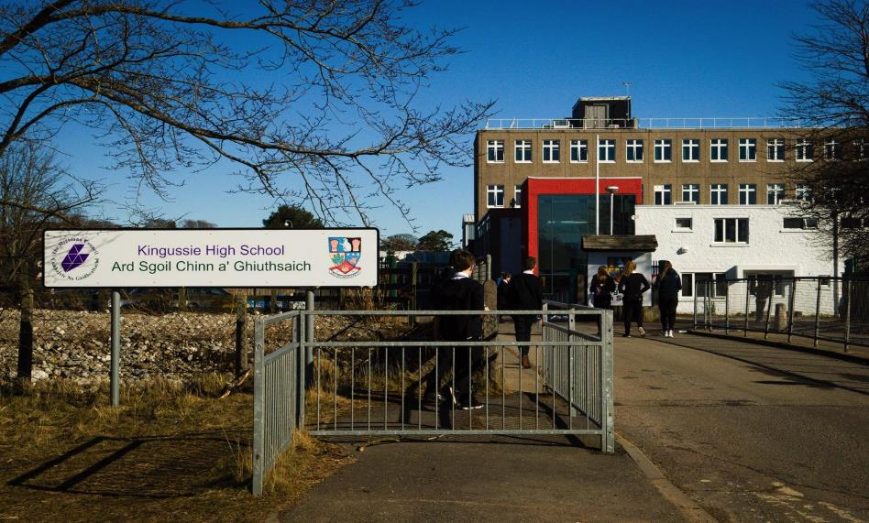
Bit of background...

Slide 3


Slide 4
WIDER ACHIEVEMENT REPORTS

Slide 5
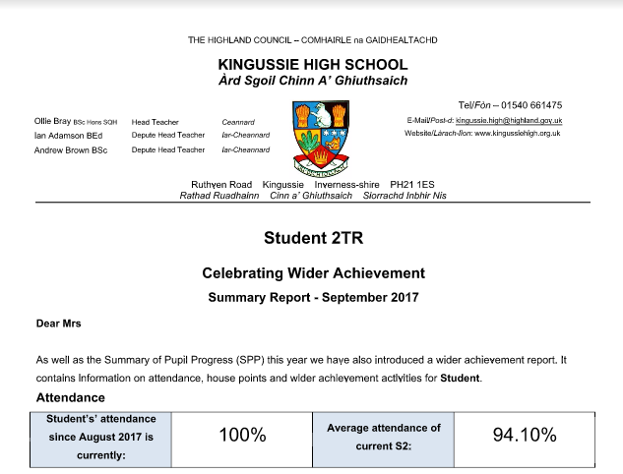

Slide 6
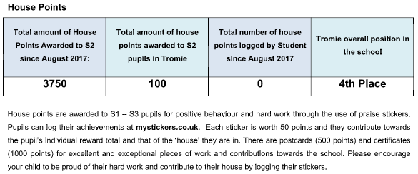

Slide 7


Slide 8

ePortfolios

Slide 9
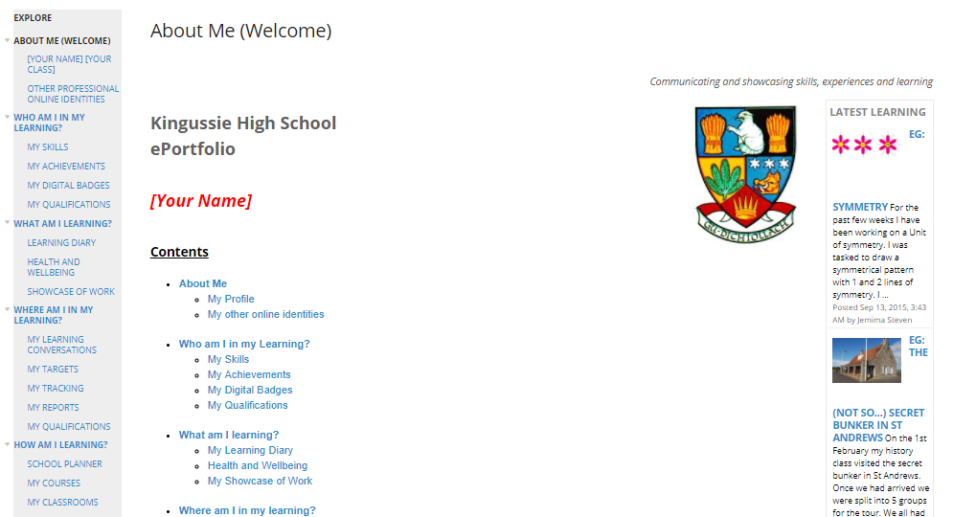

Slide 10
https://sites.google.com/a/kingussiehigh.org.uk/jemima/?pli=1
You would need a Google Account to login

Slide 11
LEARNER JOURNEY INTERVIEWS

Slide 12
S3 - ALL PUPILS
S4 - Targeted
S5 - Targeted

Slide 13
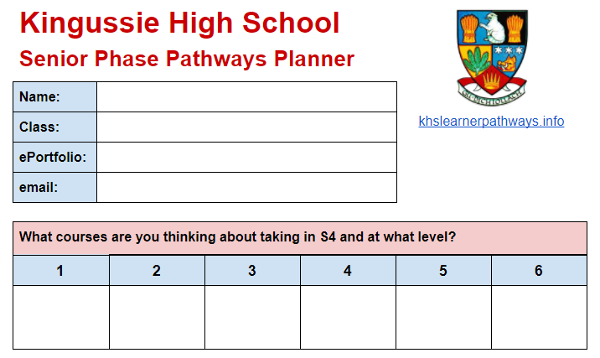

Slide 14
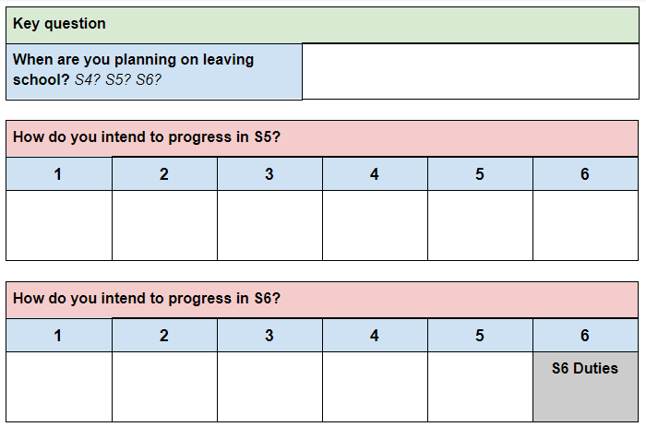

Slide 15
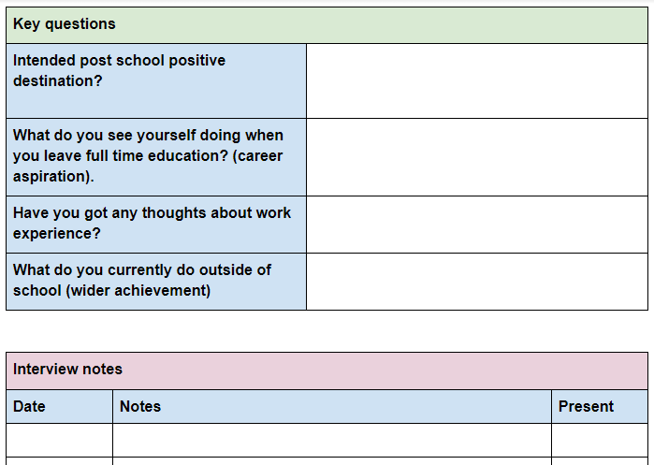

Slide 16
Visual CV’s

Slide 17
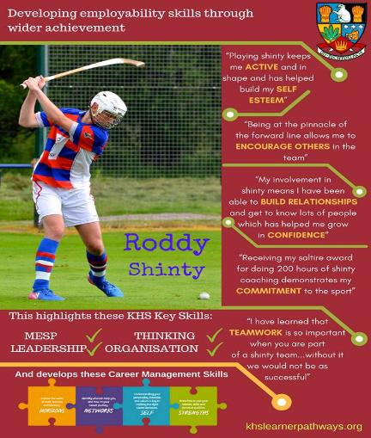


Slide 18
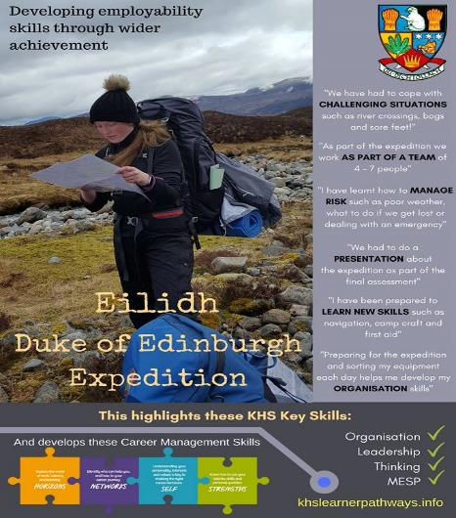


Slide 19
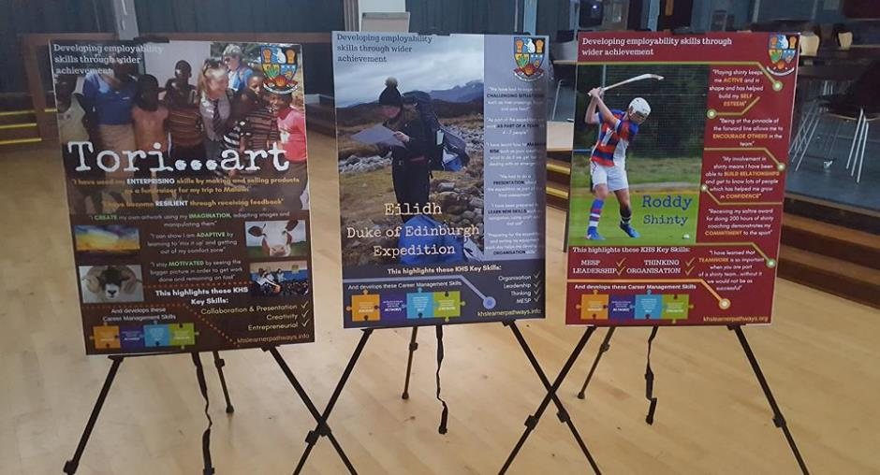

Slide 20
KHS LEARNER PATHWAYS WEBSITE
www.khslearnerpathways.info

Slide 21
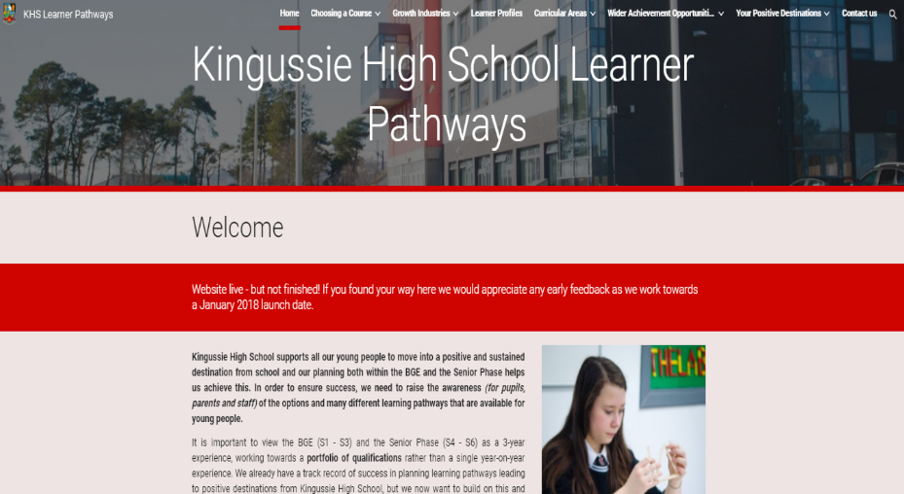

Slide 22


Slide 23
POSITIVE DESTINATIONS AT KHS

Slide 24
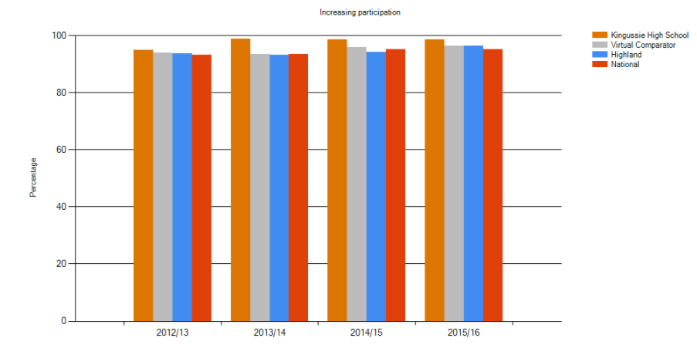
Positive Destinations

Slide 25
Contact Info:
Andy Brown (Depute Head Teacher)
andy.brown@kingussiehigh.org.uk
Ollie Bray (Head Teacher)
ollie.bray@kingussiehigh.org.uk

Slide 26


