Slide 1
Teacher Numbers – All Collaboratives
Regional Improvement Collaboratives
Mapping Tool

Slide 2
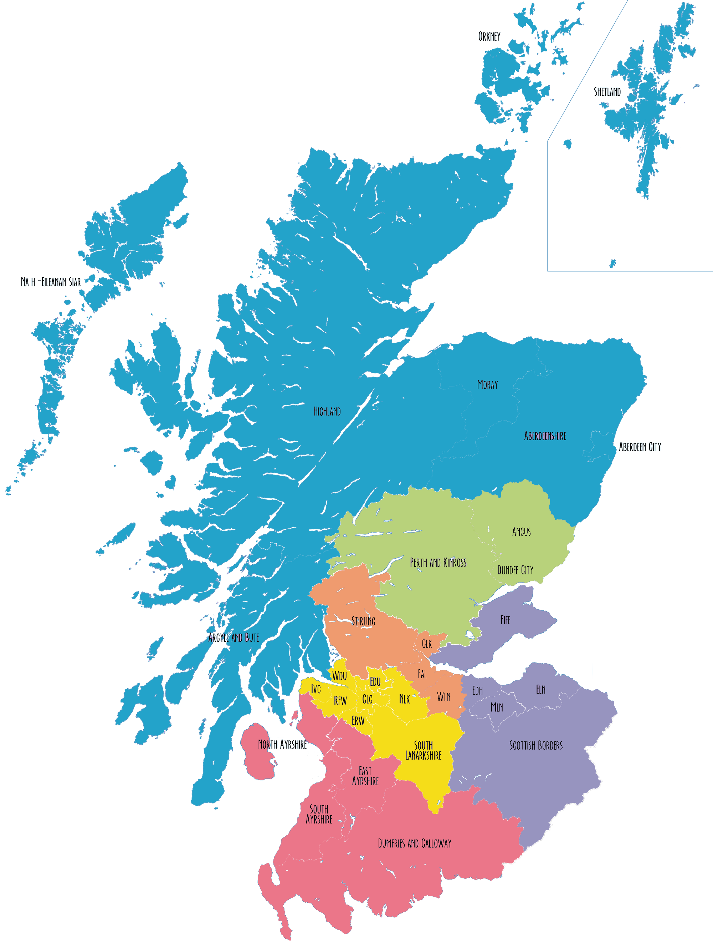
Northern Alliance
9248
Tayside Collaborative
3792
Forth Valley & West Lothian Collaborative
4982
The West Partnership
17,669
South East Alliance
9661
South West Collaborative
5,111

Slide 3
Teacher Numbers - Individual Collaboratives
Regional Improvement Collaboratives
Mapping Tool

Slide 4
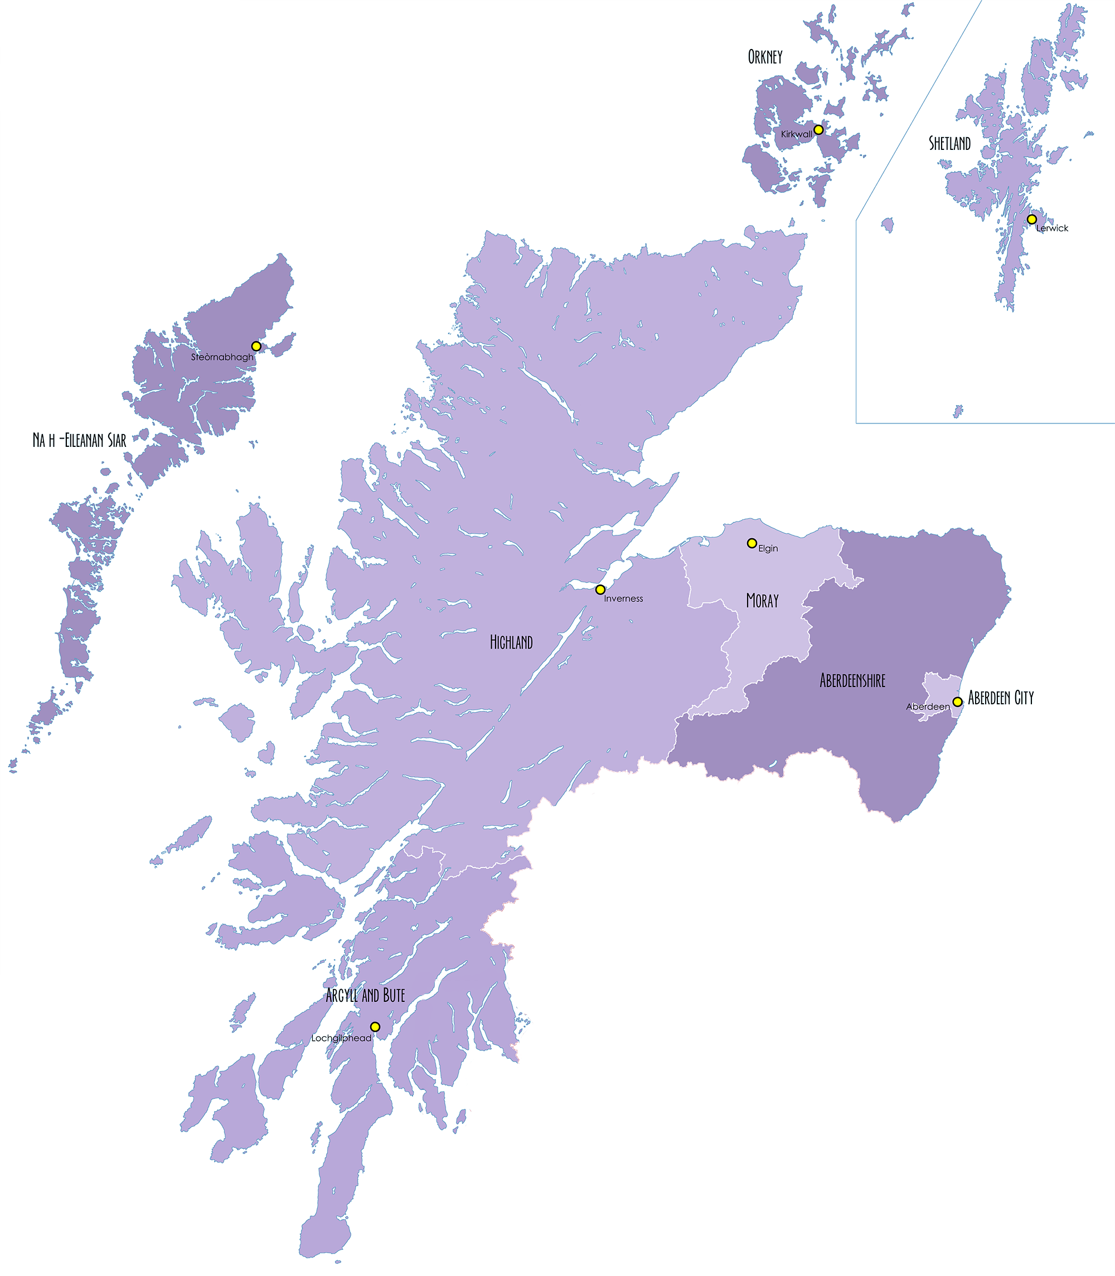
253
323
Northern Alliance
327
856
2365
1624
2675
825

Slide 5
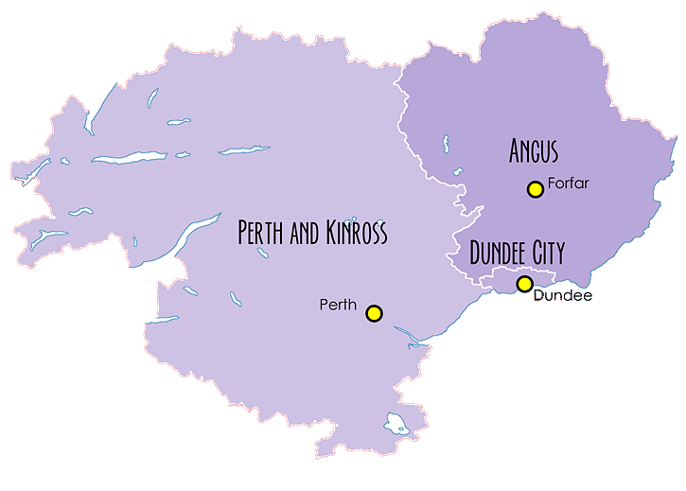
The Tayside Collaborative
1133
1329
1330

Slide 6
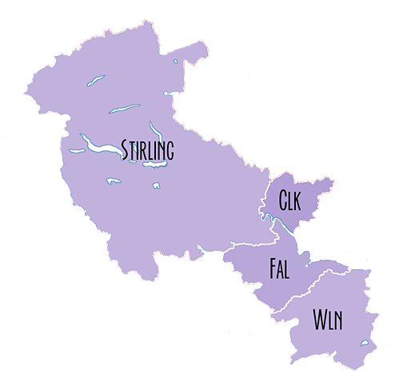
Forth Valley and West Lothian
Collaborative
925
513
1620
1924

Slide 7
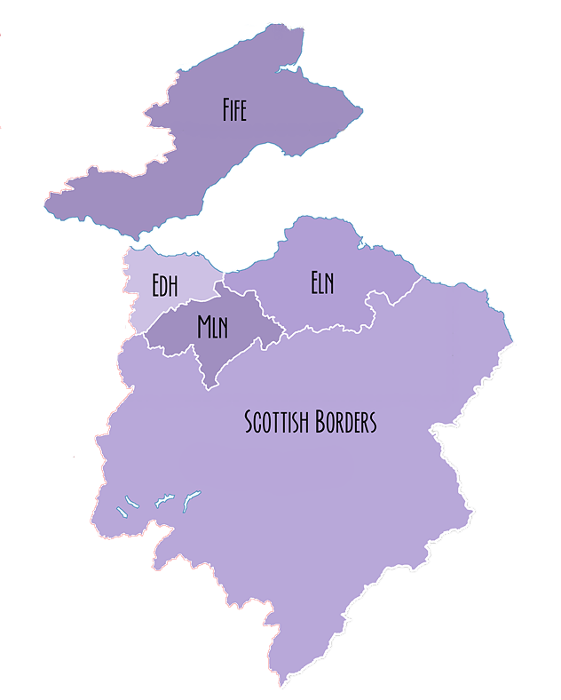
South East Alliance
3498
935
3281
892
1055

Slide 8
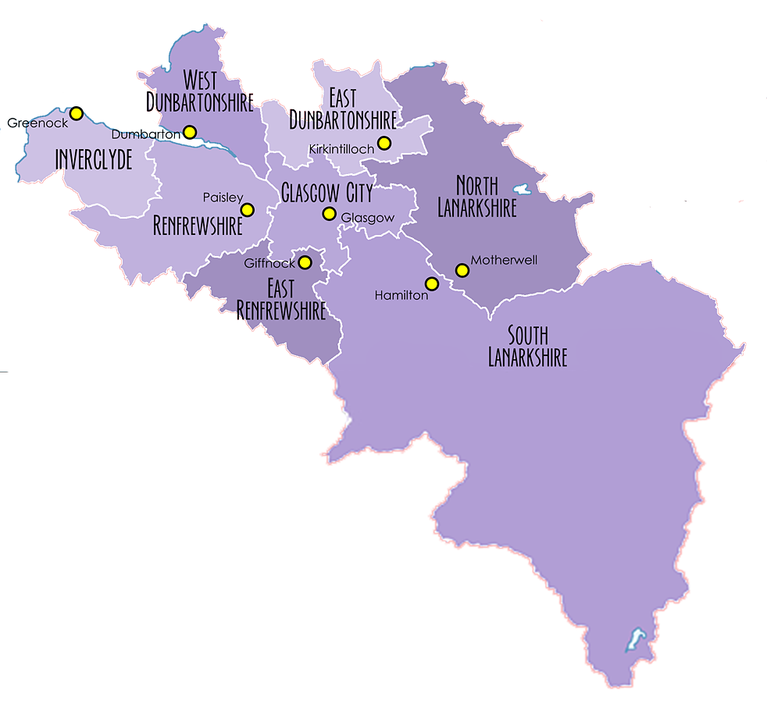
961
1245
The West Partnership
738
5020
1656
3502
1265
3282

Slide 9
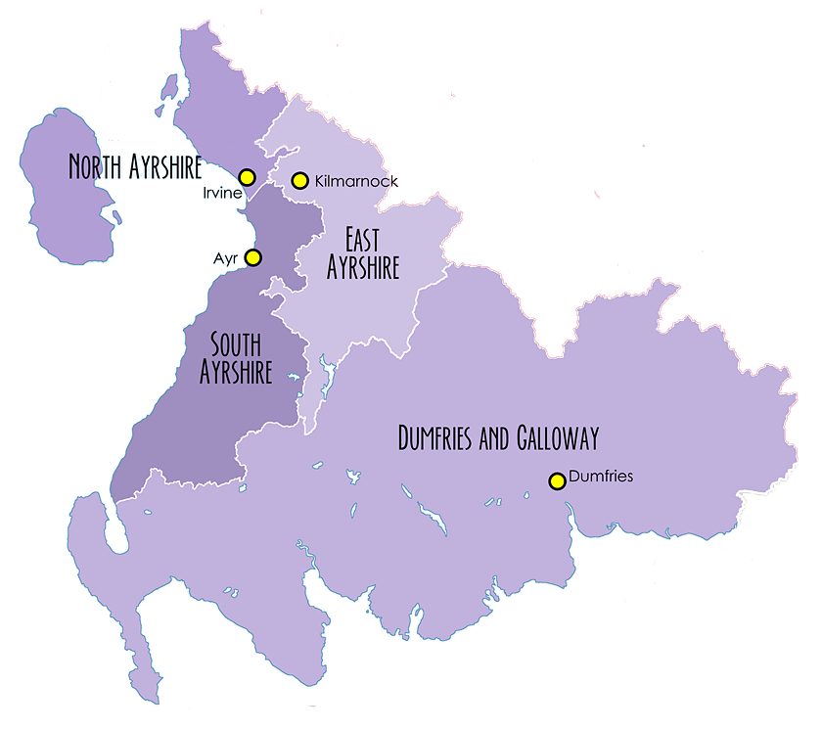
South West Collaborative
1396
1189
1056
1470

