Slide 1
From Creativity to Confidence
At Robert Gordon’s College, the programme of curricular and extra-curricular musical, dramatic and theatrical activities develops confidence and well-being in children and young people.
Pupils develop into learners who are confident and ambitious with high levels of self-esteem, they are motivated to explore and challenge assumptions, take ownership of their own learning and thinking, and they are imaginative, open-minded and confident risk-takers.

Slide 2
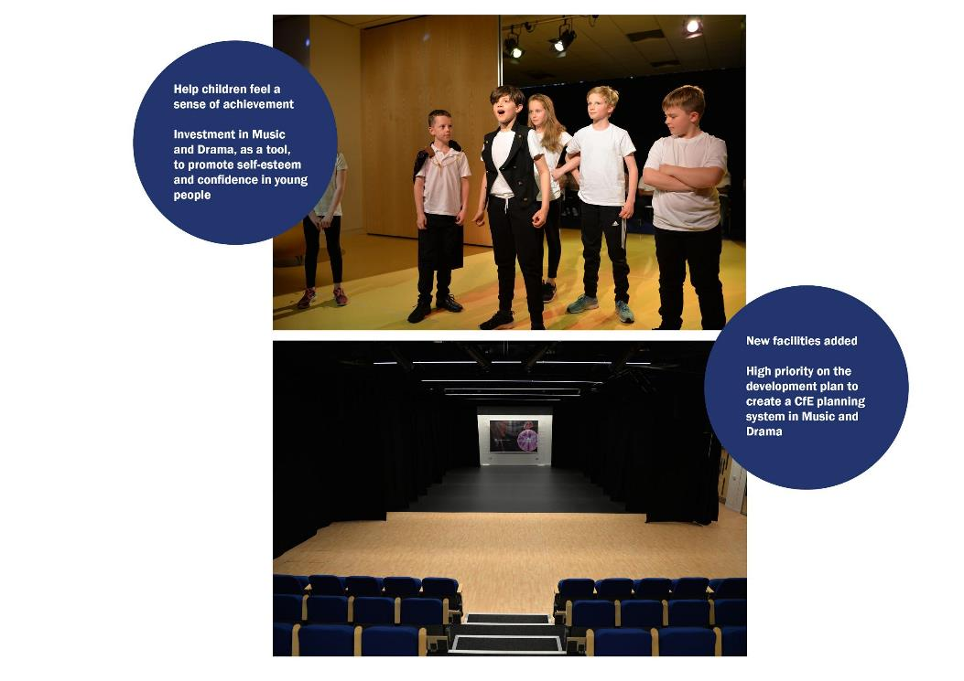
Rationale and Philosophy

Slide 3
Programme Structure - Overview

Slide 4
Engagement Across the School Community

Slide 5
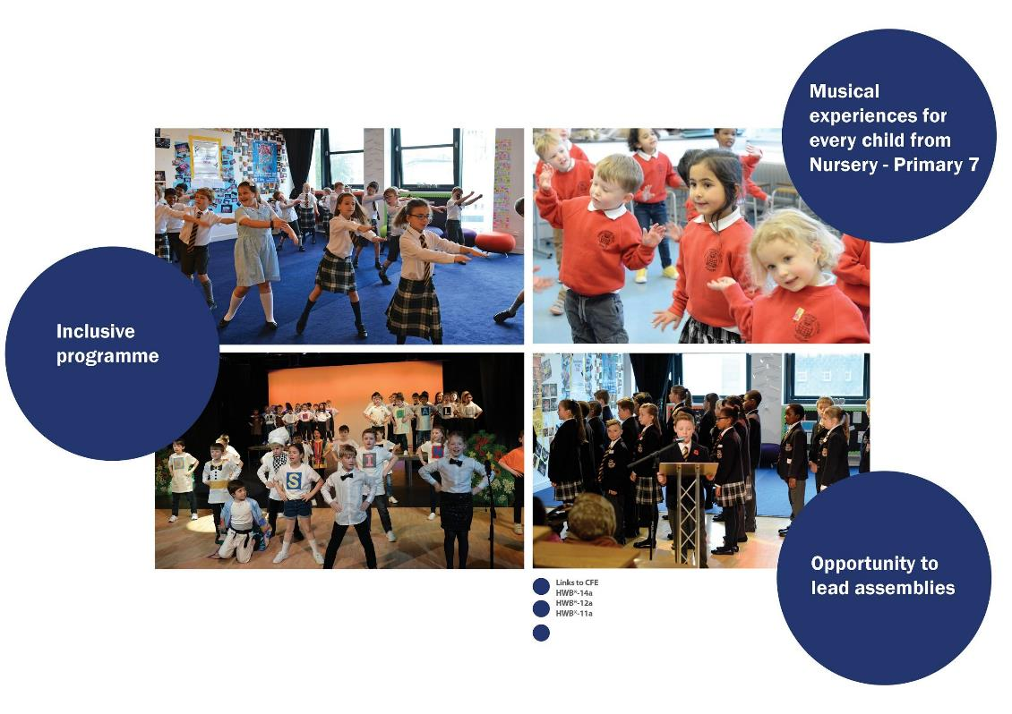
Programme Structure - Primary School

Slide 6
Programme Structure - Primary School

Slide 7
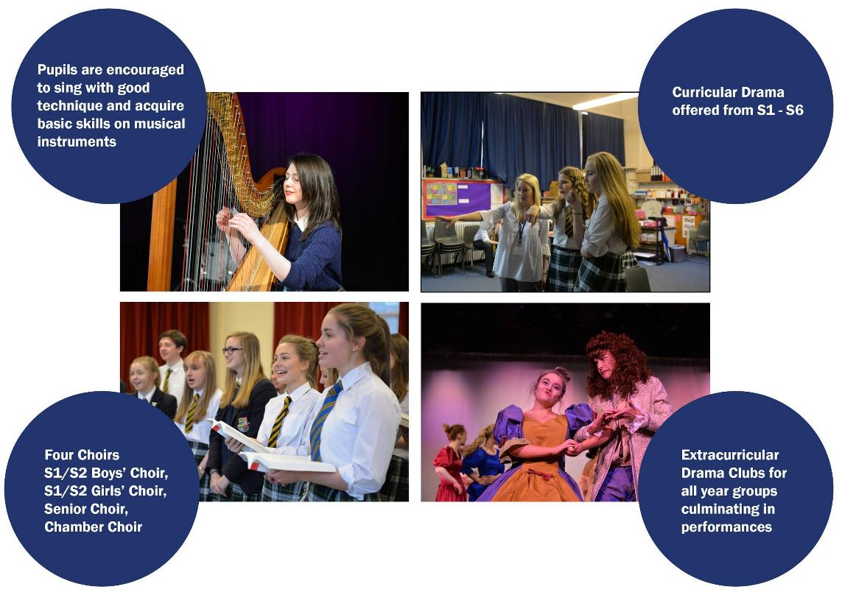
Programme Structure - Senior School

Slide 8
Programme Structure - Senior School

Slide 9
Programme Structure - Senior School

Slide 10
The Impact

Slide 11
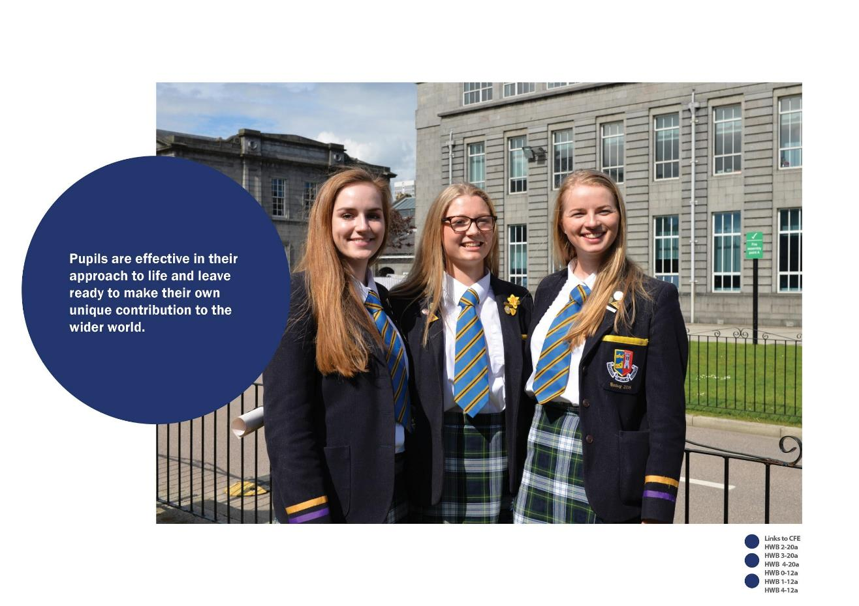
The Impact

