Slide 1
Pupil Equity Funding @
Alloway Primary
February 2018

Slide 2
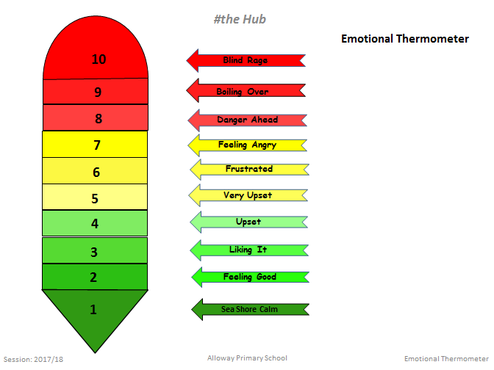
Picture of emotional tracker
Please circle the emotion you currently feel on the emotions ladder provided

Slide 3
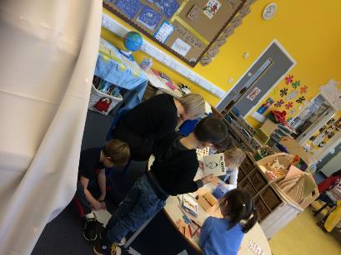
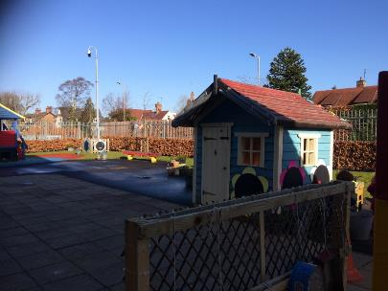
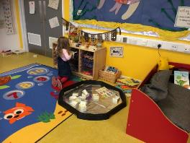
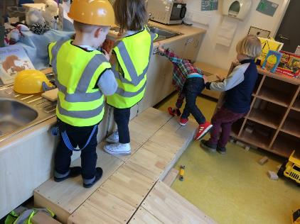
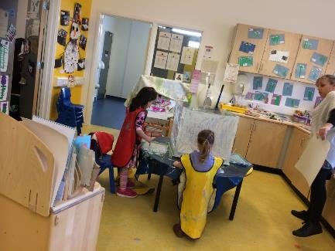
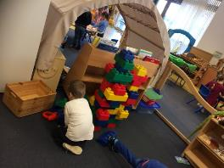
50/40 Early Years Centre

Slide 4
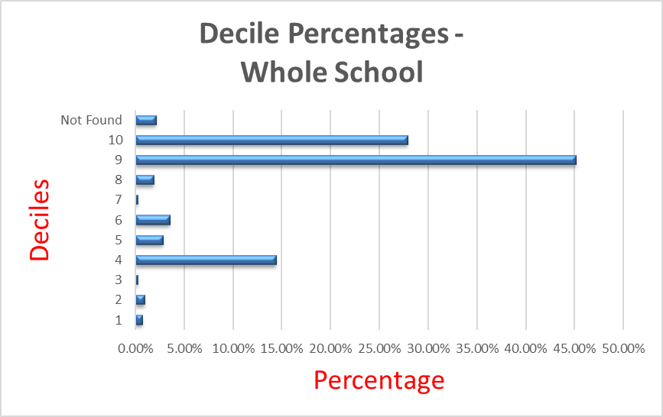

Slide 5
 |  |  |  |  |  |  |  | Maths & Numeracy |  |  |  |  |  |  | Literacy |  |  |  |  |  |  |  |  |  |  |  |  |  |  |  |  |  |  | Wellbeing Indicators |  | Notes/ Targets/ Intervention |  | Other agencies |  | Comments
 |  |  |  |  |  |  |  | CFE |  |  |  | CEM |  |  | CFE |  |  |  |  |  |  |  |  |  | CEM
 |  |  |  | Attendance as at Feb 2017 (%) |  |  |  | Math on track 9.6% 90.4% |  |  |  |  |  |  | Read On track 3.2% 96.8% |  |  |  |  |  | Write 87.1% 12.9% on track |  |  |  | Reading |  | Spelling |  | Dev Ability |  | Chronological Age |  | Schonell
Name | DOB | FSM | 1 | 2 | 3 |  | 4 | Maths | Mental |  | 1 | 2 |  | 3 | 4 | 1 | 2 | 3 |  | 4
 | 02/07/06 |  | 100 |  | 2D | 2D | 2C |  | 2C | 122 | 108 |  | 2D | 2D |  | 2C | 2S | 2C | 2C | 2C |  | 2S | 126 | +3:5 |  | 141 |  | 9:10 |  | 12:11
 | 06/11/06 |  | 99.10 |  | 2D | 2D | 2C |  | 2C | 130 | 119 |  | 2D | 2D |  | 2C | 2S | 2D | 2D | 2C |  | 2S | 134 | +2:3 |  | 127 |  | 9:6 |  | 12:8 |  | H |  |  |  |  |  |  | Confidence
 | 25/06/06 |  | 99.10 |  | 2D | 2D | 2S |  | 2S | 139 | >145 |  | 2D | 2D |  | 2C | 2C | 2D | 2D | 2C |  | 2S | 108 | +2:6 |  | 124 |  | 9:10 |  | 12:6
 | 14/12/06 |  | 100 |  | 2D | 2D | 2C |  | 2C | 109 | 108 |  | 2D | 2D |  | 2C | 2C | 2D | 2D | 2C |  | 2C | 103 | +1:2 |  | 117 |  | 9:5 |  | 10:2 |  |  |  |  | Boost Reading/ Maths
 | 29/08/06 |  | 95.50 |  | 2D | 2D | 2S |  | 2S | 139 | 130 |  | 2C | 2C |  | 2C | 2S | 2C | 2C | 2C |  | 2S | 144 | +3:4 |  | 144 |  | 9:8 |  | 13
 | 12/04/06 |  | 99.10 |  | 2D | 2D | 2C |  | 2C | 107 | 109 |  | 2D | 2D |  | 2C | 2C | 2D | 2D | 2C |  | 2C | 110 | +1:1 |  | 110 |  | 10:1 |  | 11:4 |  |  |  |  |  |  |  |  | Recent bereavement
 | 02/06/06 |  | 93.69 |  | 2D | 2D | 2C |  | 2C | 105 | 121 |  | 2D | 2D |  | 2C | 2C | 1S | 1S | 2D |  | 2D | 99 | -0:7 |  | 113 |  | 10:0 |  | 9 |  | A |  |  | Rainbow Readers/ Reading Wise/ SNIP/ Tallisman |  |  |  | Writing/ Spelling Support/motivation

Slide 6
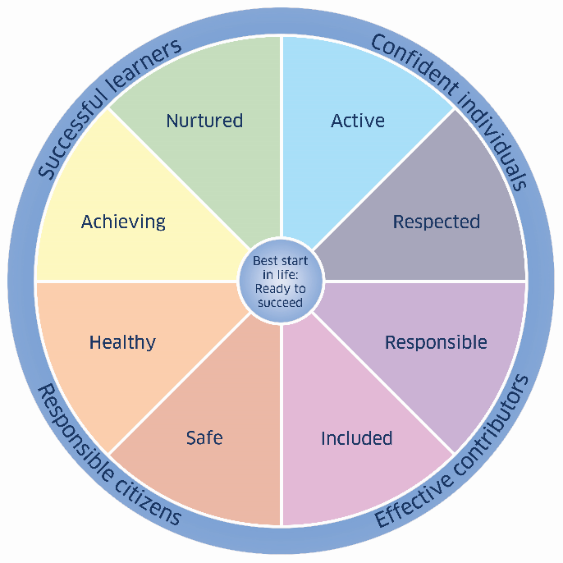
Look beyond the statistics…

Slide 8
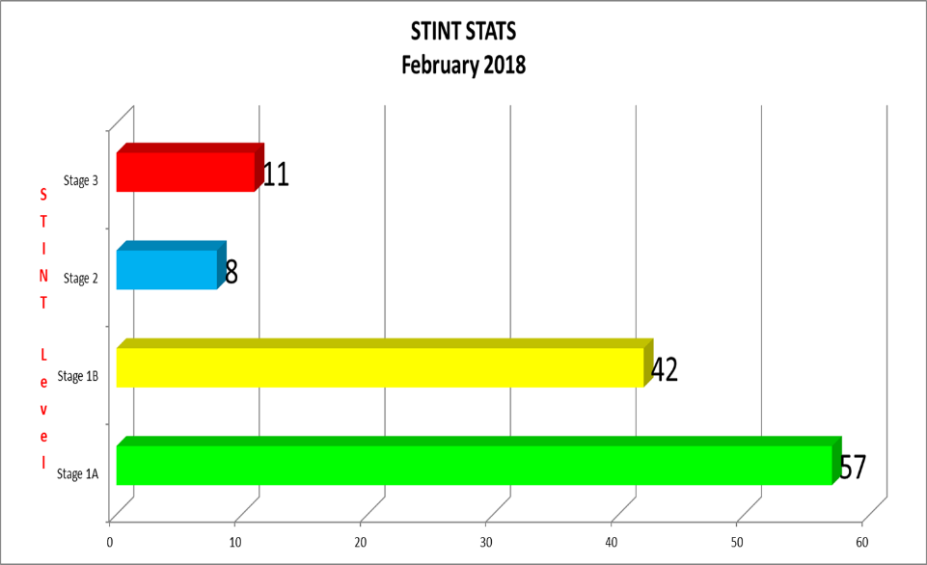
118

Slide 9
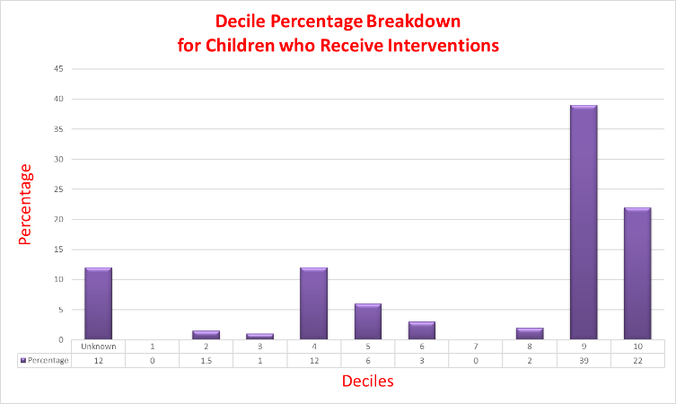
Intervention vs
Deciles

Slide 10
Decile 1 and 2 children

Slide 11
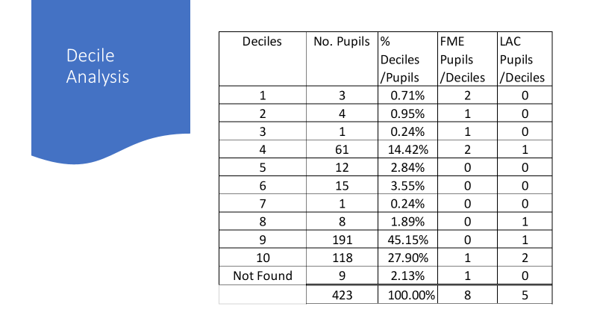
Protected Children

Slide 12

Looking Deeper
Protected Child

Slide 13
Intervention Support Assistants
Nurture Hub
ICT to Support Learning

Slide 14
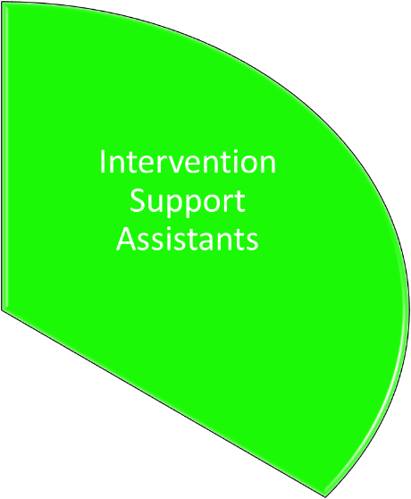
2 x 13.75 support assistants
26.5 hours

Slide 15
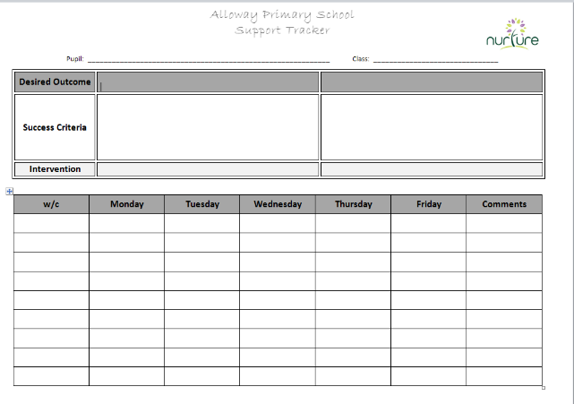
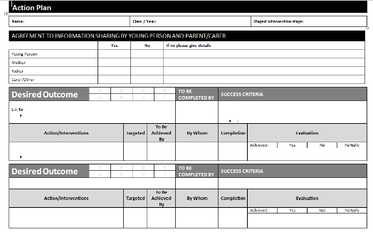
The needs of the learner are known, so that the requirement for an intervention is timeously identified (SMART STINT).
Interventions are swift, time limited and take place very close to the point of identification of need.
The interventions are recorded and shared.
The impact on the learner is measured.

Slide 16
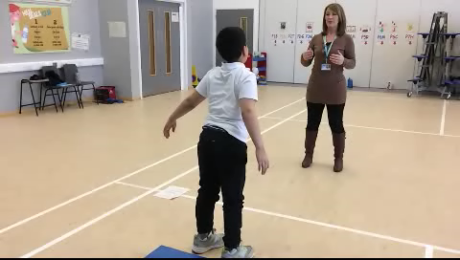
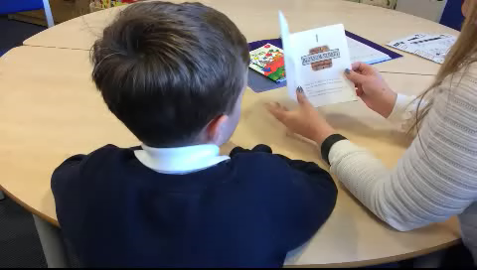
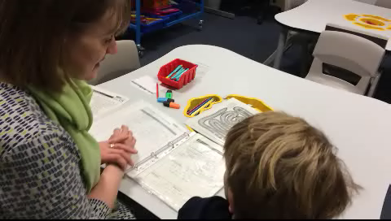

Slide 17
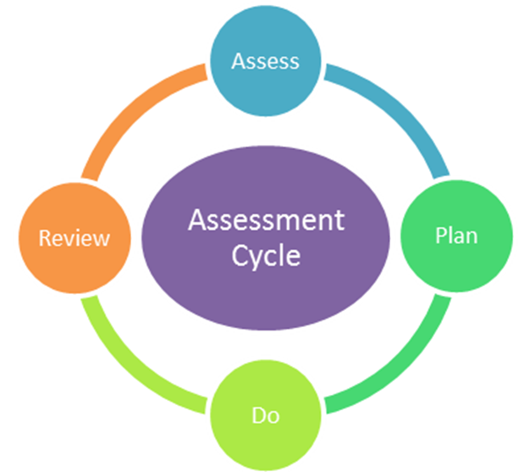

Slide 18


Slide 19


Nurture Hub

Slide 21
So, what is it I need to thrive?
What do I need in order to reach my full potential?

Slide 22
In groups, write down what early experiences children need to help them realise their potential.

Slide 23
Early experience children need:
Basic feeding
Basic care – changing, etc.
A sensitive care giver- needs met in a timely and sensitive way
Every day routine – consistency and continuity of care
Sensitive and fun social interaction
Appropriate interactions or reactions by adults
Physical touch
Modelling of language and socials skills by caregivers
Stimulation –people, environment
Healthy interactions
Connections- caregiver learns to become in tune with the baby
Sleep routine
Protection from harm

Slide 24
Now, what happens when some of these needs are not fulfilled?

Slide 25
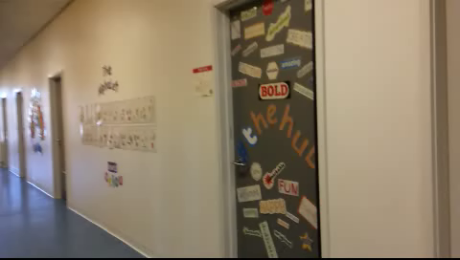

Slide 26

Learning is understood developmentally
Nurture is important to self-esteem
Language is a vital means of communication
All behaviour is communication
Transitions are important in children’s lives
Environment offers a Safe Base

Slide 27
Find a partner
Partner A begin to tell a story, a normal anecdote: something your proud of, something hilarious
We will shout ‘still face’ after one minute
Partner B will do a ‘still face’ or look away/disinterested until we say ‘stop’

Slide 29

Copy of thermometer

Slide 30

#the Hub
Session: 2017/18
Emotional Tracker Data

Slide 31
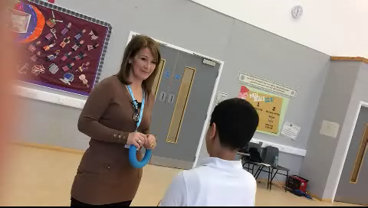
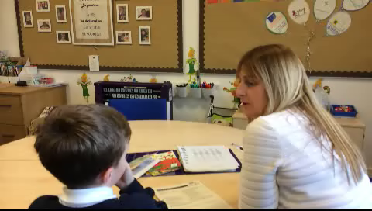

Slide 32
Catch Up Numeracy
Name | Number age at Aug 17 | Number age at Jan 18 | Gain in months | Real gain in months
Z | 6.6 | 7.8 | +14 | +9
K | 6.6 | 7.8 | +14 | +9
L | 7.8 | 8.3 | +7 | +2
R | 7.1 | 8.3 | +14 | +9
R | 6.3 | 6.10 | +7 | +2
T | Sep17: 6.3 | 6.6 | +3 | -1
M | Sep 17: 5.8 | 7.1 | +17 | +13
L | Assessed in Nov 17 as 9.9yrs | 10.7 | +10 | +8
Catch Up Literacy
Name | Reading age at Start | Reading age at end of term block | Gain in months | Real gain in months
Z | 6.9 | 7.0 | +1 | -3
C | 8.0 | 9.6 | +18 | +15
D | 7.3 | 8.3 | +12 | +6
O | 7.6 | 8.0 | +6 | +5
J | 7.9 | 9.3 | +18 | +13

Slide 33

The impact for our unique context is…
Behavioural incidents have reduced
Fewer referrals to SLT for classroom incidents
Increased classroom inclusion
Fewer concerns from parents: support and wellbeing
Interventions are having a positive impact on attainment
Learning support is targeted and measured
Targets are shared with all stakeholders: Parental Workshops, STINT Shared, Learning Conversations
Reduction in anxiety
A safe haven for children to de-escalate and regulate their emotions
Staff confidence in nurture and the use of appropriate interventions is high
Parental involvement and knowledge has increased
Children have a voice and feel listened to!

