Slide 1
Rural Vulnerability and Closing The Gap
Baltasound Junior High School

Slide 2
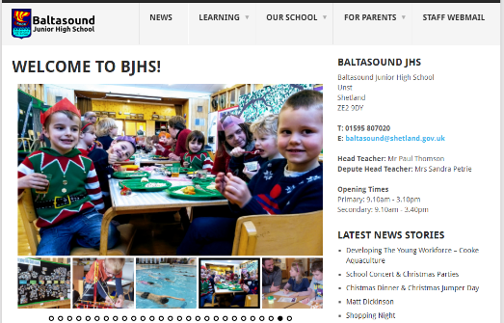
A Rural School
Baltasound JHS is the most northerly school in the UK.

Slide 3
A Rural School
Our catchment area is the island of Unst.
Our school roll is 83 students.
From Nursery (age 3) to S4 (age 16).
Primary
2 composite classes
P1 – P4 & P4 – P7
Secondary
Part time staff members split between schools.

Slide 4
Vulnerability In A Rural Context
Free School Meals Eligibility
GIRFEC
Low Income
Access To Transport
Geographic Access To Services
Social Inclusion
Clothing / Leisure
Significant Event
Internet Access

Slide 5
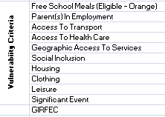
Vulnerability In A Rural Context
Student A
Student B
Student C
Student D
Student E
Student F

Slide 6
Interventions
Parents collected for GIRFEC Reviews, Parent Evenings and Community Events, if they have no transport or require support staff to attend.
Health Improvement Officer In School
Take Your Parent To School Day
CPD – Bereavement Training
Supporting Bereaved Pupils: Let’s Talk About it.
MSP, MP, BT and SSE consulted/lobbied with regard to poor broadband provision and its impact on education.
Whole School Nurture Approach

Slide 7
Participation & Engagement
Attendance In School
Attends Extra Curricular Activities
Parents Attend Parents’ Nights
Report Comments Returned
Numeracy Newsletters Returned
Community Day Involvement

Slide 8
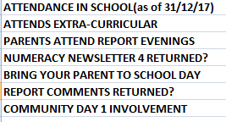
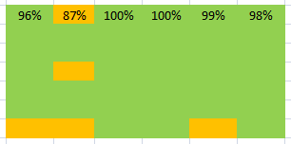
Participation & Engagement
Student A
Student B
Student C
Student D
Student E
Student F

Slide 9
Interventions
Attendance Meetings.
Additional work provided where needed.
Yammer / Glow / Packs & Resources for students with medical issues.
Fun Fit Club / Swimming Club.
Lunch time clubs paid for by the Pupil Council.
Equipment repaired by members of the community to promote more free activities.
Older pupils run clubs for the younger ones.
Transport to/from school events organised.
PEF used to design and staff a support programme over the school holidays.

Slide 10
SHANARRI Audit
Whole school SHANARRI audit performed twice per year:
Safe
Healthy
Achieving
Nurtured
Active
Respected
Responsible
Included

Slide 11
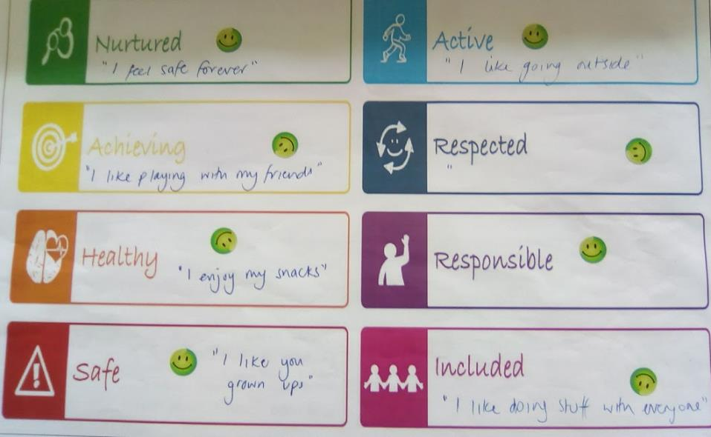
Nursery

Slide 12
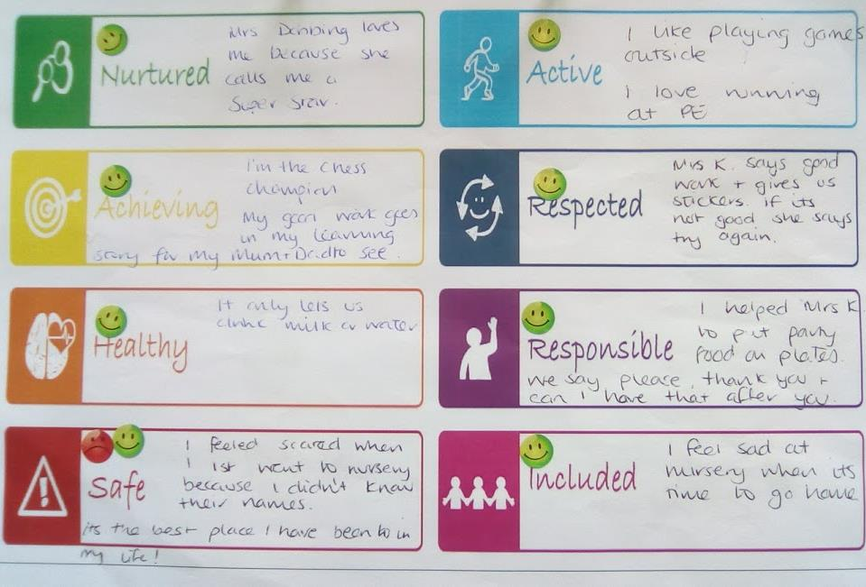
Nursery

Slide 13
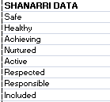
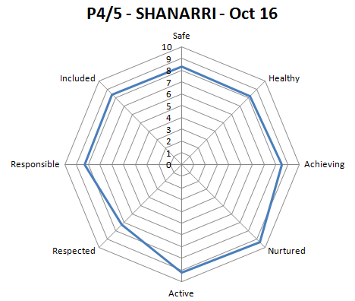
SHANARRI Audit
Safe / Healthy / Achieving / Nurtured / Active / Respected / Responsible / Included
Interventions
Respect Agenda
1:1 Mentoring / Buddying
Supporting a student through a significant event in their life.
More opportunities for activity & sport.

Slide 14
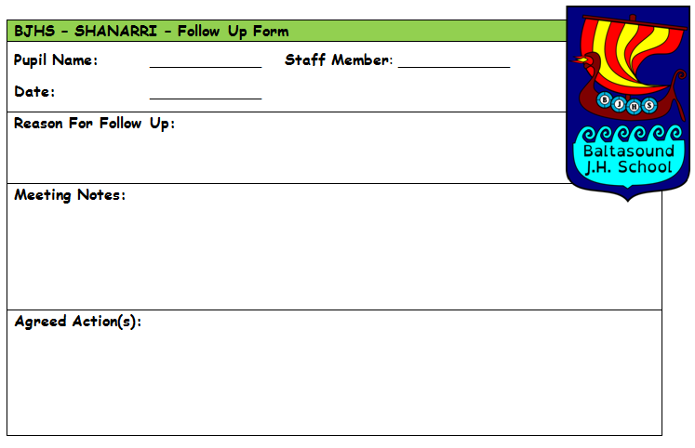
SHANARRI Audit – Follow Up

Slide 15
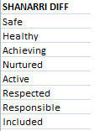
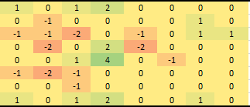
SHANARRI Audit
This allows us to compare students over the course of the year.

Slide 16
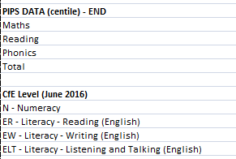
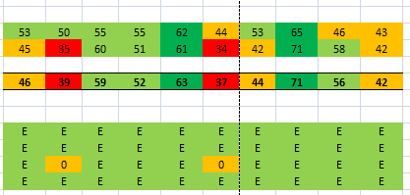
Assessment Data
PIPS / SNSA
CfE Assessments / ERT / SWST / LASS
CfE – Professional Judgement Survey
Tracking & Monitoring

Slide 17
SNSA Data
S3
Student A
Student B
Student C
Student D
Student E
P3
Student F
Student I
Student C
Student E
Student B
Student A
Student D
Student H
Student G

Slide 18
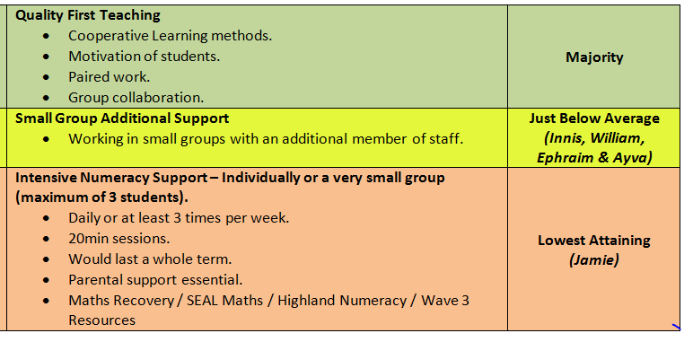
Interventions
NESSY
Highland Literacy / Numeracy / SEAL
1:2 or 1:3 - 3 x 20min sessions (weekly)

Slide 19
Interventions
Toe By Toe
Using Digital Technology
Accessibility, reading aloud, font size & colours (reader view).
Resources in PDF format.
Dedicated apps such as Inku, Image to Text and Audio Books & Magazines.
Personal support with their teacher through email and Glow.
Others Interventions:
Kinaesthetic Handwriting Program (8 week)
Beat Dyslexia

Slide 20
Other Issues That Our Families Face
Fuel poverty
Cost of living
13% greater than Shetland average & 62% greater than UK average.
Income
Average annual income is 24% lower than Shetland average and 17% lower than Scottish average.

Slide 21
Other Issues That Our Families Face
Accessing Services
100 mile round trip to nearest supermarket/hospital/dentist/cinema.
£1.34 per litre for petrol + ferry fares
Family of 4 return trip to Lerwick = £20 + £13.30 + £5.40 + £1.00 + £1.00 = £40.70
4 hour trip

Slide 22
Interventions
Healthy (subsidised) Tuckshop
Only fruit sold at break times & only 20p per item.
Ensure experiences can be delivered in school or in the community.
Self drive / staff have business insurance.
John Muir / DoE / Saltire
Community groups, local experts and National agencies used.
External funding applications – Food For Thought, Bags For Life, National Lottery...
DYW connections!
Fundraising!
We make sure all of our pupils are included in school trips.
In 2016/2017 we raised £5589.59 for school funds, local and national good causes.
This works out at £65 per student!

