Slide 1
Dalmilling Primary School

Slide 2
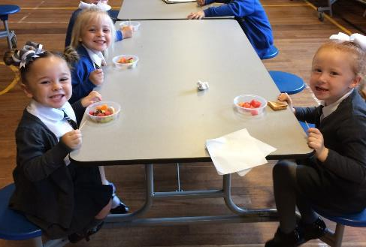
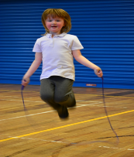
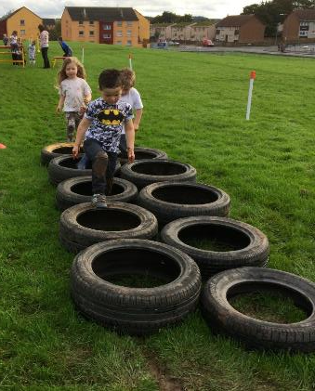
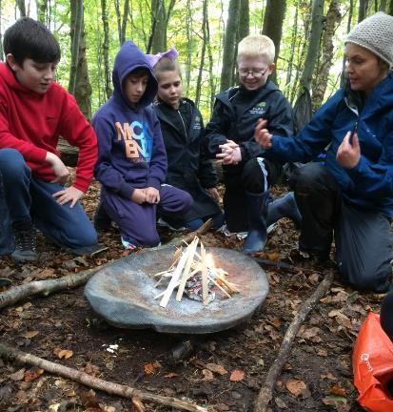
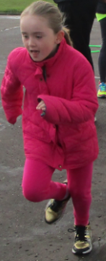
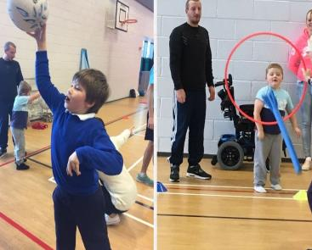
Health and Wellbeing
Being active
Balanced diet
Mental Health
Physical Literacy

Slide 3
Targeted and Universal Interventions
Better Movers Thinkers
Working Memory
Fine and Gross Motor Skills
Outdoor Learning
Forest Schools
Additional Interventions

Slide 4
Better Movers Thinkers
Goal Directed Behaviour
Working Memory
Inhibition Control
Executive Functions
Focus of Attention
Cognitive Flexibility
Planning

Slide 6
Working Memory Intervention
 | Word Series |  | Sentence Repetition
 | Aug ‘17 | Feb ‘18 | Aug ‘17 | Feb ‘18
P1R Pupil | 6 | 10 | 5 | 11
P2P Pupil | 6 | 9 | 3 | 8
P3M Pupil | 8 | 13 | 5 | 8
P4C Pupil | 7 | 15 | 6 | 10
P5L Pupil | 10 | 17 | 6 | 7
P6W Pupil | 13 | 13 | 4 | 7
P7R Pupil | 5 | 11 | 8 | 9
Average score for Word Series and Sentence Repetition - 9-11

Slide 7
Fine Motor Checklist
Gross Motor Checklist
Age | Skill | Yes | No
Primary 2 (Age 5-6) | Cutting out simple shapes.
 | Designing own Lego models.
 | Dressing and undressing independently (excluding shoe laces) - getting changed into gym kit and changing back in to uniform.
 | Writing numbers 1-10 independently.
 | Self-generating letters independently.
 | Copying a triangle.
 | Colouring with in the lines.
 | Holding a pencil with a 3 ﬁngered grasp and generating movement from ﬁngers (not wrist).
 | Cut and paste projects.
 | Drawing basic pictures.
 | Using knife and fork for soft foods.
Age | Skill | Yes | No
Primary 2 (Age 5-6) | Standing on one foot for 10 seconds.
 | Kicking a ball.
 | Walking up stairs while holding an object.
 | Walking backwards heel-toe.
 | Jumping forwards 10 times without falling.
 | Skipping forward after demonstration.
 | Running around obstacles.
 | Stepping forward with leg on same side as throwing arm when throwing a ball.
 | Walking along a line.
 | Hopping on one foot.
 | Safely performing a forward roll.
 | Catching a small ball using hands only.
 | Jumping over an object and landing with both feet together.

Slide 8
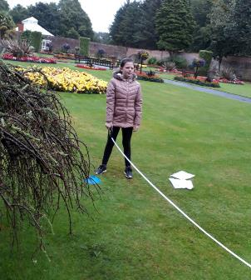
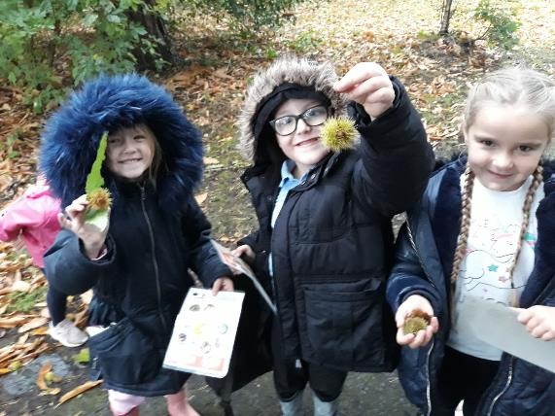
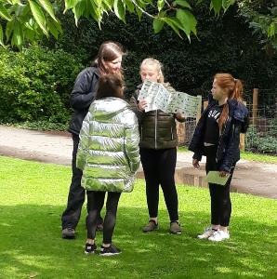
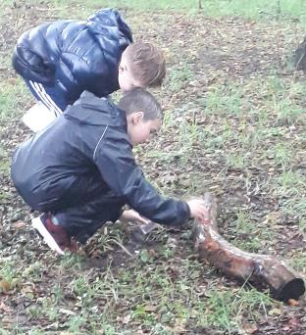
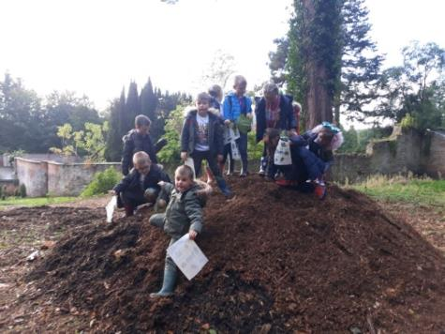
Outdoor Learning
“I learned that birds have different beaks to eat different food.” (P2 pupil)
“My favourite activity was learning how to identify trees by looking at the leaves and the different fungi that grows on the tree”. (P7 pupil)

Slide 9
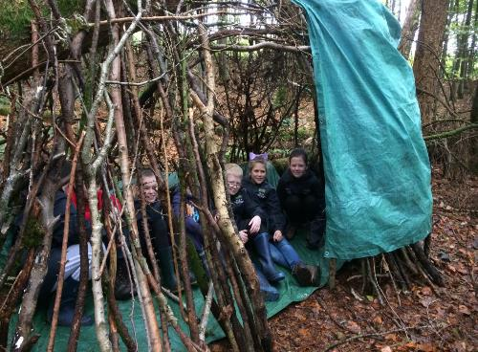
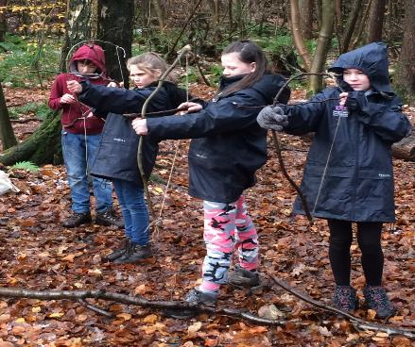
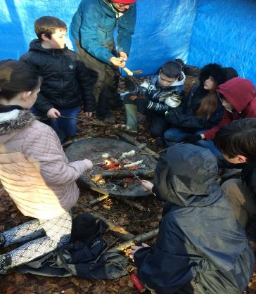
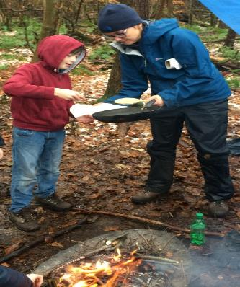
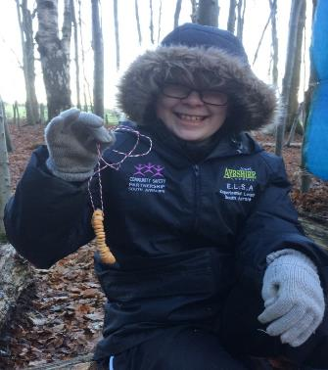
Forest Schools
Resilience
Self-esteem
Relationships

Slide 10
[Cycling programme] / Balance Bike Project

Slide 12
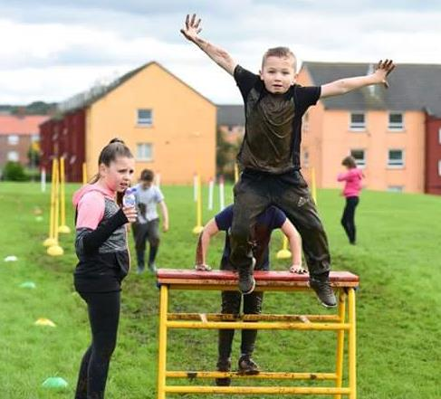
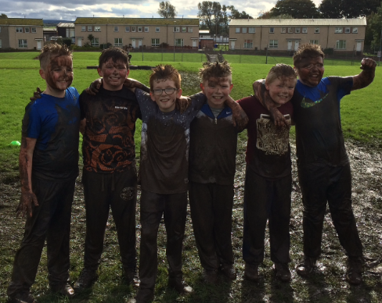
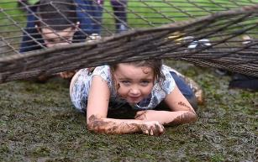
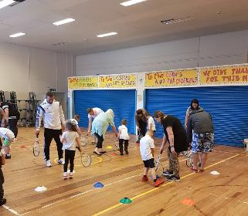
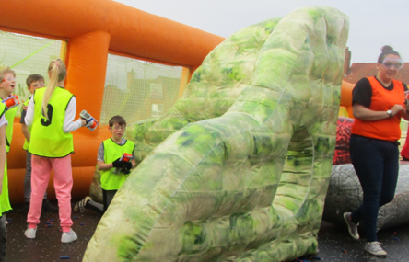
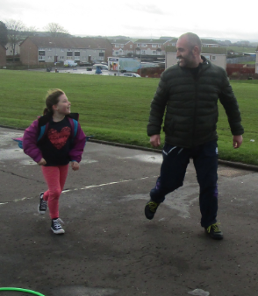
Dally Mudder and Family Fitness Day
Engagement
Opportunities
Local Club Links
Parental Involvement

Slide 13
Additional Interventions
Roots of Empathy
Allotment Project
Loose Parts Play
Nurture
Play Based Learning
Barnardos
Community Learning Development
Competitive Sports Events

Slide 14
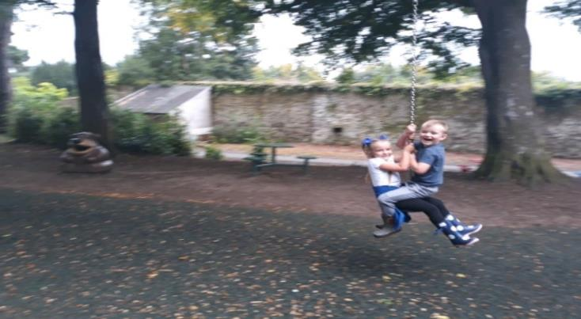
Thanks for Listening
@FionaBruce17
@Gaenor17
@Dalmillingps

