Slide 1
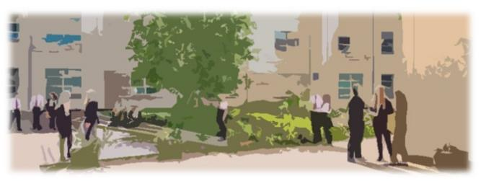
Christine McGuire Phillippa MacDougall Margaret Shedden Jacqueline Robertson Emma Reeves Eleanor McCall Francine MacKenzie
Getting It Right Together through PEF:
Partnership, Empowerment and Flexibility

Slide 2
Getting It Right Together through PEF: Partnership, Empowerment and Flexibility
Our cluster
Our approaches to PEF
Developing skills for learning, life and work

Slide 3
PARTNERSHIP
Developing New Role
P7 Profiles
Data

Slide 4
PARTNERSHIP
Enhanced Transition
P7 Summer School
Community Cooking

Slide 5
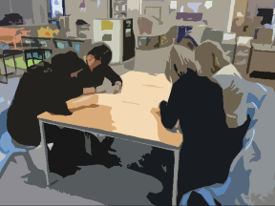
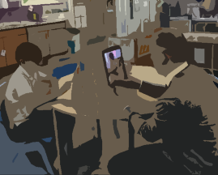
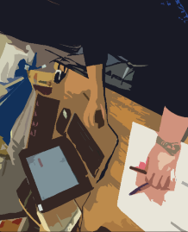
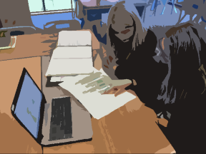
EMPOWERMENT
Building Capacity
Data
Moderation
Professional Judgement
Professional Learning

Slide 6
FLEXIBILITY
Communication
Relationships
Equity
Meeting Pupil Needs

Slide 7
Getting It Right Together through PEF: Partnership, Empowerment and Flexibility
Cluster Improvement Planning
Culture Survey
Sustainability

Slide 8
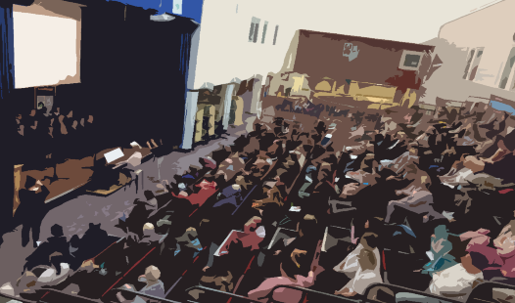
Emma Reeves
gw15reevesemma@ea.n-ayrshire.sch.uk
Jacqueline Robertson gw14robertsonjacquel@ea.n-ayrshire.sch.uk
Francine MacKenzie gw09mackenziefrancin@ea.n-ayrshire.sch.uk
Eleanor McCall gw09mccalleleanor@ea.n-ayrshire.sch.uk
Christine McGuire gw09mcguirechristin2@ea.n-ayrshire.sch.uk
Margaret Shedden gw09msheddenmargaret@ea.n-ayrshire.sch.uk
Phillippa MacDougall gw09macdougallphil@ea.n-ayrshire.sch.uk

Slide 9
Getting It Right Together through PEF:
Partnership, Empowerment and Flexibility

