Slide 1
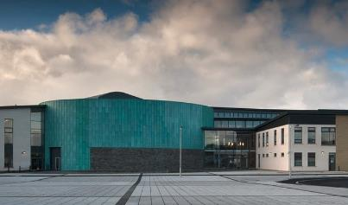
Don Hawkins, Headteacher

Slide 2
Setting the context - KGS
752 pupils
45 FSM (6%)
0% Deciles 1, 2, 3 and 10?
PEF award - £37,200

Slide 3
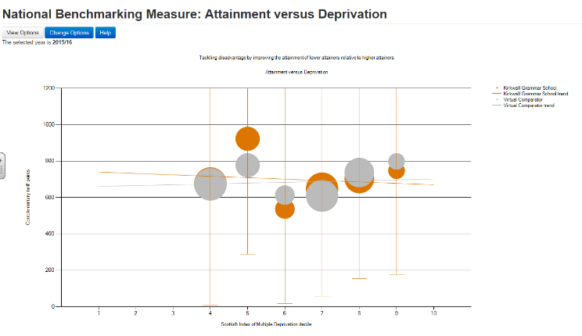
S4 / 5 / 6

Slide 4
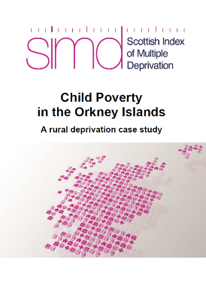
The Child Poverty Map of the UK (2016) showed that 14% of children living in the Orkney Islands are in poverty (after housing costs). This is the equivalent of 508 children or 17 school classes.
Source: SIMD http://www.gov.scot/Resource/0051/00514497.pdf

Slide 5
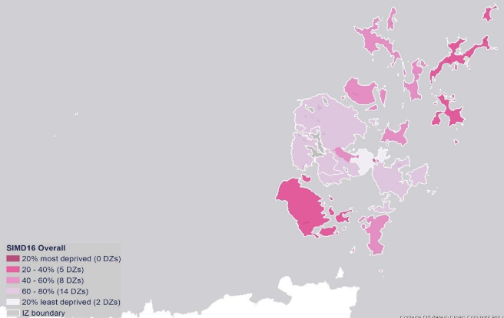
There are no data zones in the Orkney Islands which are in the 20% most deprived in Scotland. However, this does not mean that people living here do not experience deprivation.
Source: SIMD http://www.gov.scot/Resource/0051/00514497.pdf

Slide 6
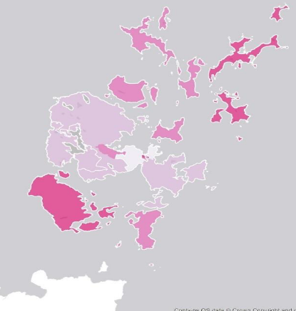
Kirkwall Grammar School
Papdale Primary School
Glaitness School
St Andrews Primary School
Burray Primary School
Hope Primary School
North Walls Primary School
Orphir Primary School
Shapinsay Primary School
Rousay Primary School
Eday Community School
Papa Westray School
Westray Junior High
Sanday Junior High / Sanday Community School
Stronsay Junior High School
Source: SIMD http://www.gov.scot/Resource/0051/00514497.pdf

Slide 7
There are no data zones in the Orkney Islands which are in the 20% most deprived in Scotland. However, this does not mean that people living here do not experience deprivation.
Source: SIMD http://www.gov.scot/Resource/0051/00514497.pdf

Slide 8
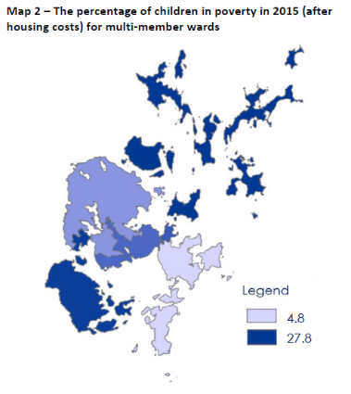
The percentage of children living in poverty ranges from 4.8% in the East Mainland, South Ronaldsay and Burray ward, to 27.7% in the North Isles. If we compare Map 1 and Map 2, we can see that some of the areas with the most child poverty, are also among the most deprived.
Source: SIMD http://www.gov.scot/Resource/0051/00514497.pdf

Slide 9
Source: SIMD http://www.gov.scot/Resource/0051/00514497.pdf

Slide 10
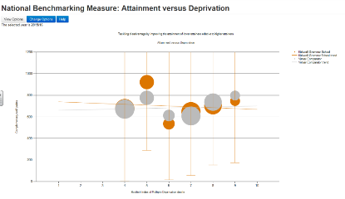
New HT in an unfamiliar community
Higher SIMD profile
Rural poverty
Mental Health & Wellbeing
Literacy and Numeracy
The Pupil Equity Funding must enable schools to deliver activities, interventions or resources which are clearly additional to those which were already planned.

Slide 11
Intent → Implementation →Impact
Pupils
Working in partnership
Parents
Staff
Local Authority
Identify the gap
Provide a Focus
What does it look like?
Where is it?

Slide 12
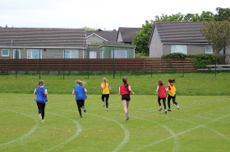
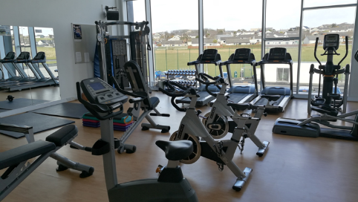
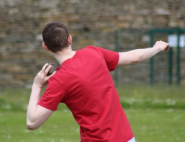
Sports

Slide 13
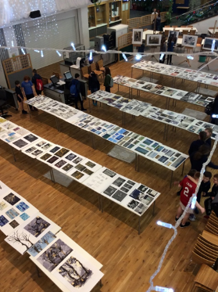
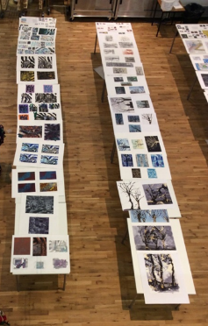
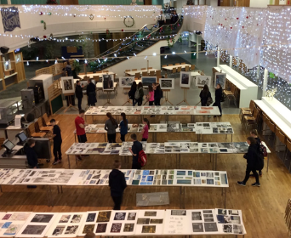
Art & Design

Slide 14
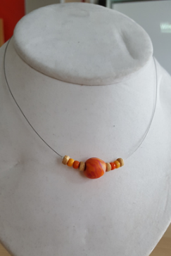
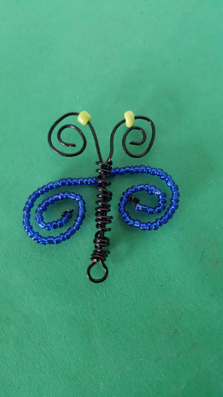
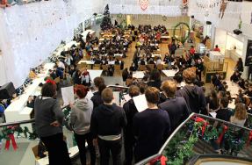
Music and Crafts

Slide 15
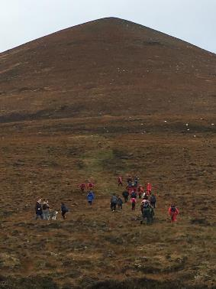
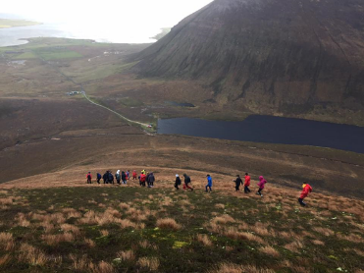
Outdoor Education:
Duke of Edinburgh, John Muir etc.

Slide 16
Implementation
Numeracy: Improvement
Who – P7 to S1
Improved Numeracy attainment
Data management & tracking
Literacy:
Improve attainment in literacy
Purchase of a Digital Theatre Licence
Curriculum Support Integration and Literacy
Health & Wellbeing
In School Counselling.
Access to Outdoor Education.
Partnership working. SDS, VAO, CLD, Social Work etc.
Transition for Isles pupils
Curriculum support – John Muir award and residential activities.
0.5 FTE Home School Support Worker

Slide 17
Impact
“I have always had a healthy respect for the work my primary colleagues deliver but it can now be described as a massive respect and sense of awe at the challenges they face and overcome.”
Numeracy
Increased team teaching with primary and secondary colleagues
Shared understanding and improved working partnerships
Development of shared language on numeracy across schools
“It was lovely to see the children who were quite apprehensive about going to KGS feeling much happier.”
“We are developing a shared language of maths and numeracy. This requires conversations and face time and I hope this will ease the transition for pupils.”
“We solved problems, used number puzzles, learned how to use coordinates and had great fun.”

Slide 18
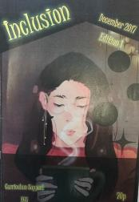
“I really enjoyed making the magazine, it gives me a chance to speak out on disabilities and share my experiences”
Impact
Literacy
Inclusion: Curriculum Support Magazine
“It was a very tight timetable, but I am really proud that I edited the whole magazine.”
“Writing about the Food Bank was also good because we got to interview [name] and find out about the facts about how many people use the Food Bank.”
“The magazine was a really enjoyable project and it gave me something to do when I felt really down. It also helped me feel that I was doing something productive! Thank you magazine!”

Slide 19
“It's great to see live productions, but digital theatre lets you go back and see it again and again if you are unsure of the story or want to remind yourself of it."
Impact
Literacy
Digital Theatre. Access to performance and script development and performance – both in school and at home
“Our remote location limits our access to live theatre but now we have it at our fingertips. The quality of the productions, the interviews, essays and resources have improved the quality of our lessons and helped us to bring an additional buzz back into the department
“Reading a play in class doesn't bring it to life or excite you the way watching it live does. Being able to watch it again at home in one showing really helps too."

Slide 20
“The statistics show a downward trend. Their (pupils’) ability to cope has increased and their distress has decreased”
Impact
Health and Wellbeing
In school counselling
2015-16: 454 sessions attended
2016-17: 587 sessions attended. (58, 7.7% of pupils)
Demand continues to increase.
“Having access to counselling has really helped me cope. I have a place to go”

Slide 21
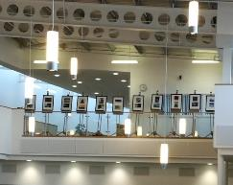
Impact
Health and Wellbeing
S3 Art and Fashion Show
Peer motivation as pupils support each other to a real deadline
“The pupils were encouraged to reflect on their work each choosing two of their own photographs to exhibit”
“I developed my ability to reflect on my work and make effective choices”
“My communication skills got better as I had to ask people’s permission to take photos”

Slide 22
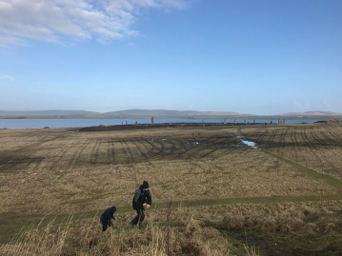
Impact
“John Muir is fun. I’m helping make sure [Name] (from RSPB) doesn’t have to carry everything. Its good to help nature else we wont have potatoes or chips”
John Muir Award:
Improved access to outdoor learning
“I liked going to Cottascarth. We built bug hotel to help feed the birds and bees to help our local environment.
I learned about nature and insects. Its good to get fresh air and not be trapped in a classroom”
“As a teacher, I feel this encourages a holistic approach to learning as pupils learn to take responsibility for managing their time and volunteering to help in the community”

Slide 23
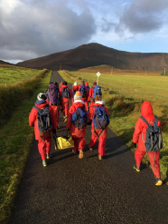
Impact
“Hoy was great because there was so much to do. Even when the weather was bad we still enjoyed ourselves learning leadership and map reading”
“Trusting each other.”
“problem solving and teamwork.”
Hoy Residential Trip:
“A great opportunity for pupils to develop their awareness of the outside world and take part in Challenge by Choice activities”
“Experiencing new things like coasteering and raft building.”

Slide 24
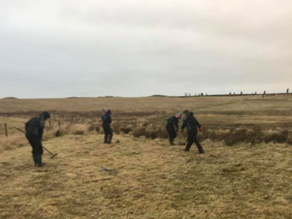
Impact
A very windy day for raking grass at Brodgar today but everyone did a fantastic job building a ‘Bug Hotel’ and for the RSPB and the local Bee population!
Access to Funding:
Technical
Home Economics
Art & Design
Football Trip(s)
Music Trip(s)
Curriculum Support – KGS Outdoor Education

Slide 25
At Kirkwall Grammar School, Pupil Equity Funding has:
Allowed for continued access to in school counselling to build resilience, self respect, support and self belief.
Improved numeracy transition by developing a shared language and shared understanding.
Improved literacy provision by giving students access to over 370 plays and productions in school or at home
Improved the transition arrangements for pupils coming to the Orkney mainland from isle schools.
Levelled the playing field by providing access to improve teamwork, learning skills, skills for work & life.
Improved integration of curriculum support in the daily life of the school
Encouraged and supported the re-engagement of learners by building and developing support networks.
Raised aspirations
Improved outcomes for those that need it most.

Slide 26
Thoughts on Future projects:
0.5 FTE Home School support worker for hard to reach pupils and parents.
Continued use of in school counselling service
Enhancement of integrated curriculum support provision
Make inroads into team teaching and partnership working with primary colleagues to focus on literacy
Continue to raise aspirations
Improved outcomes for those that need it most.

