Slide 1
Measuring Impact Through Effective Tracking
Renfrewshire Council
Notes:
This presentation will showcase the development of primary tracking systems in Renfrewshire. These systems aim to link all pupil information together to support data analysis and evaluation. We will discuss how having this system in place allows for evaluation of PEF interventions to be embedded within the tracking process.

Slide 2

Introduction
Susan Dalrymple
  Head Teacher, Wallace Primary School
Emma Mavers
  Head Teacher, Barsail Primary School
Fiona Wright
  Management Information Officer, Renfrewshire Council Attainment Challenge
Iain Shearer
  Active Schools and Community Club Development Officer Lead, Renfrewshire Leisure

Slide 3
Tracking and Monitoring
Aim to have all tracking systems meeting key criteria
  Pupil level information
  Different types of data are linked
  Long term progression & trends can be identified
  Summary data is easy to access
  Information can be added/ removed as required
Focus on ease of use so time can be spent on analysis- not on calculations
Each school involved in design so that specific needs are met

Slide 4
Example Template
Termly Tracker
Long Term Tracker
Pupil Profile
Cohort Summary
School Summary
Attainment Gaps
Pivot Table
Data entry tabs
Pre-calculated summary tabs
Additional summary data can be generated
Please note: All data included within this presentation does not relate to individual pupils, but is based on trends within the two schools.

Slide 5
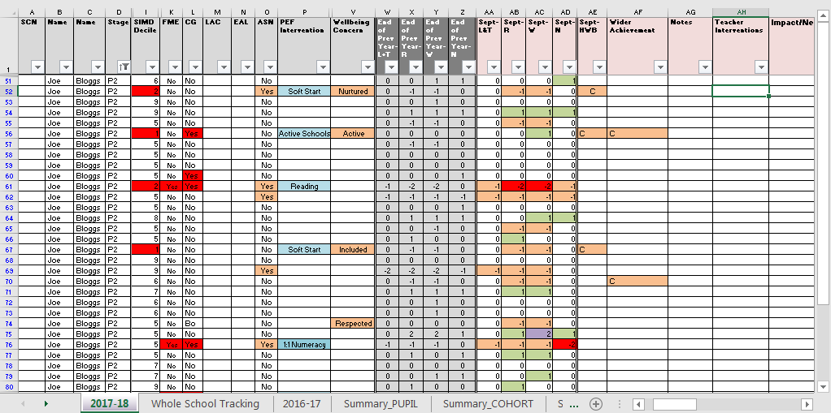
Termly Tracker
Previous Year Data
Pupil Information
Term 1 Tracking Information

Slide 6
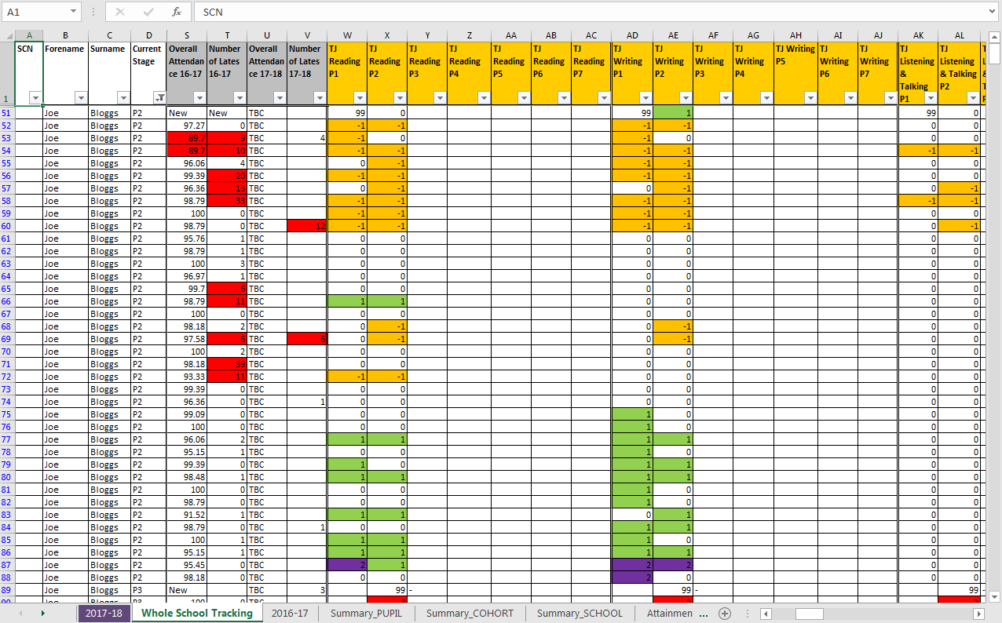
Long Term Tracker
Pupil Information
Attendance & Lates
Curricular Areas

Slide 7
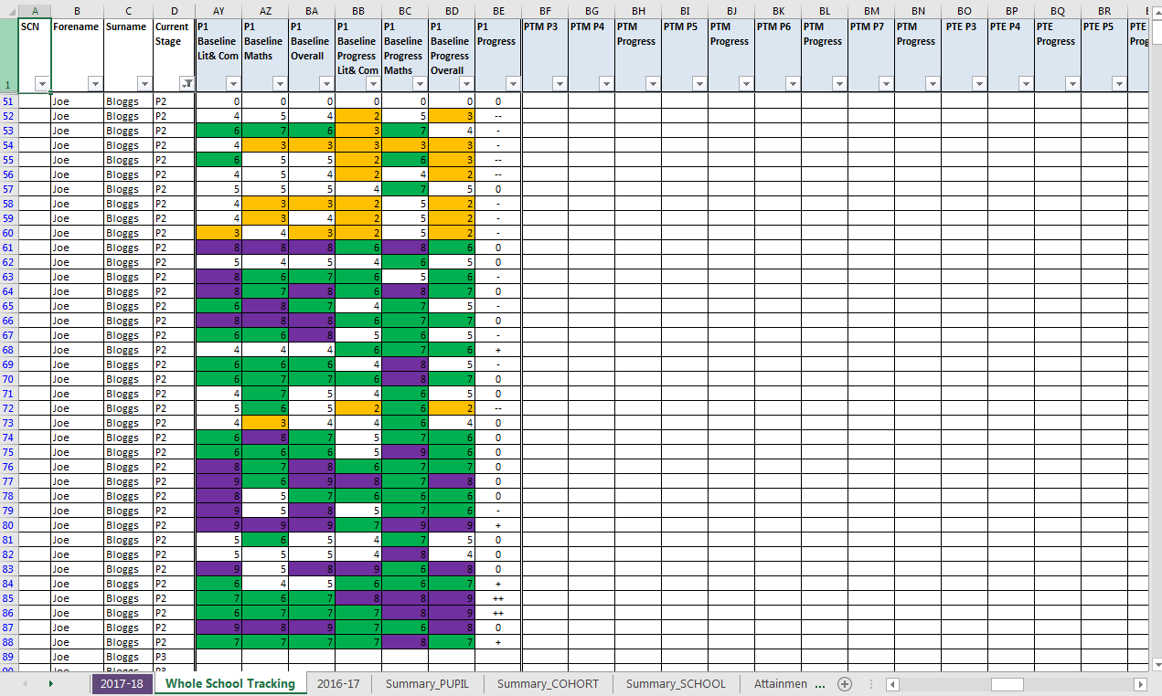
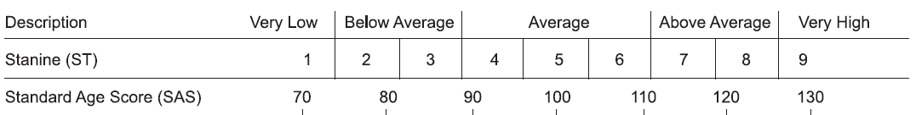
Long Term Tracker
Pupil Information
Testing Data
GL Progress Categories
-- - 0 + ++
Much Lower
Lower
Expected
Higher
Much Higher

Slide 8
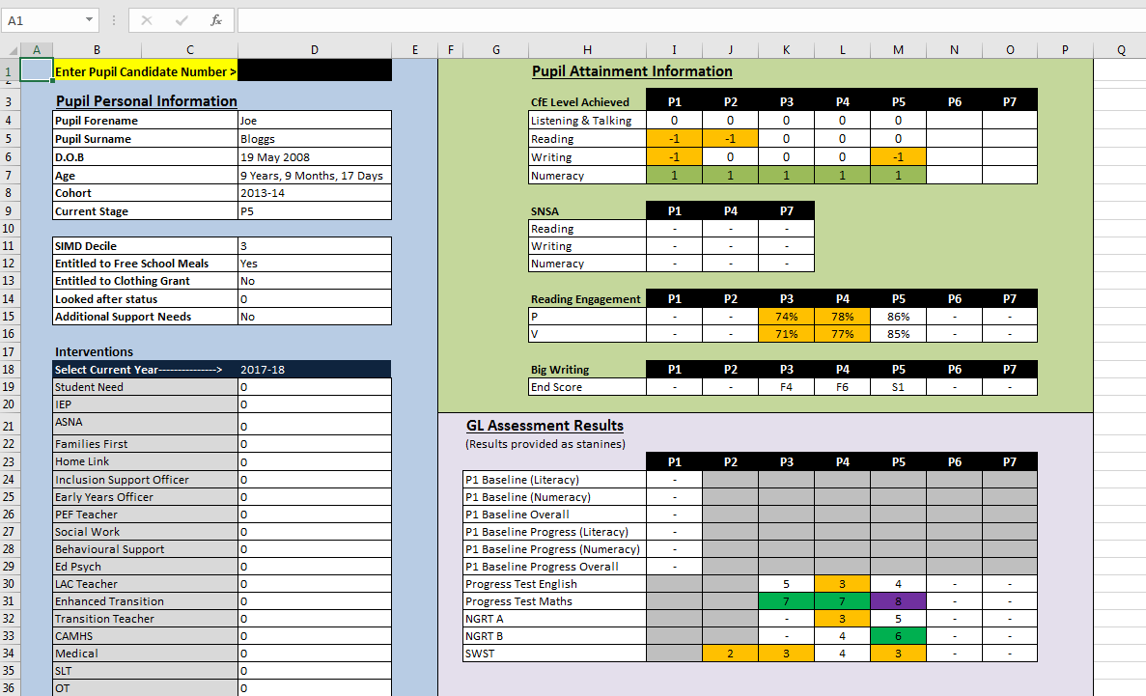
Pupil Profile
Candidate number entered to pull information

Slide 9
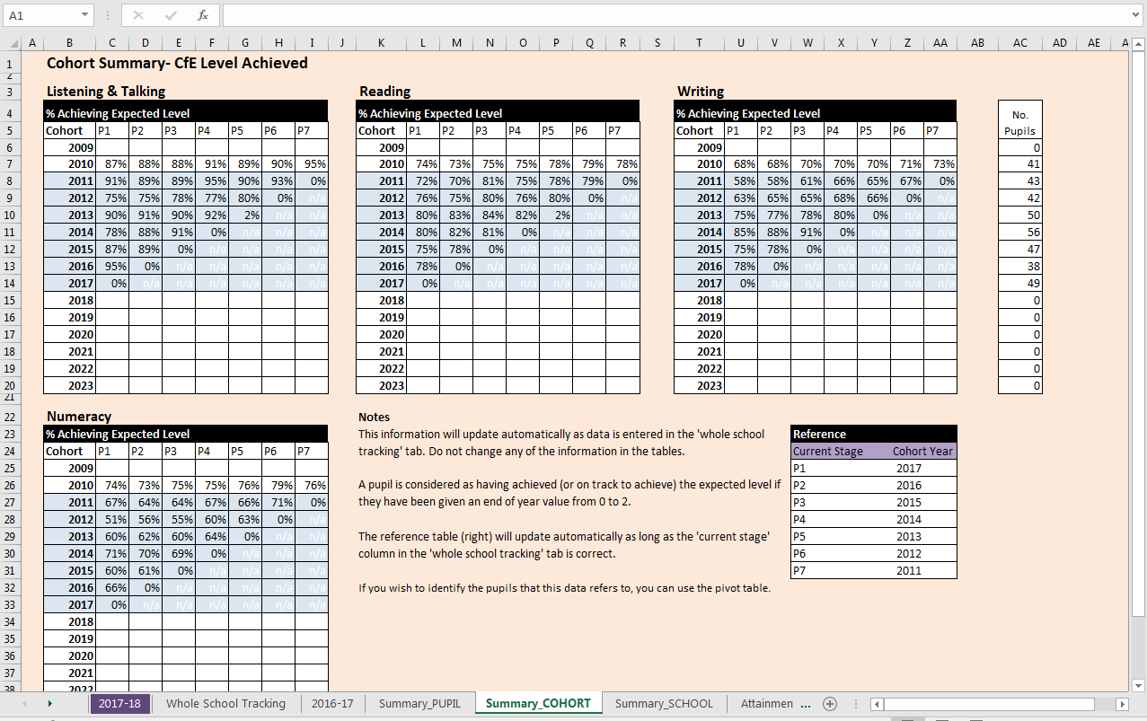
Cohort Summary

Slide 10
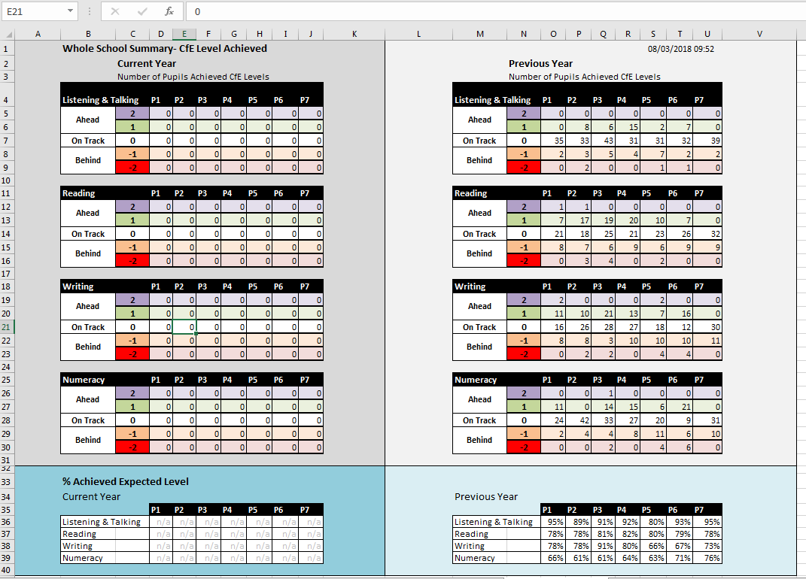
School Summary

Slide 11
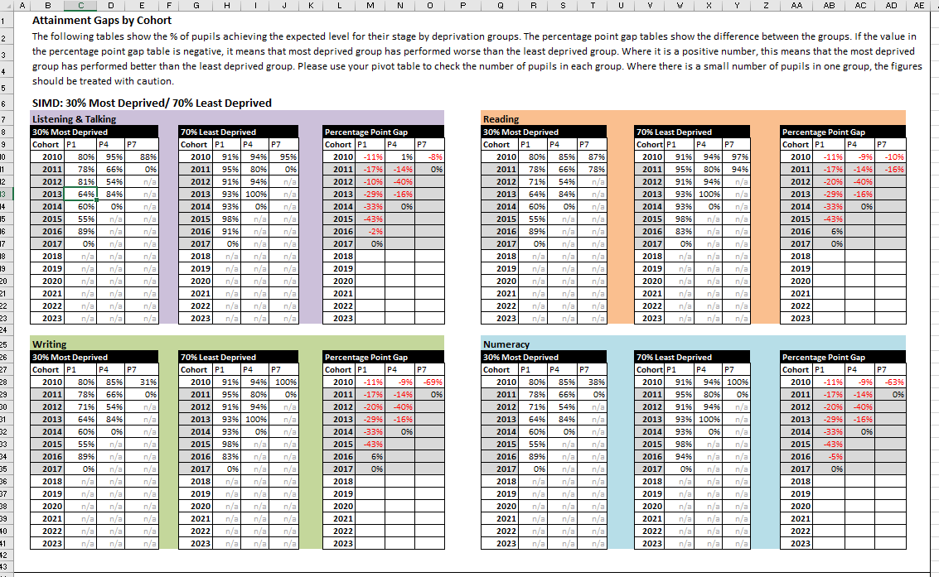
Attainment Gaps
Second set of table for pupils entitled to free meals/ clothing grants
SIMD grouping can be adapted to fit school

Slide 12
Identifying Interventions & Measurement: Literacy
Intervention | PEF Teacher to support pupils in reading (0.4)
Aim | To improve reading skills of pupils that are behind the expected level for their stage
Target Group | Pupils selected from each stage based on level in reading (-1 or -2) n=17 Pupils identified using PEF referral system.
Success Criteria | 1. Pupils have increased point on progress scale (end of year) 2. Pupils able to meet set criteria relating to reading skills (termly) Example Criteria -To know 70-80%+ of vowel digraphs and to demonstrate awareness of alternative vowel digraphs covered -Blending and segmenting 5 sound words with vowel digraphs -Common words/tricky words for Phase 5 -To name/describe 4+ decoding strategies
Example Baseline Data | % of target pupils 2 years or more behind in reading (-2) % of target pupils 1 year or more behind in reading (-1) Data available for individual pupils tracked against specific criteria

Slide 13
Identifying Interventions & Measurement: Literacy
PEF Referral System
  To identify individuals to target
Termly tracker
  Level assigned for each pupil for each term in reading
  Teacher comments and assessment of impact available on individual progress
PEF Funded Teacher
  Baseline Assessments
  Recording individual progress on specific criteria relating to reading skills

Slide 14
Identifying Interventions & Measurement
Wellbeing
Intervention | Soft Start Programme
Aim | To reduce late coming and improve attendance.
Target Group | Pupils who were late on more than 10 occasions in 2016 – 2017. Pupils with less than 80% attendance in 2016 – 2017. Indicators of poverty used to prioritise.
Success Criteria | Pupils that have attended programme have reduced number of late comings compared with previous year. Attendance rate has improved for pupils that have attended programme
Example Baseline Data | Average late comings for target group Under 90% attendance rate for target group Individual pupil/ family data- number of lates & attendance rate

Slide 15
Identifying Interventions & Measurement
Wellbeing
Information Recorded
  Pupil Attendance at Soft Start
  Number of late comings for target pupils (monthly)
  Attendance rate of target pupils (monthly)

Slide 16
Identifying Interventions & Measurement
Wider Achievement
Intervention | Active Schools
Aim | To increase the number of hours of physical activity per week Maximise number of pupils involved in extra-curricular activities
Target Group | Pupils who were identified through parent/ pupil survey and interviews
Success Criteria | Pupils attend extra-curricular activities (school sport) Pupils attend local approved HUB clubs (club sport)
Baseline Data | % rate of pupils identified as red on the activity scale (active for less than 3 hours a week)

Slide 17
Identifying Interventions & Measurement
Wider Achievement
Tracking progress
  Data is gathered through parent and pupil survey
  The survey allows information on
    Hours of activity per week
    What opportunities are being accessed extra-curricular (Schools and Active Schools)
    What opportunities are being accessed in the wider community (Active Schools and HUB Clubs)
    Pupil suggestions to create personalisation for active schools programme.
    Swimmer and Non Swimmer information
Data gathering on SEEMiS
  Available as a pivot table. Can filter using poverty indicators.

Slide 18
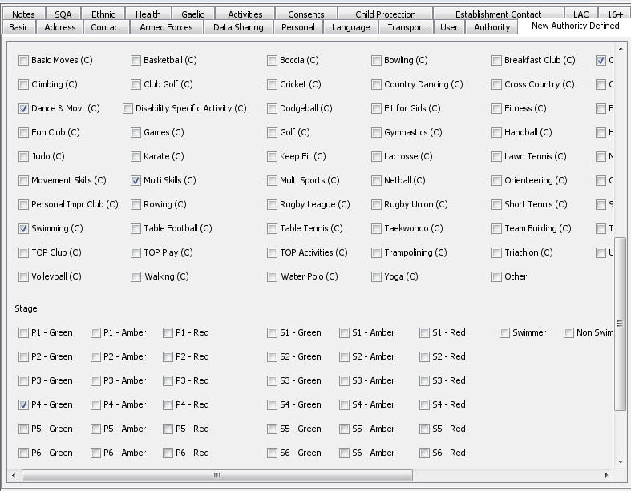
Identifying Interventions & Measurement
Wider Achievement
Tracking progress

Slide 19
Assessing Impact of Intervention
Key questions
Has there been improvement?
Has success criteria been met?
Do all sources of information tell the same story?
To what extent do I know that these actions are responsible for the change?
How can I use this information going forward?

Slide 20
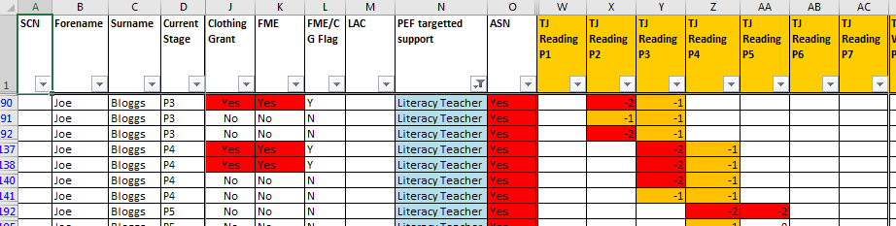
Assessing Impact of Intervention
Literacy
Success Criteria
1. Pupils have increased point on progress scale (end of year)
2. Pupils able to meet set criteria relating to reading skills (termly)
Example Summary Data
Level Assigned in Reading | Baseline | Follow-up
2 years behind | 80% | 10%
1 year behind | 20% | 80%
On track | - | 10%
Example Pupil Data
 | Term 1 | Term 2
Vowel Digraphs | 76% | 100%
Alternate Phonemes | N/A | 81%
Blending | 63% | 96%
Segmenting | 53% | 96%
Tricky words (1st 100) | 85% | 97%
Holborn Reading Test | 9yrs 3mths | 9yrs 9mths

Slide 21
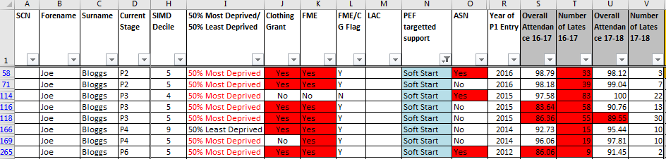
Assessing Impact of Intervention
Wellbeing
Success Criteria
Reduced late comings of target pupils/ families
Improved attendance of target pupils/families
Target Group
% of pupils with improved attendance rate | 67%
% of pupils with reduction in late comings | 81%

Slide 22
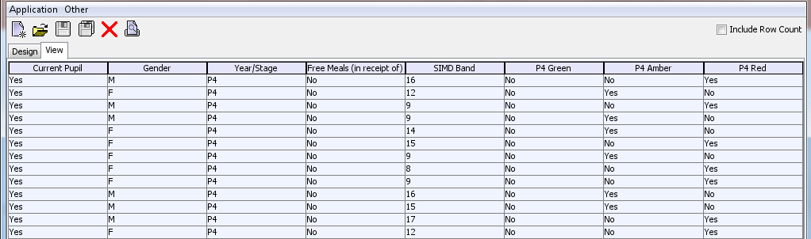
Assessing Impact of Intervention
Wider Achievement
Success Criteria
Target Group
% of pupils with improved physical activity rate | %
% of pupils engaged in school sport | %
% of pupils progressing to club sport | %
% of pupils increased that are classed as swimmers | %

Slide 23
Conclusions
How effective tracking can help to measure impact
Data is available in one document
Minimal time is spent summarising and calculating
Having data linked helps to give a better understanding of all the factors involved
Trend data allows us to get a better picture of strengths/weaknesses
Long term progression can help to see short and long term impacts of interventions
Positive partnerships can support process of gathering and analysing information

Slide 24
Questions?

