Slide 1
PEF Health & Wellbeing Coach
Mark Coyle– St John’s Primary
Colette Wallace– St Michael’s Primary

Slide 2
Context
St John’s Primary &
Nursery Class
St Michael’s Primary
227 pupils
24/24 Nursery
SIMD 1 + 2 = 49.5%
SIMD 3 – 9 = 49.5%
No SIMD Code = 1%
FME = 14.5%
Attainment Challenge School (Year 1)
229 pupils
SIMD 1 + 2 = 62.9%
SIMD 3 = 14%
SIMD 4 = 2.2%
SIMD 5 = 10.9%
SIMD 6 = 8.7%
SIMD 9 = 1.3%
FME = 29.7%
Attainment Challenge School
(Year 2)

Slide 3
PEF Intervention
Background:
Introduction of PEF to close the poverty related attainment gap through targeted interventions
Identified GAP in our schools –
Promoting Positive Relationships
Social Interaction
Promoting Positive Behaviour
Making Right Choices
Targeted intervention to address needs of pupils
Identification of Health & Wellbeing Coach role to address barriers
Implementation of plans
Evaluation of what is working
Identify next steps

Slide 4
Gap Research
Social and emotional development
Children living in SIMD 1 and 2are more likely to require adaptations to the curriculum to support their social skills and emotional literacy.
Children living in SIMD 1 and 2 are more likely to be excluded.
Parental engagement/family learning
Children living in SIMD 1and 2 are less likely to attend afterschool clubs.
Attendance
Children living in SIMD 1 and 2 are more likely to have attendance issues.
Children living in SIMD 1 and 2 are more likely to have a higher occurrence of lateness.

Slide 5
Our Challenges
High number of referrals from playground incidents
Pupils commenting that they did not feel safe in the playground – older pupils taking over areas
Pupils commenting that the MUGA was always used for football
Pupil commenting that there was nothing to do in the playground
Lack of respect for property/equipment – linked to lack of playground activities
Lack of play opportunities in the infant playground
Low Breakfast Club attendance
Limited Afterschool clubs
No Lunchtime Clubs

Slide 6
What were our desired outcomes?
Happy pupils
Safer more engaging playgrounds
Pupils developing leadership roles
Pupils using Restorative Approaches effectively
A greater emphasis on healthy choices
More choice of activities for all pupils
Increased attainment as a direct result of targeted interventions

Slide 7
Health & Wellbeing Coach Role
Remit:
Had to be specific to meet needs of our desired outcomes
Had to be different from other roles – e.g. Active Schools Coordinator/Home-link Support
Require appropriate qualifications to support PE Activities and have a Nurturing Approach
Job sized appropriately – Priority for recruitment
Follow HR Safe Recruitment Procedures

Slide 8
Planning – Target Support
Breakfast Club Intervention
Structured playground activities
Increased opportunities for pupils to participate – variety of clubs – both after school and during school
Timetabled support for targeted pupils
Develop Sports Leaders – pupils to lead activities - sustainability
Build positive relationships – pupils/staff/parents/external agencies
Support targeted pupils during PE lessons
Tracking the interventions
Amending plans to address barriers that arose during the initial intervention

Slide 9
Implementation
Appoint appropriate person linked to created job specification and remit – unique post
Devise timetables/plans to have greatest impact on outcomes for pupils
Find out what pupils wanted and expected from role
Timetable for evaluations of impact
Pupil responses
Data interrogation
Identification of next steps
Keep doing/stop doing/start doing

Slide 10
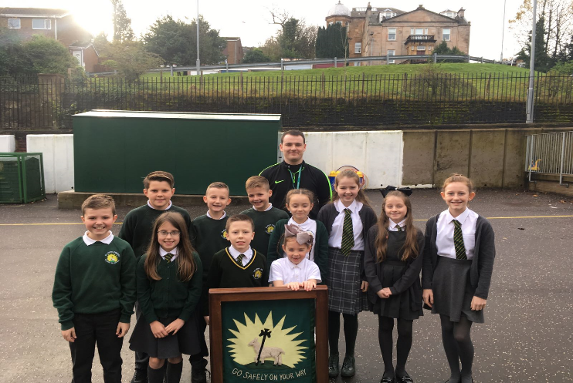
Sports Council

Slide 11
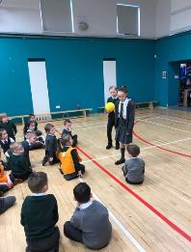
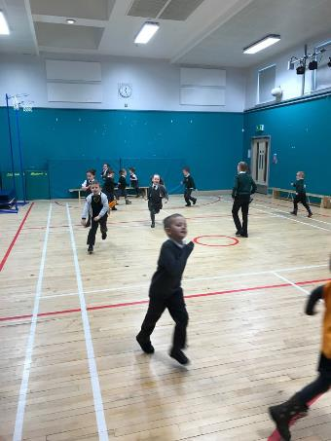
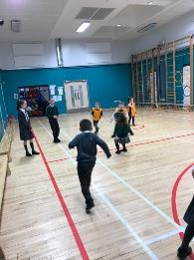
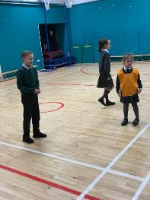
Clubs

Slide 12
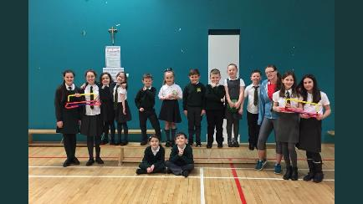
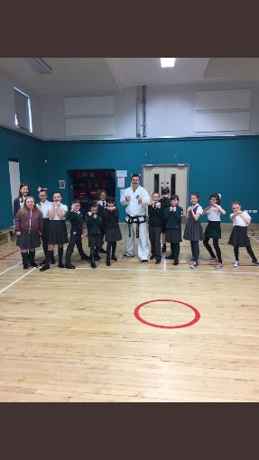
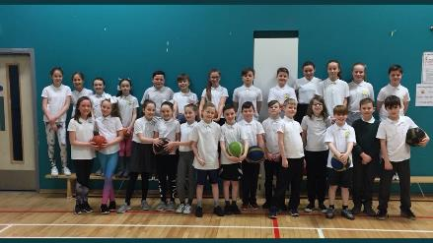
Clubs

Slide 13
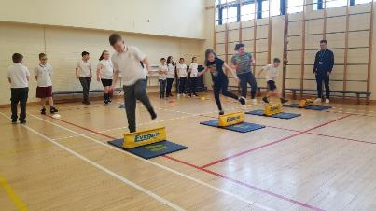
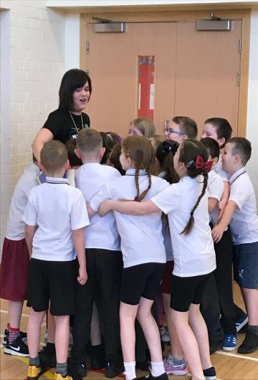
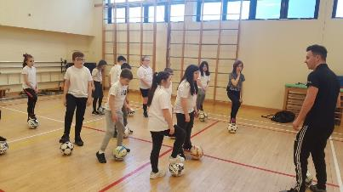
Clubs

Slide 14
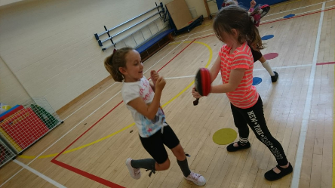
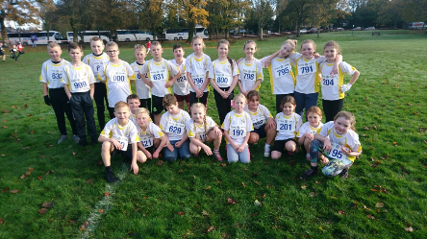
Clubs

Slide 15
Data
St Michael’s Primary
St John’s Primary
Average increase of 57% in attendance at Breakfast Club
No referrals from Senior playground
73.5% of pupils with FME have engaged in additional physical or sports based activities
Of those not participating, 11.8% are within same class
Average increase of 75% in attendance at Breakfast Club
Reduced referrals
61.6% of School Role participated in Term 1
School Club Links rose from 1 to 5
Activity Sessions in Term 1 = 94 / 8 activities compared to 28 / 4 last session

Slide 16
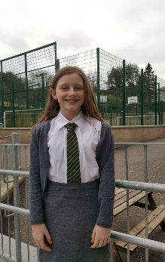
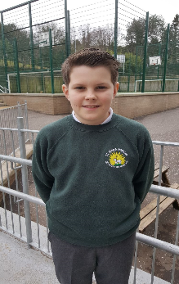
Views
I enjoy being part of the Sports council – we are able to make a difference to the playground making it a happier place through developing the rota and organising Playground Games.
Helping the P1 and P2 pupils at the Lunchtime Clubs is great because we get to show the wee ones how to develop new sports skills.

Slide 17
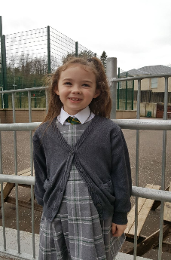
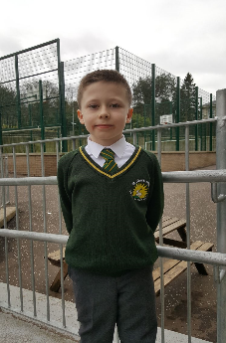
Views
The MUGA is better now as we can try different sports rather than just football all the time.
I think that it is great that we have lots of afterschool clubs for all the pupils, not just for the older ones.

Slide 18
Views
Breakfast Club was so much better with Kayleigh. She had so many activities for us to do and it got us ready for the day ahead.
It was great having Kayleigh. She helped with extra training sessions for athletics. When she took us to netball tournaments she was really supportive. She boosted our confidence.
Having Kayleigh in our gym lessons made us more confident. She was dead approachable and we could ask her anything. She was always able to help us when we weren't sure. Having two adults at gym made it so much better.
We had so many after school clubs when Kayleigh was here. She really listened to us at our Sports Council when we shared our opinions. She made things happen!

Slide 19
Views
In the Sports Leaders they've been teaching us how to use communication skills, leadership skills and responsibility. We've learned how to use our voice to get others to join in activities and we've learned other strategies too.
In our Sports Leaders programme we've learning how to lead others, especially the little ones. Leadership skills are something that we'll really need in the future.

Slide 20
Changes to the Original Plan
Increased hours to improve support
Targeted support through nurture – individual pupils
Increased support for teaching staff to support improved outcomes for pupils during PE lessons

Slide 21
Case Study at St John’s Primary
Pupil
Excluded
Part-time timetable
Attachment Issues
Gender Respect Issues
Intervention
One to One engagement
Sporting Hook
Nurturing approach
Impact ~ Outcomes for pupils
Increased time in school
Increased Confidence
Positive Role Model
Increase Self Esteem
Relationship Building

Slide 22
Case Study at
St Michael’s Primary
Observation
Challenges – concentration, communication, following instructions, impulsivity
Tae-Kwando – focused, concentrated, followed instructions, interacted similarly to peers
Interventions
Initial pilot - daily physical activity 1:1 with HWB Coach prior to class based learning
Impact
Followed structure and routine
Understanding of sharing and turn taking
Opportunity to develop language skills
Positive feedback from class teacher
Improvement in self-esteem, motivation and engagement

Slide 23
IMPACT!
Increased opportunities for pupils
Increased attendance at Breakfast Club
Introduction of Lunchtime Clubs
Reduced referrals from the playground
Structured interventions for targeted pupils/groups
Pupils developing leadership skills
Support during PE Lessons for targeted pupils

Slide 24
Next Steps:
Developing Support Staff skills
Family Fitness Programme – SIMD 1 + 2 Families
Involvement with Educational Psychologists to support Relationship Building Programme
Nursery transition – after-school club (pre – school)
Applying for Gold Sports Award

Slide 25
Thoughts???
What would this look like in your context?
What advice would you give us to improve our programme?
Any questions?

Slide 26
Contact Details
Colette Wallace:
inhgl491@glow.sch.uk
@SMPG1964
Mark Coyle
inmac008@glow.sch.uk
@StJohnsPG

