Slide 1
Early years photos: 35 images
Primary stereotype images: 36 images
The images are grouped into rough themes and we have made some suggestions of scenarios they could illustrate. However, please feel free to use individual photos as suits.
Note that suggestions are based on the final images, and may not reflect what was actually happening in the activity.
Please note also that some of the photos were staged. No pupils were actually hurt or excluded, scenarios were set up for illustrative purposes only
Produced by the IOP as part of the Improving Gender Balance Project. This work is licensed under a Creative Commons Attribution-NonCommercial 4.0 International License.

Slide 2
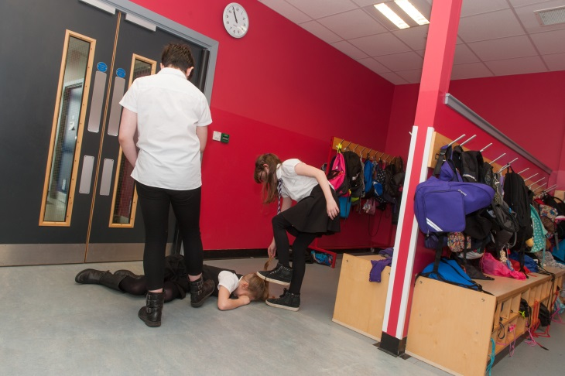
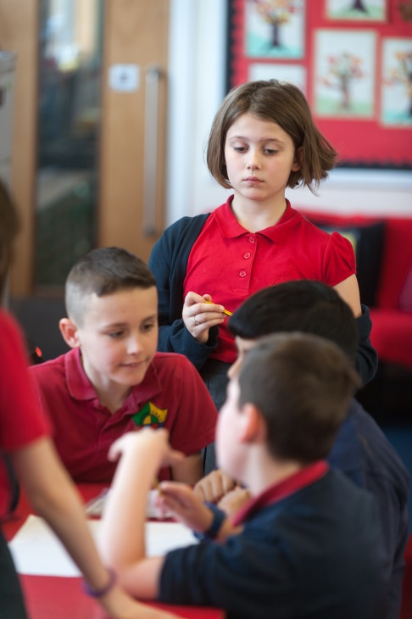
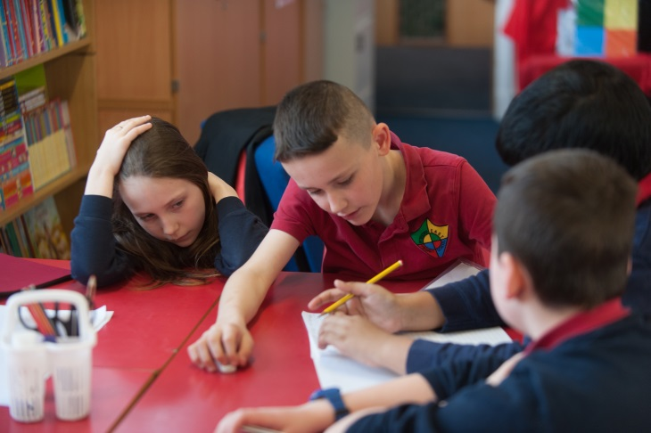
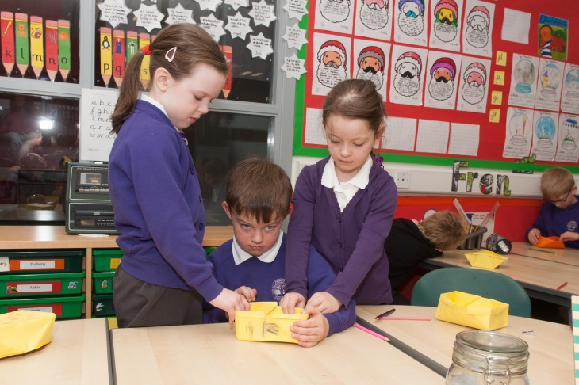
1
2
4
3
5
Notes:
This set illustrates exclusion and aggressive / bullying behaviour. Please note these images were all staged.
Potential stereotypes challenged:
Girls are not physically aggressive (1, 2)
Girls are good at helping (5)
Girls work well in teams / boys do not (3,4)
Potential stereotypes illustrated:
Girls and boys don’t work well together in teams / boys tend to take over (3, 4)

Slide 3
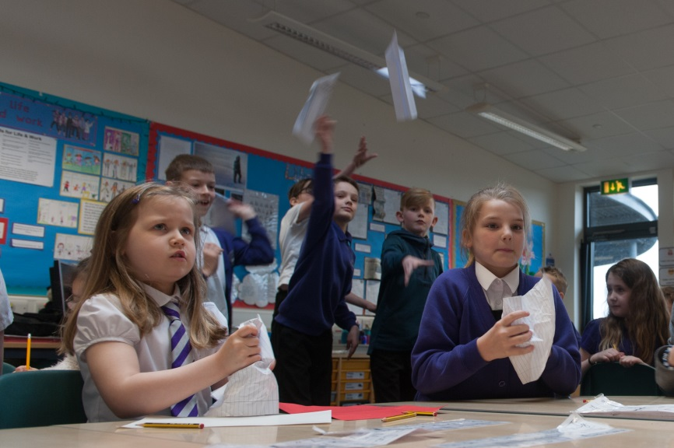
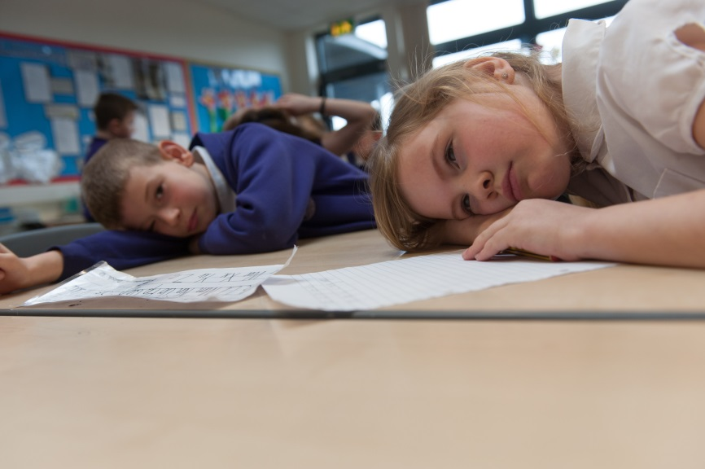
1
2
Notes:
This set illustrates some behaviour issues.
Potential stereotypes challenged:
Girls are generally engaged and well behaved in class

Slide 4
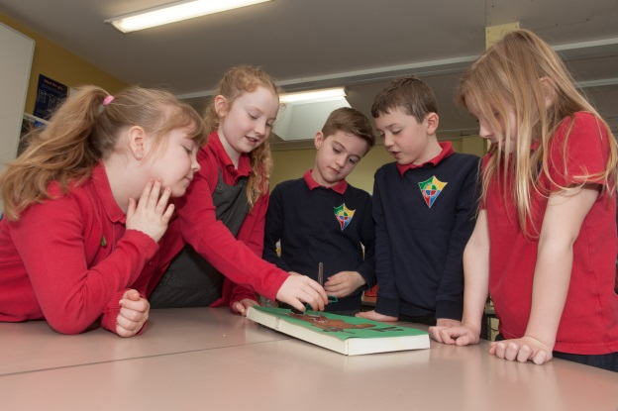
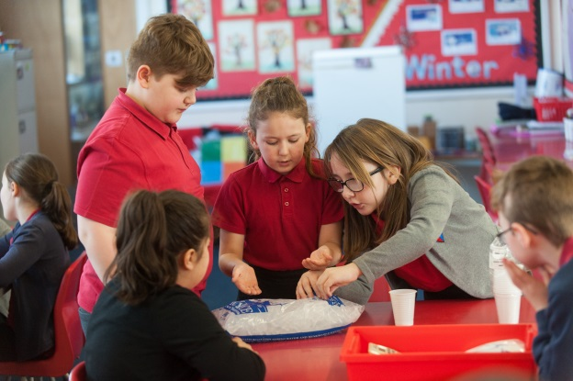
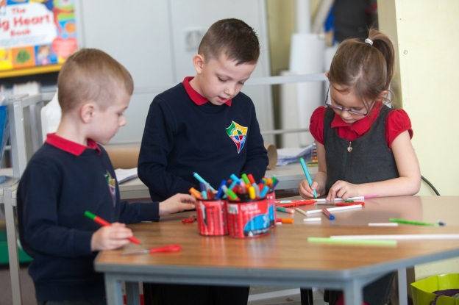
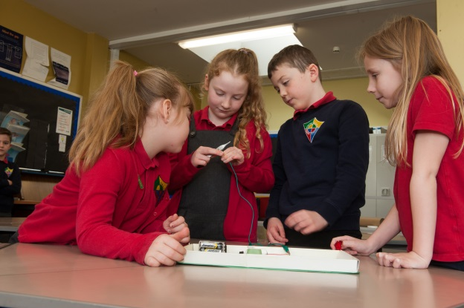
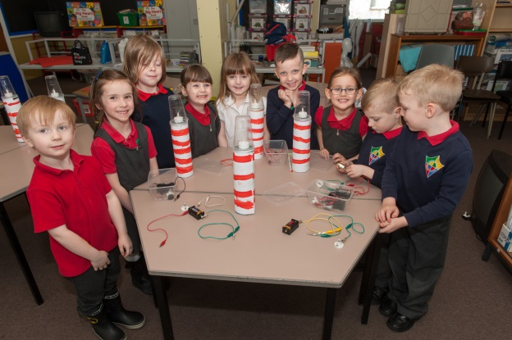
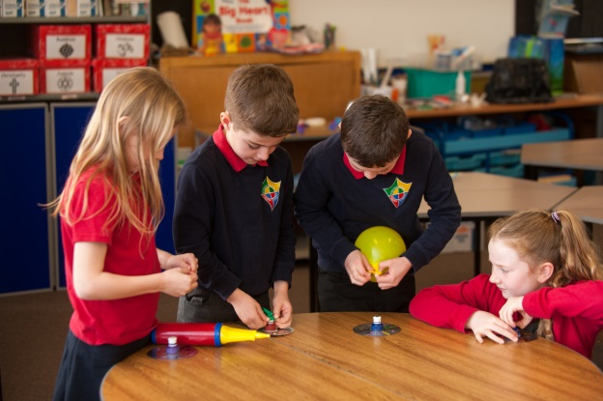
1
2
3
4
5
6
7
Notes:
This set illustrates mixed groups of children working in STEM.
Potential stereotypes challenged:
STEM isn’t as interesting for girls
Mixed groups don’t work well together
Boys tend to take over in practical activities (1, 2, 3)
Girls don’t make good leaders (1, 2, 3, 6)
Concentration is an issue for boys
Art doesn’t interest boys (3)
Boys struggle with writing (6)
Potential stereotypes illustrated:
Boys tend to take over in practical activities and the girls look on (7)

Slide 5
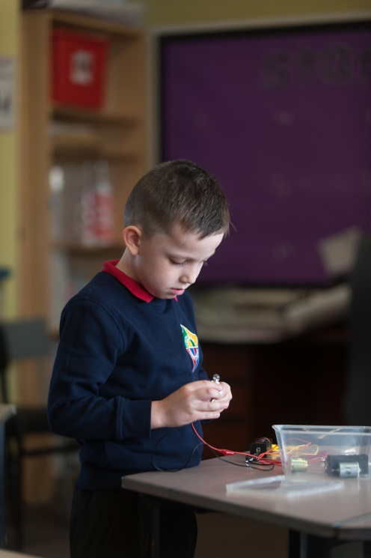
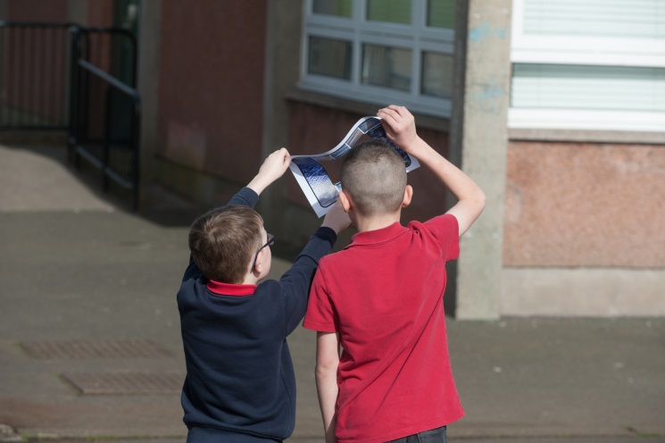
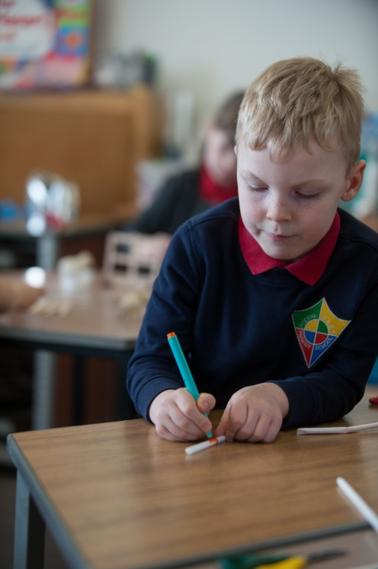
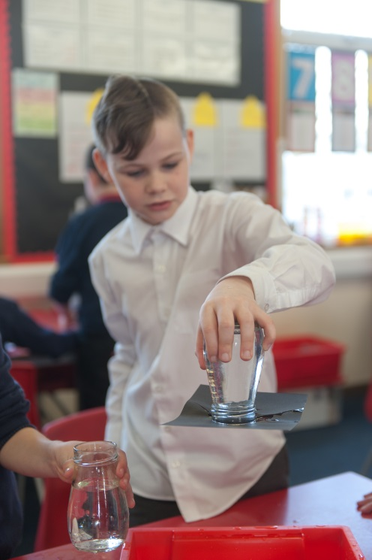
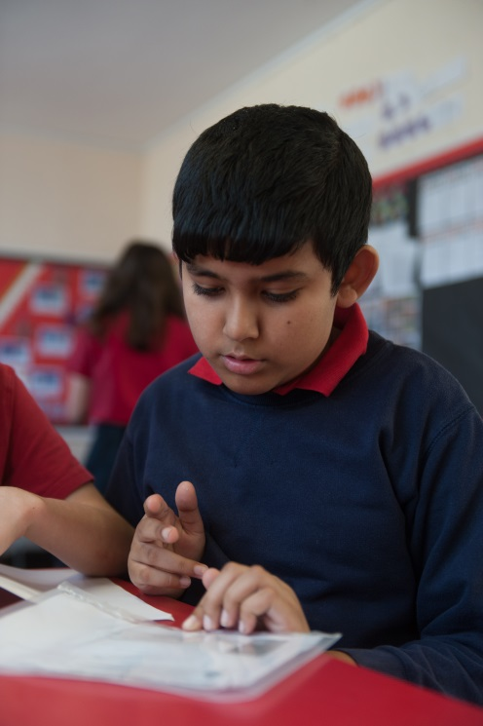
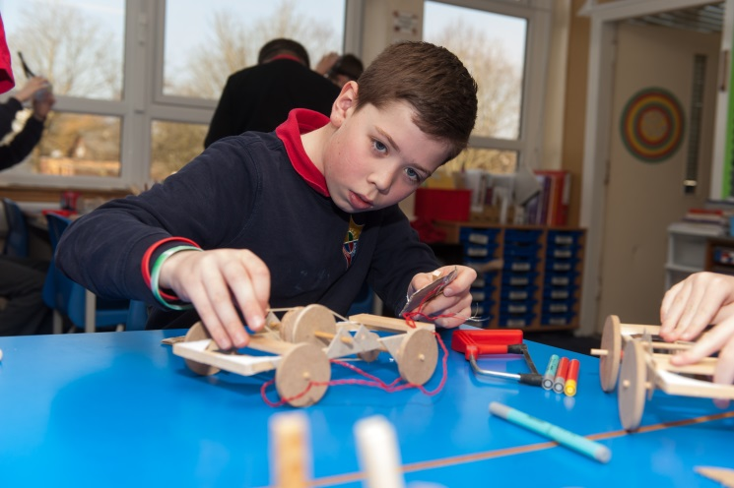
1
2
3
5
6
4
Notes:
This set focuses on boys in STEM work, concentrating, working in teams, reading, and taking part in art based activities.
Potential stereotypes challenged:
Boys find it hard to concentrate
Boys don’t work well in teams (2)
Art doesn’t interest boys (3)
Boys struggle with reading and comprehension (6)
Potential stereotypes illustrated:
STEM is predominantly a boy’s subject area.

Slide 6
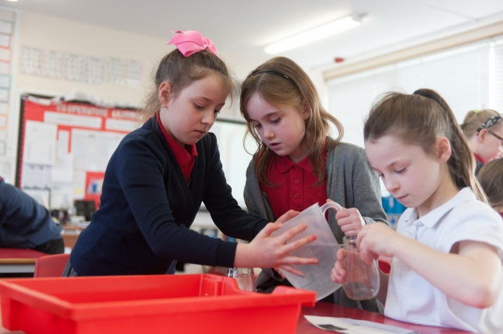
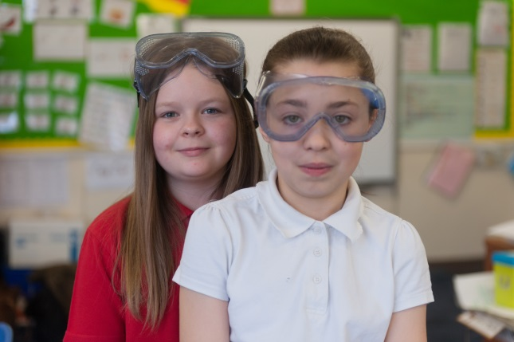
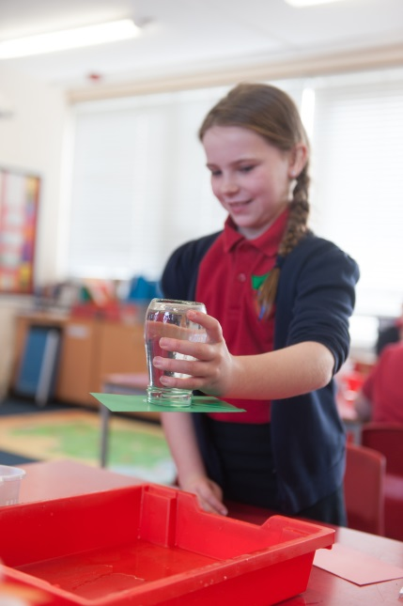
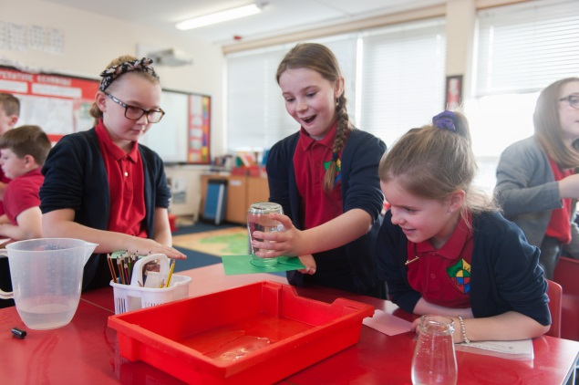
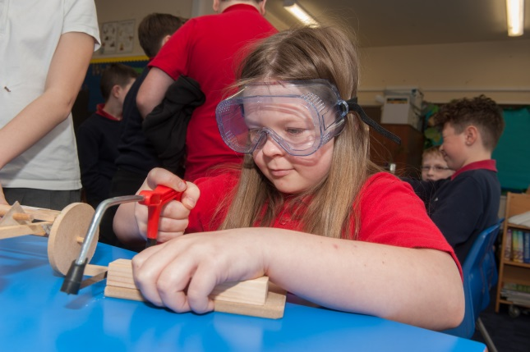
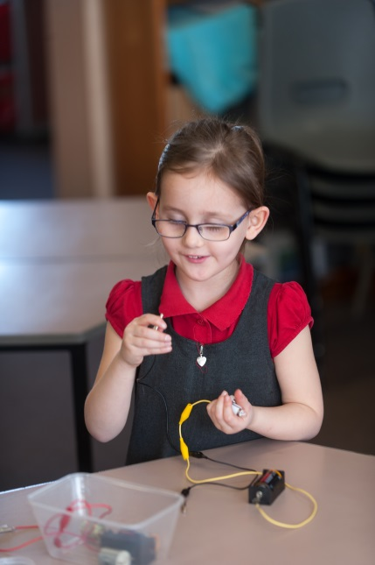
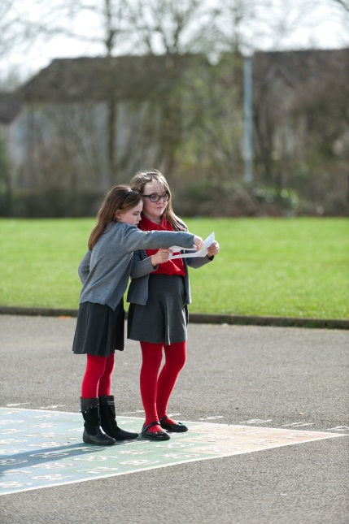
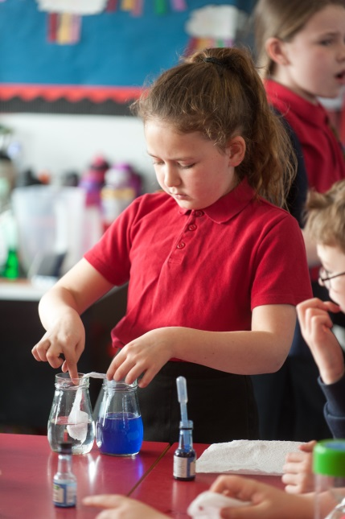
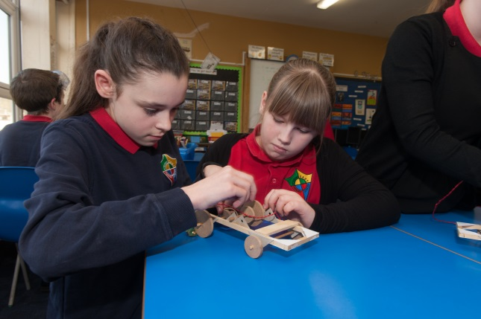
1
2
3
5
4
7
8
9
6
Notes:
This set focuses on girls in STEM work, concentrating, working in teams, using tools, and taking part in outdoor learning.
Potential stereotypes challenged:
STEM is predominantly a boy’s activity
Girls don’t like getting messy (1, 3, 5, 9)
Using tools, building and fixing things is predominantly masculine (4, 6, 7)

Slide 7
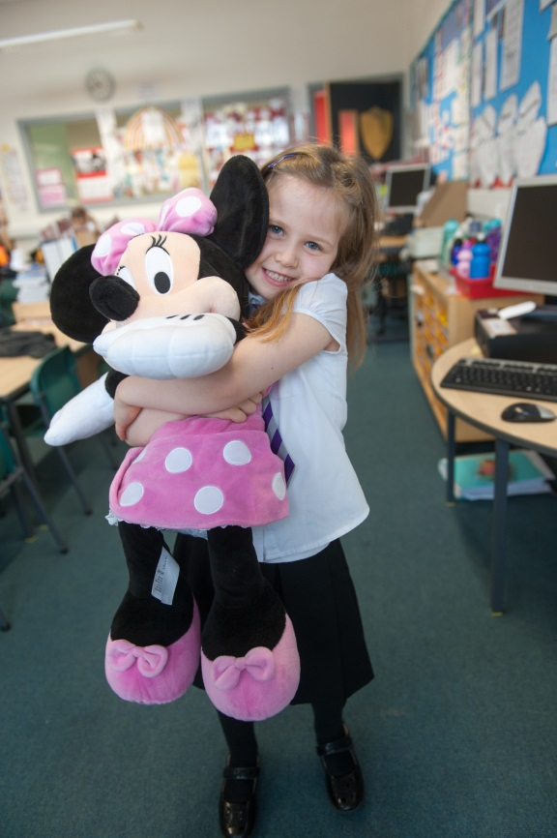
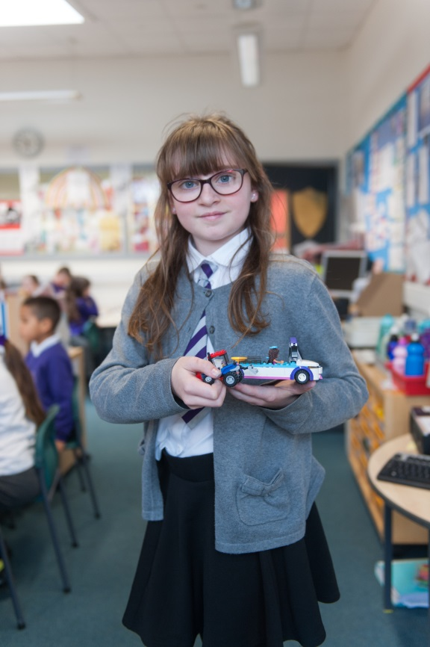
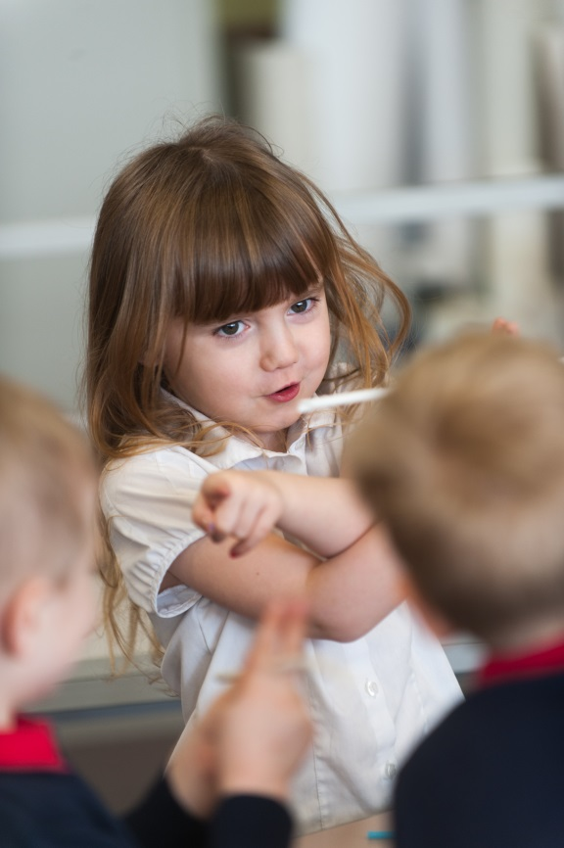
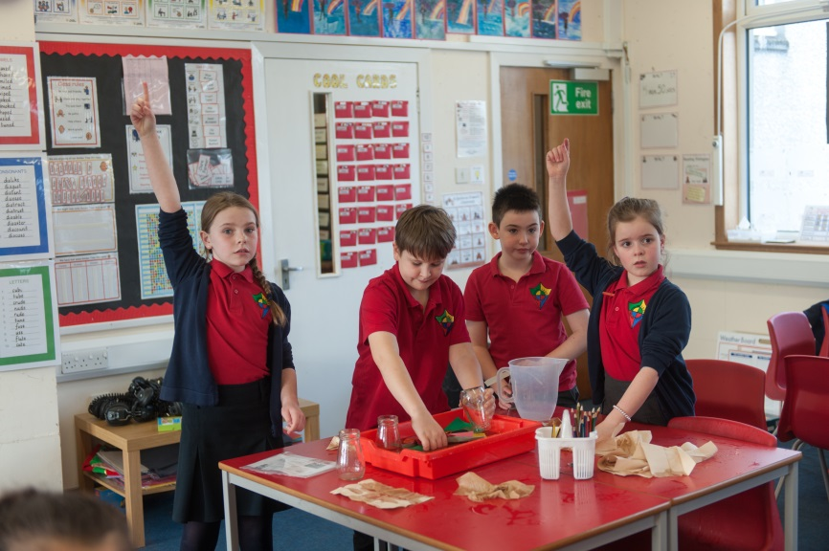
1
2
3
4
Notes:
This is a mixed set showing toy choices, and classroom behaviour.
Potential stereotypes challenged:
Cars and tractors are boys’ toys (2)
Leadership positions are more suited to boys OR girls work well in teams depending on context (3)
Girls don’t participate in class as much as boys (4)
Potential stereotypes illustrated:
Girls toys are pink and cuddly (1)
Girls are bossy (3)
In a practical activity boys will rush to do the practical aspect leaving the girls to clarify learning first (4)

Slide 8
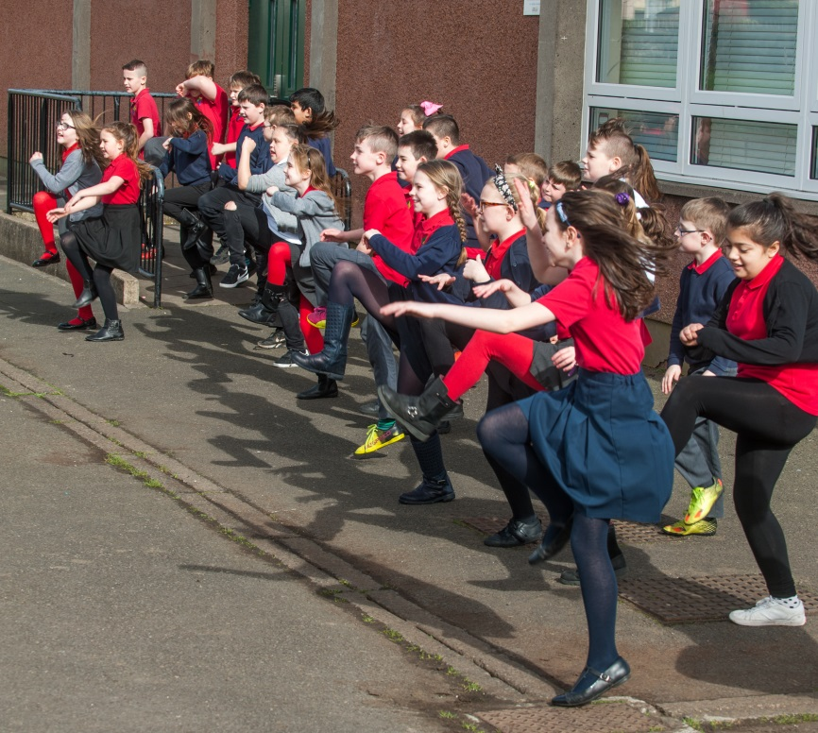
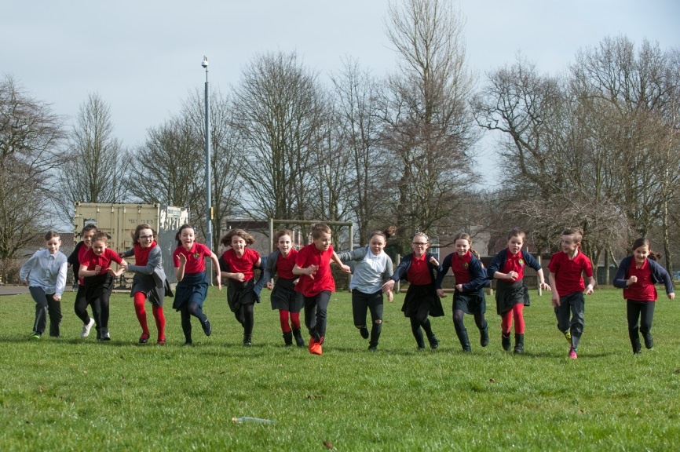
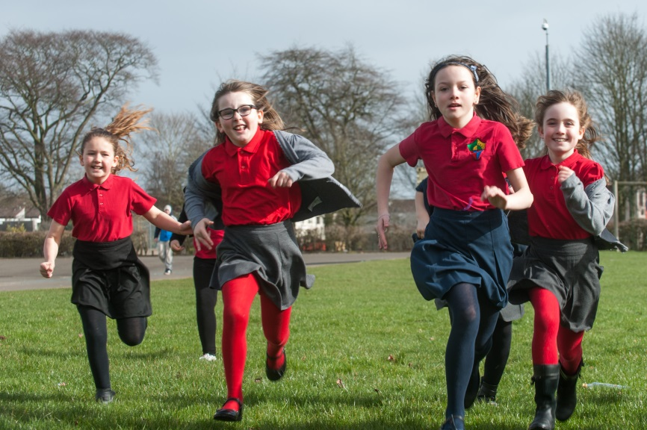
2
1
3
Notes:
This set shows groups of children engaged in active, outdoor activity.
Potential stereotypes challenged:
Girls aren’t interested in PE / being active
Boys and girls have different physical capabilities at primary school

