Slide 1

Pedagogical Leadership in Early Learning and Childcare
Professional Development Resource

Slide 2
How to use this professional learning resource
Think
Discuss
Act
Notes:
Voice over

Slide 3
What is Pedagogy?
“Pedagogy is about learning, teaching and development, influenced by the cultural, social and political values and principles we have for children in Scotland, and by a strong theoretical and practical base.”
“Pedagogy is about the interactions and experiences which support the curriculum and the process of how young children learn.”
Learning and Teaching Scotland (2005) Let’s talk about pedagogy
Scottish Executive
Scottish Government, (2014) Building the Ambition
Edinburgh: Scottish Government

Slide 4

Post a Tweet giving a definition of pedagogy in your own words.
Remember to tag
@Cafteam
and
#ELCleadership

Slide 5
Pedagogy at the heart of the curriculum?
Watch the video clip here: https://www.youtube.com/watch?v=1WwNoW6pY4E

Slide 6
So, what is pedagogical leadership?
Management of the setting
Passion
Delegation
Professional values
Excellent knowledge of how young children and infants develop and learn
Monitoring quality of provision
Sharing good practice
Control of budgets
Reviewing staff forward plans
Notes:
Here are some ideas statements for you to consider. Which of these help to define pedagogical leadership and which can occur without pedagogical leadership being evident?

Slide 7
Pedagogical leadership in practice
Watch the video clip here: https://www.youtube.com/watch?v=ZZBwto00JQo
Notes:
Listen to footage has this helped you in defining pedagogical leadership, can you identify what it is and is not.

Slide 8
So, what is pedagogical leadership?
Monitoring quality of provision
Passion
Delegation
Professional values
Excellent knowledge of how young children and infants develop and learn
Reviewing staff forward plans
Sharing good practice
Management of the setting
Control of budgets

Slide 9
What’s important at Springvale Early Years Centre
Watch the video clip here: https://www.youtube.com/watch?v=adKqVblNxoA

Slide 10
What’s important?
Empowering staff
Shared Vision
Relationships at all levels
Creativity and innovation
Linking research and practice
Effective communication and consultation
High quality learning and teaching
Self-evaluation and monitoring
Positive role models

Slide 11
Actions of a pedagogical leader
Watch the video clip here: https://www.youtube.com/watch?v=dRGjrD3sZBU

Slide 12
Linking research and practice
A pedagogical leader:
Identifies new developments in pedagogy.
Engages in open discussion and exchanges with their colleagues by presenting their ideas in public forums and documents.
Sets the pedagogical agenda by maintaining an awareness of the issues in pedagogy.
Is able to communicate the views and findings of practitioners and researchers to others involved in the ELC field.
Achieves and maintains credibility in both the practitioner and research worlds.
Help researchers and practitioners understand each others’ perspectives and their contributions to the field of ELC.
Katz, L. G. (1997). Pedagogical Leadership. In S. L. Kagan & B. T. Bowman (Eds.), Leadership in Early Care and Education
(23-33). Washington, DC: National Association for the Education of Young Children.

Slide 13
Looking outward
Watch the video clips here:
https://www.youtube.com/watch?v=V2-yDFpa0pE
https://www.youtube.com/watch?v=FfPduQQnEW4

Slide 14
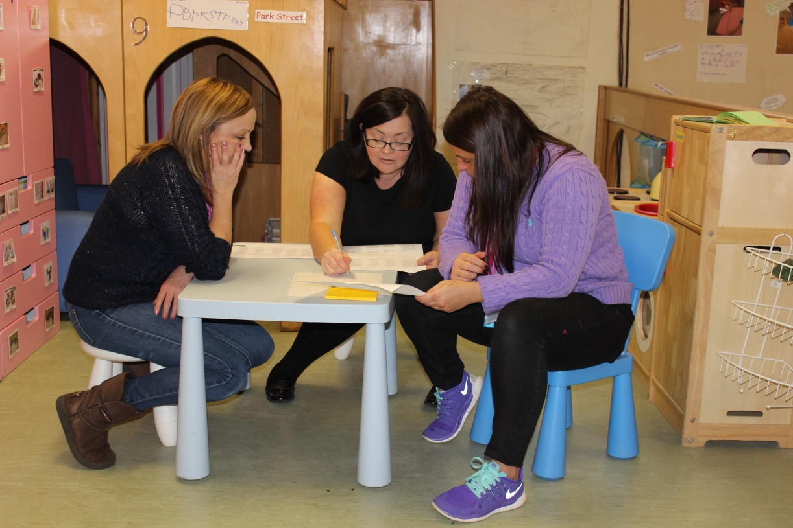
Pedagogical leadership in practice
“I like to think of a pedagogical leader as someone who understands how children learn and develop and makes this happen, taking account of every element of the service from home to school including significant relationships at home, at school and within the wider community.”
O’Sullivan, J. (2009) Leadership skills in the early years: Making a difference. London: Network Continuum Education.
Notes:
Transition to practice. Having thought about some of the theory around pedagogy and pedagogical leadership need to think about how this looks in practice and how we recognise it.

Slide 15
As a pedagogical leader how do you encourage staff to reflect and improve their practice?
Watch the video clip here: https://www.youtube.com/watch?v=-xVKo4DD6Pw

Slide 16
Actions of a pedagogical leader
Leadership of change
Enhance discussions of pedagogy, increasing expertise.
Helps support and develop well thought out innovation.
Self-Evaluation for self-improvement
Creates a strong vision.
Enhances the capacity and commitment of others to change.
Curriculum
Leadership of learning
Sets a good example by striving to provide high quality early learning and childcare.
Creates a strong culture of improvement.
Notes:
You now need to look more closely for these actions in your own practice or setting. To do this, you might use HGIOELC. These are starter QIs that have particular relevance to pedagogical leadership in practice.

Slide 17
How do you know when you are having high quality professional dialogue?
Watch the video clip here: https://www.youtube.com/watch?v=JF9t4Jd-jyU

Slide 18
As a pedagogical leader how do you know staff are meeting the learning needs of all children.
Watch the video clip here: https://www.youtube.com/watch?v=85Ncr0lAk6k

Slide 19
Think
Discuss
Act
Pedagogical leadership is…
Pedagogical leaders are…
Pedagogical leaders can…

