Slide 1
Creative Learning Networks
Regional Improvement Collaboratives
Mapping Tool

Slide 2
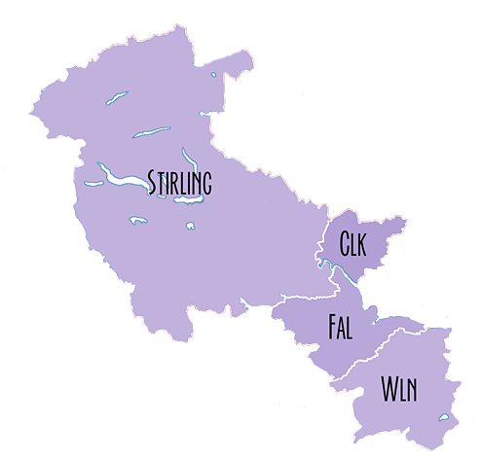
Forth Valley and West Lothian
Collaborative
&
Creative Learning Networks
Forth Valley CLN
West Lothian CLN

Slide 3
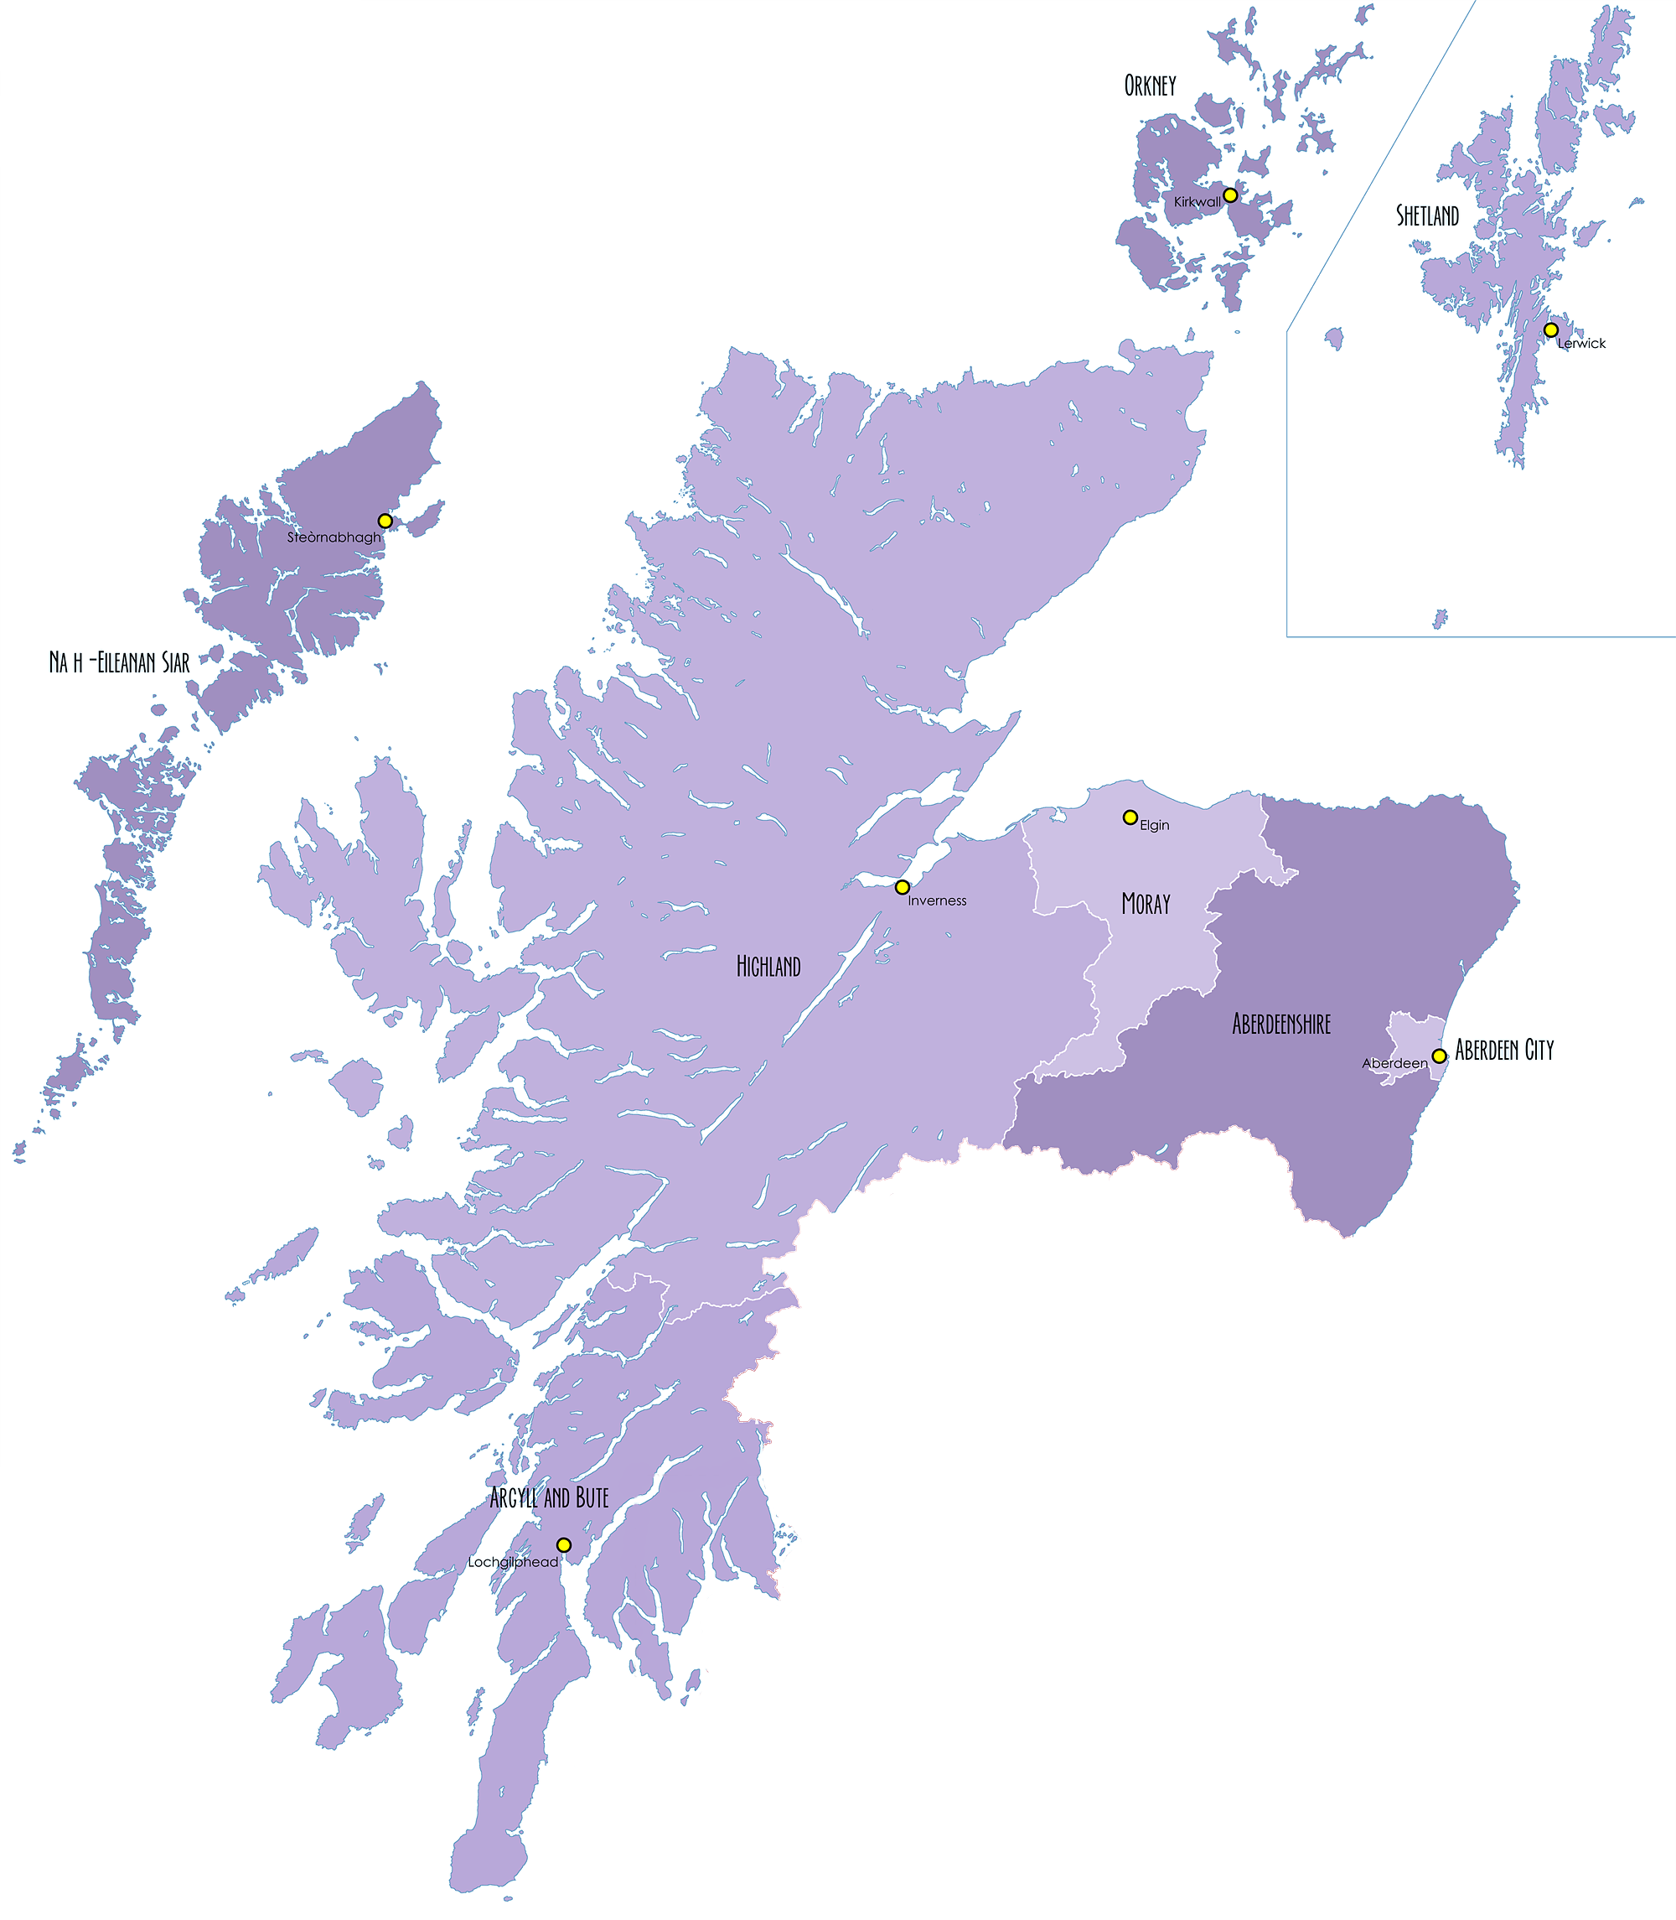
Orkney CLN
Active Contact
Northern Alliance
Eilean Siar CLN
Moray CLN
Highland CLN
Aberdeen City CLN
Aberdeenshire CLN
New Contact

Slide 4
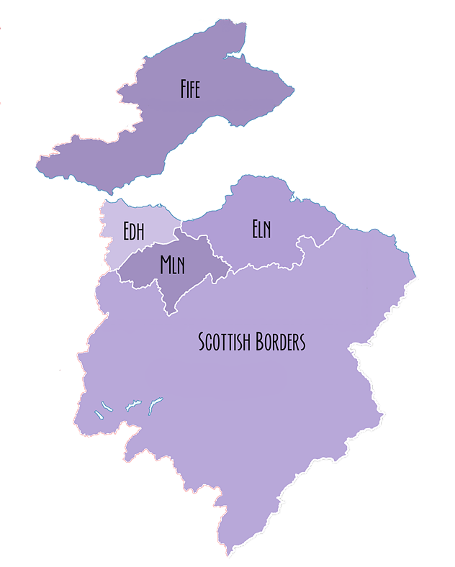
South East Improvement Collaborative
No CLN
Edinburgh, East and Mid Lothian CLN
Scottish Borders CLN

Slide 5
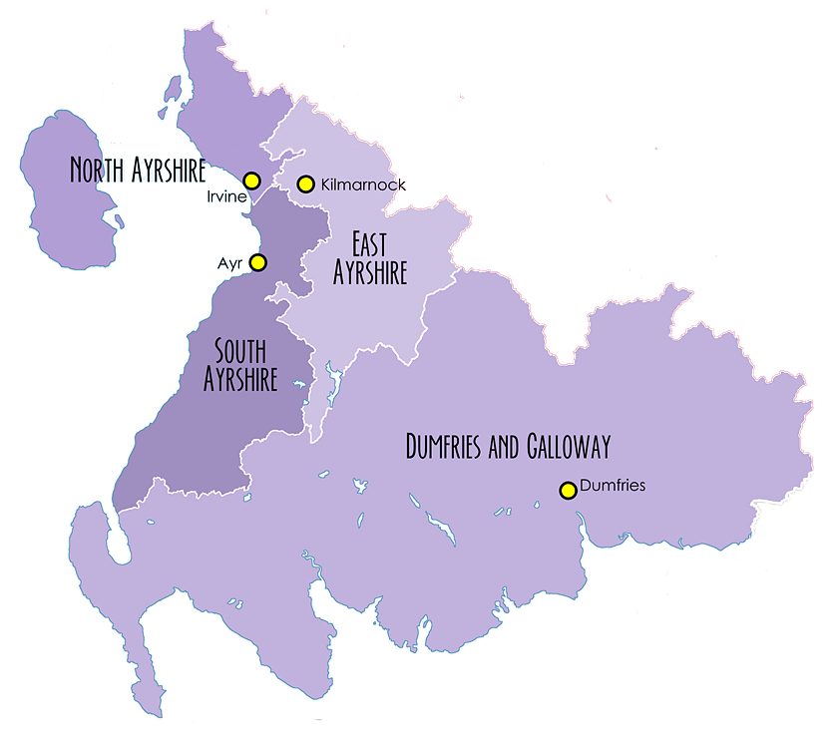
South West Collaborative
North Ayrshire CLN
East Ayrshire CLN
South Ayrshire CLN
Dumfries & Galloway CLN

Slide 6
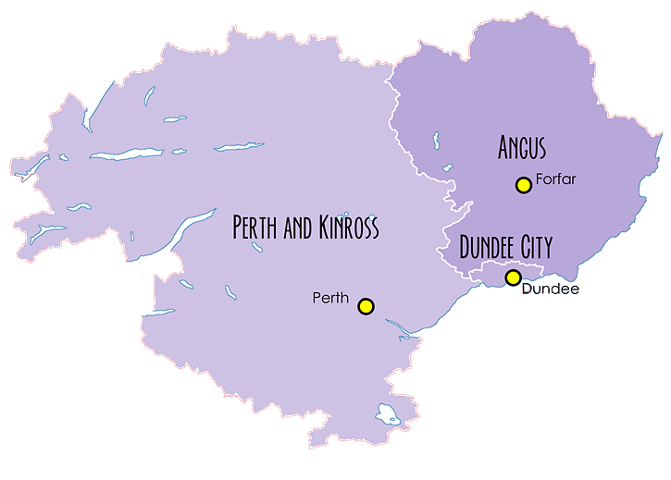
The Tayside Collaborative
Angus CLN
Perth & Kinross CLN
Active Contact

Slide 7
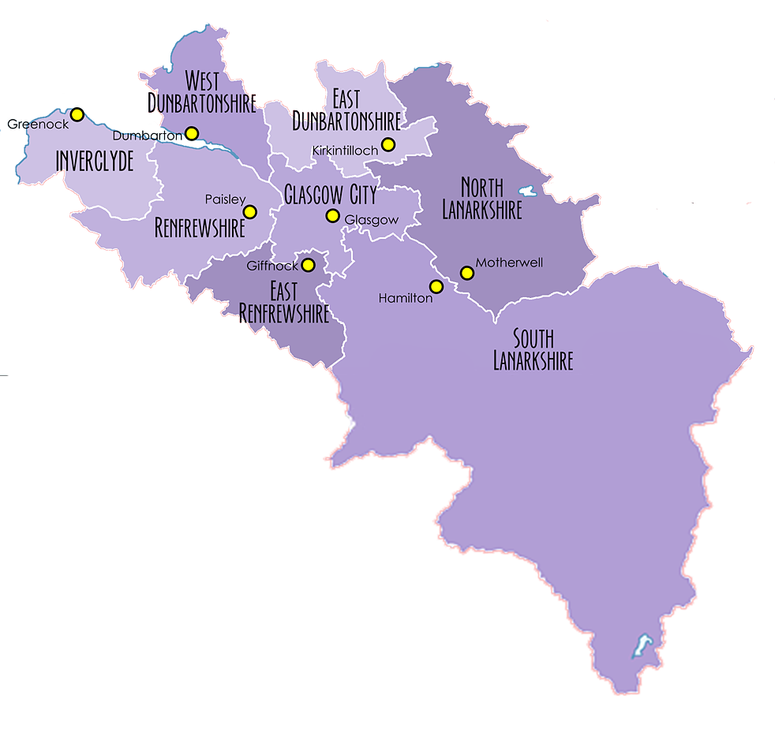
West Dunbartonshire CLN
East Dunbartonshire CLN
The West Partnership
Inverclyde CLN
No Bid
Renfrewshire CLN
Glasgow CLN
No Bid
South Lanarkshire CLN

