Slide 1

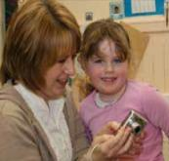
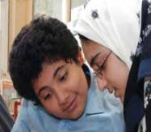



Transforming Learning
Empowering transformational change and leadership at all levels.
Notes:
This short powerpoint sets the context for using the Transforming Learning approach

Slide 2
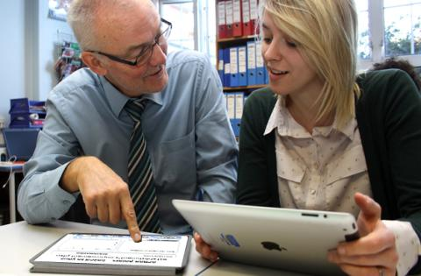
Empowering
transformational change and leadership at all levels.
Notes:
Logo added

Slide 3
The Transformation Learning Approach
The approach can be used to support transformational change actions across all learning
Early Learning and Childcare
Community Learning and Development
Schools
Further Education
Third sector and Training providers
Local Authority
Notes:
Logo added

Slide 4
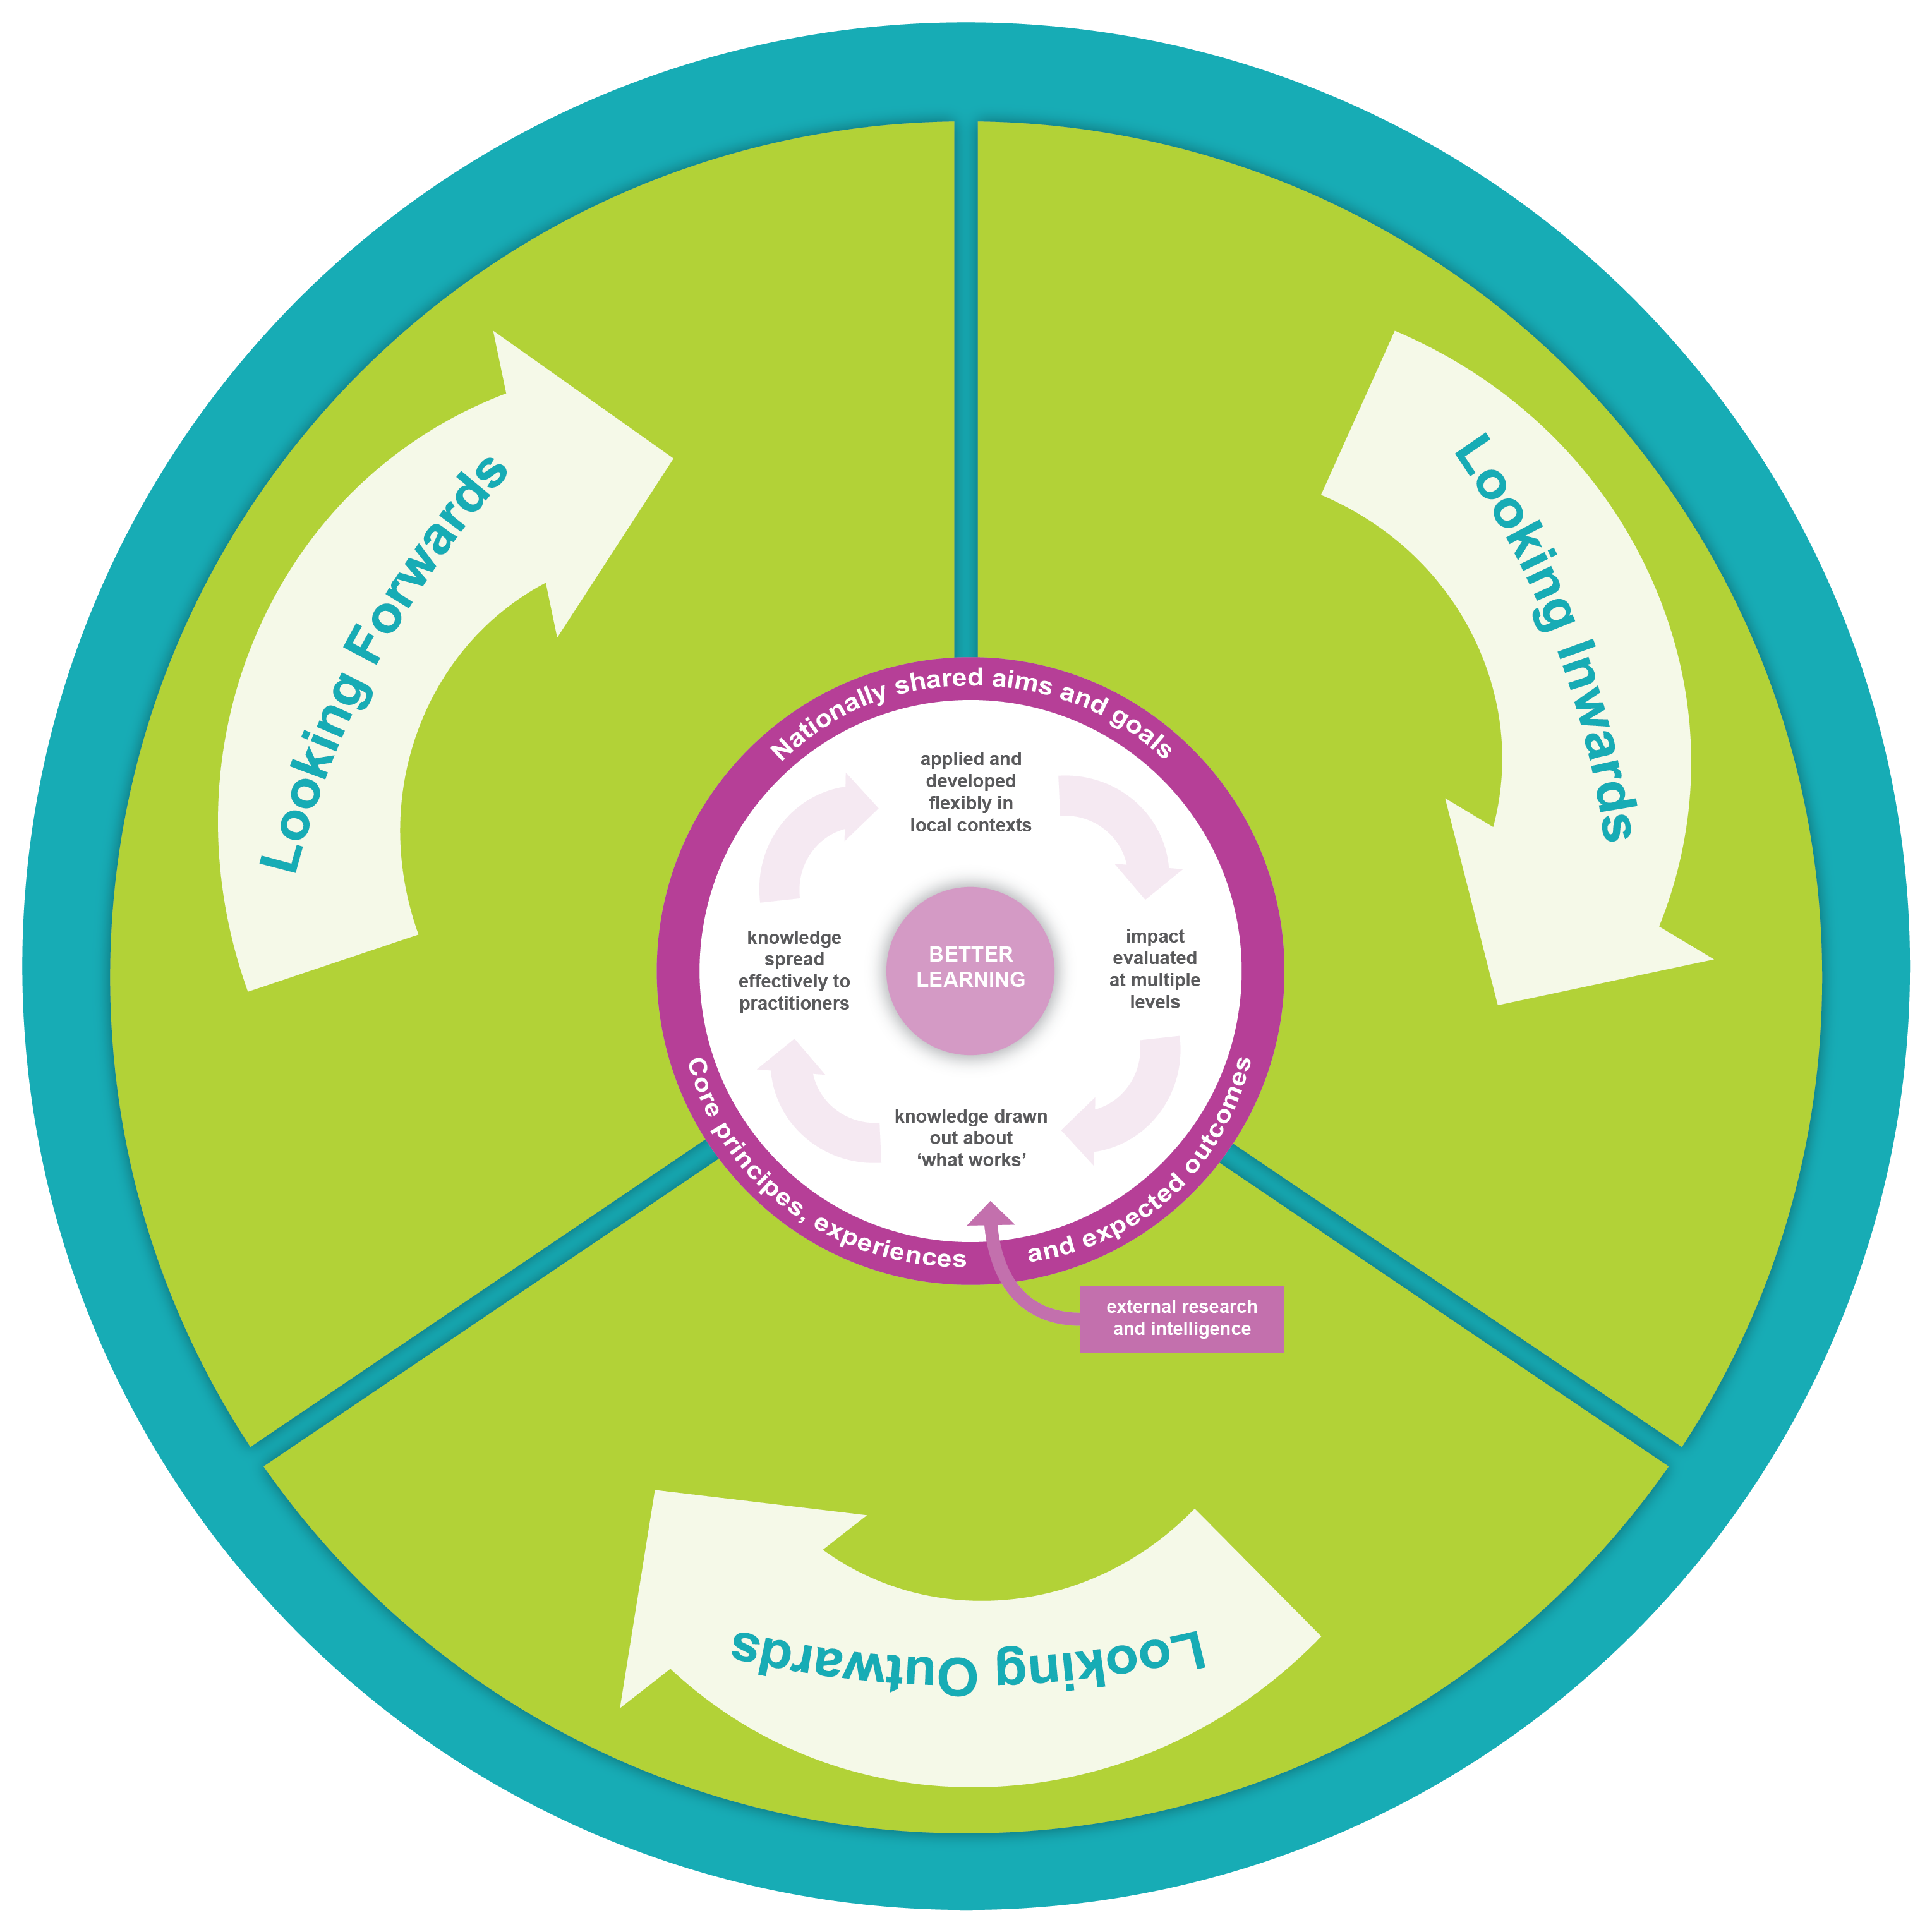
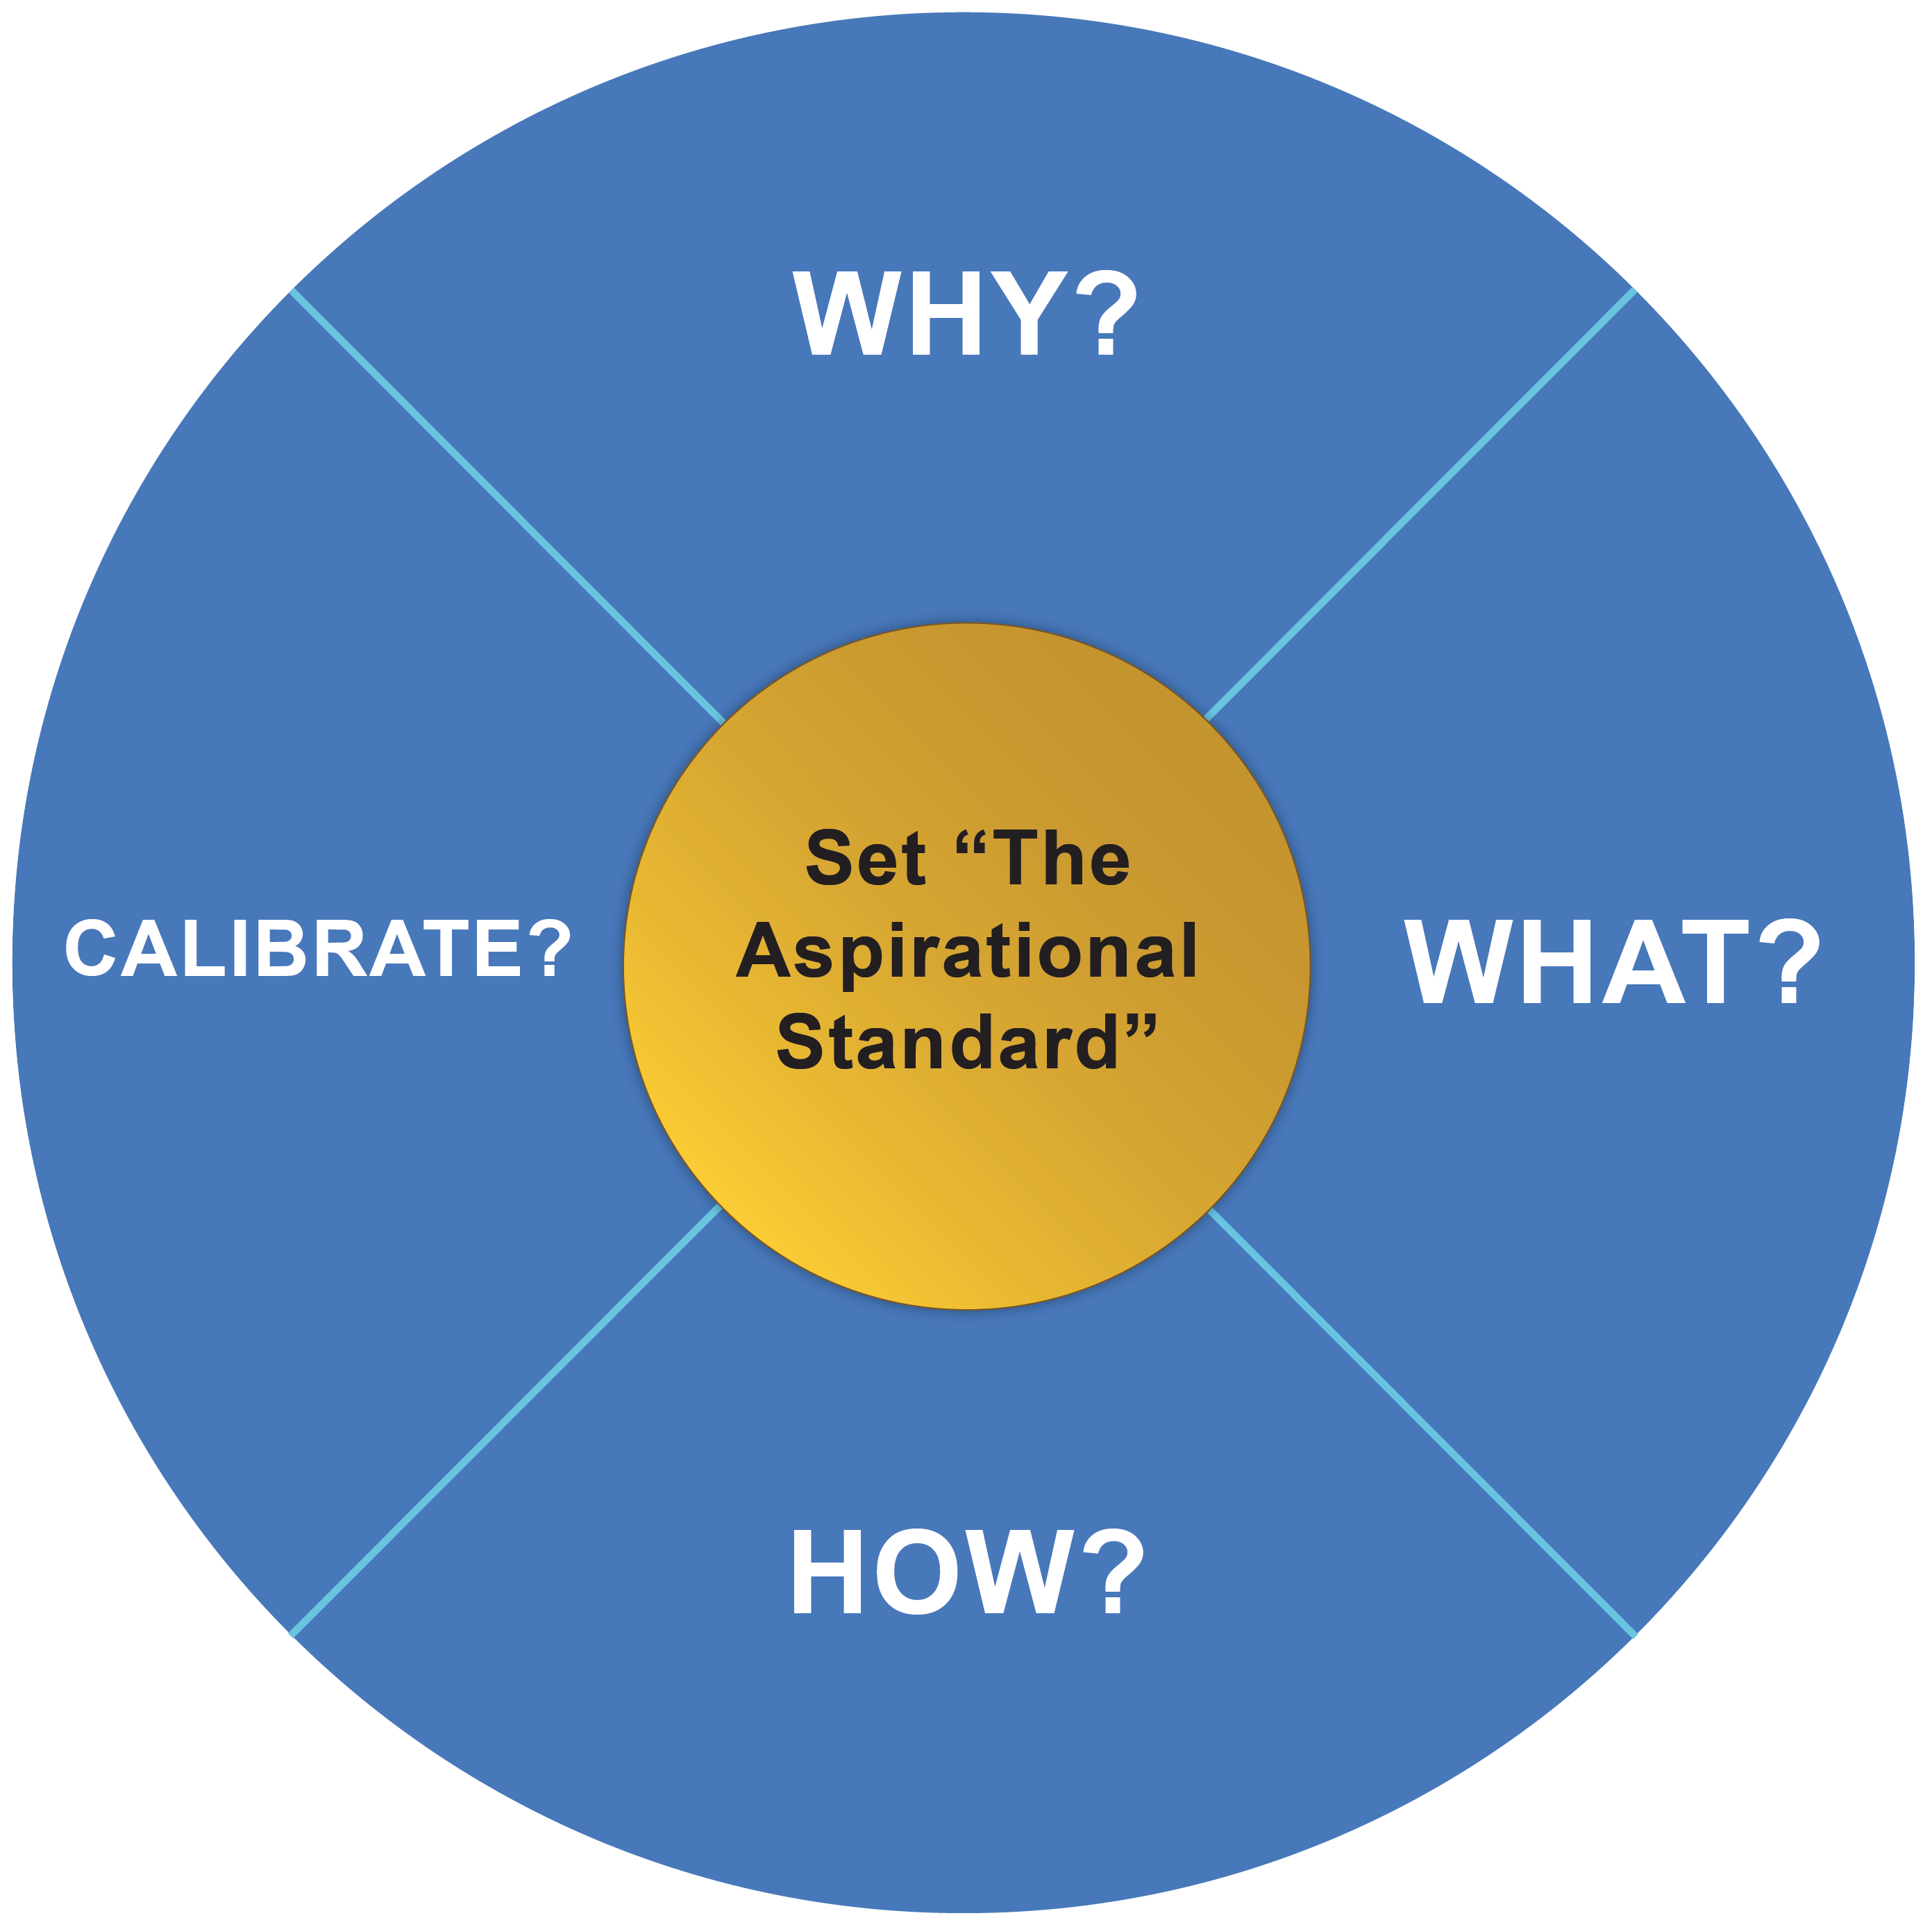
Three change wheels
The Transforming Learning Approach offers a 3 wheels framework which allows practitioners to agree transformational change actions and follow them through to successful completion over 1 to 3 years.

Slide 5
The cycle of self-evaluation and planning
Looking inwards
to evaluate performance at every level and use the information gathered to decide on what needs to be done to improve.
Looking outwards
to learn from research, others and best practice and use this to facilitate innovation and creativity and inform improvement actions.
Looking forwards
to explore what the future might bring and use this information to anticipate what change is required to ensure the education system is responsive to the future needs of all learners.

Slide 6

Types of change and features within change
Transformational change is fundamental change. It can be seen as radical in its approach and stems from a need for improvement in the present system based on incremental and disruptive change happening elsewhere.
Transformational change has a strong focus on what’s happening right now, in the present. It is distinguished by radical breakthroughs in paradigms, beliefs and behaviour.
Transformational change balances critical thinking with the consideration of what is already excellent. It then focuses on all that is possible.
The art of transformational change is to be able to give deep attention to what is worthwhile in an ever changing world.

Slide 7
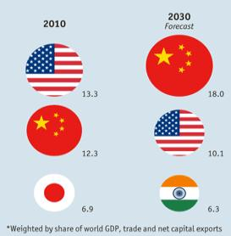

Questions for consideration
Globalisation and the world wide web will empower collaboration across borders.
Will ‘nation’ as both a cultural identity and a source of power diminish?
If China becomes the largest power in the world with both India and Africa building in terms of population and growth, what effect might that have on Scotland?

Slide 8
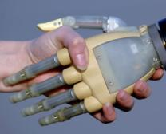


Technology will continue to blend in with our lives and become ever more intuitive.
Already available tools, including wearable technology, will interpret and anticipate the world for us more actively than ever.
Technology will become more and more personalised: ‘The Internet of Me’.
How might this impact on, for example, health, privacy, handwriting, language learning and how we use our memory in the future?

Slide 9

Driver-less cars are already legal in four US States and UK trials began in 2015.
Publicly available when ?
Could we see children driving themselves to school?

Slide 10

The UK will have at least one Spaceport in the next 5 years, opening up a brand new industry to the UK.
Scotland has almost all of the viable locations.
Could travel times to distant destinations be cut dramatically to bring us even closer to the rest of the world?
Could Canberra, Australia be a very short journey and what are the implications of that?

Slide 11

























Early level
Senior phase

Slide 12
Totality of the Scottish Curriculum - broad, wide and progressive
Values
Wisdom, justice,
Compassion, integrity
The curriculum
Ethos and life of the school…
Curriculum areas and subjects
Interdisciplinary learning
Opps for personal achievement
Effective teaching and active, sustained learning
Experiences and outcomes
Expressive arts
Languages and literacy
Health and wellbeing
Mathematics and numeracy
Religious and moral education
Sciences
Social studies
Technologies
The curriculum includes Entitlements e.g.
Coherent curriculum 3 to 18
Broad general education from age 3 to
the end of S3
Senior phase: opportunities for qualifications and other opportunities to develop the four capacities
Skills for learning, work, life
achieve to highest levels
Positive / sustained destinations
Personal Support
Review of learning / next steps
Learning activities - meet needs
Ops for personal achievement
Changes / choices MCMC
Pre-school / schools working with partners
Principles for planning
Challenge and enjoyment
Breadth
Progression
Depth
Personalisation and choice
Coherence
Relevance
Arrangements for
Assessment
Qualifications
Self-evaluation &accountability
Professional development
Support the purposes of learning
Notes:
12

Slide 13

Are we able to follow our own motivations?
Is everything that can happen, happening in Curriculum for Excellence?
“Practitioners are the key.... The quality of learning and teaching in every setting – and the inspiration, challenge and enjoyment which can come from practitioners’ enthusiasm and commitment – will be critical to achieving our aspirations for all young people.”
Building The Curriculum 1

Slide 14


Cross-sector career-long
professional learning
Learning through high quality engagement with other colleagues across all sectors

Slide 15


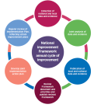




The Transformation Learning Approach
The approach supports the following work:
Excellence through raising attainment: ensuring that every child achieves the highest standards in literacy and numeracy and the right range of skills, qualifications and achievements to allow them to succeed; and
Achieving equity: ensuring every child has the same opportunity to succeed. The Scottish Attainment Challenge will help to focus our efforts and deliver this ambition
The approach complements work completed for:
NATIONAL IMPROVEMENT FRAMEWORK

