Slide 1
DYW Groups
Regional Improvement Collaboratives
Mapping Tool

Slide 2
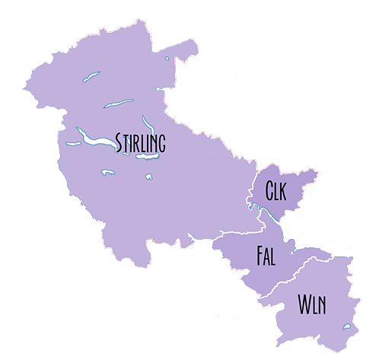
Forth Valley and West Lothian
Collaborative
Forth Valley DYW
West Lothian DYW

Slide 3
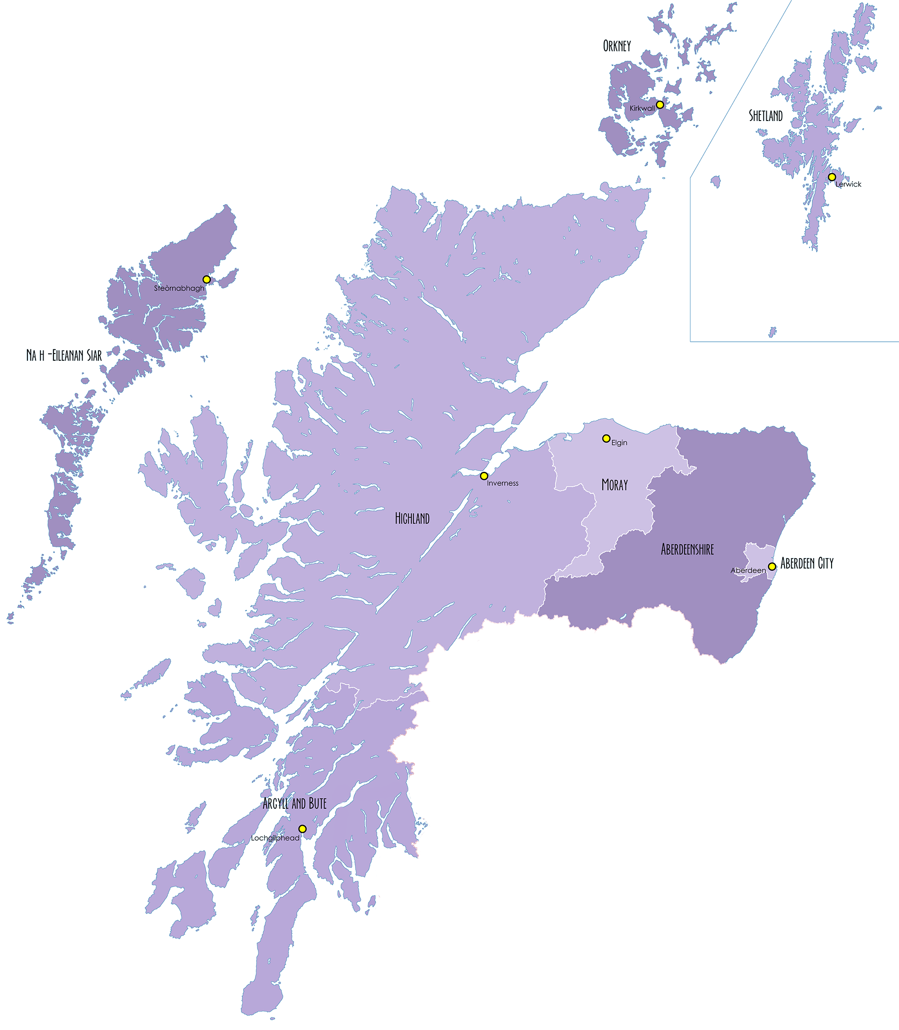
Orkney DYW
Shetland DYW
Eilean Siar DYW
Northern Alliance
Inverness & Central Highland DYW
Moray DYW
North East DYW
(Aberdeenshire and City)
West Highland DYW
Argyll & Bute DYW

Slide 4
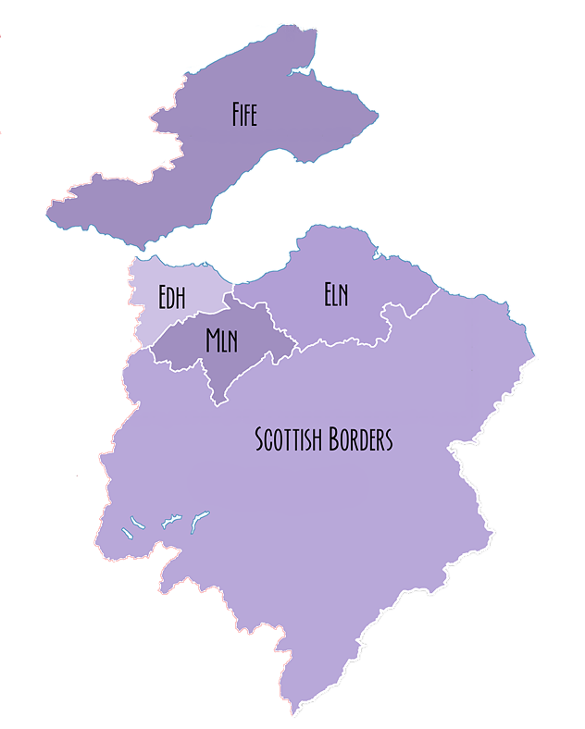
South East Improvement Collaborative
Fife DYW
Edinburgh and Lothians DYW
Borders DYW

Slide 5
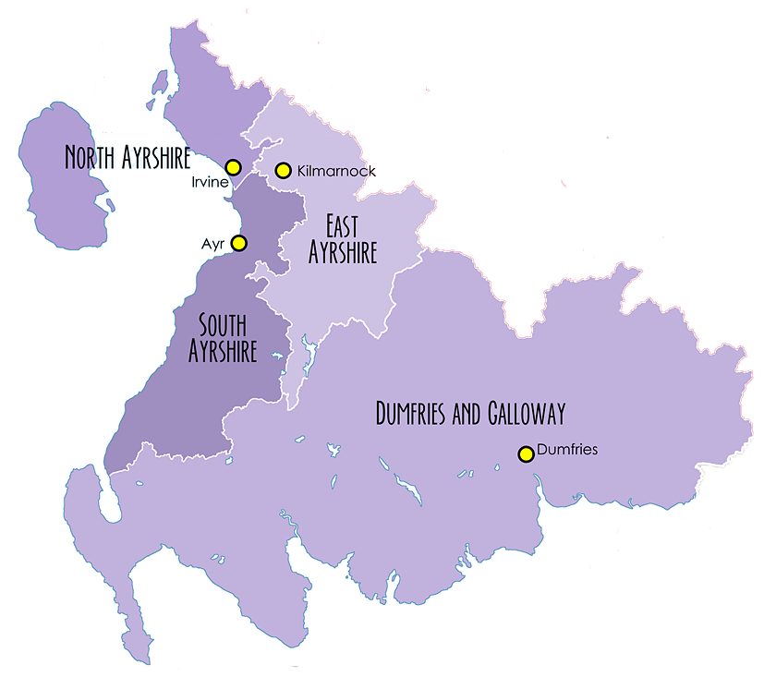
South West Collaborative
Ayrshire DYW
Dumfries and Galloway DYW

Slide 6
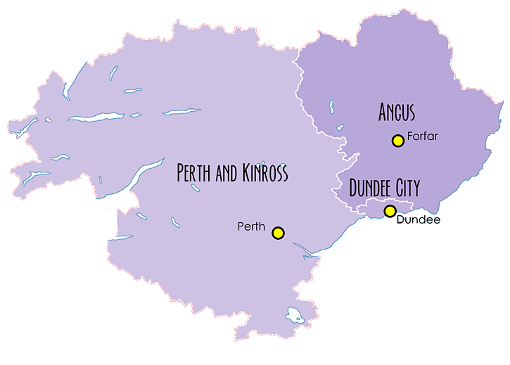
The Tayside Collaborative
Dundee and Angus DYW
Perth & Kinross DYW

Slide 7
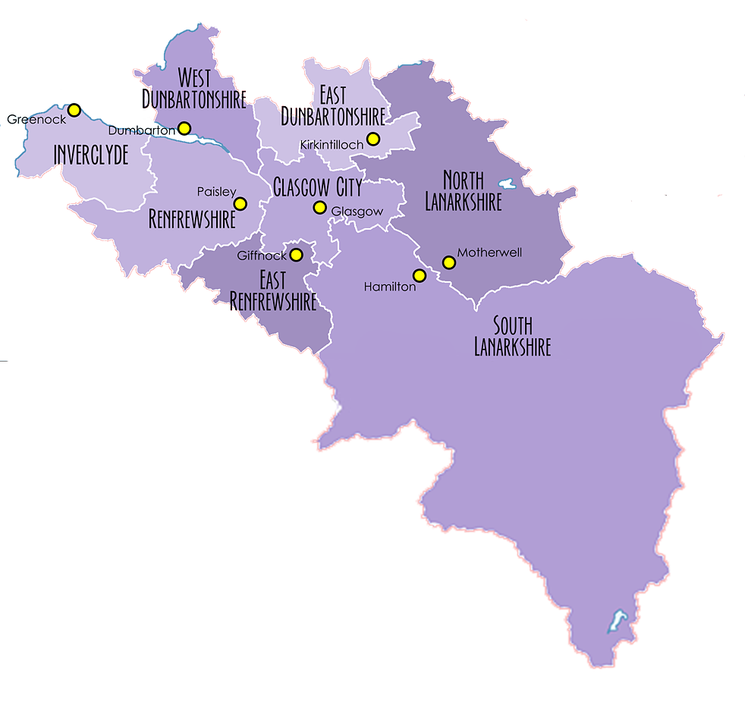
The West Partnership
Glasgow DYW
West Region DYW
Lanarkshire DYW

