Slide 1
Building Connections through PACE
Created by Argyll and Bute Educational Psychology Service
Notes:
How to use this resource​:
This professional learning is suitable for anyone working with children, young people and adult learners in an educational context.
Slides can be used to facilitate professional learning in a group or whole-setting, or as a self-directed learning activity as an individual.​
Facilitation notes are included at the bottom of each slide​. Please do not remove or change any of the slides included.​
You are welcome to add slides or activities relevant to your own setting, to support discussion and exploration of the topic. You will know participants’ needs best.​
Anyone who works in an educational setting can be a facilitator and use these slides. For reflection or discussion activities, it is important to establish a safe space which encourages respect and honesty to ensure that everyone can participate. ​
More information on using Inclusion, Wellbeing and Equalities Framework resources is available on the education Scotland website (link on the slide)
These slides can be used to facilitate professional learning in a group or whole-setting, or as a self-directed learning activity as an individual. ​
Facilitation notes are included at the bottom of each slide ​
Please do not remove or change any of the slides included. ​
Facilitators are welcome to add slides or activities relevant to your own setting, to support discussion and exploration of the topic. Facilitators will know their participants’ needs best. ​
Anyone who works in an educational setting can be a facilitator and use these slides. ​
For reflection or discussion activities, it is important to establish a safe space which encourages respect and honesty to ensure that everyone is able to participate.​
​
FACILITATION NOTES can also be found on a separate Word document on the Education Scotland Inclusion, Wellbeing and Equalities Professional Learning Framework.

Slide 2
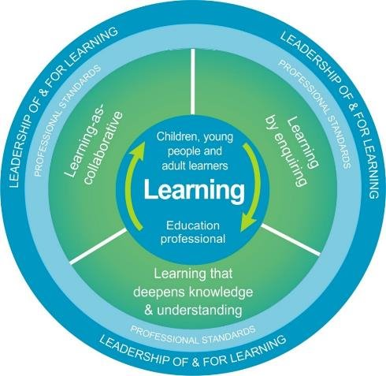
National model
This professional learning resource This professional learning forms part of the national model for professional learning and is designed to help you gain more knowledge and have a deeper understanding of inclusion, wellbeing and equalities​​. On completion of this professional learning, you will be asked to consider what your next steps will be​​.
The national model of professional learning (education.gov.scot)
Notes:
This professional learning resource follows the national model for professional learning and is designed to help you gain more knowledge and have a deeper understanding of inclusion, wellbeing and equalities.​
You will have the opportunity to consider how to take this learning forward on your own and with others and, on completion of the professional learning, you will be asked to consider what your next steps will be. ​
Please take some time to consider the reflective questions at the end of this resource
This session provides an opportunity to:​
Raise awareness of prejudice-based behaviours and hate crime in education settings.​
Increase confidence in identifying early signs of prejudice-based behaviours and hate crime.​
Develop an understanding of what to do when prejudice-based behaviours and hate crime occur, including how to report them and support those affected.
The resources listed can also support understanding, preventing and responding to hate crime and prejudice-based behaviours and:
Bias and Inequality (to help prevent hateful behaviours)​
Impact of Inequality (to understand the impact of hateful behaviours)​
Talking about Diversity (to support conversations about prejudice and diversity)​
Develop your Religious Literacy Parts 1 and 2 (to support an understanding and prevention of religious-based prejudice and hate)​
Mirrors and Windows: Diversity in the Curriculum (to prevent and address the development of prejudice through the curriculum)​
Relational Approaches (to support trauma-informed, restorative and solution-oriented approaches)​
Active Listening​
Co-regulation and de-escalation (to help manage conflict between individuals)​
Expectations and Consequences (to help prevent hateful behaviours and crime)​

Slide 3
Development of this resource
This work has been developed by Argyll and Bute Educational Psychology Service to support the Inclusion, Wellbeing and Equalities professional learning framework.

Slide 4
Welcome
This session provides an opportunity to reflect on:
PACE Principles
PACE in Action
Prior Learning
The following Informed Level modules offer a solid foundation for this module:
Attunement
Self-Regulation
Co-regulation and De-escalation
Regulate, Relate, Reason & Restore
Window of Tolerance

Slide 5
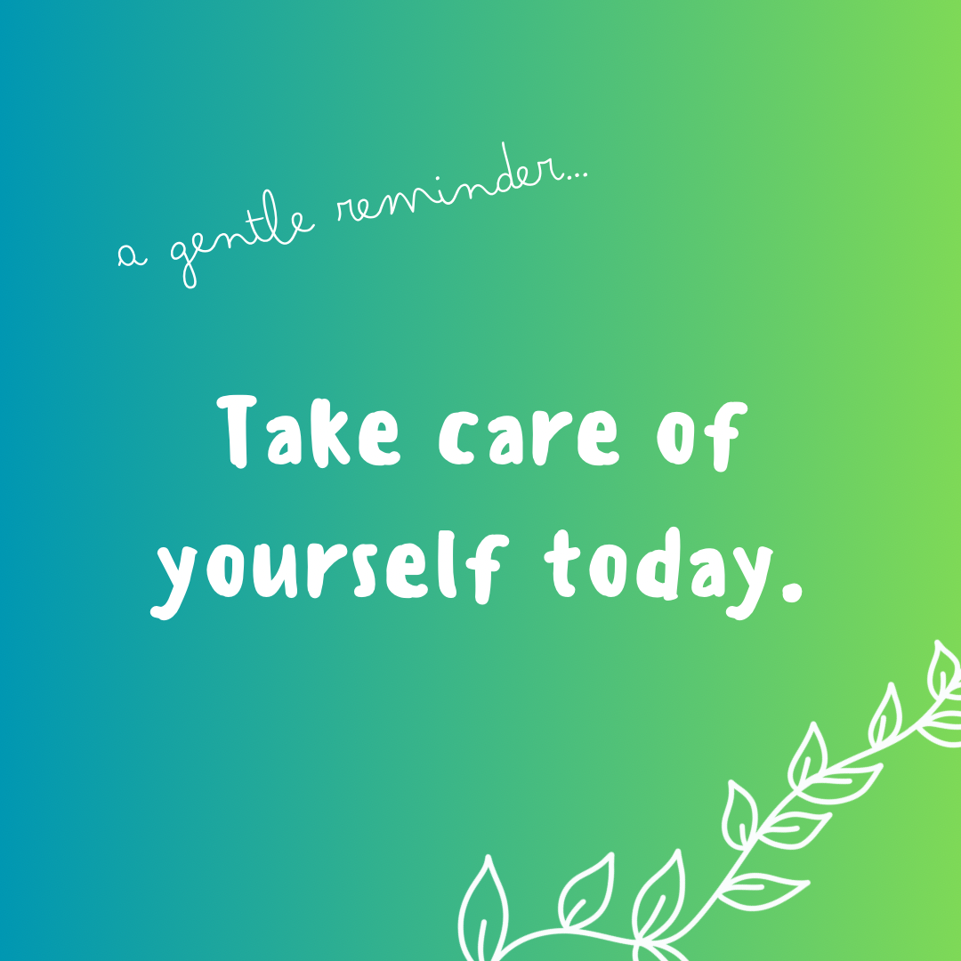
Self-Care
During this module, please remember to take care of your own well-being.
Notes:
During this module, please remember to take care of your own well-being.
We all have our own story to tell, and discussing certain topics might cause your mind to wander, recalling and reflecting on personal experiences which may be positive or unsettling. This is perfectly normal.
So, if you need a break, please take one!

Slide 6
PACE
PACE was developed by clinical psychologist, Dan Hughes.
“It is a way of thinking, feeling, communicating and behaving that helps a child feel safe. It helps to promote secure attachments and enables a child to reflect on their thoughts and behaviours without being judged.”
PACE - A Therapeutic Approach - Help Children Live Better
Playfulness
Acceptance
Curiosity
Empathy

Slide 7
Promoting connection
PACE is a way of engaging with others to promote connection by:
  Increasing levels of understanding and emotional support
  Developing secure relationships
  Supporting the co-regulation of emotions
  Reducing the impact of stressors
When we hold the attitude of PACE, we will naturally talk in a more lilting, rhythmic voice that is more like storytelling than lecturing.
Playfulness
Acceptance
Curiosity
Empathy
Notes:
PACE should be a habitual way of engaging with pupils, but also parents, staff and the wider learning community to promote connection and engagement whilst also supporting both de-escalation and co-regulation.
It recognises that the words we speak only attribute to 7% of our communication. A reassuring tone of voice and non-threatening body language are vital to ensure the conversation remains open and engaged.
While PACE is best understood as a whole approach, it is also important to consider each principle separately. Golding et al describe it as being like learning to drive a car. It is vital to know all the different actions you will need to take, but once it is routine, part of daily life, the individual components disappear as you combine them all effortlessly to successfully drive the vehicle. The ‘whole’ will emerge and the ‘parts’ recede into the background.

Slide 8
Playfulness
Both in actions and tone of voice.
  Builds security, promotes connection and develops relationships
  Brings joy and a sense of fun
  Diffuses difficult or tense situations
A child can’t experience shame when being happy and joyful.
Trauma shuts down the capacity for intimacy and play (Porges, 2017)
We must be attuned to what our pupils can accept in terms of playfulness – it may not be needed or appropriate.
Playfulness
Acceptance
Curiosity
Empathy
Notes:
When we play with children, we create connection and a sense of safety because there is shared interaction, enjoyment and fun. This positive relational experience acts as a protective factor, building trust as the pupil enjoys feeling connected.
Children who laugh and experience joy can also become less defensive or withdrawn as it engages the parasympathetic nervous system – which helps put the brakes on their fight or flight response. It can lead to the child experiencing themselves as delightful, enjoyable, and of having value.
So, for all our pupils, but especially those who are most vulnerable, it’s important to create opportunities for play such as a game of football at lunch time, sharing a card game during soft start or whole class bingo.
However, playfulness is not just about moments of structured play. Playfulness can be reflected in small gestures such as a hi-five greeting or in our conversations. Using a light, story-telling tone with your voice rather than an irritated tone when you communicate creates an atmosphere of lightness and interest. It can also diffuse a difficult or tense situation, reducing the likelihood of a child feeling shame and help to restore connection if there’s been any prior conflict or separation.
Some children are wary of connection and playfulness, especially if they lack a secure attachment to a key adult, so it may take some time to be reciprocated. Some children may not appreciate humour and can become frustrated when an adult doesn’t seem to be taking their feelings seriously, so knowing your children is very important. We must be mindful that having a playful stance isn’t about being funny all the time or making jokes. Nor should it be used to avoid difficult feelings and genuine frustration.

Slide 9
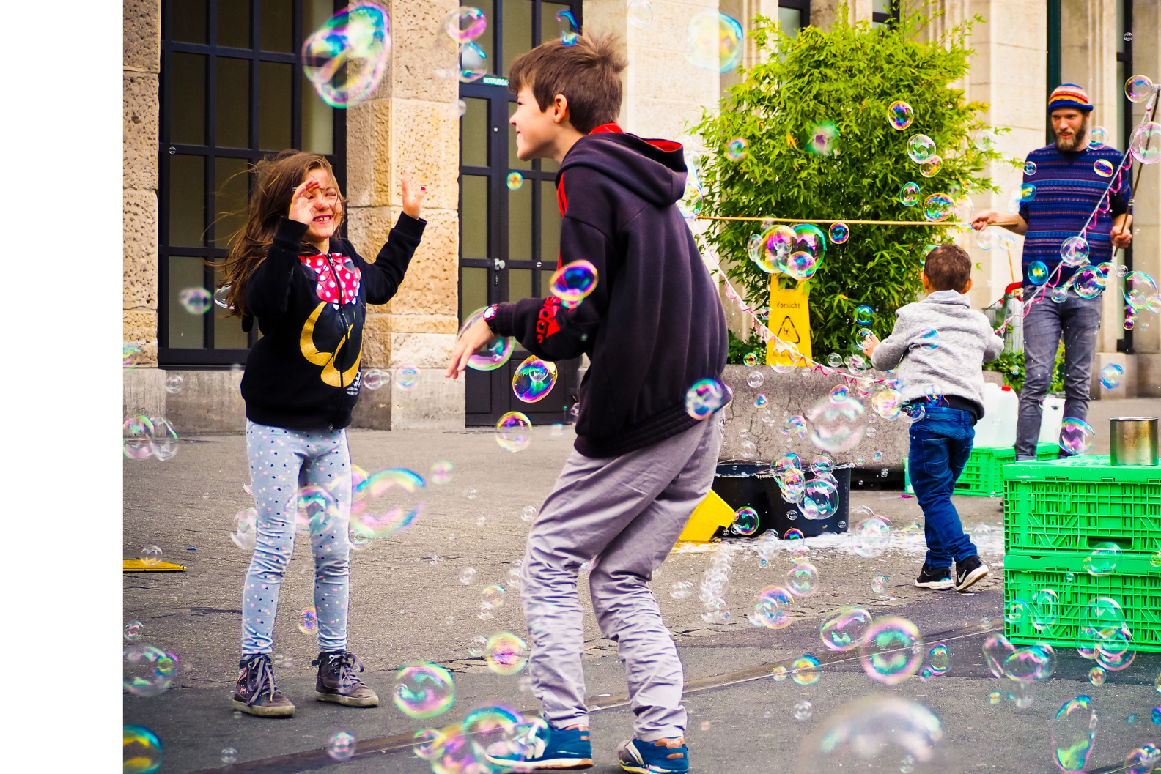
Playful moments
“Playful moments can provide an oasis in a day that feels like a walk through a desert – hard, tiring and with little end in sight. Holding on and treasuring the playful, fun times can carry the staff member and pupil a long way through the desert.” (Golding, Phillips & Bomber, 2021)
Playfulness
Acceptance
Curiosity
Empathy
Notes:
It is important to note that playfulness may not come into your interaction at all, if there is an emotional ‘emergency.’
In a physical, medical emergency – where do you go? Usually to Accident and Emergency – A&E. It is just the same in an emotional emergency we may need to go to A and E first. Acceptance and Empathy.

Slide 10
Acceptance
Validates feelings without judgement
Recognises the emotional experience behind behaviour
Does not accept harmful behaviours
Understands the child’s experiences shape their thoughts
Understands that distressed behaviour is an adaptive response to feeling unsafe
Communicates that behaviour makes sense and that there is no emotional experience that we can’t accept and come to understand.
Playfulness
Acceptance
Curiosity
Empathy
Notes:
Unconditional acceptance is at the core of developing a child’s sense of emotional safety. Acceptance of how a child feels, without judgement is hugely impactful. When our feelings are validated it releases the feel-good hormone, dopamine, so it enables the child to feel seen and heard which opens up the possibility for understanding the ‘why’ behind the behaviours.
A child’s feelings will be affected by their experiences and as a result may be perceived rather than ‘real.’ This can be hard, as it means sitting with some strong emotions, together. It can be painful, uncomfortable or even frustrating, but also very powerful. If a child expresses distressing emotions about themselves or others (e.g. “nobody loves me”, “I’m stupid”, “I’m bad”, “you hate me”) it is hard not to challenge them as being wrong, but it is really important to accept those feelings and acknowledge them with curiosity and empathy.
We often hear behaviours or actions being described as “unacceptable”. Acceptance in relation to PACE is the unconditional acceptance of the emotional experience that lies behind behaviour. So we do not accept harmful behaviours in favour of ‘making the child feel better’, but in a significant moment, usually of dysregulated behaviour, it is about acknowledging the relevance of a pupil’s thoughts and feelings.
We can accept that a pupil is angry, but not accept the throwing of furniture or destruction property. We can accept that the pupil thinks that the teacher doesn’t like the pupil, without accepting the pupil swearing at the teacher.
The restoration and resolution that is required after a child has displayed distressed behaviour can be addressed when the child is able to engage their pre-frontal cortex, relate to the adult and process the events that have occurred.
Typically the education system has operated by trying to change the behaviours through behavioural methods – reward good behaviours and punish negative ones. If we understand and accept that the behaviour we find challenging is actually an adaptive response to feeling unsafe, then trying to change behaviours through reward and punishment is akin to playing whak-a-mole! If we are to change problematic behaviours we have to change the experienced sense of safety and to accept that underlying emotional experiences of shame, fear, anxiety and rage drive challenging behaviour.
We need to find a way that communicates their behaviour makes sense given their underlying experiences and that there is no emotional experience that we can’t accept and come to understand. So, what does this look like in practice?

Slide 11

Acceptance: receiving angry and negative statements
I can see that it feels like I am really cross with you, that is a really difficult feeling to have. I wonder if that is really scary and that you feel you would be better off outside the classroom. Although it doesn’t feel like it, I really want you in my classroom.
You’re angry and you don’t want me in your class.
It is really hard to feel that I am cross with you, that is such a scary feeling.
Using PACE in School (oxfordshire.gov.uk)
Notes:
When children make negative statements about themselves or you, for example,
‘You’re angry and you don’t want me in your classroom’
It is tempting at this point to reply with a practical response which may or may not be true.
‘I’m not angry and of course I want you to be here’
The PACE alternative would go something like this.
‘I can see that it feels like I am really cross with you, that is a really difficult feeling to have. I wonder if that is really scary and that you feel you would be better off outside the classroom. Although it doesn’t feel like it I really want you in my classroom.’
If this is too much to say to a child who at that moment is very distressed use the Emotional A and E response
‘It is really hard to feel that I am cross with you, that is such a scary feeling.’
Take a moment to read this extract taken from Using PACE in School (oxfordshire.gov.uk) The link to this document in full is included in the resources page of this webinar.
Can you identify the phrases which promote Acceptance?
Pause the webinar here for reflection or discussion.

Slide 12
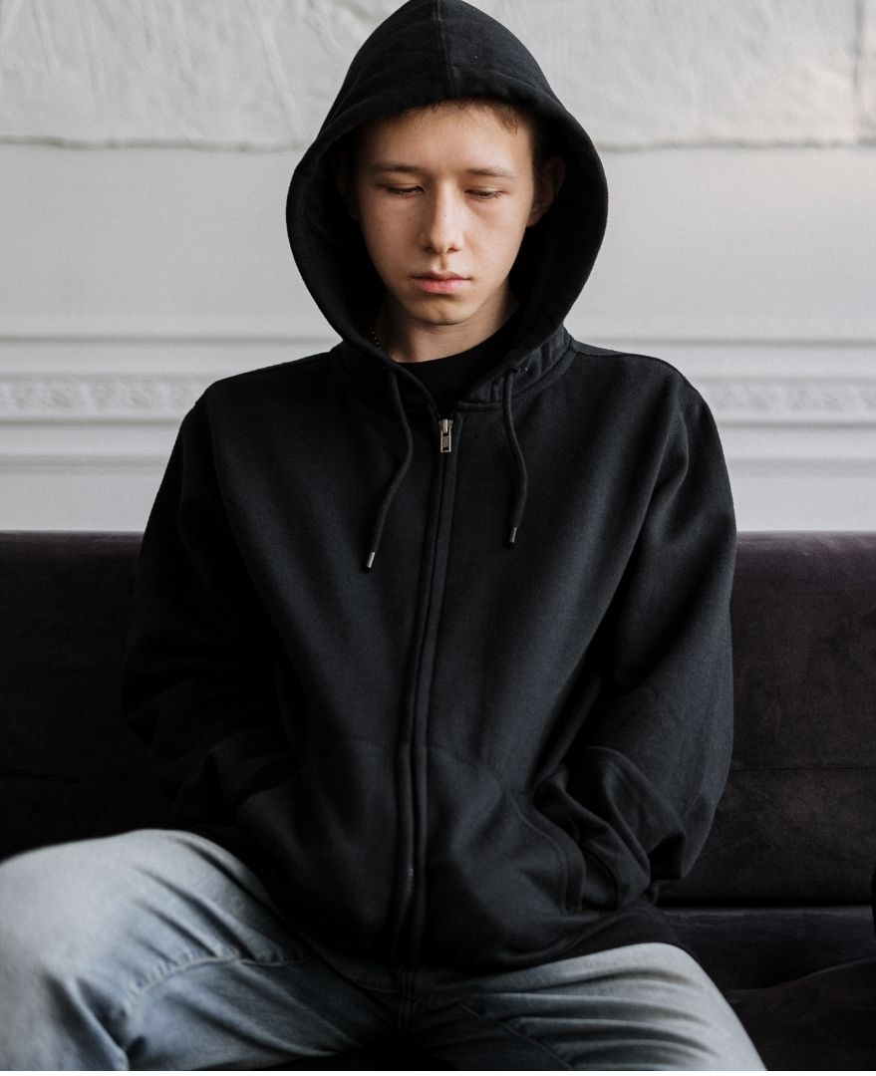
Acceptance Example
Notes:
The child is perceiving that the adult is angry. The child is also trying to convey that they perceive a sense of rejection. Neither may be true, but to enable the child to feel a sense of safety the adult needs to acknowledge those big feelings. Disagreeing, dismissing or reprimanding the child for being ‘rude’ could cause the child to become more dysregulated as their fight/flight response is triggered.
Traumatised children are often unable to separate their behaviour from who they are. So a statement like ‘We love you, but we don’t love your behaviour’ would be a very difficult concept for a child to understand.

Slide 13
Acceptance in Action
I am sorry you feel that way.
That must be such a difficult thing to feel.
Those are really big emotions.
I can see why it would make you feel like that.
It must be worrying to think that…
I am here for you when you are ready.
Playfulness
Acceptance
Curiosity
Empathy
Notes:
Whilst we want PACE to be based on authentic interactions and to avoid it feeling scripted, it can be helpful to have some sentence starters as prompts as you practice embedding the approach.
“It must be so frustrating to think the classroom rules are stupid. You must feel so angry having to spit your last piece of chewing gum in the bin. I can see why you would feel like that.”
After a pause to prevent overwhelm and remembering to keep a light tone.
“Wow, it’s really tricky for you to put that in the bin. Remember I am here to help you.”
After another moment of pause to give the child opportunity to communicate or act - if it feels appropriate to bring in playfulness.
“Hey, how’s your basketball skills? Here’s a tissue, pop your chewing gum into the tissue, I’ll hold the bin here and you try and throw it in. Ready, set, go!”

Slide 14
Curiosity
Is an act of discovery that can lead to responsive, non-judgemental care
Helps children to reflect and communicate what lies behind the behaviour
Avoids promoting shame and fear
Strengthens connections in the brain to support self-regulation and self-reflection
Enables the adult to slow down and avoid making judgements
Wondering out loud can bring in playfulness
Playfulness
Acceptance
Curiosity
Empathy
Notes:
Curiosity without judgement is how we help children to reflect and communication. Like acceptance, it is another component in helping a child feel safe. Given that all behaviour is communication, we need to be curious about what the child’s behaviour is telling us about their underlying experiences – their thoughts, feelings, wishes, fears and insights.
Children often know that their behaviour was not appropriate, they don’t need to be reminded or lectured! What they might not know is why they responded that way. As they become more aware, they become better able to self-regulate. As we become more aware, we are better able to co-regulate.
Experience suggests that there are some consistent emotional themes that underlie a vast array of challenging behaviours in our children and young people. Shame and fear would be among the top three.
However there are many possibilities for shaping a child’s beliefs, perceptions, thoughts and emotional experiences that we need to slow down and never assume that we understand why our pupils act as they do. It could be sensory integration or learning difficulties, adverse childhood experiences, trauma, grief or neurodiversity. It is our job is to figure out what might be contributing to their behaviours, then to help them and those around them to understand.
Curiosity also helps strengthen connections in the brain which can support their ability to self-reflect. If we assume that a distressed child is operating from the more emotionally reactive right hemisphere that is registering alarm and causing a fight or flight response, then the more cognitive and analytical processes are very weak or off line all together.
It’s justified to assume toddlers don’t know why they feel the strong emotions they have or why they did something in appropriate. In the same was don’t assume that our distressed pupils know. It is up to us to assist them in organising their experience and exploring its possible meanings by wondering out loud with them about what they may be thinking and feeling.
If the team supporting the child are not curious, they are more likely to make rapid judgements about the pupil. This is turn can shut down relationships. Curiosity is an act of discovery that can lead to responsive, non-judgemental care and deepened acceptance and empathy.

Slide 15
Curiosity in action
I have noticed that…
I wonder if…?
Can you tell me more about…?
Could it be…? Would it help if…?
What do you think was going on?
I think you are letting me know that….
Playfulness
Acceptance
Curiosity
Empathy
Notes:
Showing a child that you are interested in what is going on for them and willing to do something about it is a very powerful experience.
“I’ve noticed that you haven’t been able to start your maths today.” or “I’ve noticed that you’re finding it difficult to stay in class.”
Share your curiosity with the child by making valid and respectful guesses, wondering, not telling them what is going on. Avoid asking ‘Why?’ and instead try “Is it ok if I share my idea of what is going on for you? I might be wrong but these are my ideas.”
“I wonder if you are struggling to concentrate?” “What do you think is going on?”
Sometimes young people will disagree with our guesses even when we are pretty sure we are right….accept the disagreement and suggest we keep trying to figure it out. ”Sorry, I think I’ve got that wrong.” “What do you think was going on?”
Being curious and wondering out loud can be a lovely way to bring in playfulness and to communicate that behaviour is just behaviour, and that what is really important is figuring out together what the underlying experience is. However, be mindful that any use of humour must be attuned and correctly timed to ensure the child still feels safe and genuinely supported.
“I noticed you were shouting at Tom in the playground at interval. I’m wondering if he said something to make you feel angry?”
“No, I’m not angry it’s always Tom’s fault.”
“Oh, sorry I got that wrong. I’m glad you weren’t feeling angry. Maybe you’re sad? It must be difficult to think something is Tom’s fault. Can you tell me more about that?”
“He’s always picking on me and says my stuff isn’t cool.”
“Wow, I can see how it could be difficult for you if you think someone doesn’t think your stuff is cool. What stuff was he saying wasn’t cool today?”
Depending on how the conversation unfolds, we are careful not to judge or agree with accusations being made about another person, but to remain curious and support the child to unpack the tricky emotions. It may be that Tom simply smiled and noticed that the child had new shoes, but if the child was feeling self conscious about that or mis-read the smile as ‘laughing at them,’ its powerful to help the child to process and reflect.

Slide 16
Empathy
Is the vehicle for communicating that we understand the others’ experience
Not sympathy, Not reassurance, Not fixing
Builds secure attachment
Reduces the likelihood of a fight/flight/freeze response Remains open and engaged
“If this child could do better, they would”
Playfulness
Acceptance
Curiosity
Empathy
Notes:
Empathy is the vehicle for communicating that we understand – and to some extent experience – the others’ experience. It is not sympathy, nor is it reassurance. It is not fixing, and it is not an attempt to change the child’s mind. Empathy is about being with the other person in an accepting, non-judgemental way.
When we experience empathy from another, we feel “felt” and that helps us stay safe in the relationship. This safety can help build a secure attachment. If we feel safe, we are less likely to use our behaviour for fight, flight or freeze.
It is easy to imagine how we use empathy for pupils who are crying, who are sad and withdrawn, but how do we have and communicate empathy for the pupil who is swearing, shouting or throwing things around? This requires us to stay open, engaged and regulated to avoid our own fight or fight response. This is not easy!
Holding on to acceptance of “if this child could do better they would” helps. Being curious about what is underneath the behaviour helps. Looking after our own-wellbeing helps.

Slide 17
Empathy in action
That sounds really difficult.
It makes me sad to hear that…
What is it like to feel…?
That must be really hard.
Being so scared made you run away, I was really worried about you. It’s so nice to have you back.
Playfulness
Acceptance
Curiosity
Empathy
Notes:
For empathy to be accepted by the child we have to match the state they are in. If a child is highly distressed, we must match the energy of the emotion they are expressing for them to really feel like we understand. For example, if the child is yelling and the adult is whispering, the pupil might become annoyed and more distressed in their attempt to get us to understand how angry they are. Similarly, if a child is sad and the adult is cheerful and positive, the child will not feel the adult is really ‘in tune’ with how they are feeling.
Matching their energy, does not mean the adult gets angry! Instead we match the energy through which the child is expressing their emotion through gestures, tone and speed.
Expressing empathy with matching energy enables the child to feel that you understand and will enable the child to feel safe. Then naturally slow the speed and tone of your voice to reflect a more empathetic, soft and reassuring lilt. When we are attuned in this way, matching the child’s energy and then moving them to a slower more regulated place, through the use of our voice, it is hard for the child to remain reactive and defensive.

Slide 18
Pace in action
Teacher: I can see how angry you are. I’m sorry you feel so angry.
Jenny: It’s stupid, it’s always my fault!
Teacher: It must be so hard if you feel everything is your fault.
Jenny: And teachers are always cross with ME!
Teacher: I’m sorry you feel like teachers are always cross with you. I’m not cross with you, but I would like to help.
Jenny: You are cross, you’re always cross.
Teacher: I’m definitely not cross when I eat chocolate! (shares a playful smile) How about we go to the comfy seats and you can tell me what happened? I’d really like to understand. Then we’ll tidy up the class together. Remember, I’m here to help.
Notes:
Jenny’s been reprimanded in the playground for hitting another child. She runs into the classroom, pushes things off a child’s desk and knocks over several chairs. When she flops onto the floor the teacher approaches calmly.
Read through this final example of PACE in Action. Can you identify the four principles in action?
Pause the webinar here for reflection or discussion.

Slide 19
PACE and nurture
The Environment offers a Safe Base
All Behaviour is Communication
Language is a vital means of Communication
Notes:
Whilst a PACEful approach will support all six nurture principles, when it’s embedded as the regular way of interacting non-judgementally with our children and young people it promotes emotional safety within your setting.
Acceptance and curiosity enhances the process of establishing what experiences, emotions or beliefs lie behind the behaviours.
And, helping children to reflect and modelling an alternative way to communicate develops their emotional literacy, equipping them with vital transferrable life skills.
But PACE isn’t just for our children and young people. Utilise a PACEful approach across your entire learning community and in interactions with wider networks to foster meaningful and purposeful connections.

Slide 20
Further resources
Using PACE in School The Attach Team Oxfordshire 13 pages
'PACE: A trauma-informed approach to supporting children and young people' NHS Wales 17 pages
‘Understanding PACE - A Way of Being’ by Cardiff and Vale University Health Board 5 page leaflet for families
PACE-Approach-for-Trauma-and-Attachment-Poster.pdf Poster on left available as a free download
Notes:
Using PACE in School The Attach team Oxfordshire Using PACE in School
cavuhb.nhs.wales/files/resilience-project/resilience-project-logo-adjustments/pace-pdf/

Slide 21
Reflection
From what you have learned so far, think about:
How has this made you feel?
What has this made you think about?
What one action would you like to take forward?
How can you link what you plan to do with others in your setting?
How you will know that this learning has made a difference?
Notes:
Participants can do this in groups.​
Encourage educators to look at reflection questions and consider how they may be taken forward in enquiry.
Consider impact of the actions / learning

Slide 22
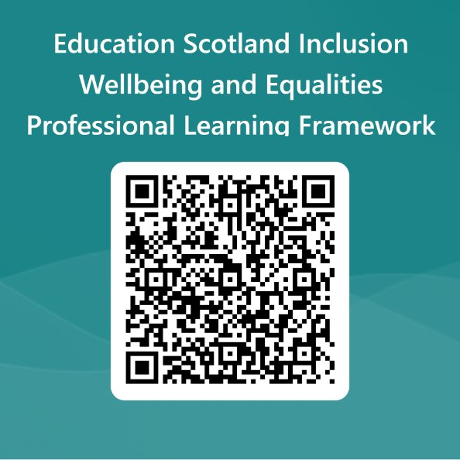
We value your feedback​
Your feedback could help us improve this resource and add to the overall value of the professional learning framework to the educational system​
Please complete this short form, using the link or QR code, to let us know what you thought of it and any suggestions you have on how it could be improved ​
Inclusion wellbeing and equalities feedback form

Slide 23
Thank-you
With thanks to Argyll and Bute Education Psychology Service for creating and sharing this professional learning resource.

