Slide 1
Parental Involvement and Engagement Census
2021/22

Slide 2
Background
Learning together: national action plan on parental involvement, engagement, family learning and learning at home 2018 – 2021:
Action 46 - As part of the annual National Improvement Framework cycle the Scottish Government will gather, analyse and publish key performance information on parental involvement and engagement on an annual basis and throughout the timescale for this plan.
Action 47 - The Scottish Government will work with local authorities to pilot a new national survey of parents and carers by summer 2019, with a view to wider roll out in academic year 2019/20.
The purpose of the PIE Census is to make more evidence available for use all levels from school to national. It does this by collecting data once for use by all stakeholders, so reducing the burden and providing consistent evidence to support the wide range of needs.

Slide 3
PIE Census 2021/22
20 local authorities collected data using the PIE Census 2021/22, 18 of which shared their data with Scottish Government:
Angus | Falkirk | Scottish Borders
Argyll & Bute | Glasgow City | South Ayrshire
City of Edinburgh | Inverclyde | South Lanarkshire
Clackmannanshire | Moray | Stirling
Dumfries & Galloway | North Ayrshire
Dundee City | Perth & Kinross
East Renfrewshire | Renfrewshire

Slide 4
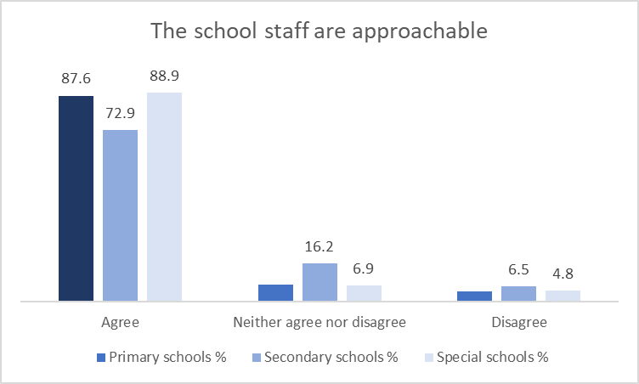
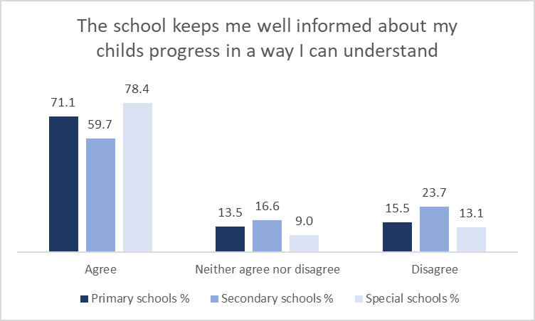
Key Findings 2021/22

Slide 5
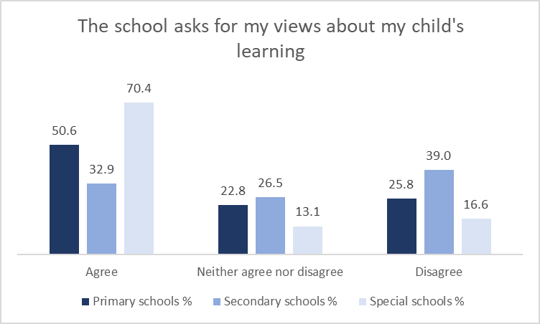
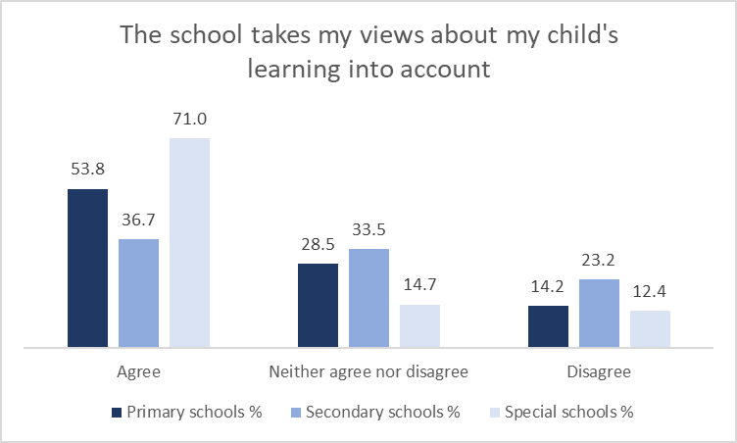

Slide 6
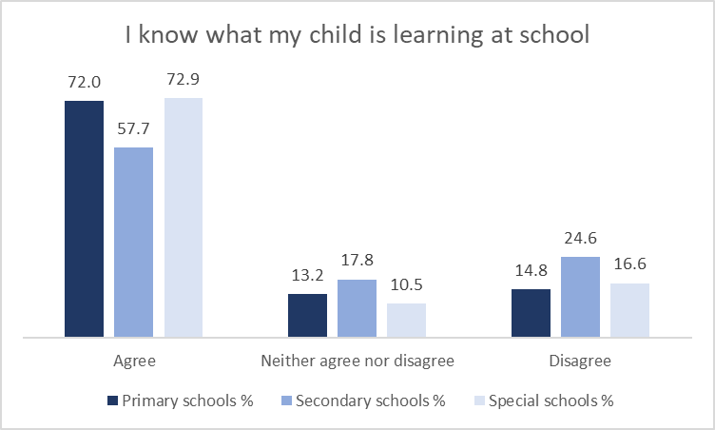
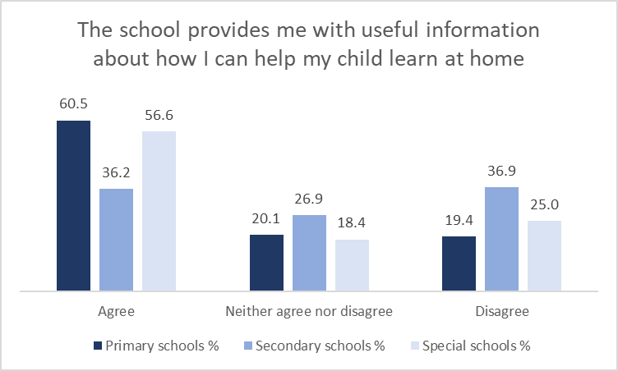

Slide 7
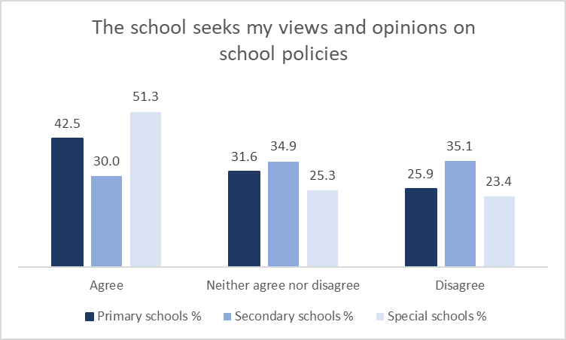
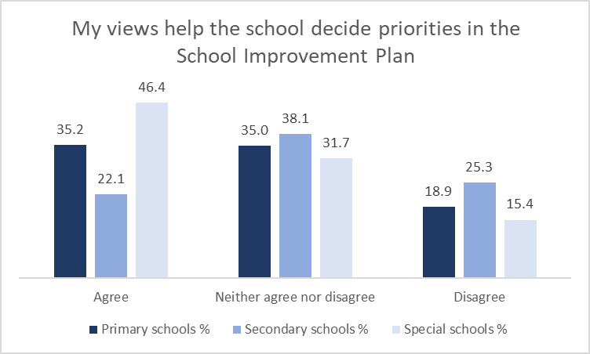

Slide 8
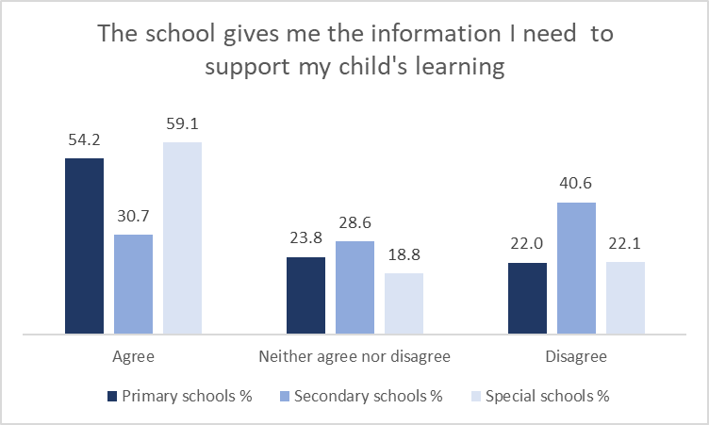
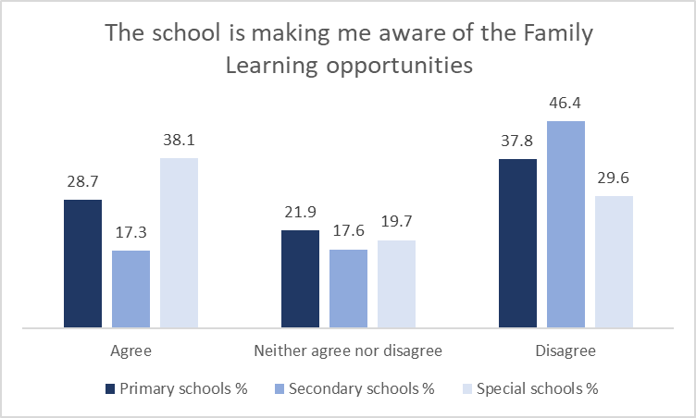

Slide 9
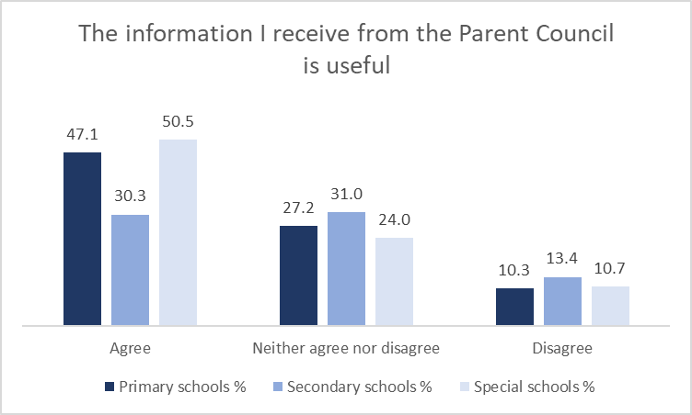
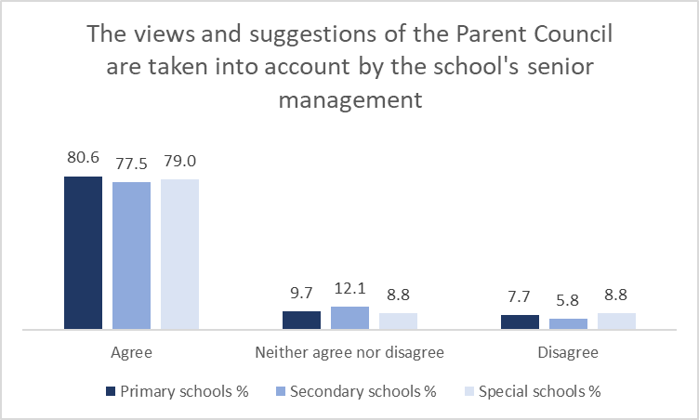

Slide 10
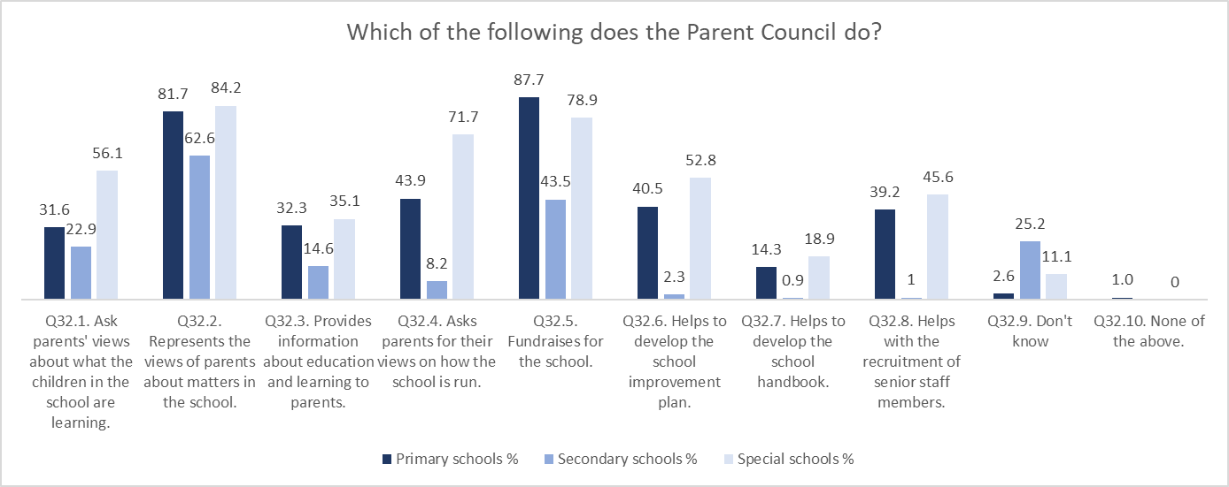

Slide 11
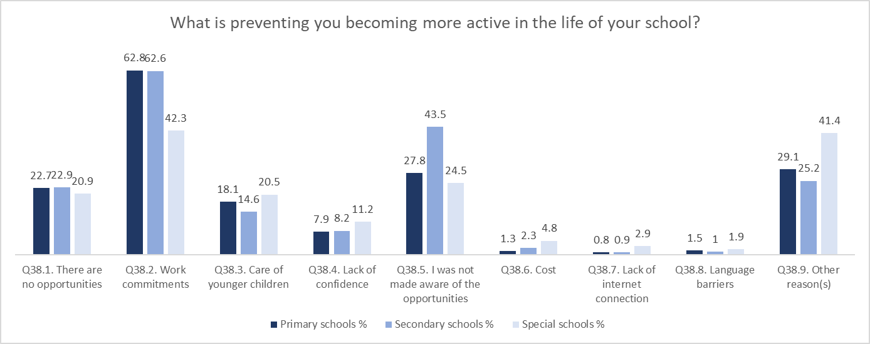

Slide 12
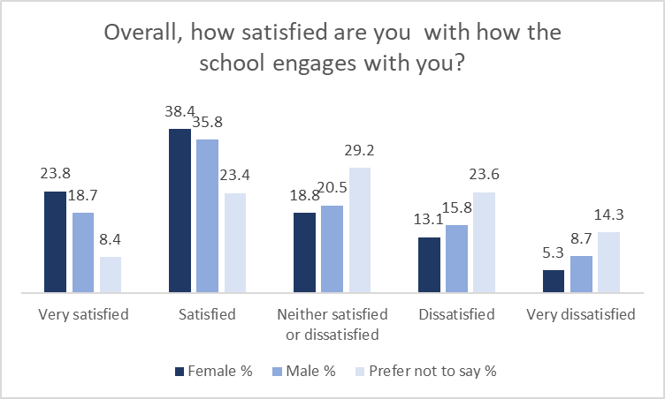

Slide 13
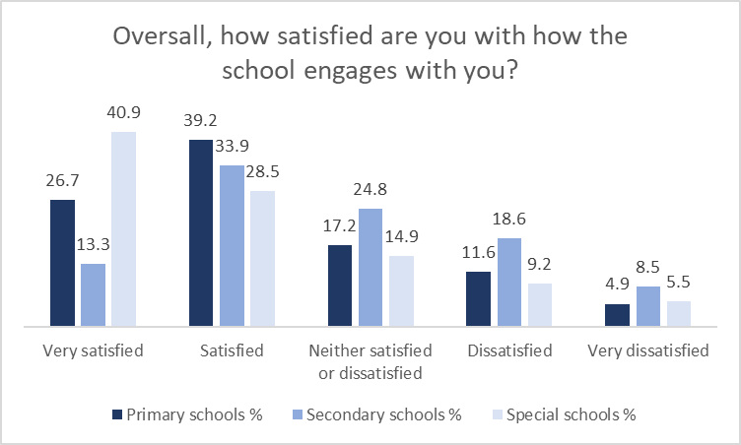

Slide 14
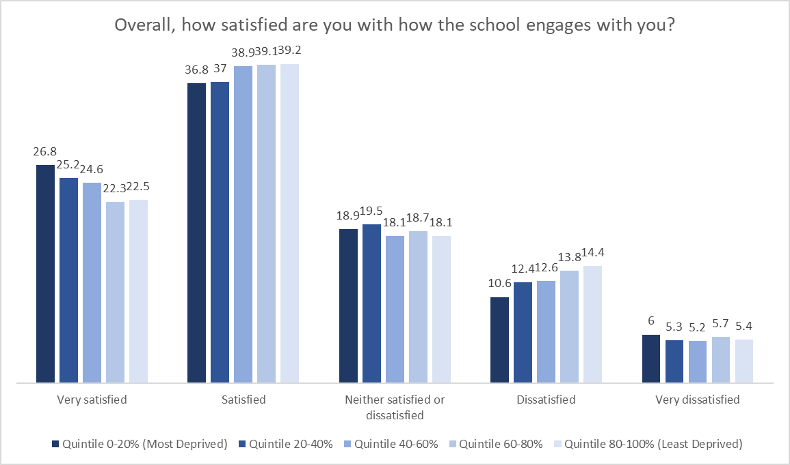

Slide 15
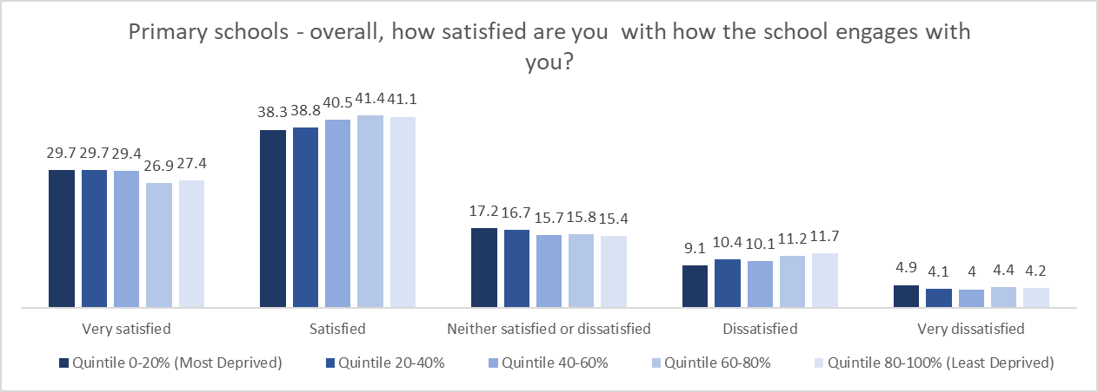
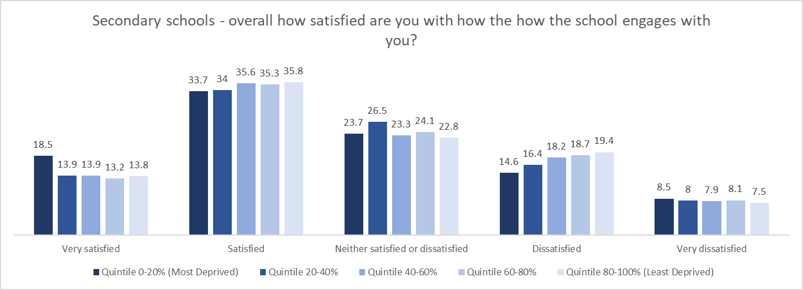

Slide 16
Barriers to Involvement
around six in ten (62.5%) parents and carers said that work commitments were preventing them from being more active in the life of the school.
nearly a third (32.8%) said they were not made aware of opportunities to take part in the life of the school.
just over a fifth (22.7%) said there were no opportunities to take part in the life of the school.

Slide 21
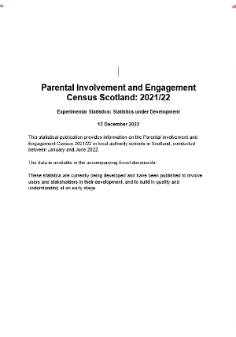
Further Information
https://www.gov.scot/publications/parental-involvement-and-engagement-census-scotland-2021-22/

