Slide 1
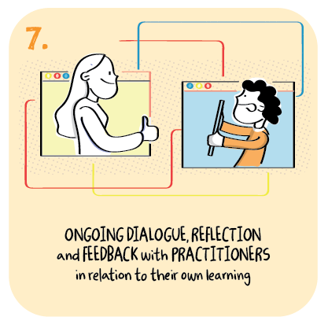
Using information to plan and support learning which improves learners’ experiences and motivation Liberton High School, The City of Edinburgh Council
>National overviews of practice<

Slide 2
Liberton High School - case study
To monitor and evaluate levels of participation, the school has developed a three point scale to support staff when evaluating young people’s involvement and contributions during and after remote learning lessons. The three point scale used by teachers ranges from full, partial to no engagement and is underpinned by teacher professional judgement on how young people are progressing in their learning. Using this data, senior leaders alert young people and their parents and carers to any concerns and also use this information to celebrate young people’s achievements. This data is regularly reviewed and used to identify those young people requiring additional support. For example, a few young people in the senior phase now have bespoke learning programmes to reinforce learning concepts. Data gathered by the school now shows a reduction in the number of senior phase pupils not engaging in remote learning activities. Weekly house meetings focus on addressing particular challenges young people are facing at home and in their learning.

Slide 3
Liberton High School - continued
At the start of the second lockdown, staff identified a group of young people who were not engaged in remote learning during the previous lockdown. To re-engage these learners, support for learning teachers now make weekly calls to check in with families and young people to see how pupils are getting on, to offer advice and follow up any issues with class teachers. Learners are provided with three support sessions across the week to direct them towards particular lessons and assignments. This support helps them to organise their week and encourages them to contact class teachers about any specific issues. These approaches have increased engagement as well as supporting positive home school relationships.

