Slide 1


Participatory Budgeting in Schools
Notes:
Primary school children in Aberdeen City watching a video clip pitching for funding. A total of 3755 young people across five areas voted!

Slide 2
What is participatory budgeting?
1. People come up with ideas on how to spend a budget
2. People vote for their priorities
3. The priorities with the most votes get funded
PB gives people a voice. It brings them together both face to face and online.
It helps more people to get involved and have a say.
Notes:
Began in Brazil in 1980s
Home of the respected educational innovator Paulo Freire.
Main purpose a desire to reallocate public money to where it was needed, locally and democratically, and to build active citizenship.
Has been used in around 3,000 localities around the world.

Slide 3
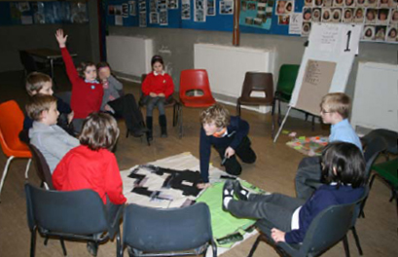
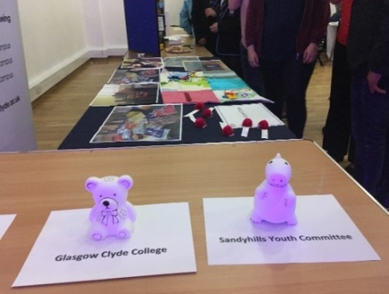
PB happens in many places and in many different ways.
Participatory budgeting is more than just getting pupils to vote on options,
they need to explore the issue and come up with suggestions themselves.
Notes:
2016/17 Community Choices Fund
39,000 voters (this included online votes)
122 Events – led by councils, CPPs, health & Social Care Partnerships, community councils and many more
1,352 local projects were successful in getting funding – tackling social isolation, improving health and wellbeing, reducing the cost of the school day.
total of £2,621,441 was distributed to these projects
France: Regional government of Poitou-Charentes
used PB to decide 10% of capital school budgets
across 93 schools. 1400 projects implemented over 5 years
Zambian schools used PB for the first time this year,
with the innovative D21 digital democracy platform.
Schools in Phoenix Arizona, and elsewhere in the USA,
have been testing PB, with great results.
Curriculum resources and lesson plans are already freely available online in the USA.

Slide 4
PB in Schools in Scotland
Midlothian Council is working with teachers and families in 11 primary schools on an £80,000 initiative aimed at reducing the disadvantage families experience in meeting the cost of the school day.
Using e-voting, Young Scot and North Ayrshire Council worked with over 5,000 young people to decide how £60,000 should be allocated to 67 youth projects.
Pupils and parents in two primary schools in Glasgow decided how £20,000 should be allocated to help reduce the cost of the school day.
“It’s open to more people. If, as a parent, you have reading issues or dyslexia, sending forms to the school is more difficult. Whereas here you are coming along, hearing it first-hand and then you are literally putting a token in a tin and I think more people are involved because of that”. Primary School Head Teacher.

Slide 5
Why do PB in Schools?
PB in schools will:
Build more confident and active young citizens
A real experience of democracy in action.
Offers a positive engagement experience.
Strengthens school culture by building positive relationships.
Awareness of wider community needs and ways of addressing them.
Contribute to raising attainment across the whole school
Motivates young people to work collaboratively.
Develops research, interviewing and presentation skills.
Builds useful skills in budgeting and financial literacy.
Integrate with the school curriculum
Contributes to maths, literacy, PSHE, technology and critical thinking.
Supports school councils and promotes peer to peer learning.
Can fit neatly within a busy school calendar.

Slide 6
Video – PB in Action
How would young people spend the school’s budget?
A video from the Participatory Budgeting Project in the USA shows the experience of PB in 5 schools in Phoenix, Arizona.

Slide 7
Questions for Discussion
How might some of the outcomes expressed in the examples you have just seen, help raise attainment and increase parent and child engagement?
What opportunities exist for you to try PB in your school, for example, how could it help you allocate the pupil equity fund?
What support, information or tools would be helpful for you to introduce PB in your school?

Slide 8
Support Materials – www.pbscotland.scot
Notes:
A number of learning documents have been developed for Scotland in the past three years. A few examples are:
Introduction to PB Booklet
Guides for running and evaluation PB processes
National evaluation of progress to date
Digital Case Studies
PB Animation Video produced by the Church of Scotland
All of these and many more are available on the PB Scotland Website

Slide 9

Contact Details and More information
Further information: info@pbscotland.scot
Simon Cameron, PB Development Manager, COSLA
simonc@cosla.gov.uk
Tel: 0131 474 9261
Kathleen Glazik, PB Policy Manager, Scottish Government
Kathleen.glazik@gov.scot
Tel: 0131 244 0831
Participatory Budgeting Website
www.PBScotland.scot

