Slide 1




1- Building strong Outcomes – Impact & Measures
2- School Improvement Planning,
Self-evaluation
& P.E.F.
Notes:
Discuss a case study and contribute towards the identification of expected impact of PEF interventions

Slide 2
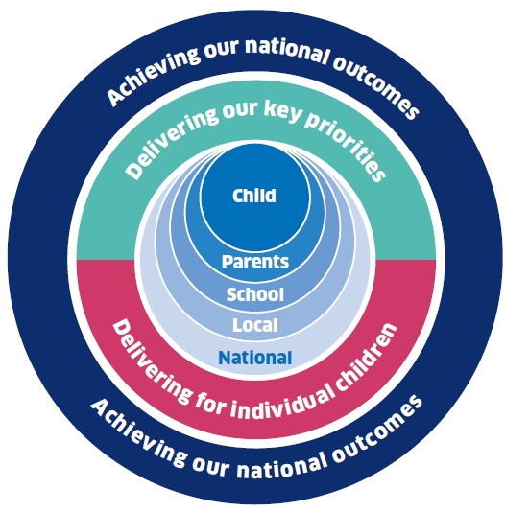
Aim –
Participants acquire the skills to clearly define outcomes in order to measure improvement and to raise attainment and are confident about the relationship between the positioning of PEF within whole school priorities.
Excellence through raising attainment: ensuring that every child achieves the highest standards in literacy and numeracy and the right range of skills, qualifications and achievements to allow them to succeed; and
Achieving equity: ensuring every child has the same opportunity to succeed. The Scottish Attainment Challenge will help to focus our efforts and deliver this ambition.
“Be rigorous about the gaps to be closed and pursue relentlessly “ closing the gap” and “raising the bar simultaneously” Improving Schools in Scotland: An OECD Perspective 2015

Slide 3
What is an outcome?
A change which happens as the result of a programme or activity.
Transforming Lives Through Learning
Notes:
TRANSFORMATIONAL CHANGE 2020………………
Be brave be bold!

Slide 4
Task
Look at three ‘outcome statements’ from the given list. One in each group is considered to be stronger than the other two.
On the A3 sheet individually put a blue dot to the left of the statement you think is the strongest.
Transforming Lives Through Learning

Slide 5
What does an look like?
outcome
Consistent features: Who, what & how
Specific
Achievable
Measurable
….this all helps to build shared understanding and produce actionable information.
Transforming Lives Through Learning

Slide 6
Strong building block
outcome
How it’s going to change
What will change
Who is going to experience change
Transforming Lives Through Learning

Slide 7
Who will experience change?
Practitioners
Headteachers
Learners
Parents/carers
Who will change first*
* Immediate recipients of outputs, or who are directly participating in activities.
Transforming Lives Through Learning
Notes:
This is a worked example from a list that is not exhaustive.
These are the groups who are the immediate recipients of our outputs, or who are directly participating in our activities.
‘Who’ are absolutely critical.

Slide 8
What will change?
Motivation
Knowledge
Awareness
Understanding
Attitudes
Thinking
Perceptions
Opinions
Aspirations
Confidence
What change do they experience first (in the short term)?
Transforming Lives Through Learning

Slide 9
What will change?
Changed State
Practice
Actions
Behaviour
Policies
Content
Processes
Provision
Decision-making
Partnerships
Collaboration
What change do they experience next (medium or long term)?
Using of info/data
Engagement/participation
Transforming Lives Through Learning
Notes:
These changes need to be achievable during the lifespan of the programme….ideally quite soon after they receive the output, or participate in the activity if you want to get a decent amount of evidence of whether something is working or not.

Slide 10
What’s in an ?
Outcome
They…
Experience changes to….
Motivation
Knowledge
Awareness
Understanding
Attitudes
Thinking
Perceptions
Opinions
Aspirations
Skills
Practice
Actions
Behaviour
Policies
Content
Processes
Provision
Decision-making
Partnerships
Practitioners
Headteachers
Learners
Parents
Transforming Lives Through Learning
Notes:
How does it change – up down, right left, increase decrease – what is the movement or shift we’re looking for?

Slide 11
Finally, what else is in an ?
Outcome
Increased
Decreased
More/less
Raised
Lowered
Improved
Enhanced
Higher quality
More effective
How does it change?
Transforming Lives Through Learning
Notes:
How does it change? – we need to describe how it’s going to change. – You could say ‘it will exist’ because now it doesn’t. but we need to be very sure it doesn’t, and there might be preceding things which do need to change to get that ‘thing’ or ‘skill’ to present itself.

Slide 12
Putting together a strong building block
Practitioners
Learners
Parents
Increased
Decreased
More/less
Raised
Lowered
Improved
Enhanced
Higher quality
More effective
Motivation
Knowledge
Awareness
Understanding
Attitudes
Thinking
Perceptions
Opinions
Aspirations
Skills
Focus
Increased
Decreased
More/less
Raised
Lowered
Improved
Enhanced
Higher quality
More effective
Practice
Actions
Behaviour
Policies
Content
Processes
Provision
Decision-making
Partnerships
Short term: “Increased practitioner knowledge/awareness/skills (….X)”
Medium or long term: “Practitioners practice is more effective (…X)”
Outcome(s)
Transforming Lives Through Learning
Notes:
Add they context in your environment to complete the statement e.g. Practitioners will have an increased knowledge and awareness of Nurture principles leading to more effective classroom practice.
It has now been contextualised and I will need know to define the incremental shift.

Slide 13

Five key indicators in identifying and closing the poverty gap
Attainment
Attendance
Exclusion
Engagement - in every lesson and beyond school
Participation
Transforming Lives Through Learning
Transforming Lives Through Learning
Notes:
This can sometimes be useful to measure the softer and often more immediate impact of a change or intervention. Qualitative as well as quantitative.

Slide 14
Primary Focus
How it’s going to change
What will change?
Improved reading skills through development of phonic awareness with P1-SIMD 1&2 young people.
Who is going to experience the change?
Expected Impact
Identified group engagement increased by 7% by Dec’17
Reading skills gap closed to within 9% of class by Jun’18
Levels of support with learning at home improved from 28% to 50% by Jun’18
Measures : Short / Medium / Long term
Teacher judgement on levels of pupil engagement / Use of resources
Resource assessments / Attainment levels in P1 – June 2018
Parent Pre/Post survey on engagement and impact at home
Transforming Lives Through Learning

Slide 15
Secondary Focus
How it’s going to change
What will change?
Increased awareness of the Mindset programme in young people, parents and staff.
Who is going to experience the change?
Expected Impact
Identified 3rd sector engagement by Oct‘17
Calendar of Professional Learning opportunities – Nov’17
Attendance improved by 15% and late-coming 25% - Dec’17
Referrals for disengagement in learning down by 20% - Feb’18
Increased Parental engagement from 18% to 40% - Jun’18
Increased parental confidence in supporting learning at home from X to Y
Measures: Short / Medium / Long term
3rd sector engagement at two points throughout the year
Staff feedback in Professional Learning opportunities
Attendance and late-coming
Referrals for disengagement in learning
Parental feedback in related family learning opportunities
Monitoring and tracking in literacy and numeracy
Surveys through available ICT
Attainment levels in literacy and numeracy
Transforming Lives Through Learning

Slide 16
What does an look like?
outcome
Consistent features: Who, what & how
Specific
Achievable
Measurable
….this all helps to build shared understanding and produce actionable information.
Transforming Lives Through Learning

Slide 17
Task
Look at the same three ‘outcome statements’ considered earlier.
if you have changed your thinking -
Put a Green dot to the right of the statement which you now consider to be the strongest
if the your choice remains the same –
Put a BLUE dot to the right of the same statement.
How many have selected a different outcome? Has your thinking changed?
Transforming Lives Through Learning

Slide 18
Points to consider when reporting:
Specify:
The short and medium term outcomes the initiatives are trying to achieve
When you expect to achieve them
What evidence you are gathering to measure the extent to which they are achieving these outcomes
What the evidence you are gathering is telling you about what is working (the impact it is having)
Transforming Lives Through Learning

