Slide 1
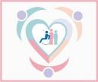
Inclusion, Wellbeing and Equalities Framework – Rights and Equalities
Bias and inequality: Reactive and proactive approaches
Level – Informed
@ESInclusionTeam
For Scotland's learners, with Scotland's educators
Do luchd-ionnsachaidh na h-Alba, le luchd-foghlaim Alba
Notes:
Slide 1

Slide 2
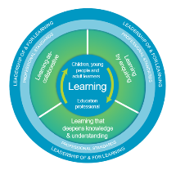
How to use this resource
Pause for Thought…
These slides can be used to facilitate professional learning in a group or whole-setting, or as a self-directed learning activity as an individual.
Facilitation notes are included at the bottom of each slide
Please do not remove or change any of the slides included.
Facilitators are welcome to add slides or activities relevant to your own setting, to support discussion and exploration of the topic. Facilitators will know their participants’ needs best.
Anyone who works in an educational setting can be a facilitator and use these slides.
For reflection or discussion activities, it is important to establish a safe space which encourages respect and honesty to ensure that everyone is able to participate.
Notes:
Slide 2
These slides can be used to facilitate professional learning in a group or whole-setting, or as a self-directed learning activity as an individual.
Facilitation notes are included at the bottom of each slide
Please do not remove or change any of the slides included.
Facilitators are welcome to add slides or activities relevant to your own setting, to support discussion and exploration of the topic. Facilitators will know their participants’ needs best.
Anyone who works in an educational setting can be a facilitator and use these slides.
For reflection or discussion activities, it is important to establish a safe space which encourages respect and honesty to ensure that everyone is able to participate.

Slide 3
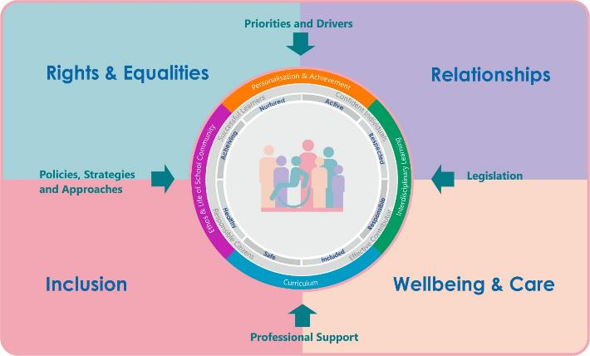
IWE Professional Learning Framework
Notes:
Slide 3
This professional learning resource comes under the Rights and Equalities theme of the Inclusion, Wellbeing and Equalities Professional Learning Framework.

Slide 4
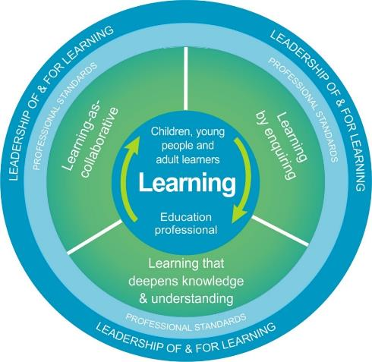
National Model for Professional Learning
This professional learning resource will support you to deepen your knowledge and understanding.
You will have the opportunity to consider how to take this learning forward on your own and with others.
The National Model of Professional Learning (education.gov.scot)
Notes:
Slide 4
On completion of this professional learning, you will be asked to consider what your next steps will be
Take some time to consider the reflection questions

Slide 5
Welcome
Pause for Thought…
This session aims to provide an opportunity to:
Explore the concept of unconscious and conscious bias
Consider how you can become more aware of your own biases and ways to challenge them
Notes:
Slide 5
This session aims to provide an opportunity to:
Explore the concept of unconscious and conscious bias
Consider how you can become more aware of your own biases and ways to challenge them

Slide 6
Diversity
Linguistic
Religious
Socioeconomic
Ethnic/Cultural/Racial
Disability
Gender/Sex
Neurodiversity
Sexual Orientation
Age
Family
Notes:
Slide 6
You may have explored the concept of diversity and different identities/characteristics in the professional learning ‘Mirrors and Windows: Diversity in the Curriculum’. In the next few slides we will be focusing on gender stereotypes and unconscious bias that can arise from this, but it’s important to remember that stereotypes and bias can be held about any of the identities on this slide and more.
Groups of people and issues to consider for each type of diversity (see the Intersectionality & Diversity resource for a more detailed breakdown)
Linguistic Diversity: Gaelic, British Sign Language, multilingualism, EAL (often lumped as one homogenous group), Urdu/Arabic/Polish (most speakers in Scotland), Standard English, Accents (working class / foreign) & discrimination associated to languages and accents. ASN legislation.
Religious Diversity (protected characteristic under the Equality Act): Antisemitism, Islamophobia, sectarianism, discrimination related to faith and religion (specific religious/cultural practices), examples of diverse religions and faiths
Ethnic/Cultural Diversity (considered "race" as protected characteristic under the Equality Act): ethnicity (family lineage, cultural practices, etc.), race (social construct, how people perceive you), nationality (passport/belonging to a nation), xenophobia (discrimination based on being foreign, linked to nationality/accent/language/cultural practices), racism (history of colonialism and enslavement), groups to consider (Gypsy, Roma & Travellers, refugee & asylum-seekers, BAME communities)
Diversity of Gender / Sex (protected characteristic "sex" & "gender reassignment" under the Equality Act): men, women, transgender people, non-binary people, intersex people. Gender roles and stereotypes. Sexism and transphobia.
Diversity of Sexual Orientation (protected characteristic under the Equality Act): Homophobia & biphobia. Lesbians, gay people, bisexual people, asexual people. History of Section 28 in Scottish education.
Diversity of Family (partly a protected characteristic - "pregnancy" under the Equality Act): care-experienced CYP (the Promise), young carers, LGBT families, cultural/religious diversity in families, families affected by status of being a refugee, asylum-seeker or migrant, families in the Armed Forces (ASN legislation), families living on islands, families living in poverty
Diversity of Age (protected characteristic under the Equality Act): older people & UNCRC, ageism
Neurodiversity: ASN legislation, sometimes considered a disability, Complex Learning Needs, Dyslexia, Dyspraxia, Autism, ADHD, etc.
Diversity of Disability (protected characteristic under the Equality Act): social model of disability (social construct), ASN legislation, physical/mental disabilities, ableism, (visible/non-visible disabilities?)
Socioeconomic Diversity: poverty-related attainment challenge, working class people, people affected by poverty, hunger and homelessness
The Education (Additional Support for Learning) (Scotland) Act 2004 lists 4 inter-related factors which may individually or jointly impact on a child or young person's ability to learn:
Learning environment
Family circumstances
Disability or health
Social or emotional factors

Slide 7
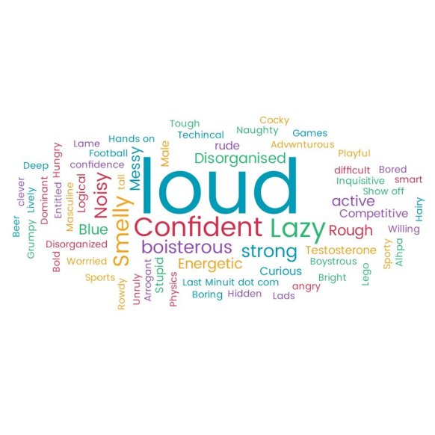
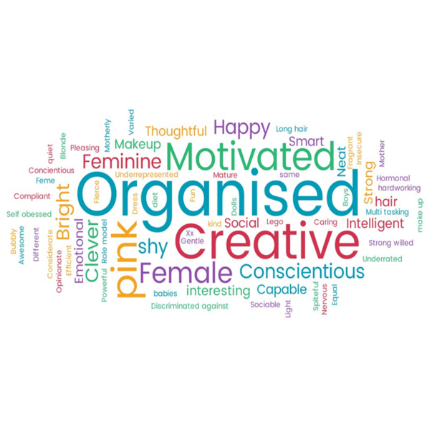
Gender Stereotypes
Notes:
Slide 7
Before exploring the concept of bias and how we can begin to explore and challenge our own biases, it is firstly important to understand how biases are formed and how they relate to societal inequality.
The word clouds in the slide show some of the gender stereotypes that emerged when practitioners were asked to consider words they might commonly associate with boys and with girls.
Ask participants to take a couple of minutes to identify any patterns and differences for each gender.
You will see that the word cloud for the boys has words that focus on physicality, strength, activenessand competitiveness. The word cloud for the girls has words that focuses on compliance, passivity, appearance and nurturing behaviours. (the boys word cloud is top left, girls bottom right).
It’s important to know what the stereotypes are so that we become aware of them and can begin to dismantle them. We should be living in a society where every child and young person has the potential to hold a characteristic and for it not to have connotations about gender, race or other diversity feature, because that can be limiting.
The definition of a stereotype is a widely held belief or generalisation about the behaviours, characteristics and roles performed by a specific group (e.g. women and men for gender stereotypes). Gender stereotypes reinforce the idea of gender being binary and fixed, when most young people will possess a mixture of the traits above, regardless of gender. However, these stereotypes are so entrenched in our societal narrative that we will likely have biases that have been influenced by them, often without us even realizing.

Slide 8
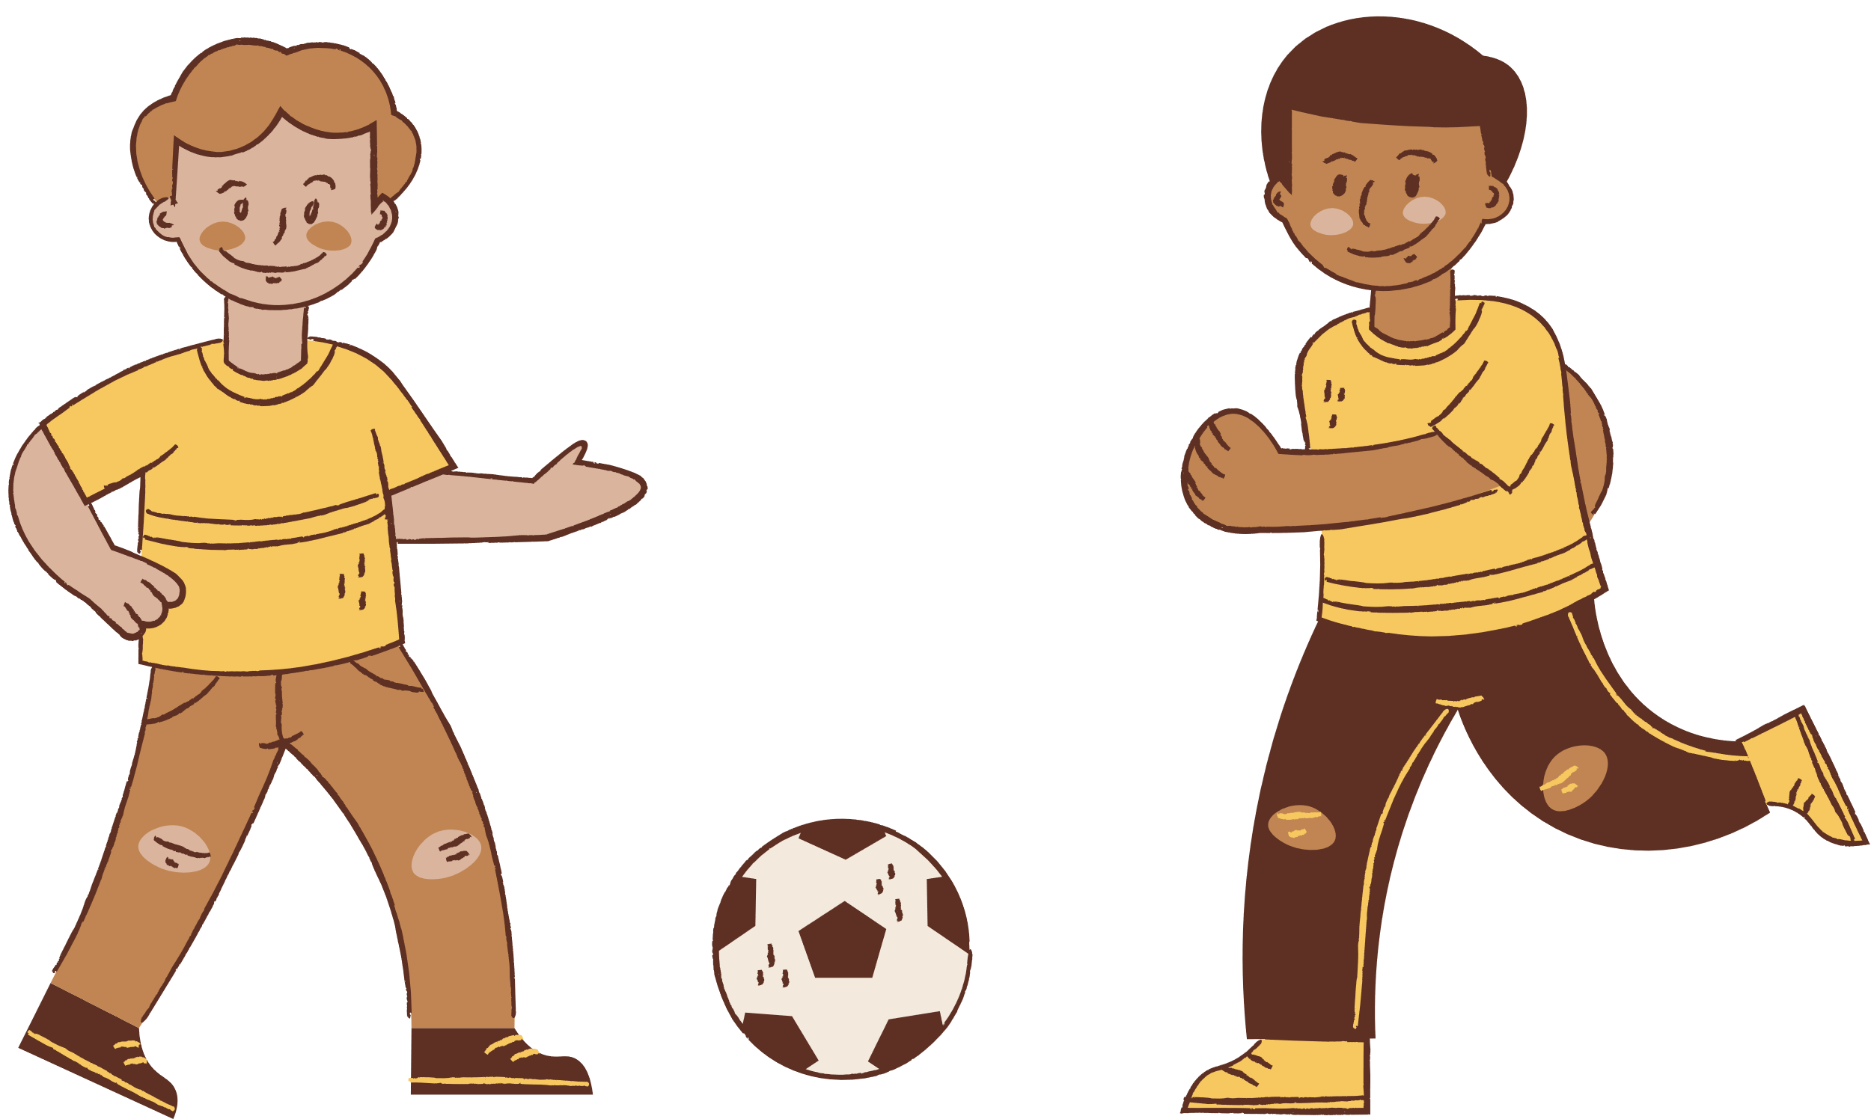
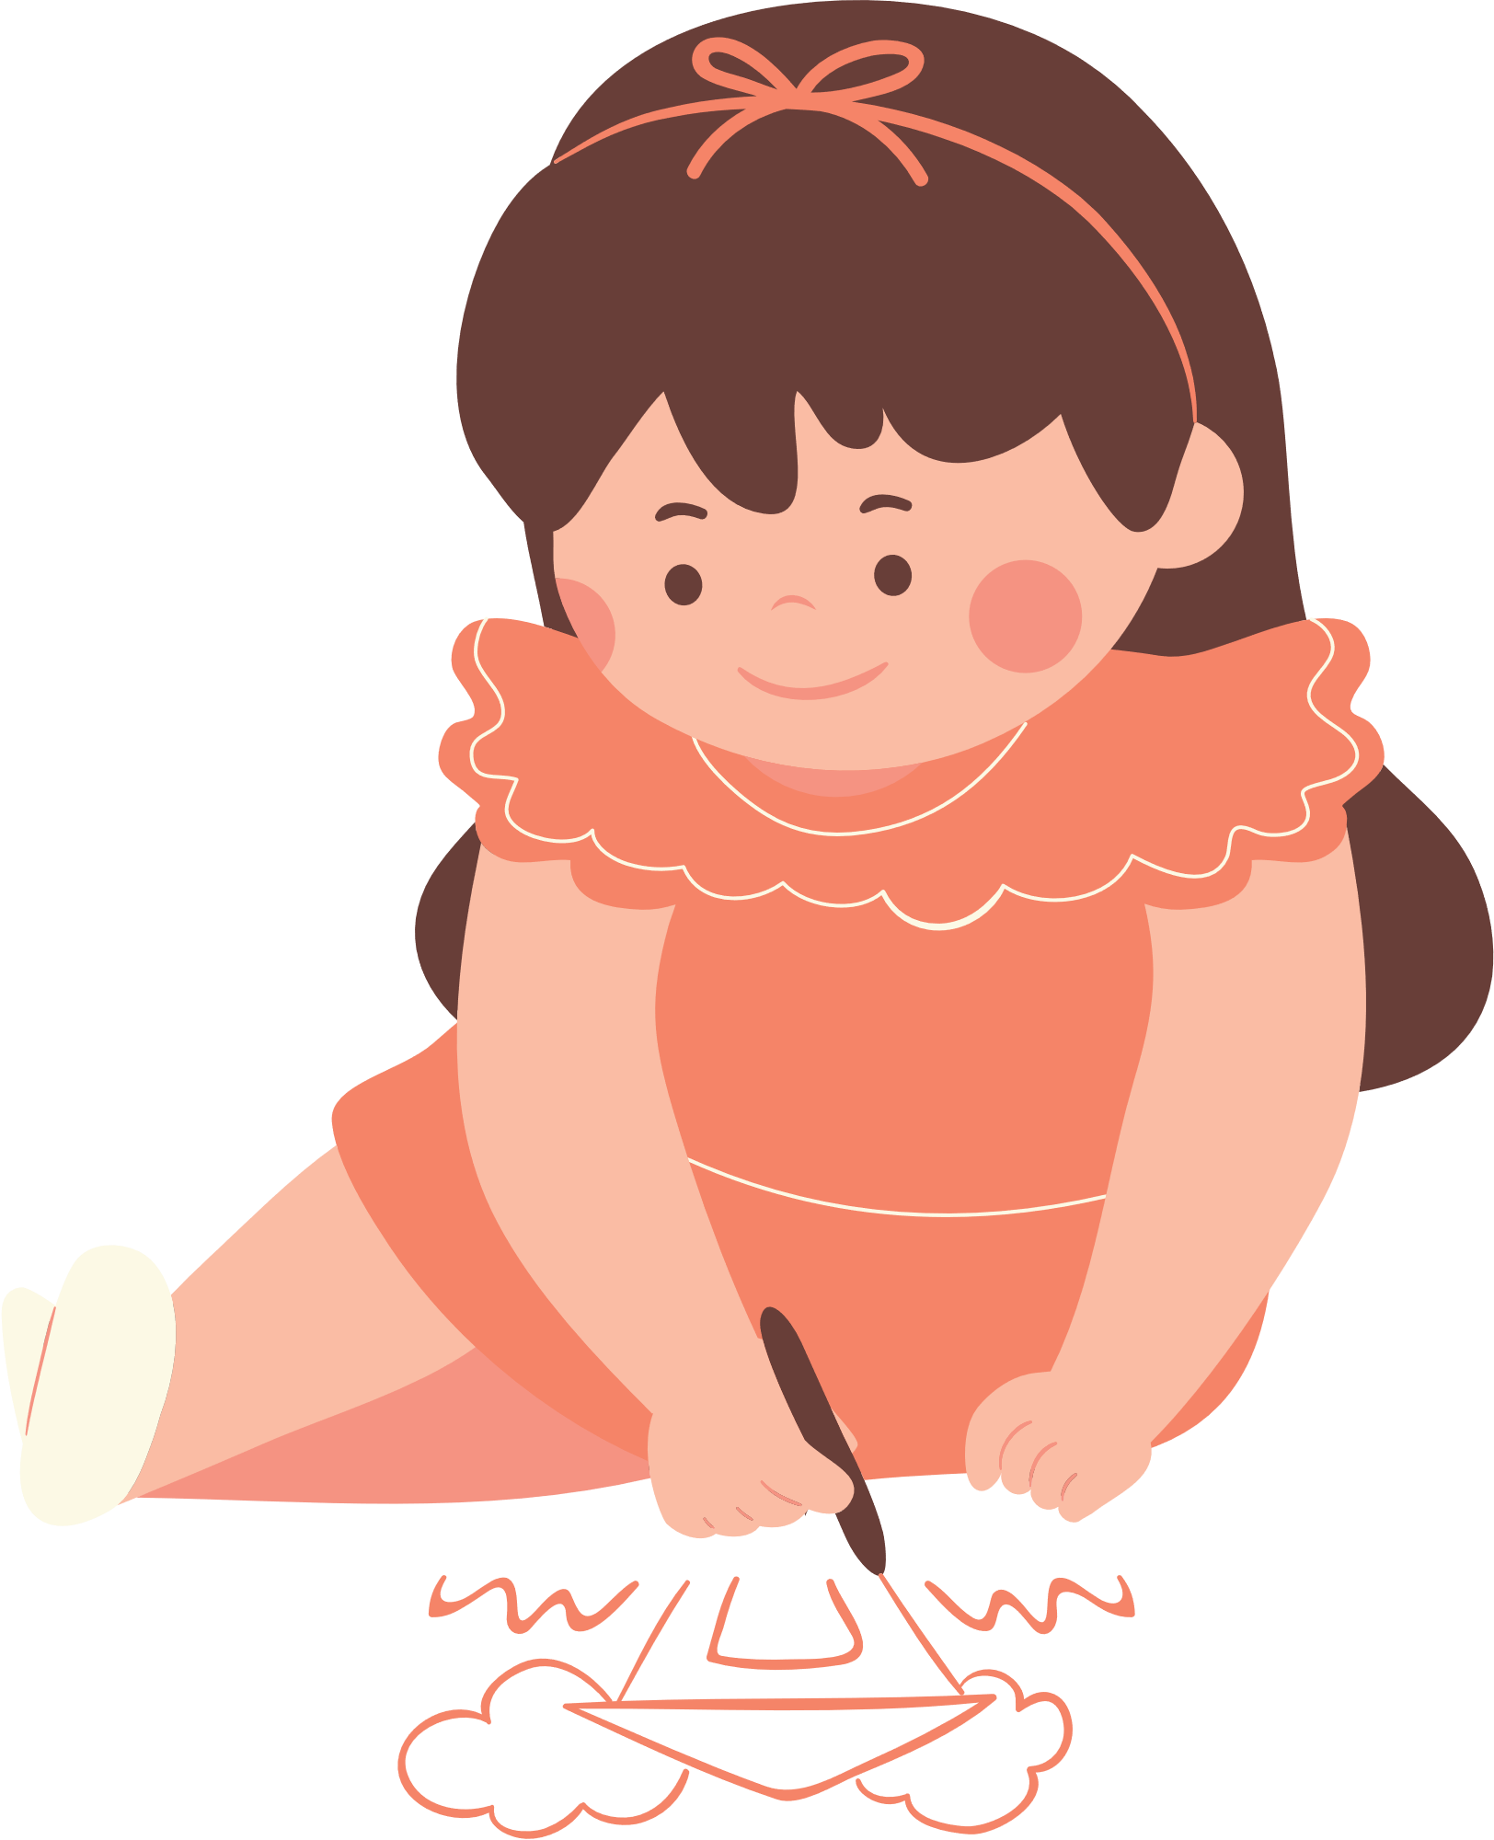
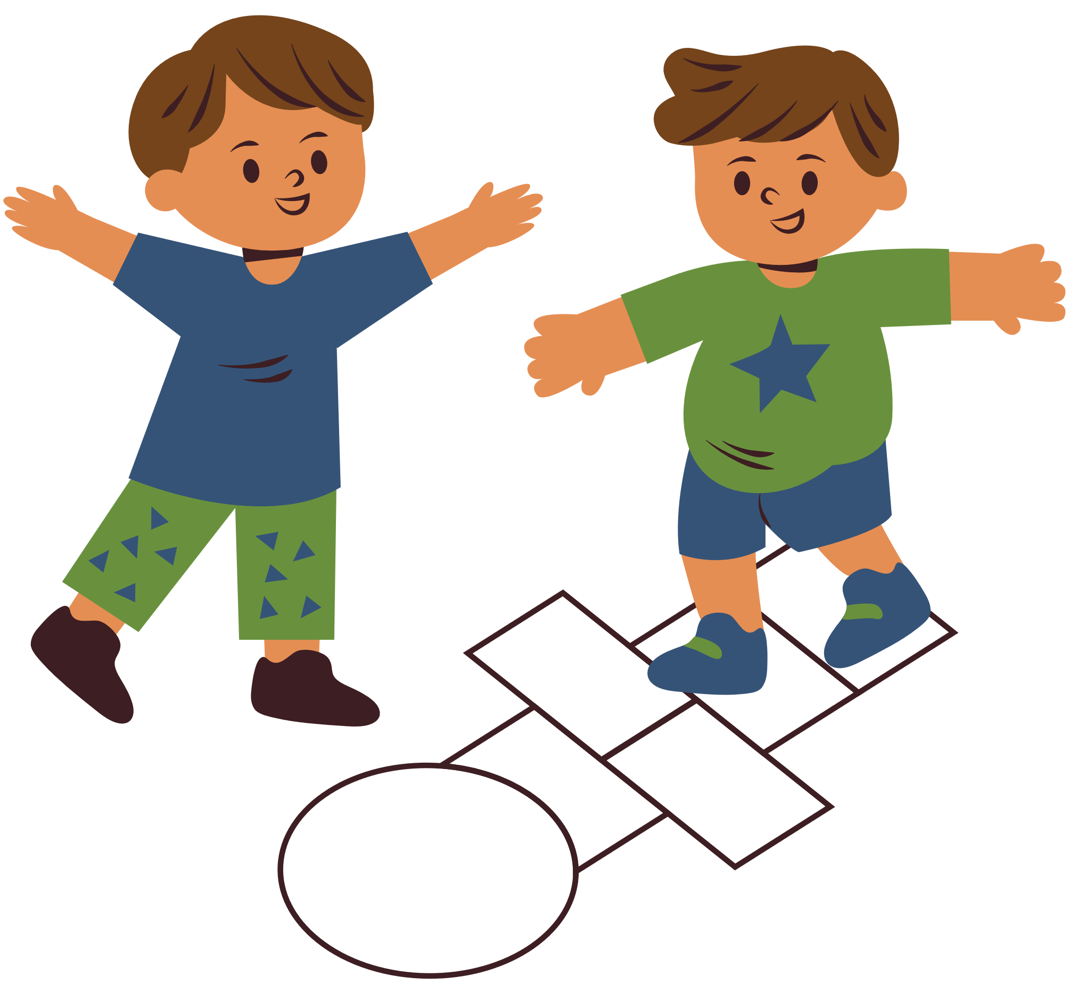
Gender stereotypes and unconscious bias
Gender stereotypes
Unconscious bias
Notes:
Slide 8
The stereotypes we have began to unpick in the previous slide, act as a foundation for unconscious and conscious bias. They create expectations which we unknowingly project onto others.
Stereotypes lead to bias, which in turn reinforces stereotypes.
We are speaking specifically about gender stereotypes here, but the stereotypes can be held about different characteristics such as the ones listed on slide 6.

Slide 9
Unconscious vs Conscious Bias
Unconscious bias is...
Conscious bias is...
Rapid categorisation of people
Based on assumptions
Socially influenced
Unintentional
Can be in opposition to a person's values or beliefs
Affinity bias
If unchecked can lead to prejudice
A reflection of a person's feelings/values and beliefs
Involves active discrimination, exclusion or harm to another person/group of people
Can present as tokenism
Notes:
Slide 9
When first thinking about the concept of bias, it is useful to consider both unconscious, or implicit bias and conscious bias. We all possess unconscious bias, but it is likely that many of us will also have more conscious forms of bias too.
It's important firstly to consider the function of unconscious bias. Our mind uses a dual processing system, because we have to process so much information that our conscious mind cannot keep up. Our conscious mind works more slowly and is responsible for more rational and considered thinking. However, to function efficiently, our unconscious mind processes a lot of information for us and helps us to make snap decisions or inform our actions in certain situations, e.g. when playing sports or driving our cars. It helps us make these decisions through using our experiences and identifying patterns to predict the correct course of action. Unfortunately, experiences can be informed by societal stereotypes and so often decisions based on these experiences can be harmful to the people/group that the stereotype is held about.
When we are unaware of it, unconscious bias often happens automatically. It can often be in direct opposition to a person’s values or beliefs. Our unconscious bias is very often wrong and if unchecked it can lead to prejudice.
Whilst we can’t get rid of it there are ways we can try and mitigate it – the first of these is by trying to be aware of when you may have made a decision that has been influenced by unconscious bias. Some thoughts will enter our heads automatically as a result of years of social conditioning from the media or from our own experiences, e.g. But what is important is that we recognise that this may constitute bias and consider whether it is influencing our perceptions, interactions and actions.
On the other hand, conscious bias is a reflection of a person’s feelings and values, and involves active discrimination, exclusion or harm to another person/group of people.
Conscious bias can be informed by belief systems, so it can be helpful to examine the belief systems and cultural values that you adhere to and consider whether they have been informed by or benefit from prejudice.
The only way we can challenge our own biases is by becoming aware of what they are first.
Participants can try the Harvard Implicit Bias test in their own time.
Links: http://bit.ly/HarvardTest

Slide 10
Who do I trust?
On a piece of paper, write down the names of 6 people that you trust.
Do not include family members.
Notes:
Slide 10
This next section includes an activity that will help us to explore diversity, and how our unconscious bias may be formed and reinforced through our life experiences.
Overview
To explore the diversity, or lack of it, within our own “in-group”.
Preparation
Either ensure that everyone will have paper and pen.
Or print and copy the handout – enough for one per person
Activity
Ask the participants to write the names or initials of the 6 people they trust the most. Try to avoid using family members.
Reassure participants that this is private and they don’t need to share it with anyone else.

Slide 11
Who do I trust
Now expand on the information about who you trust using the table below as a guide
Ethnic Origin
Disability
Sexual Orientation
Name
Age
Gender
Education
Notes:
Slide 11
Now ask participants to expand the information to include age, gender, ethnic origin, education and other information (other information might include where they met the person or shared hobbies etc).
Summarise activity on trust – we are drawn to people who are similar to us.
Discussion
There will be variation in answers but generally people trust people who are like them e.g. of a similar age or ethnic origin.
Our increased likelihood of trusting someone like us is an example of an unconscious bias in action.
Commonness leads to comfort which leads to perception of competence.

Slide 12
Allport's scale
Societal inequality
Harmful behaviours
Discrimination
Avoidance
Antilocution
Pause for Thought…
Mass discrimination, violence, political and economic inequality
Violence, hate crimes
Denying jobs, services and rights
Avoiding interaction, excluding people
Stereotypes, bias, discriminatory speech 'banter'
Notes:
Slide 12
Stereotypes and bias are a cause and a consequence of inequality, where they reinforce a power imbalance between different groups by limiting opportunities and allowing discrimination. This inequality creates a foundation for the perpetuation of stereotypes and bias. To interrupt this cycle we have to explore our own bias and create a culture where stereotypes are challenged.
This pyramid shows Allport's scale, and we will explore this more in the section exploring impact. However, you can see that bias and stereotypes make up the bottom layer of the pyramid, providing a foundation for increasingly harmful behaviours that contribute to societal violence. To prevent this progression we have to start by challenging the low level, everyday behaviours such as bias and stereotypes consistently.
Prejudice And Allport’s Scale (the-classroom.org.uk)

Slide 13
Bias and racism
Interpersonal racism
Institutional racism
Structural racism
Internalised racism
Pause for Thought…
https://blogs.glowscotland.org.uk/glowblogs/promotingraceequalityandantiracisteducation/terminology/
Notes:
Slide 13
We have been considering bias as an interpersonal issue but important to remember that it has structural roots. The definitions of interpersonal, internalised, institutional and structural racism can help us to understand this relationship.
INTERPERSONAL RACISM
Prejudices, individual actions and discriminatory behaviours where a person makes assumptions about the abilities, motives and intents of other people based on race. This set of prejudices can lead to cruel actions (e.g. racist hate speech) and unintentional actions towards a person or a group of people.
INTERNALISED RACISM
This occurs as a result of subliminal messages of racial inferiority and superiority present in society. This can cause Minority Ethnic people to internalise negative messages about their own abilities and intrinsic worth.
INSTITUTIONAL RACISM
When institutions and organisations discriminate against Minority Ethnic people to limit their rights. The Stephen Lawrence Inquiry defined it as:
‘The collective failure of an organisation to provide an appropriate and professional service to people because of their colour, culture or ethnic origin. It can be seen or detected in processes, attitudes and behaviour which amount to discrimination through unwitting prejudice, ignorance, thoughtlessness and racist stereotyping which disadvantages Minority Ethnic people.’ (6.34)
STRUCTURAL RACISM
This refers to the economic, political, social and cultural structures, actions and beliefs that systemise an unequal distribution of privilege, resources, safety and power in favour of the dominant racial group at the expense of all other racial groups. Examples of this can be found in the over-representation of certain Minority Ethnic groups in poverty, unemployment and Covid-related deaths
https://blogs.glowscotland.org.uk/glowblogs/promotingraceequalityandantiracisteducation/terminology/

Slide 14
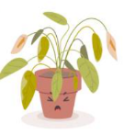
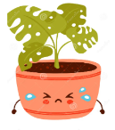
Mood check-in
Enraged | Jittery | Shocked | Surprised | Excited | Ecstatic
Livid | Frustrated | Restless | Energised | Motivated | Cheerful
Anxious | Annoyed | Nervous | Pleased | Focussed | Hopeful
Troubled | Concerned | Uneasy | Calm | Content | Fulfilled
Pessimistic | Sad | Apathetic | Relaxed | Thoughtful | Balanced
Hopeless | Sullen | Drained | Sleepy | Peaceful | Serene
High energy
Low energy
Negative
Positive
Notes:
Slide 14
Today we have explored some issues which may be challenging to discuss and think about, including our own biases and harmful stereotypes. It's important that we take time to reflect and acknowledge the emotional impact having these discussions can have on us. T
Ask participants to take a couple of minutes to look at the mood meter on the slide and think about how they might be feeling after this session. Which word summarises their feeling most accurately? Invite to share if they feel comfortable.

Slide 15
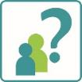
Reflection
From what you have learned so far, think about:
How has this made you feel?
What has this made you think about?
What one action would you like to take forward?
How can you link what you plan to do with others in your setting?
How you will know that this learning has made a difference?
Notes:
Slide 15
Participants can do this in groups.
Encourage educators to look at reflection questions and consider how they may be taken forward in enquiry.
Consider the impact of the actions on learning.

Slide 16
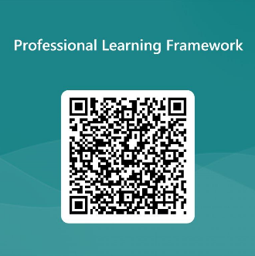
We value your feedback
From now until March 2024 we will be taking feedback on these resources so that we can make changes in advance of a formal launch of the Professional Learning Framework in June 2024
Your feedback could help us improve this resource
Please complete this short form, using the link or QR code, to let us know what you thought of it and any suggestions you have on how it could be improved
LINK: https://forms.office.com/e/b5PCpJJJ3P
Notes:
Slide 16

