Slide 1


Slide 2

Today we will learn:
What a stereotype is and identify some examples.
What a visible difference is.
How stereotypes of visible difference are often used in film and on TV.
What impact negative stereotypes of visible difference can have on people.

Slide 3

Remember that when we discuss a topic:
Only one person should talk at a time
– no interrupting.
Show respect for the views of others.
Challenge the ideas not the person.
Use appropriate language – no rude comments.
Allow everyone to express their view, to ensure that everyone is heard and respected.
Don’t share personal stories without permission.

Slide 4

What does a ‘baddie’ from a film look like?
Think about the ‘baddies’ you’ve seen in films and on TV and draw a picture of one of them.

Slide 5

CLASS
DISCUSSION
What does the word stereotype mean?

Slide 6

A stereotype is an idea about a particular group of people that is often untrue or unfair.

Slide 7
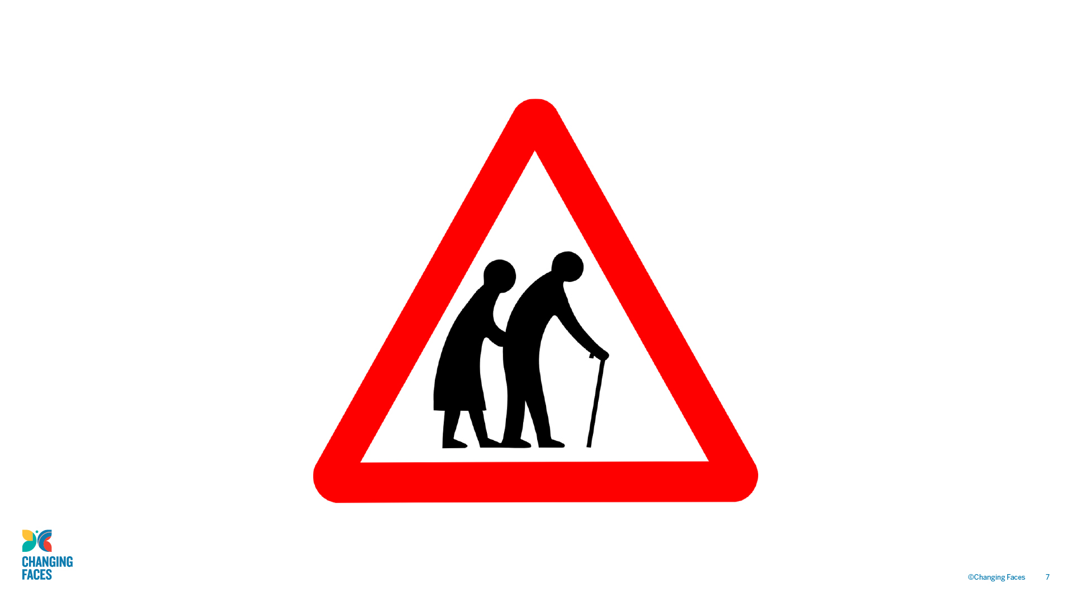

Slide 8
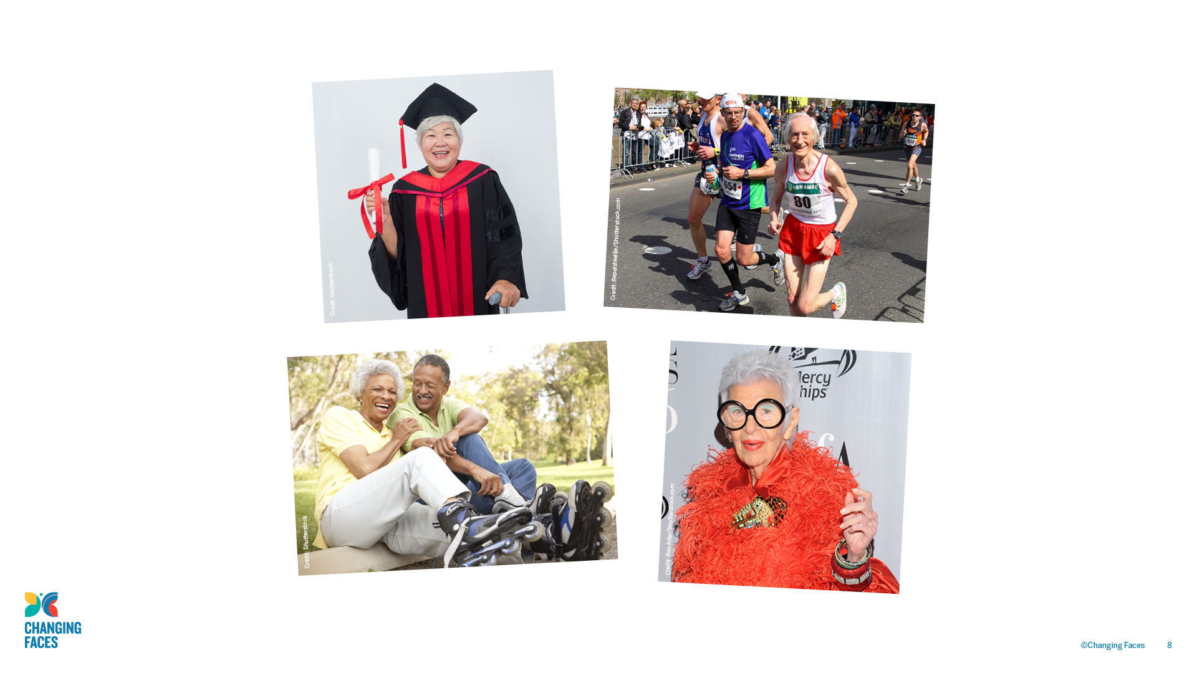

Slide 9

Today we’re going to be talking about how stereotypes
affect people who have a visible difference
(a mark, scar or condition that affects how they look).

Slide 10

Causes of a visible difference:
Skin conditions like eczema, acne, or vitiligo
Burns
Birthmarks
Craniofacial conditions, affecting the growth and development of the skull and face
Cleft lip/palate (a gap or split in the upper lip and/or roof of the mouth)
Cancer

Slide 11
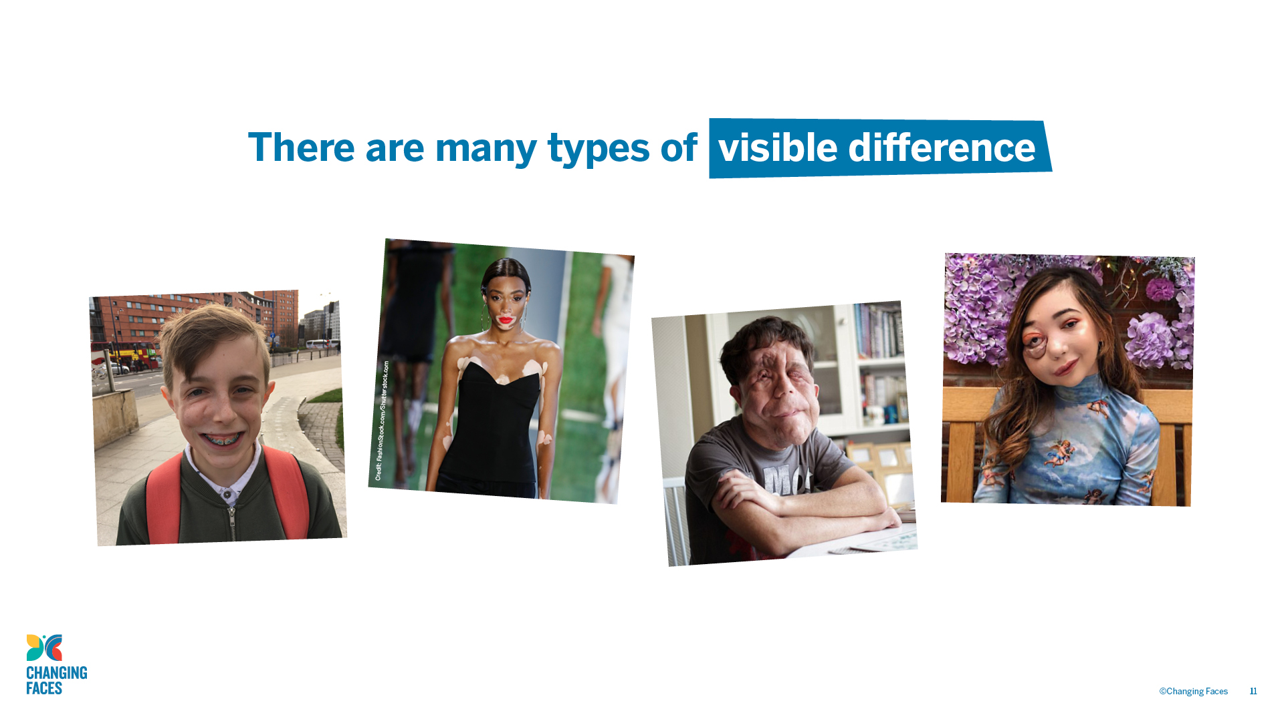

Slide 12

ACTIVITY
In your group, make a list of film or
TV characters that have a scar, mark or condition that affects their appearance.

Slide 13
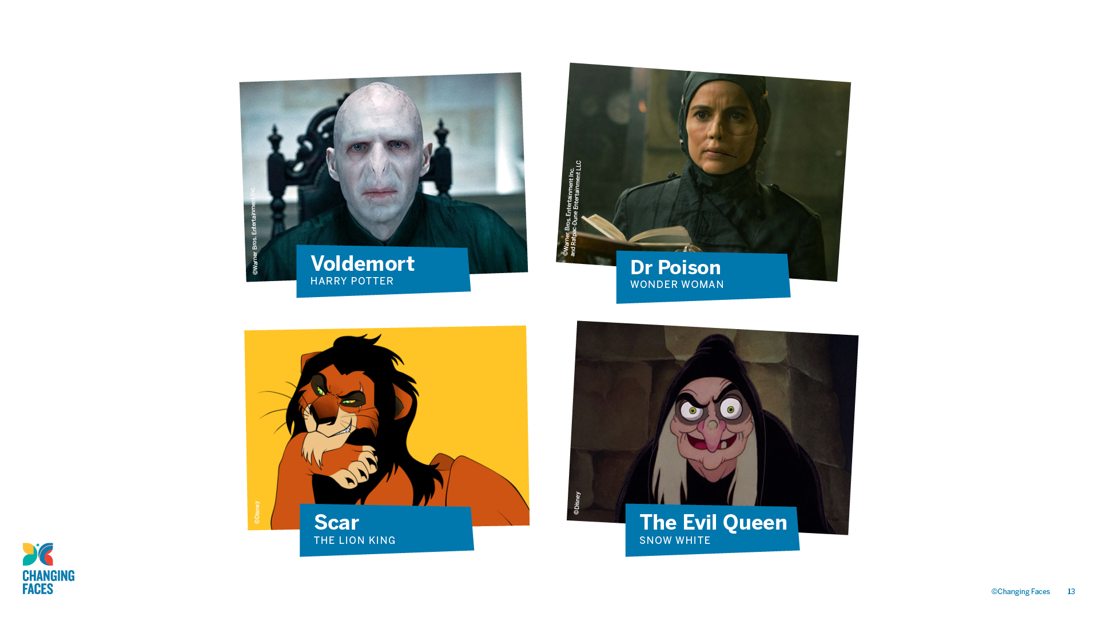

Slide 14

DISCUSSION
How might seeing stereotypes in films and on TV affect the feelings of people who have a visible difference?
Do you think seeing stereotypes makes people treat others differently, if they look different?

Slide 15

TIME TO
REFLECT
What have you learned about stereotypes?

Slide 16

Other helpful websites
youngminds.org.uk
respectme.org.uk
Find out more about visible differences and respecting difference: changingfaces.org.uk
Worried about anything we’ve discussed?
You can contact Childline for help:
childline.org.uk

Slide 17


Slide 18

Today we will learn:
Other ways that a ‘baddie’ character can be shown.
How all stereotypes can be challenged.
How much you have learned about stereotypes
and visible difference.

Slide 19

Remember that when we discuss a topic:
Only one person should talk at a time
– no interrupting.
Show respect for the views of others.
Challenge the ideas not the person.
Use appropriate language – no rude comments.
Allow everyone to express their view, to ensure that everyone is heard and respected.
Don’t share personal stories without permission.

Slide 20
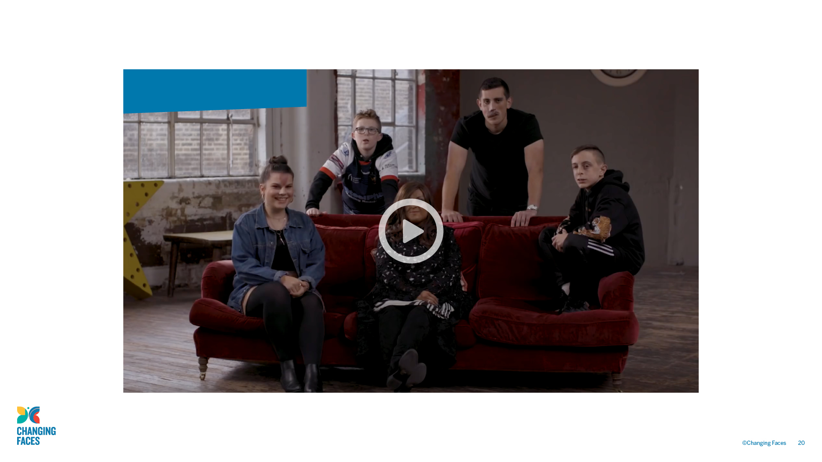
#iamnotyourvillain

Slide 21

Other helpful websites
youngminds.org.uk
respectme.org.uk
Find out more about visible differences and respecting difference: changingfaces.org.uk
Worried about anything we’ve discussed?
You can contact Childline for help:
childline.org.uk

