Slide 1
Language Learning Weekly planner
First to Second level
My eco life:
How to introduce simple recycling phrases
For Scotland's learners, with Scotland's educators
Notes:
This is a front cover page and can only be used once. Use the corresponding blue internal and back pages if you are using this page. You may add a title and a subtitle if needed only. Do not add anything else or move elements around.

Slide 2
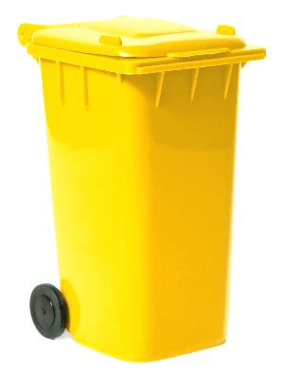
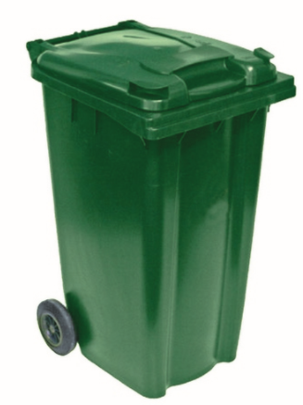
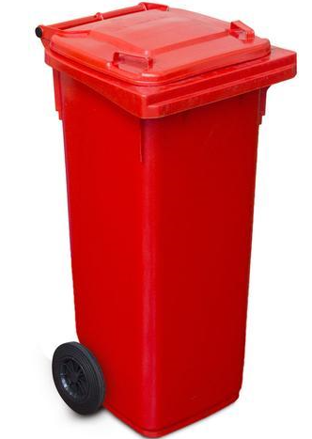
On trie les déchets et on recycle!
Ordures mixtes
Verre
Papiers
Emballages
Notes:
Intro based on colour recognition and introduces more focused listening and paired talking activity/ card game
Vocab building through visuals
Qu’est-ce qui manque?
Transcript

Slide 3
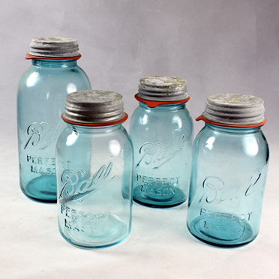
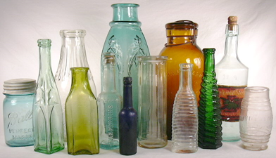
Dans le conteneur bleu on met
des boîtes à conserves
Verre
des bouteilles
Notes:
Intro based on colour recognition and introduces more focused listening and paired talking activity/ card game
Vocab building through visuals
Qu’est-ce qui manque?
Transcript

Slide 4
Dans le conteneur jaune on met…..
des magazines
Papiers
des journaux
Notes:
Intro based on colour recognition and introduces more focused listening and paired talking activity/ card game
Vocab building through visuals
Qu’est-ce qui manque?
Transcript

Slide 5
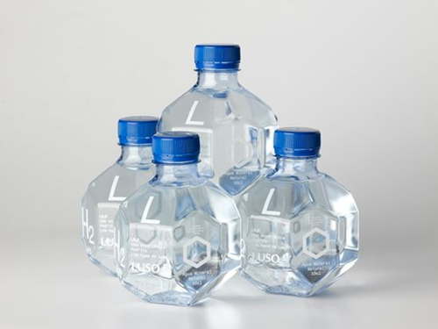
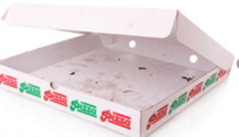
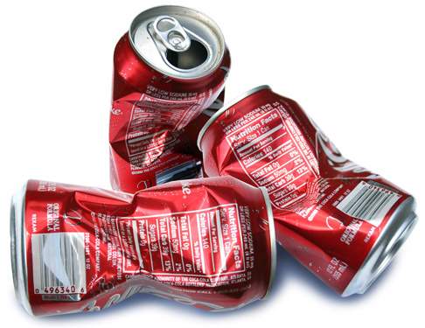
Dans le conteneur vert on met…..
des bouteilles en plastique
des boîtes de pizza
Emballages
des canettes
des briques de lait
Notes:
Intro based on colour recognition and introduces more focused listening and paired talking activity/ card game
Vocab building through visuals
Qu’est-ce qui manque?
Transcript

Slide 6
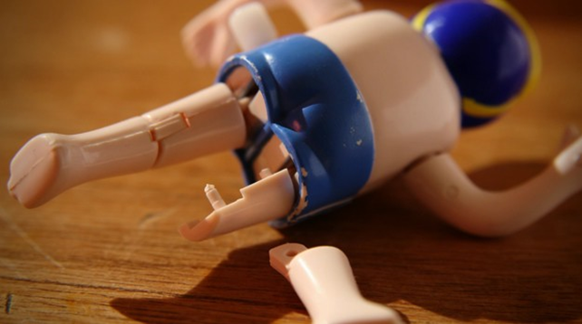
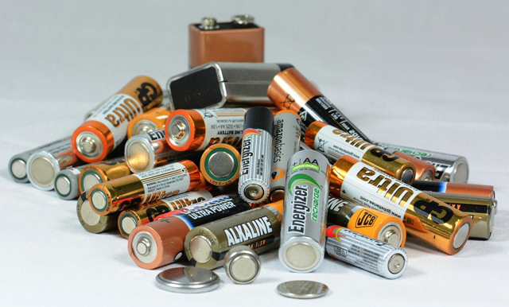
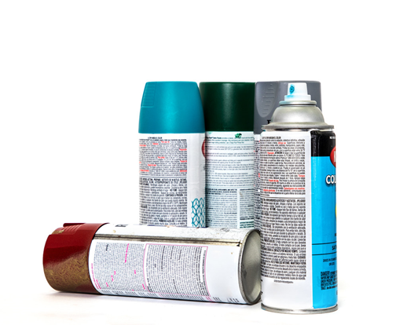
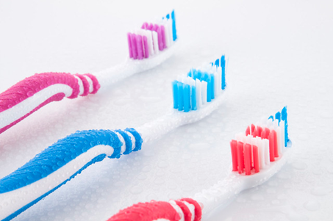
Dans le conteneur rouge on met….
des piles
Ordures mixtes
des bombes aérosols
un jouet cassé
des brosses à dents
Notes:
Intro based on colour recognition and introduces more focused listening and paired talking activity/ card game
Vocab building through visuals
Qu’est-ce qui manque?
Transcript

Slide 7
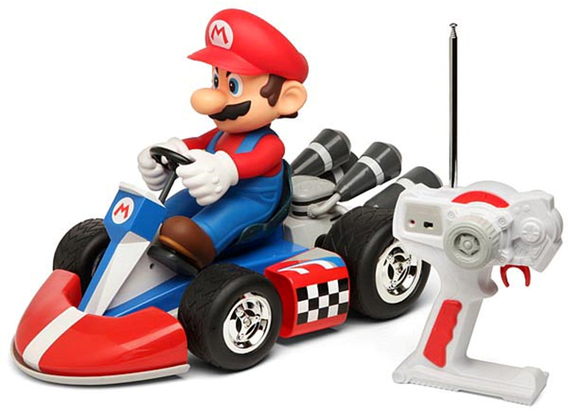
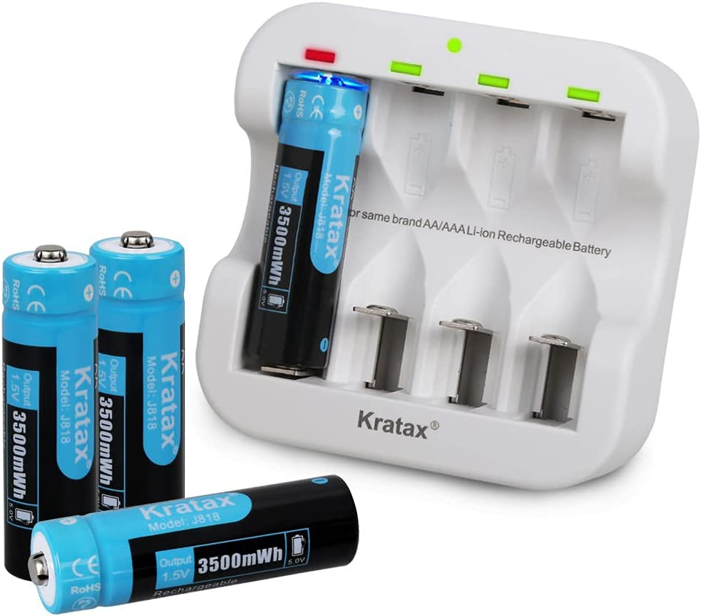
Pour protéger la planète…………..
Je recharge les piles de mes jouets

Slide 8
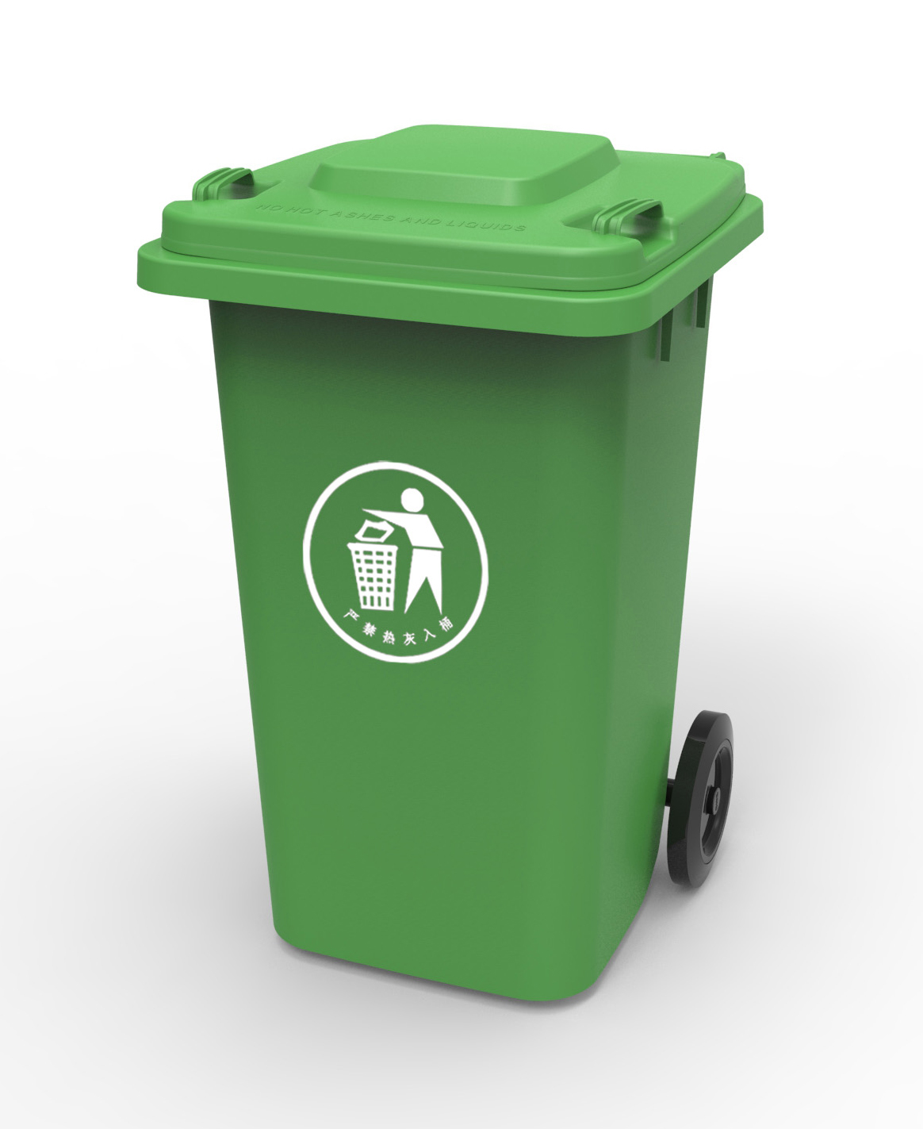
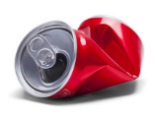
Pour protéger la planète…………..
Je recycle mes canettes de coca

Slide 9
Pour protéger la planète…………..
Je consomme l’eau du robinet

Slide 10
Pour protéger la planète…………..
Je donne mes vieux jouets

Slide 11
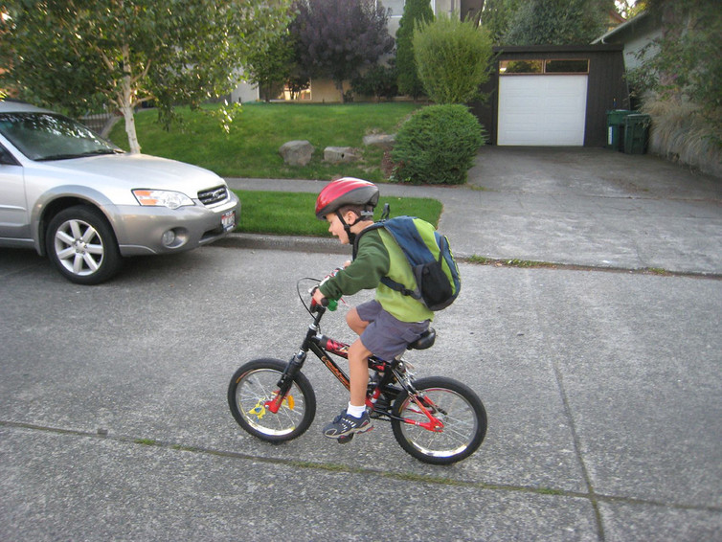
Pour protéger la planète…………..
Je vais à l’école à vélo

Slide 12
Education Scotland
Denholm House
Almondvale Business Park
Almondvale Way
Livingston EH54 6GA
T +44 (0)131 244 5000
E enquiries@educationscotland.gsi.gov.uk
For Scotland's learners, with Scotland's educators
Notes:
This is a back cover page in blue. You may edit the address if needed only. It can only be once and at the end of the PowerPoint presentation. Use the corresponding blue internal and back pages if you are using this page.

