Slide 1




EQUITY: Mitigating the impact of poverty
on Scotland’s children and young people
Introductory session
Notes:
This PowerPoint is intended to support local authority facilitators to deliver the first introduction group session on the Equity: Mitigating the impact of poverty on Scotland’s children and young people. This session will take place once programme participants have completed the initial introductory activities in advance.
This PowerPoint is a template that facilitators can adapt to suit their own context and style of presenting. It can be added to, but please do not remove any slides as they are all essential to the Introductory session. You may wish to add the date, a logo alongside the Education Scotland one, and /or to add a link to a feedback form into the last slide.
Within the slides, suggested timings, key messages to get across, facilitator notes and reflective questions are included.
The session this PowerPoint is intended to support has been designed to be delivered by facilitators in 60/90 minutes, depending if the session is being delivered in person or online. We would encourage you to use that time for (more) discussion of the reflective questions and perhaps invite some feedback. Suggested approximate timings can be found in the notes for each slide.
IMPORTANT NOTES:
This PowerPoint refers to the Education Scotland Equity: Mitigating the impact of poverty on Scotland’s children and young people (Equity: Mitigating the impact of poverty on Scotland’s children and young people | Leading professional learning | Professional Learning | Education Scotland). It is anticipated the presenter will be familiar with the content of these pages. It will be particularly useful to be familiar with Introductory Activities 1-5, before delivering this session.
While use of the Equity PL Reflective Workbook is optional, we would encourage its use as part of this facilitated programme. If used, it will be helpful for participants to have it to hand during this session.
You might also want to consider planning follow up sessions to check in/support those engaged in the learning and to share learning from Professional Learning Activities undertaken throughout the programme.

Slide 2

Ways of working together
We all work together
We learn from, with and on behalf of each other
We create a safe space to share ideas and build learning
We agree that everyone is an equal and valued participant
We remain ‘in the room’ (follow email and phone protocol)
Notes:
Slide 2 Suggested timing: 5 minutes
Key messages:
Take a moment to establish group protocols (or ‘group agreement’).
Ask participants to comment on anything they would like to add or amend.
Is there anything that participants feel is missing or anything they would like to remove?
The protocols on the slide are suggestions to be amended for your context.
Why establish group protocols?
Effective professional learning goes beyond simply delivering information. It fosters a learning community where educators can learn with, from, and on behalf of one another. To achieve this, the facilitator of this learning should establish clear protocols and a positive learning environment at the outset. The general notes below will support the facilitator to help everyone feel comfortable participating and contribute to a rich learning experience.
1. Contract a safe space: Co-create a Safe Space agreement with your group. This agreement outlines expectations for respectful communication and active listening. A safe space allows trust to flourish, fostering a collaborative environment where everyone feels comfortable sharing ideas and taking risks.
2. Shift from top-down to collaborative learning: Move beyond the traditional model where one person imparts knowledge. Embrace a collaborative approach where all participants actively engage. This means learning with, from, and on behalf of one another. By leveraging the diverse perspectives within the group, gaining a richer understanding and creating a more impactful learning experience for everyone.
3. Holding the ladder: Shared expertise and recognition : Holding the ladder signifies a two-fold approach. 1) Sharing expertise: Those with experience can share their knowledge and insights. 2) Recognise everyone’s contribution: Actively listen and be open to learning from the unique perspectives and experiences of colleagues. Build on each other's ideas to foster a collaborative environment where everyone feels valued, and their contributions are respected.
4. Hold space for silence and respectful discussion: Hold space for silence after someone speaks or asks a question. It can be tempting to jump in to fill silence but allowing time for quiet can avoid interrupting thought and produce more thoughtful responses. Everyone deserves to be heard and understood. Adapt the time allocation based on the size of the group and the complexity of the topic.
5. Schedule regular breaks: Schedule regular breaks throughout the session. This allows participants to process information, refocus, and return with renewed energy, leading to a more productive learning experience.
6. Centre learning in real life: Connect the learning to real-life experiences by encouraging participants to share relevant personal anecdotes or applications. This strengthens understanding and makes the learning more relatable and impactful for all.

Slide 3

Today’s session
In this session we will:
‘Poverty Myths’ connector following the ‘listen’ introductory activity
Professional dialogue with colleagues around shared understanding of equity and poverty
Familiarise with the programme ahead, including
- using the PLAs
- reflective workbook
Think about our next steps
Notes:
Slide 3 Suggested timing: 1 minute
Facilitator notes:​
​
This slide shows what will be looked at in this session, to be shared with participants. Invite any questions they may have.

Slide 4
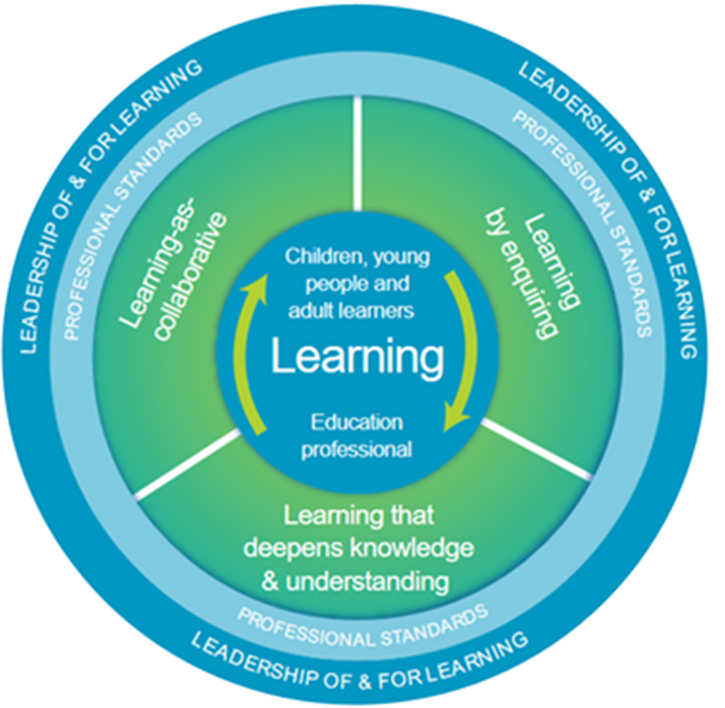
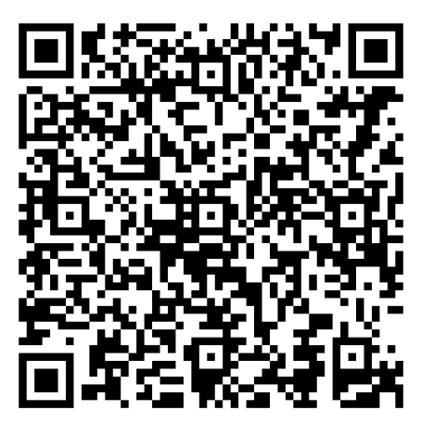
National Model of Professional Learning
Notes:
Slide 4. Suggested timing: 3 minutes
Key messages:
As education professionals, we engage in professional learning to stimulate our thinking, deepen our understanding, and enhance our practice.
The NMPL supports this by outlining the key principles and features of effective professional learning, helping us build capacity and foster collaborative approaches across our settings.
The model encourages us to be critically informed and responsive to current educational contexts, ensuring our practice remains relevant and impactful.
Explore the NMPL further here:
The national model of professional learning | National approach to professional learning | Professional Learning | Education Scotland
Alignment with the National Model of Professional Learning. This Professional Learning Resource (PLR) aligns with several core aspects of the NMPL:
The Education Professional as a Learner: Encourages reflection on personal beliefs and assumptions about poverty and equity.
Leadership of and for Learning: Supports leadership at all levels to drive equitable practices and culture.
Professional Standards and Policy Context: Anchored in national priorities and professional standards, promoting consistency and coherence.
Learning as Collaborative: Designed to be explored with colleagues, fostering shared understanding and collective action.
Learning by Enquiring: Promotes critical enquiry into the causes and impacts of poverty, and how equity can be achieved.
Learning that Deepens Knowledge and Understanding: Builds a robust understanding of poverty and its implications for learners, families and communities.
How This PLR Supports Professional Learning
The Why: Develops a foundational understanding of poverty and equity, and why addressing these issues is essential in Scottish education.
The What: Explores the definition of poverty and its wide-ranging impact on children, young people, families, and communities.
The How: Offers strategies for creating an equitable ethos and culture, including effective use of data, pedagogy and inclusive practices.
Apply: Encourages application of learning within your own context, tailored to your role, to drive meaningful change.
See the full list of Professional Standards:
GTCS - https://www.gtcs.org.uk/knowledge-base/articles/a-guide-to-the-professional-standards
CLD Practitioners - https://cldstandardscouncil.org.uk/resources/competent-practitioner-framework/
ELC Practitioners - Social Service | Children and Young People | SCQF 7 | National Occupational Standards (NOS) Navigator (sssc.uk.com)

Slide 5
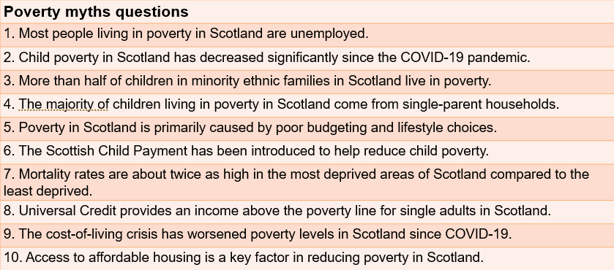




Connector
In a group or pairs talk through the poverty myths questions and refer to the answers. Was there anything that surprised you or that you found interesting?
Notes:
Slide 5. Suggested timing: 10 minutes
Connector: Poverty Myth Busting Quiz - Answers (from Introductory Activity 3 – participants should have completed this in advance and ideally have their answers to hand, possibly in their Reflective Workbook).
1. False – Most people in poverty are in working households. (Source: Joseph Rowntree Foundation, UK Poverty 2024)
2. False – Child poverty remains high and has been exacerbated by the cost-of-living crisis. (Source: Scottish Government, Poverty in Scotland 2023)
3. More than half of children in minority ethnic families in Scotland live in poverty.
Answer: True Reference: Poverty in Scotland 2024, JRF
4. True – Single-parent households are disproportionately affected. (Source: Scottish Government, Child Poverty Strategy)
5. False – Poverty is driven by structural factors such as low wages, housing costs, and policy decisions. (Source: Joseph Rowntree Foundation)
6. True – The Scottish Child Payment is a targeted benefit to reduce child poverty. (Source: Scottish Government)
7. Mortality rates are about twice as high in the most deprived areas of Scotland compared to the least deprived. Answer: True Reference: Key Facts about Poverty in Scotland, Poverty Alliance
8. Universal Credit provides an income above the poverty line for single adults in Scotland. Answer: False Reference: Poverty in Scotland 2024, JRF
9. True – Rising costs have deepened financial hardship for many families. (Source: Poverty Alliance, Challenge Poverty Week)
10. True – Secure and affordable housing is essential to tackling poverty. (Source: Scottish Government Housing Strategy)
References:
Joseph Rowntree Foundation –UK Poverty 2024: https://www.jrf.org.uk/report/uk-poverty-2024
Scottish Government – Poverty in Scotland 2023: https://www.gov.scot/publications/poverty-scotland-2023/
Poverty Alliance – Challenge Poverty Week: https://www.povertyalliance.org/challenge-poverty-week/
Scottish Government – Child Poverty Strategy: https://www.gov.scot/policies/child-poverty/
Education Scotland – Attainment Gap Reports: https://education.gov.scot/improvement/learning-resources/attainment-gap/
Scottish Government – Housing Strategy: https://www.gov.scot/policies/housing/

Slide 6
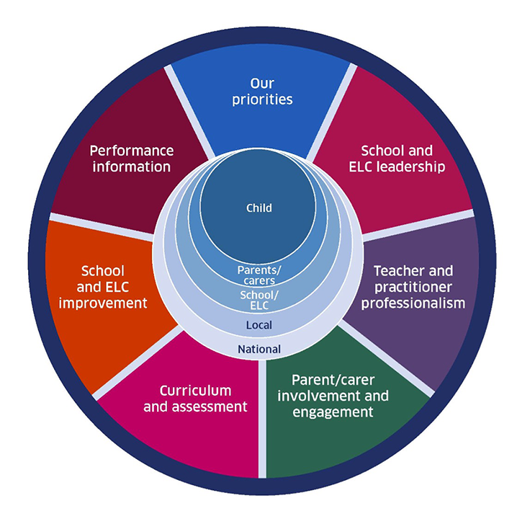

National Improvement Framework
National Performance Framework
Where do you sit within this?
Where does poverty and equity intersect within this?
Consider local policies that align to the model
Notes:
Slide 6 Suggested timing: 10 minutes
Key messages:
Connecting poverty and equity to Scotland’s national frameworks-
Scotland’s National Improvement Framework (NIF) and National Performance Framework (NPF) work together to ensure that educational improvement contributes to broader societal wellbeing. Your Professional Learning Resource (PLR) aligns with both frameworks by addressing poverty and equity—central themes that intersect across education, health, and social justice.
Facilitator notes:
Where do poverty and equity intersect within these frameworks?
1) National Improvement Framework (NIF):
Professionalism: Builds capacity to understand and respond to poverty through professional learning.
School Leadership: Promotes equity-driven leadership that fosters inclusive cultures.
Parental Engagement: Recognises the importance of family and community voice in tackling poverty.
Assessment of Children’s Progress: Encourages data-informed approaches to identify and address inequity.
2) National Performance Framework (NPF): Aligns with national outcomes such as:
- We are well educated and skilled.
- We tackle poverty by sharing opportunities, wealth and power more equally.
- We have a society that treats all our people with kindness, dignity and compassion.
This session supports these outcomes by deepening understanding of poverty and promoting equitable practice.
Where do you sit within this?
As an education professional, you are:
- A learner engaging critically with the concepts of poverty and equity.
- A leader influencing culture, ethos, and practice within your setting.
- A collaborator working with colleagues, families, and communities to drive change.
- A change agent applying learning to improve outcomes for children and young people.
Local policy alignment
This session can be mapped to local authority policies that:
- Prioritise closing the poverty-related attainment gap.
- Promote inclusive education and wellbeing.
- Encourage data-driven decision-making and community engagement.

Slide 7


Personal reflection activity
What aspects of your own upbringing or
professional journey shape how you might view this Equity PL programme ?
How might your lived experience differ from that of your learners and/or the families that you work with?
Notes:
Slide 7 Suggested timing: 7 minutes
Facilitator notes:
Our understanding of equity is shaped by our own lived experiences—both personal and professional. Recognising the differences between our experiences and those of our learners and families helps us approach equity with empathy and humility.
1. Introduction and framing Introduce the reflective questions:
“What aspects of your own upbringing or professional journey shape how you view this Equity PL programme?”
“How might your lived experience differ from that of your learners and/or the families you work with?”
Emphasise that this is a safe space for honest reflection—there are no right or wrong answers.
2. Individual reflection Invite participants to jot down thoughts in response to the two questions.
Encourage them to consider:
Socioeconomic background
Educational experiences
Career path and roles
Cultural or community influences
3. Optional share back
Invite volunteers to share key insights or themes with the wider group.
Capture common threads or tensions that could inform future learning or action.

Slide 8

Linking the programme to your context
In the introduction activities you were asked to recall a time when you witnessed poverty in your professional context and consider what poverty might look like if you were to walk through your setting or community (seen and hidden).
In a pair, trio or group share your reflections and create your own definition of
Poverty
Equity
Notes:
Slide 8 Suggested timing: 20 minutes approximately
Facilitator notes:
Poverty and equity are experienced and observed in both visible and hidden ways across settings and communities.
Professional reflection helps uncover assumptions and deepen understanding of how poverty manifests locally. Equity is not just about access, it’s about fairness, dignity, and opportunity for all.
1. Introduction and framing (2 minutes)
Revisit the earlier reflective prompt: “Recall a time when you witnessed poverty in your professional context. What might poverty look like if you walked through your setting or community?” Emphasise that poverty can be seen (e.g. lack of resources, attendance issues) and hidden (e.g. stigma, mental health, digital exclusion).
Link to National Improvement Framework (NIF) and National Performance Framework (NPF): NIF: Closing the poverty-related attainment gap. NPF: Tackling poverty and promoting wellbeing and fairness.
2. Group discussion/ definition creation (10 minutes)
In pairs, trios or small groups, ask participants to:
Share their reflections.
Discuss where poverty and equity intersect in their setting.
Consider how local policies align with national models. Encourage them to use language that reflects their local context, values and roles.
Reflect on “Where do you sit within this?”—as a practitioner, leader or advocate.
3. Definition (5 minutes)
Invite each group/table to share their definition of poverty and equity based on their discussion.

Slide 9

Next steps
Getting started on PLA 1, 2 and 3 self directed online Professional Learning Activities (PLAs) to be completed before Group Session 2 .
Notes:
Slide 9 Suggested timing: 2 minutes
Key messages:
Remind the group that all the learning for the programme is contained in Education Scotland Equity: Mitigating the impact of poverty on Scotland’s children and young people (Equity: Mitigating the impact of poverty on Scotland’s children and young people | Leading professional learning | Professional Learning | Education Scotland). Remember an account is required to access the PLAs. Once logged in, the links to the PLAs will work.
Hopefully the group now feel ready to get started PLA 1,2 & 3. They can use the link or QR code on the slide to access the Equity PL webpages or the link in the chat pane. Explore the webpages more and look for the ‘’PLAs 1-6’ section to get straight into the learning.
Facilitator notes:
You may wish to screen-share the relevant webpage as part of the session, or if participants have devices, allow some time for them to access the pages and read through them.
Tell the group each PLA takes 2-3 hours and is in ‘bite-sized’ steps that can be saved as they go along. There are reflective questions in each step with space to record reflections. Every PLA ends with an ‘impact step’. A PDF summary of each PLA, with reflections, can be downloaded once complete. Participants can also use the Reflective Workbook to record thoughts as they go through the PLA and perhaps when they have completed it as well.
A suggested timeframe for completing PLAs 1-3 is a term, but this should be negotiated and agreed with the group and /or leadership team.
Reflective questions:
Invite any questions at this point. How are the group feeling about the learning now? Are there any hopes / concerns?

Slide 10

Aims Review
‘Poverty Myths’
Professional dialogue with colleagues
Familiarisation of the programme
Think about our next steps
Notes:
Slide 10 Suggested timing: 2 minutes
Key Messages
Have we met the aims of today’s session?
Facilitator Notes
What are our key takeaways? As the session ends, encourage participants to take a few minutes to reflect quietly. Think about what resonated with you, what challenged you, and how you’ll set aside time to space out the PLAs 1-3.

Slide 11



Feedback
Notes:
Thank the group for their time and engagement and make sure they know who to approach with any questions and how to contact them. You may wish to add these details to the slide.
You may also wish to add a link or QR code for your own feedback form at this slide.
If you would like to provide feedback on this resource, as a facilitator, please go to:
https://forms.office.com/e/XxHgqvD263

