Slide 1
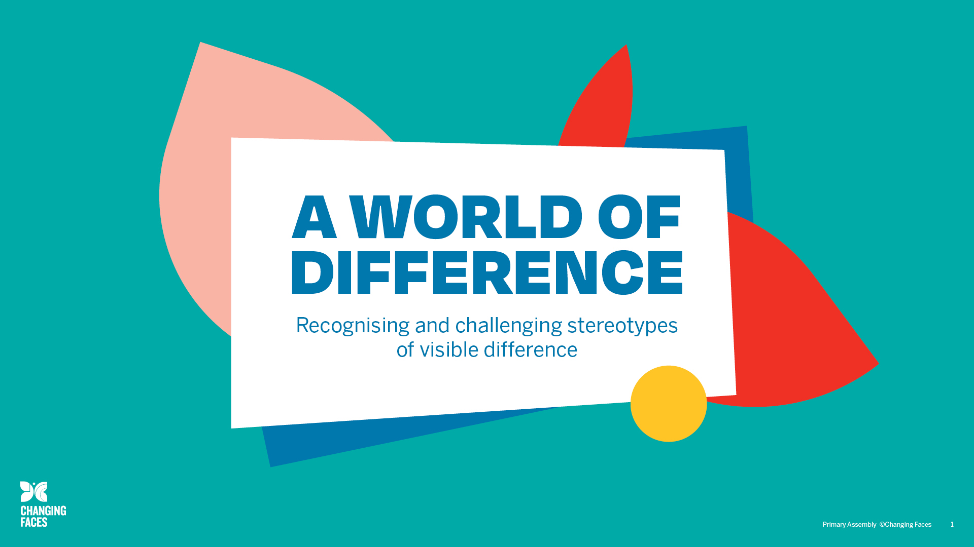

Slide 2

Today we will learn:
What a stereotype is and identify some examples.
What a visible difference is.
How stereotypes of visible difference are often used in film and on TV.
What impact negative stereotypes of visible difference can have on people.
How all stereotypes can be challenged.

Slide 3

Remember that when we discuss a topic:
Only one person should talk at a time
– no interrupting.
Show respect for the views of others.
Challenge the ideas not the person.
Use appropriate language – no rude comments.
Allow everyone to express their view, to ensure that everyone is heard and respected.
Don’t share personal stories without permission.

Slide 4

CHARACTER
QUIZ
Are these film characters
goodies or baddies?

Slide 5
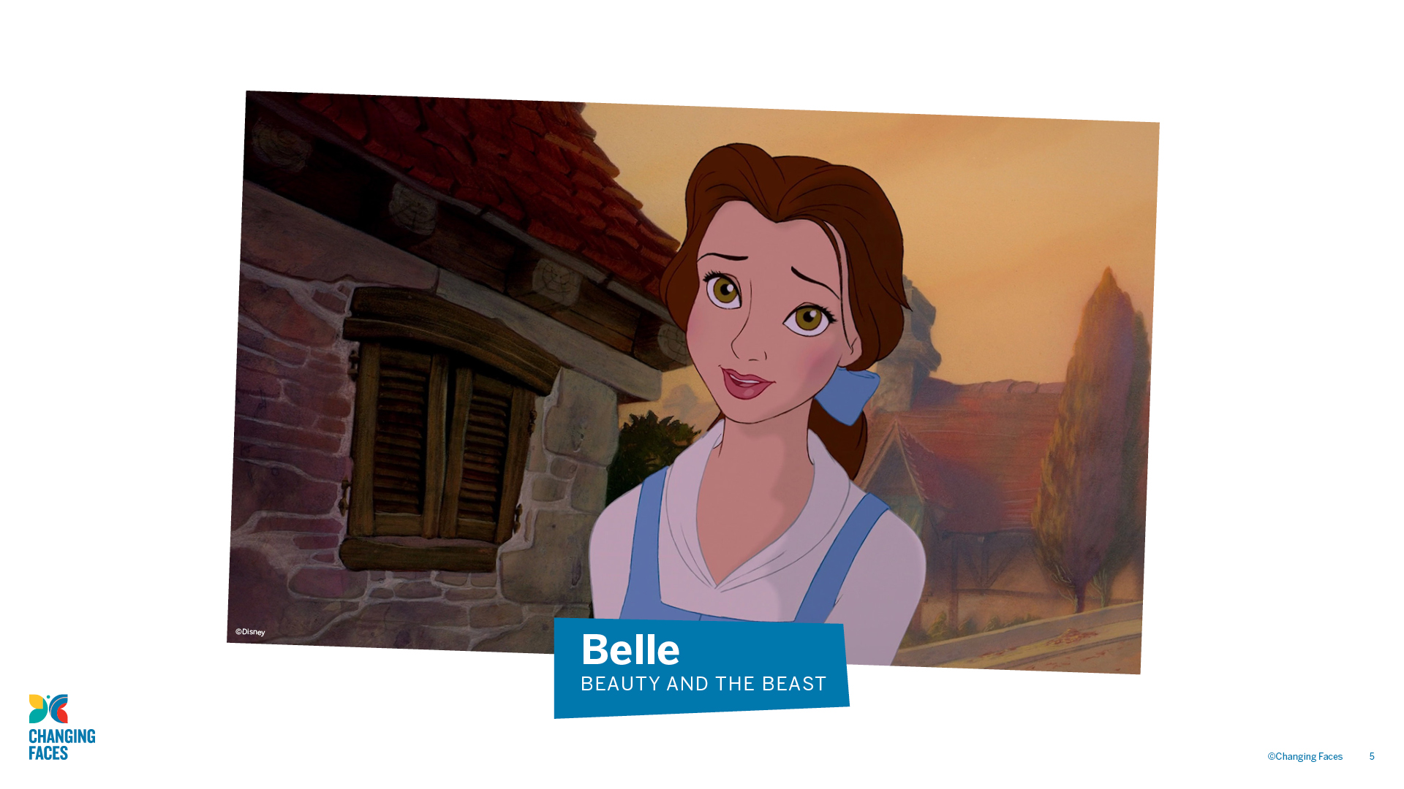

Slide 6
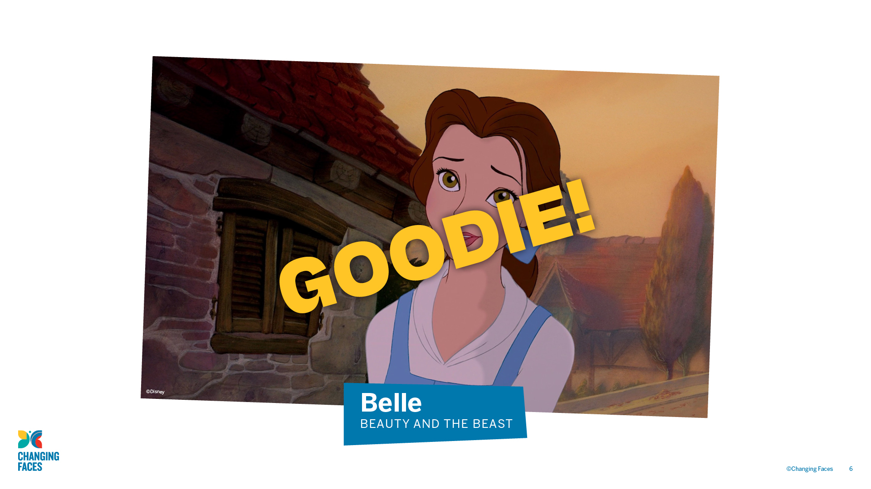

Slide 7
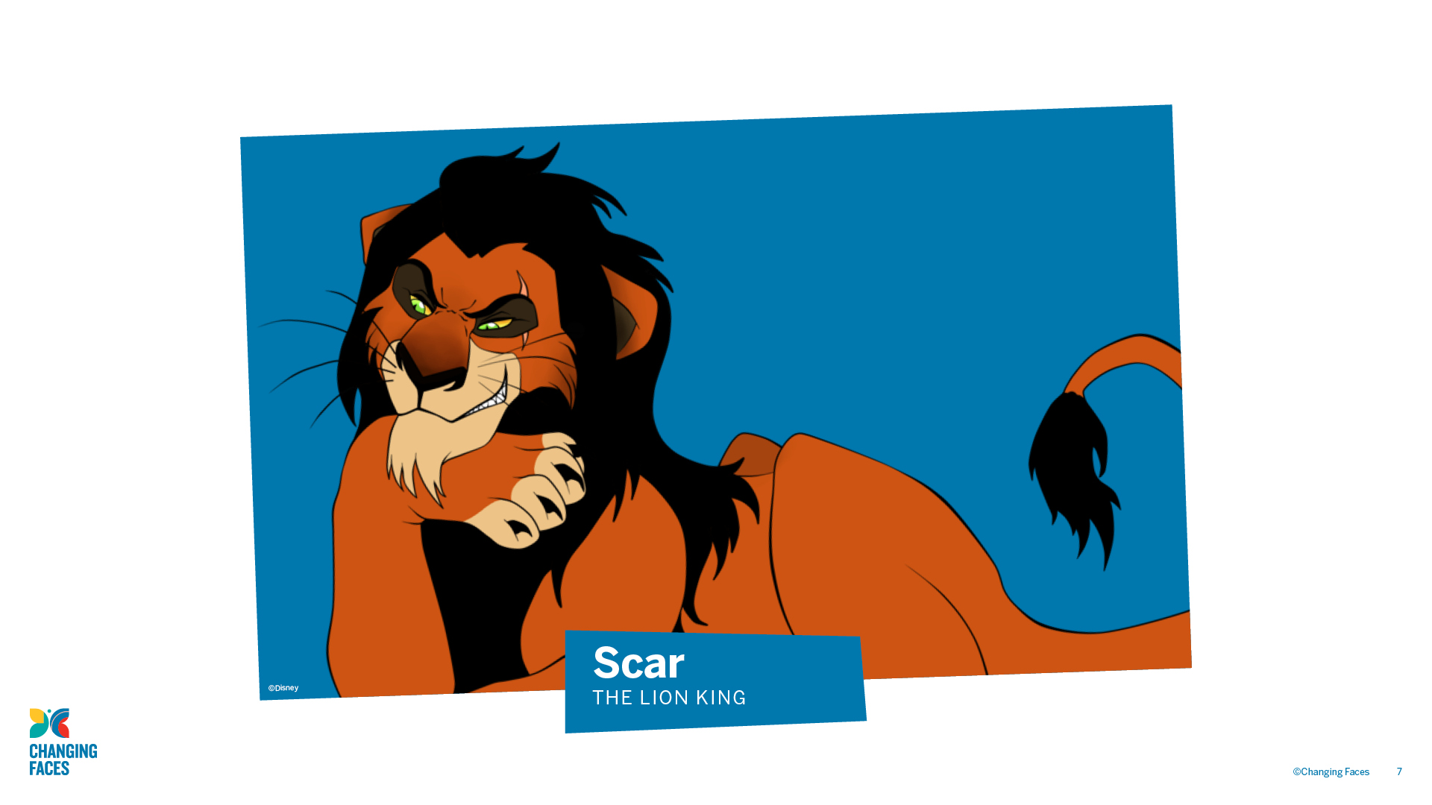

Slide 8
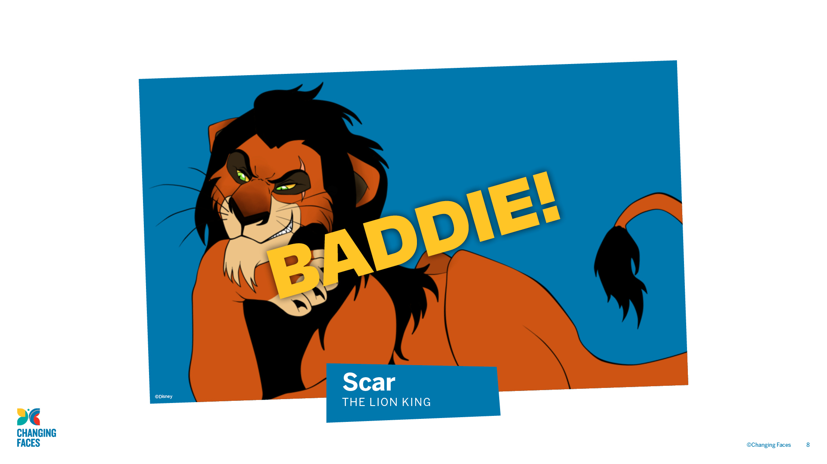

Slide 9
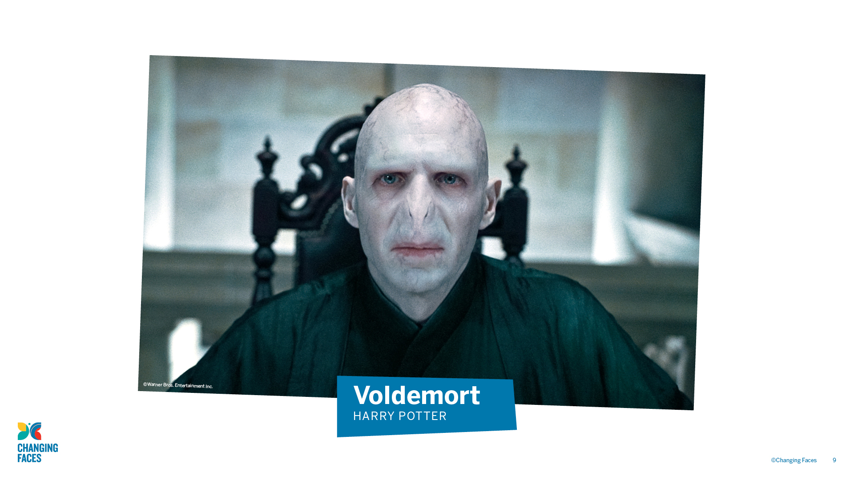

Slide 10
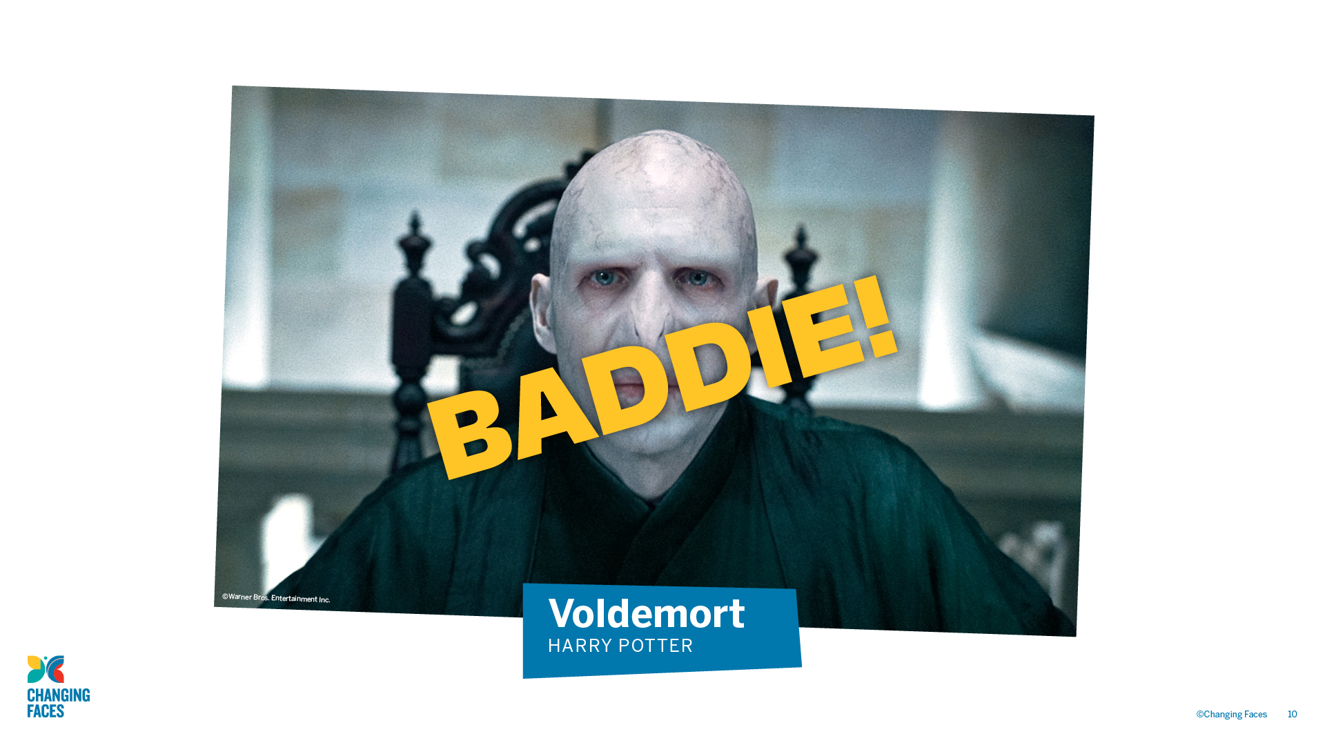

Slide 11
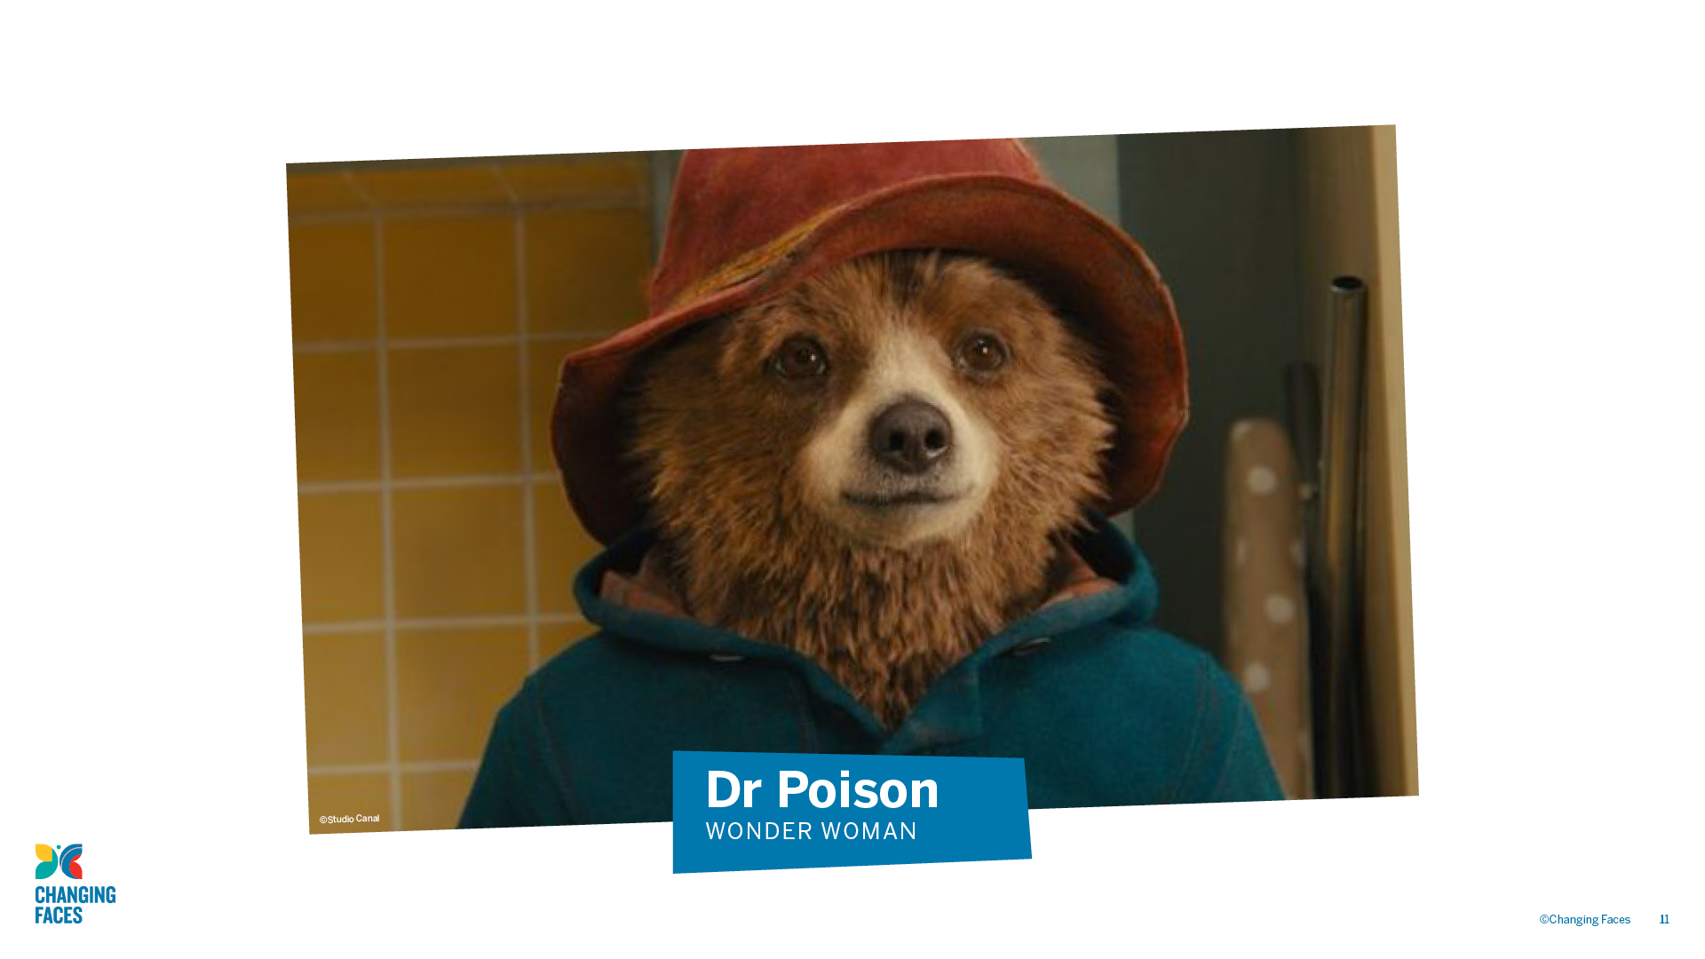

Slide 12
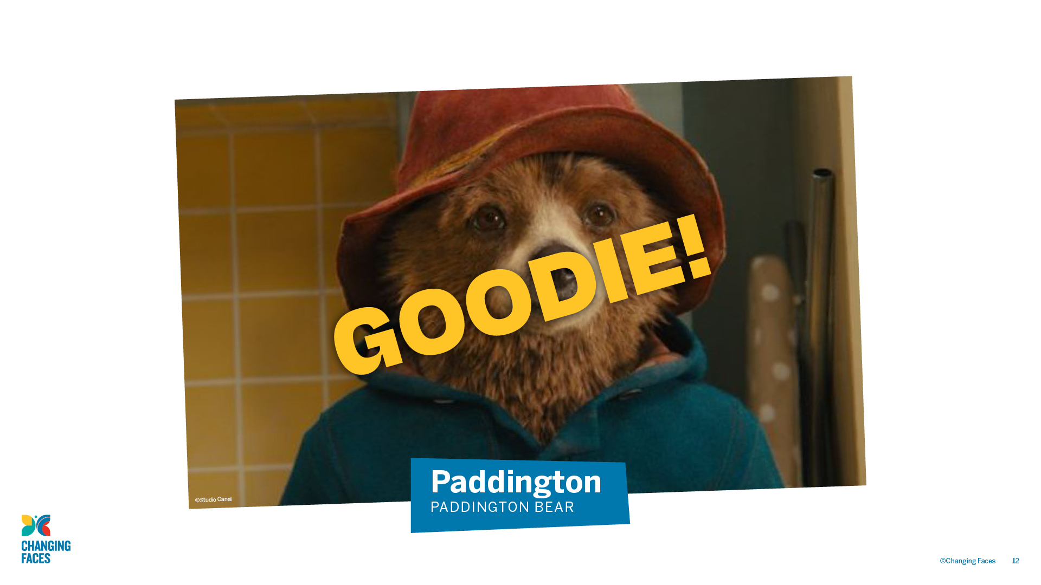

Slide 13
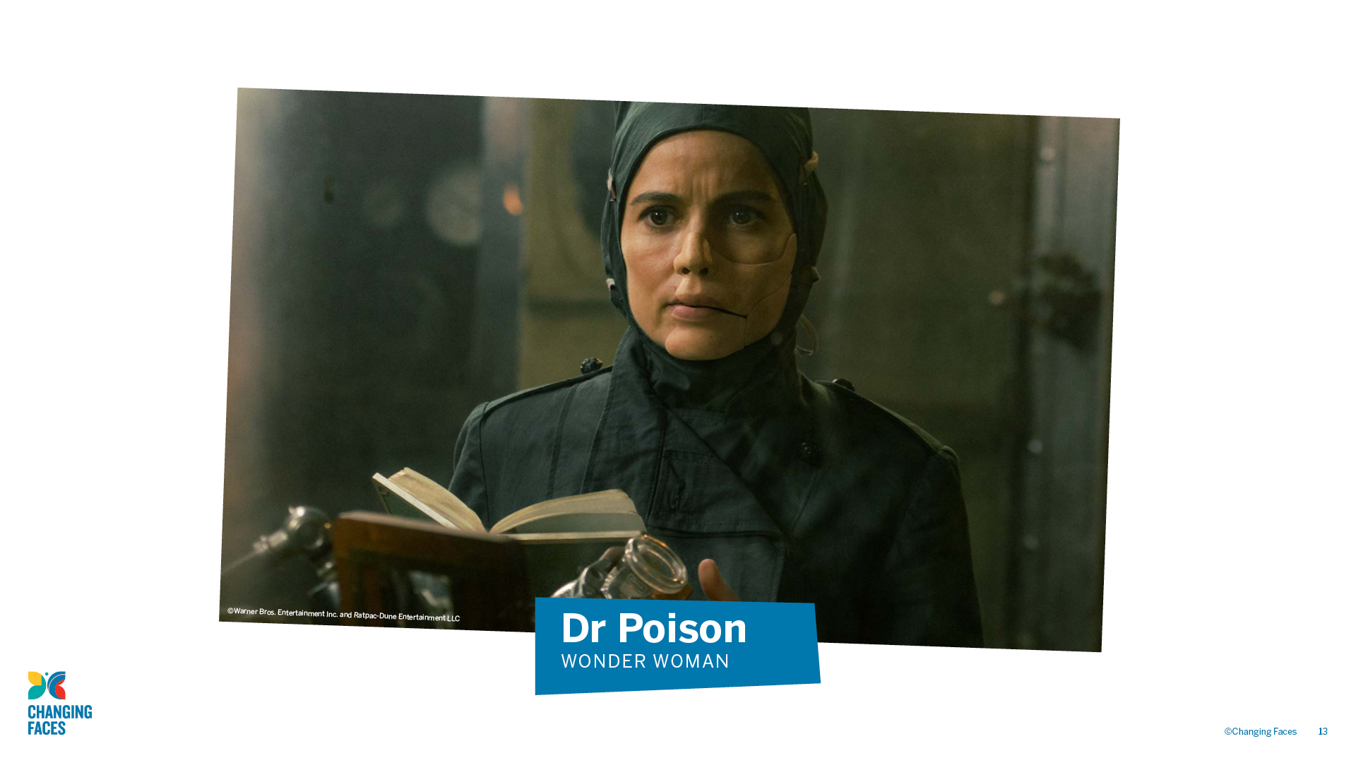

Slide 14
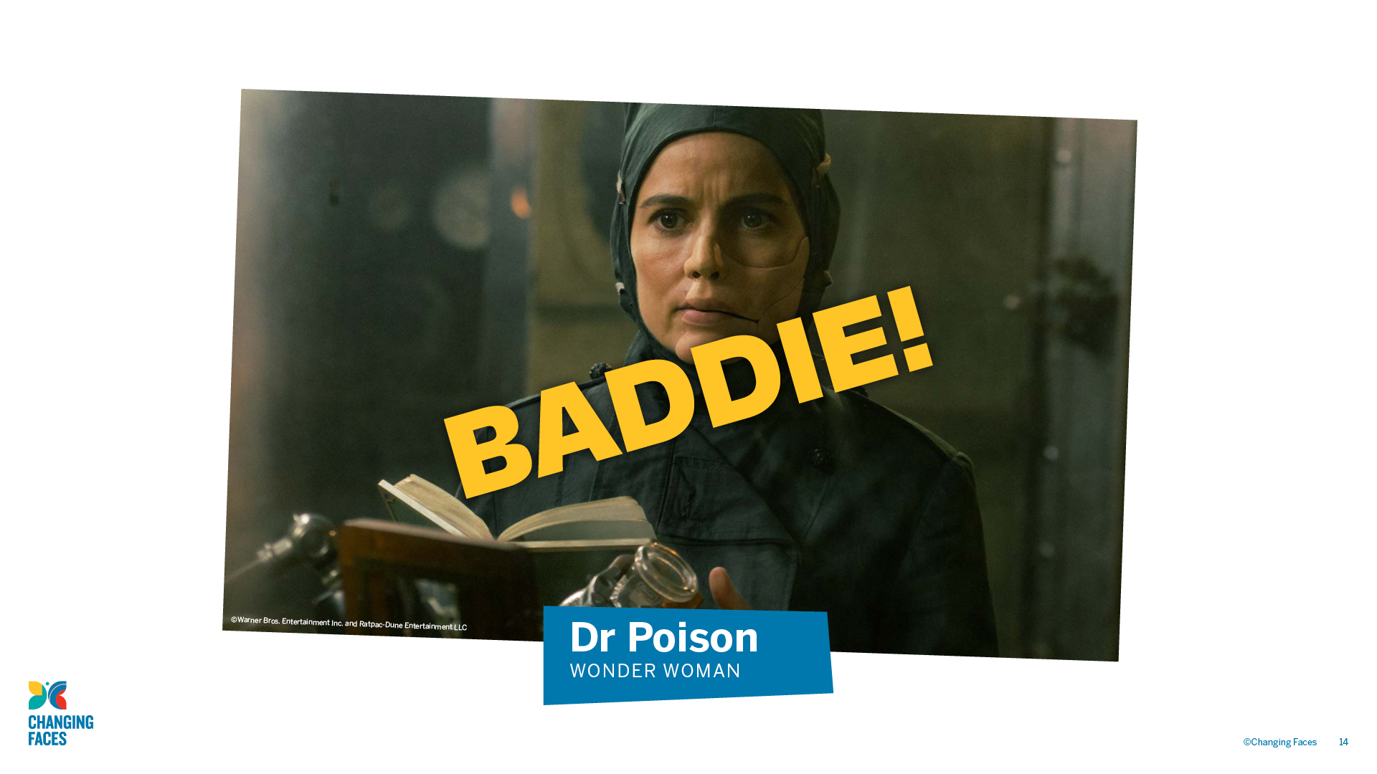

Slide 15
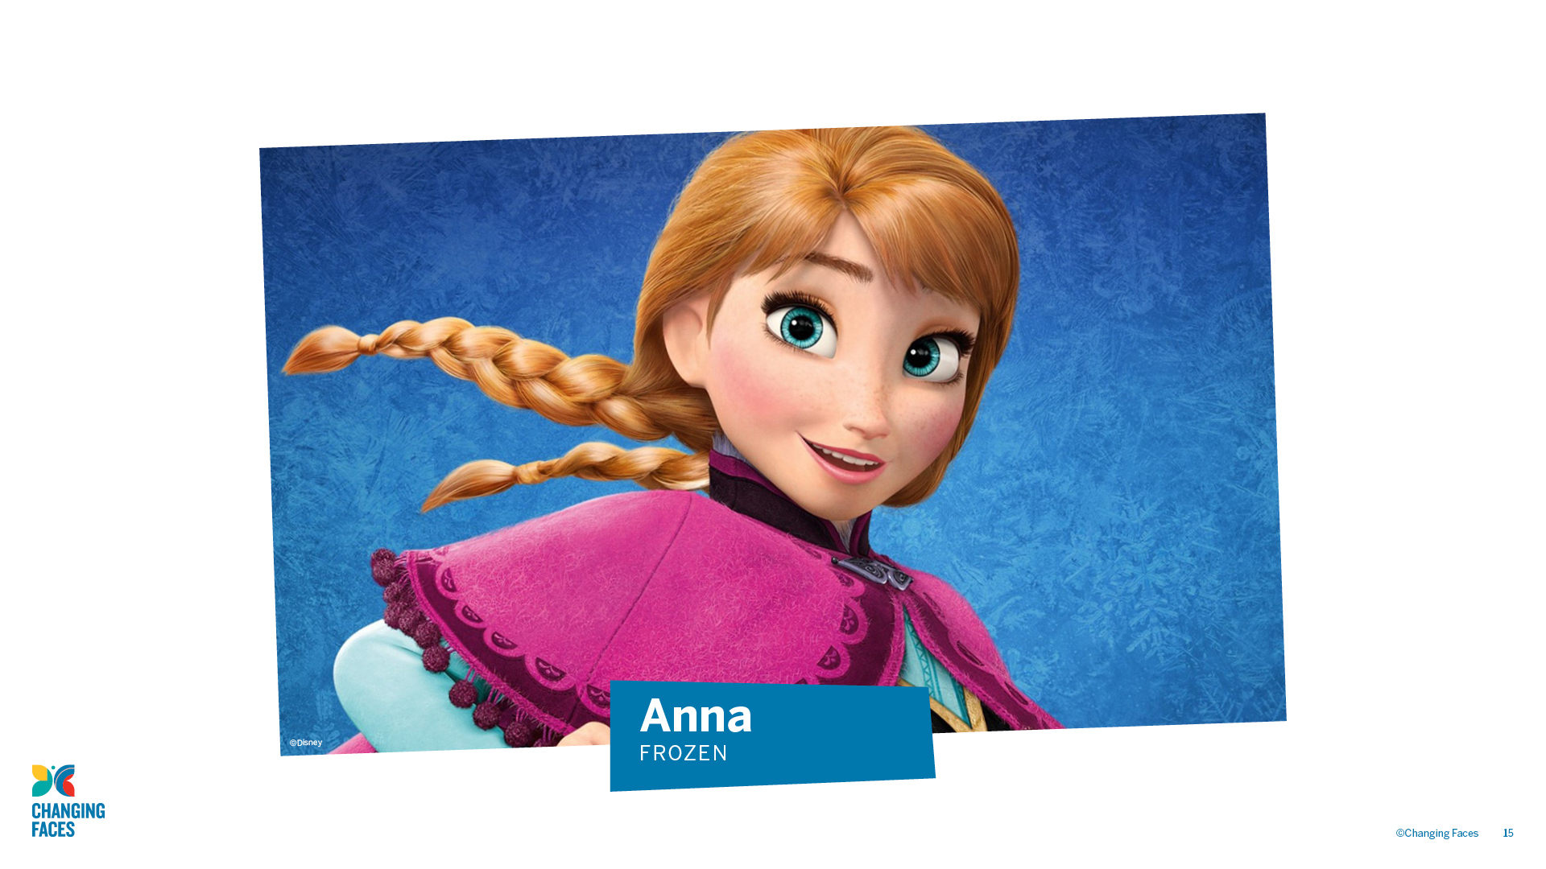

Slide 16
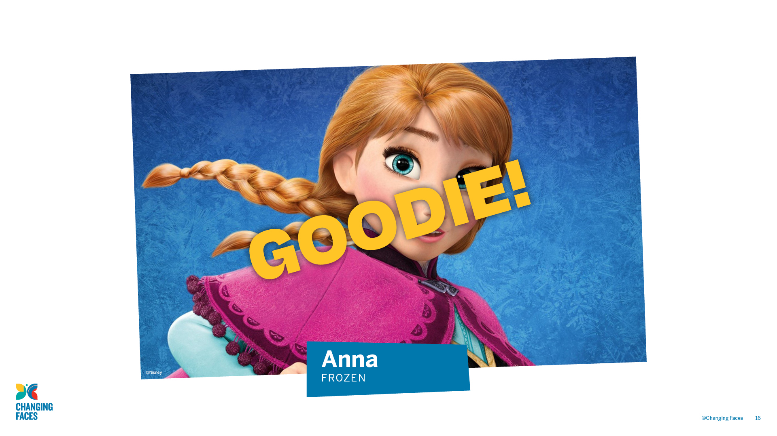

Slide 17
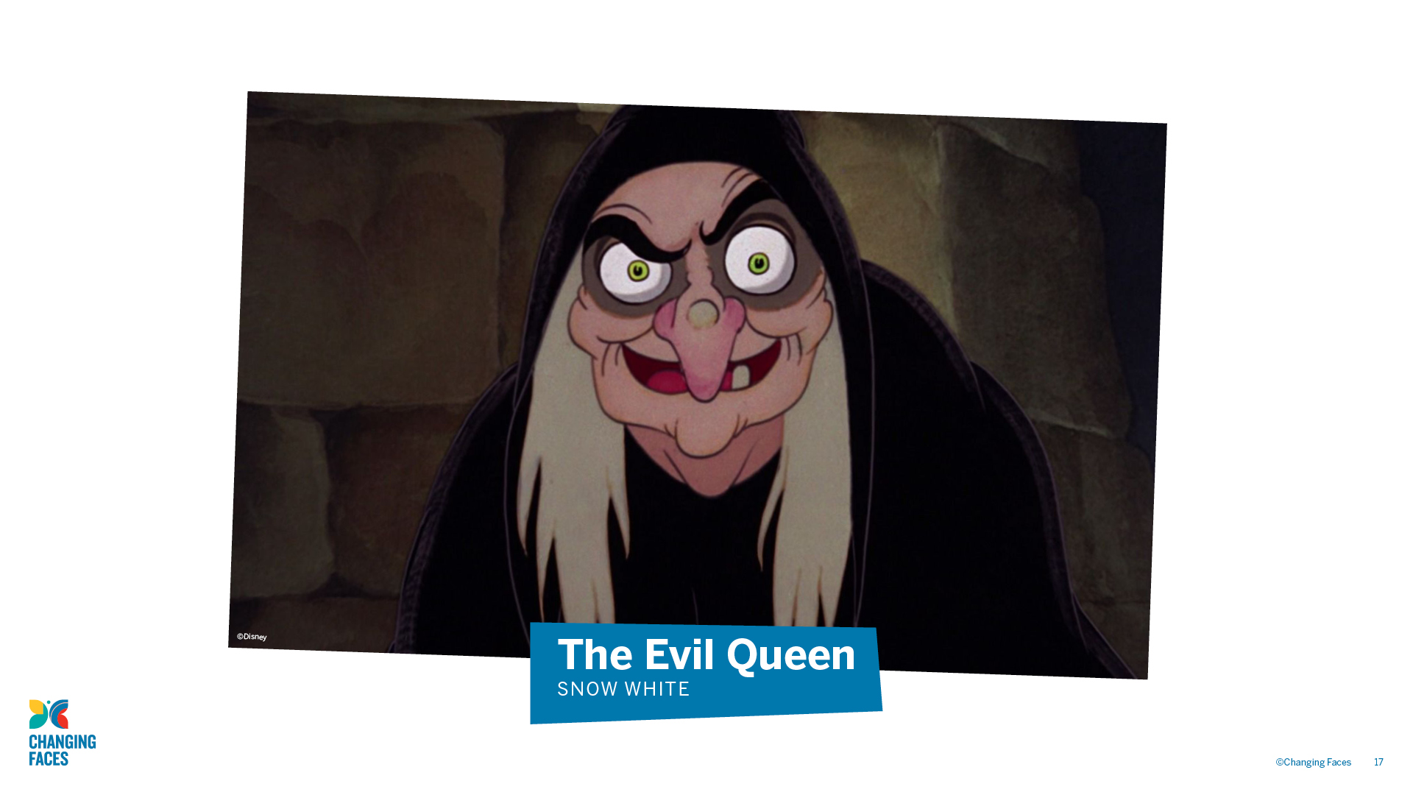

Slide 18
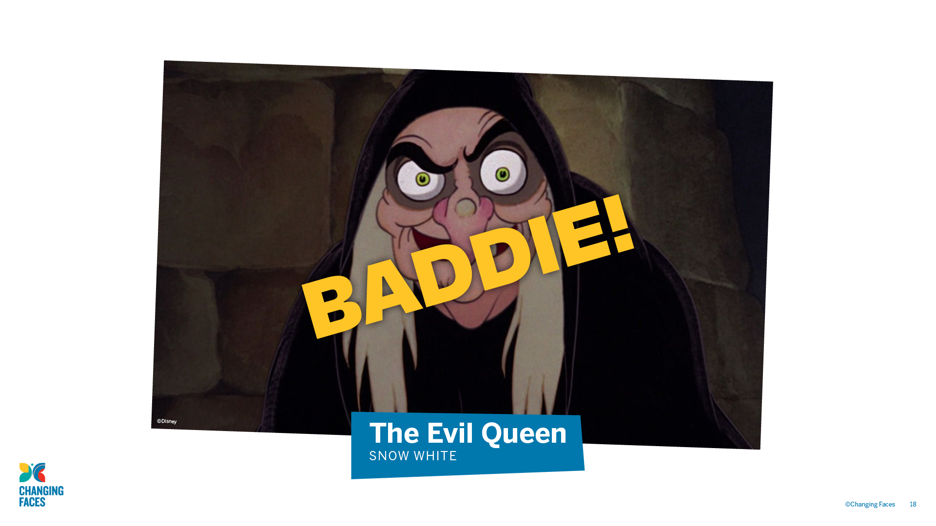

Slide 19

GROUP
DISCUSSION
What did you notice about how the baddies looked?

Slide 20

A stereotype is an idea about a particular group of people that is often untrue or unfair.

Slide 21

Lots of films and TV programmes use the stereotype that if you look different, you must be a baddie. This is really hurtful to people who look different in real life.

Slide 22

A visible difference is a mark, scar or condition that affects the appearance of someone’s face or body

Slide 23

Causes of a visible difference:
Skin conditions like eczema, acne, or vitiligo
Burns
Birthmarks
Craniofacial conditions, affecting the growth and development of the skull and face
Cleft lip/palate (a gap or split in the upper lip and/or roof of the mouth)
Cancer

Slide 24
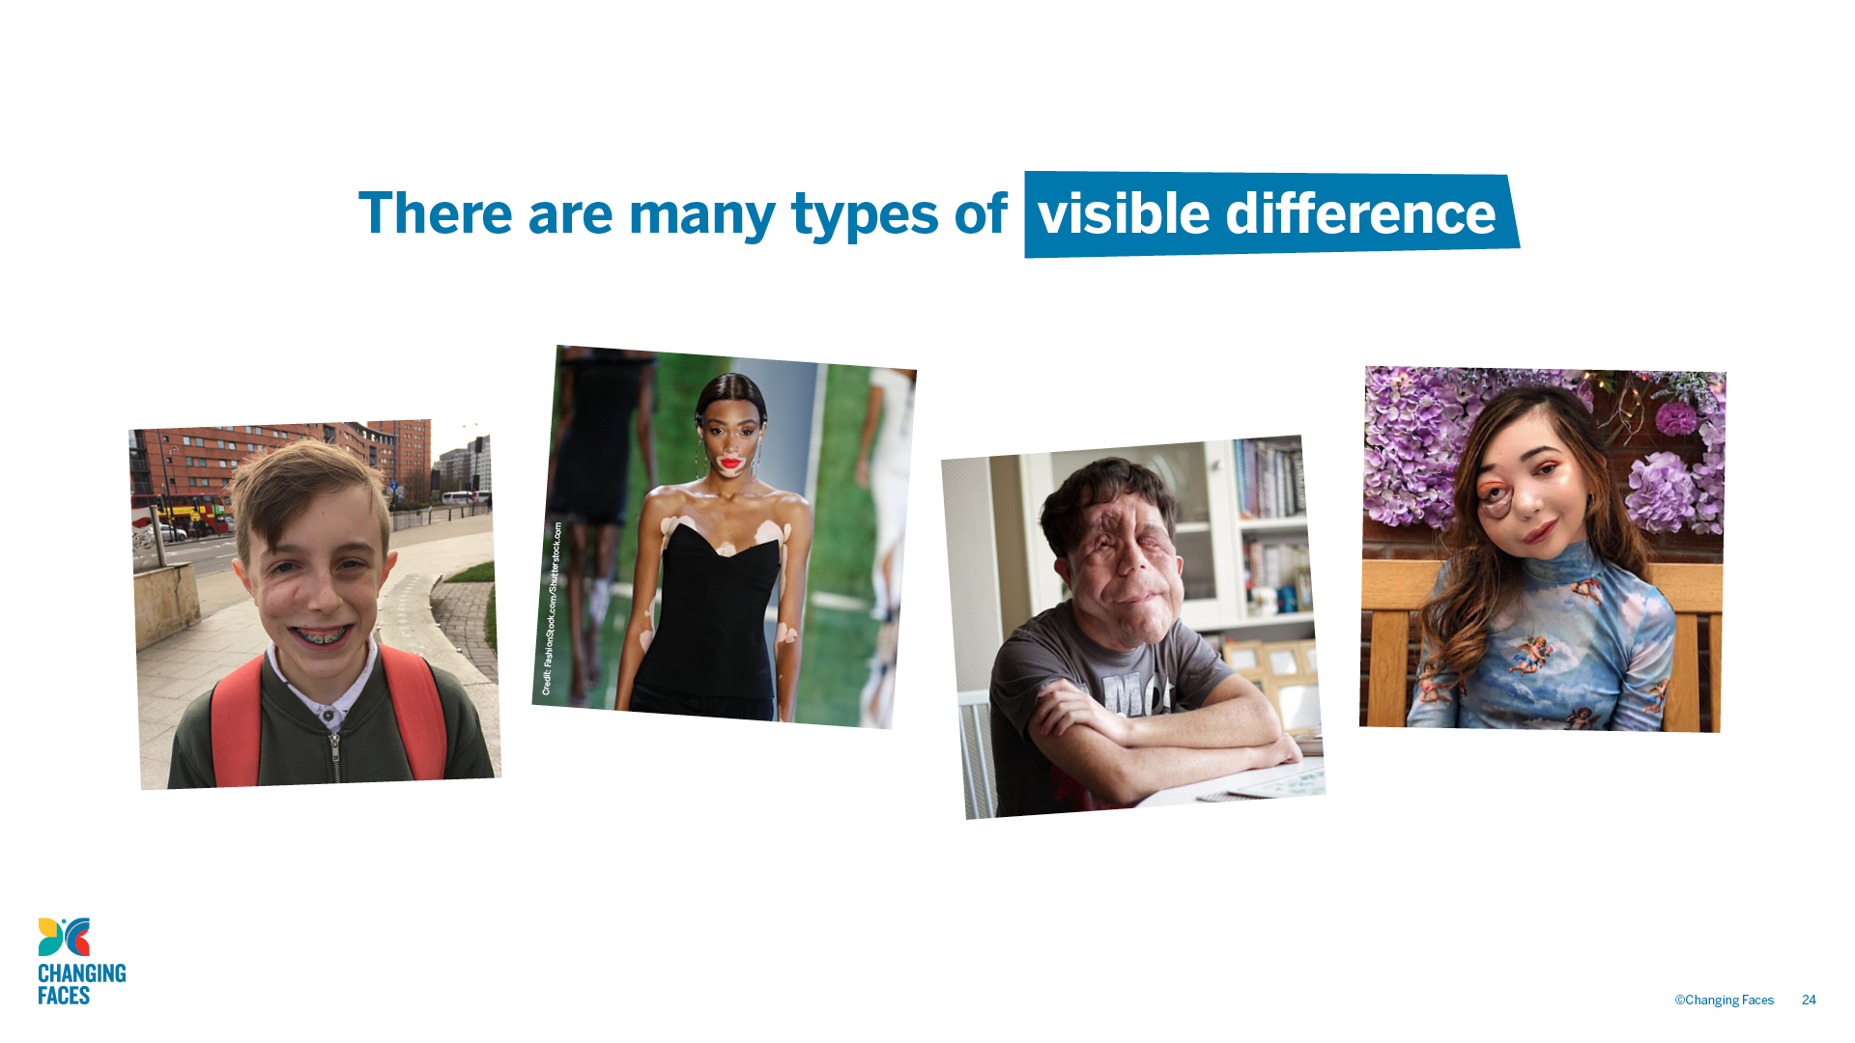

Slide 25
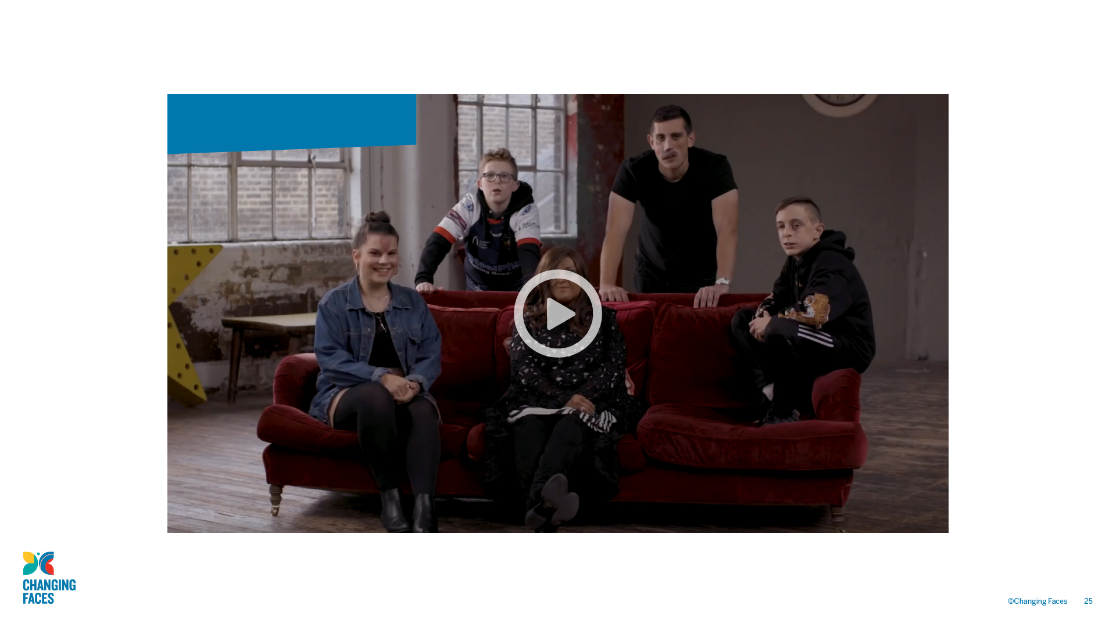
#iamnotyourvillain
#iamnotyourvillain

Slide 26

Other helpful websites
youngminds.org.uk
respectme.org.uk
Find out more about visible differences and respecting difference: changingfaces.org.uk
Worried about anything we’ve discussed?
You can contact Childline for help:
childline.org.uk

