Slide 1
The Curriculum Story Project: 3. The Curriculum Design Cycle
Discussion Activities
For Scotland's learners, with Scotland's educators
Notes:
This is a front cover page and can only be used once. Use the corresponding green internal and back pages if you are using this page. You may add a title and a subtitle if needed only. Do not add anything else or move elements around.

Slide 2
How to use this download pack
The discussion and practical activities in this pack connect to the case studies and ideas around interdisciplinary learning of
The Curriculum Story Project 3: The Curriculum Design Cycle.
While there is value in using them as standalone resources, we encourage teams to read the case studies, together, as part of their own reflective practice.
From 2020-22, The Curriculum Story Project from Education Scotland brought together nearly 200 practitioners to understand the components, processes, and thinking behind successful interdisciplinary learning and the development of broader learner pathways.
The case studies and activities are designed by NoTosh, a firm specialised in helping people think differently and choose the way they learn and work.

Slide 3
Discussion activities
First read the case studies for The Curriculum Story Project – 3: The Curriculum Design Cycle. Then use one of these discussion points for a learning session or team meeting.
Discussion 1. What are the benefits of using a design cycle for curriculum planning and progression?
For example, how could the process of a design cycle enhance current IDL projects, contexts or courses in your setting?
Discussion 2: What are the challenges for ensuring a genuinely collaborative approach to planning using a design cycle?
For example, how would you invest in the time to create collaborative spaces for educators and learners to plan together using a design cycle?
Session 3: How could you apply the practice of learning provocations to kickstart and enhance Interdisciplinary (IDL) projects in your setting?
For example, could you reflect on some recent IDL projects and suggest a variety of provocations that you could use at different intervals to hook and engage learners?
For Scotland's learners, with Scotland's educators
Notes:
This is an internal page in green and can be duplicated to create additional pages. Always keep the heading and footer as shown. Use the corresponding green front and back pages if you are using this page.

Slide 4
The Curriculum Story Project: 3. The Curriculum Design Cycle
Practical Activities
For Scotland's learners, with Scotland's educators
Notes:
This is a front cover page and can only be used once. Use the corresponding blue internal and back pages if you are using this page. You may add a title and a subtitle if needed only. Do not add anything else or move elements around.

Slide 5
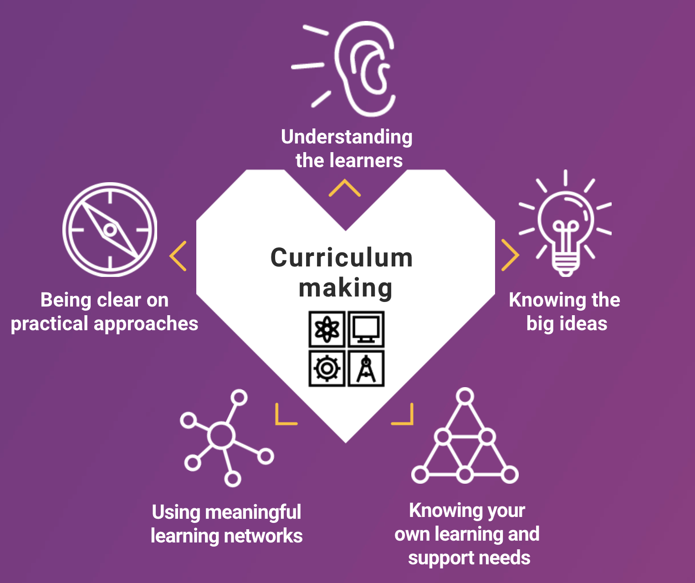
1. Adopt and adapt an enquiry design cycle
A curriculum design cycle is a method of enquiry that emphasise the importance of collaboration and the learner’s role in the process of curriculum-making. The concept of curriculum-making is central to the refreshed narrative for Curriculum For Excellence.
Curriculum-making interprets the process of curriculum planning and design as a continuous process.
For Scotland's learners, with Scotland's educators
Notes:
This is an internal page in blue and can be duplicated to create additional pages. Always keep the heading and footer as shown. Use the corresponding blue internal and back pages if you are using this page.

Slide 6
1. Adopt and adapt an enquiry design cycle
A design cycle is a framework of enquiry that adds clarity and a common language to the process of curriculum-making in educational settings. There are many examples of enquiry design cycles that you may wish to adopt or adapt to fit your context.
The international educator, Kath Murdoch, envisages curriculum design as a ‘journey of inquiry’. She has created a 5 stage framework which begins with concept-driven ‘big ideas’ and ‘compelling questions’ and contexts.
The 5 stages are: 1) Tuning In, 2) Finding Out, 3) Sorting Out, 4) Going Further and, 5) Reflecting and Acting
Prepare 5 large sheets of paper. Title the papers with each of the stages.
Select an IDL project or recent curriculum design project from your setting. Use the headings and questions to reflect on the collaborative process, the involvement of learners and the differences in approach and possible gaps when compared to the enquiry design cycle.
What do you like and what do you dislike about the process? Compare with other models.
For Scotland's learners, with Scotland's educators
Notes:
This is an internal page in blue and can be duplicated to create additional pages. Always keep the heading and footer as shown. Use the corresponding blue internal and back pages if you are using this page.

Slide 7
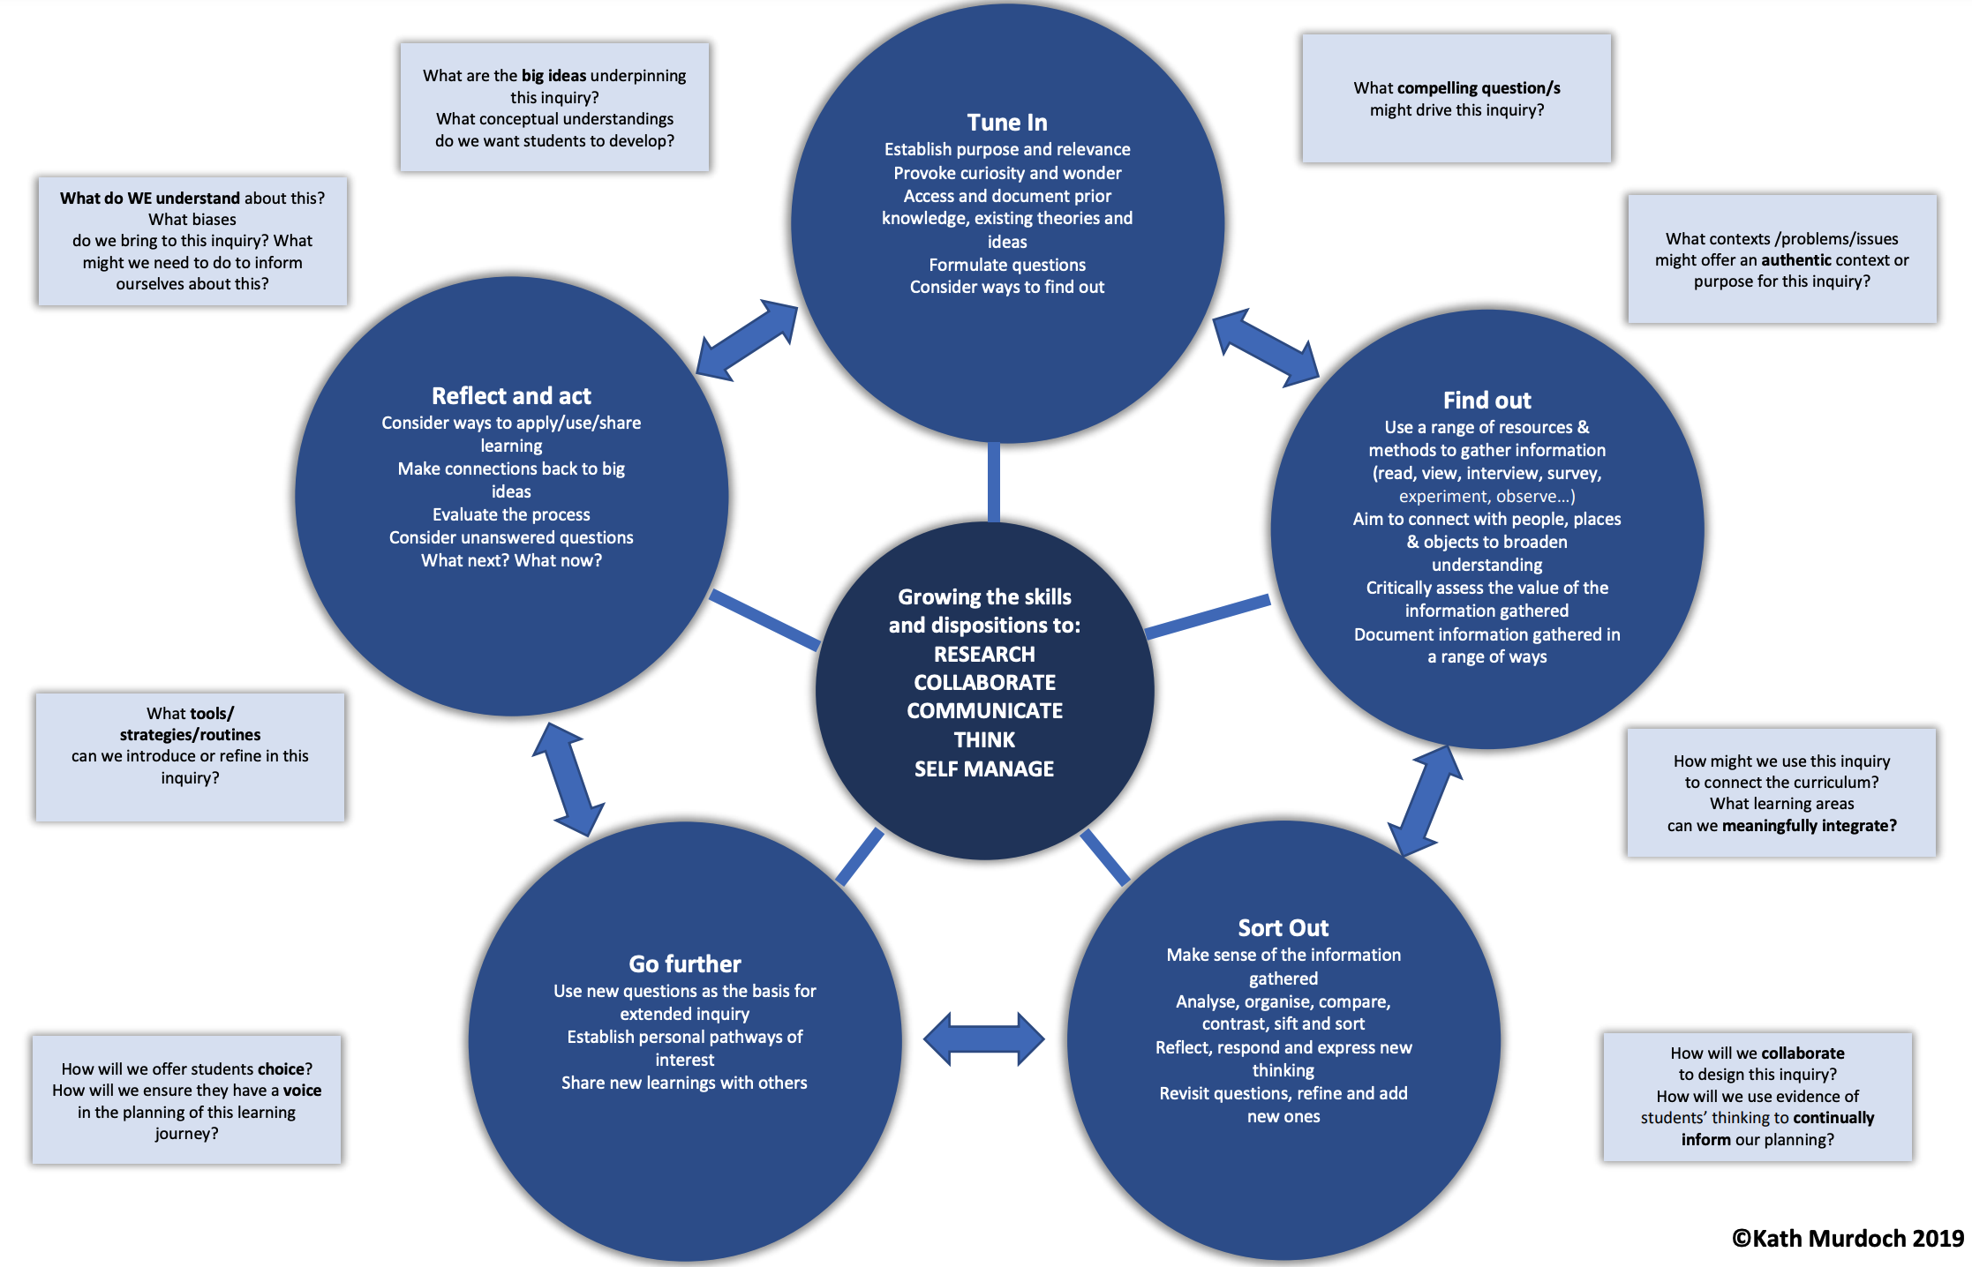
With permission pending
The Curriculum Story Project: 3. The Curriculum Design Cycle

Slide 8
1. Adopt and adapt an enquiry design cycle
Investigate other models adaptive for a curriculum design cycle.
NoTosh Design Thinking process: https://notosh.com/notosh-design-thinking
Project Based Learning – 7 Design Elements: https://www.pblworks.org/what-is-pbl/gold-standard-project-design
Outdoor Journeys – an enquiry cycle for Outdoor Learning: https://www.outdoorjourneys.co.uk/
John Muir Award – Discover, Explore, Conserve, Share: https://www.johnmuirtrust.org/john-muir-award/get-involved/four-challenges
The LAUNCH Cycle – Design Thinking Framework: https://spencerauthor.com/the-launch-cycle/
Sketchnote examples of enquiry cycles: https://www.trevormackenzie.com/sketchnotes
Project Zero Thinking Routine Toolbox – resources to support curriculum-making and a design cycle: http://www.pz.harvard.edu/thinking-routines
For Scotland's learners, with Scotland's educators
Notes:
This is an internal page in blue and can be duplicated to create additional pages. Always keep the heading and footer as shown. Use the corresponding blue internal and back pages if you are using this page.

Slide 9
2. Create a Project Nest to document the progress of the design cycle
A Project Nest is a visual space, physically or virtually, where the thinking and progress of a curriculum design cycle can be documented, shared and discussed. It works as a continual reminder of the collaborative process and a centralised hub for educators and learners to visit where they can keep their ideas and enthusiasm bubbling away. A Project Nest can also be a critical component of an IDL project’s initial phase, linking questions and research to the development of ideas and learning activities.
Think of ways to create your own Project Nest in your setting. Here are some suggestions:
Decide whether you need to use a single wall, a whole room or several set display areas.
Who will see the Project Nest? Make the space as accessible as possible, especially to include learners.
Keep items, ideas and resources at eye level – it helps to motivate participants and spot connections too.
Encourage participants to continually contribute their thoughts to the Project Nest.
Invite other colleagues, parents and the wider community to visit the Project Nest – provide post-it notes for them to leave comment.
Keep it messy! It is a work in progress until you are ready to start organising your ideas.
For Scotland's learners, with Scotland's educators
Notes:
This is an internal page in blue and can be duplicated to create additional pages. Always keep the heading and footer as shown. Use the corresponding blue internal and back pages if you are using this page.

Slide 10
2. Create a Project Nest to document the progress of the design cycle
Collaborative digital learning tools can compliment a physical Project Nest or provide an online space when working remotely or across a large setting.
Online Digital Whiteboards
Miro - https://miro.com/online-whiteboard/
Google Jamboard - https://jamboard.google.com/
Interactive 360° Virtual Spaces
Thinglink - https://www.thinglink.com/edu
CoSpaces - https://cospaces.io/edu/
Discuss and Amplify Voices
Flipgrid - https://info.flipgrid.com/
Collation tool for collecting and sharing everything in one place
Wakelet - https://wakelet.com/
For Scotland's learners, with Scotland's educators
Notes:
This is an internal page in blue and can be duplicated to create additional pages. Always keep the heading and footer as shown. Use the corresponding blue internal and back pages if you are using this page.

Slide 11
Education Scotland
Denholm House
Almondvale Business Park
Almondvale Way
Livingston EH54 6GA
T +44 (0)131 244 5000
E enquiries@educationscotland.gsi.gov.uk
For Scotland's learners, with Scotland's educators
Notes:
This is a back cover page in blue. You may edit the address if needed only. It can only be once and at the end of the PowerPoint presentation. Use the corresponding blue internal and back pages if you are using this page.

Slide 12
Notes:
This is a front cover page and can only be used at the beginning of a PowerPoint presentation once. Do not add anything else to this screen if it is being used.

