Slide 1
St.Peter’s Primary School
Food for Thought Project – Phase 8

Slide 2
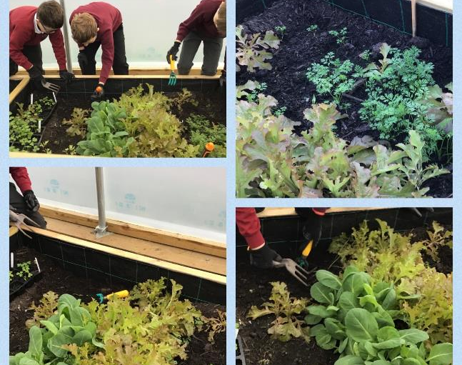
Crops Grown in Our Polytunnel

Slide 3
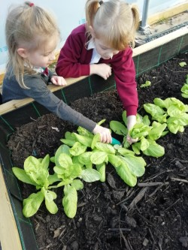
Crops Ready to Harvest

Slide 4
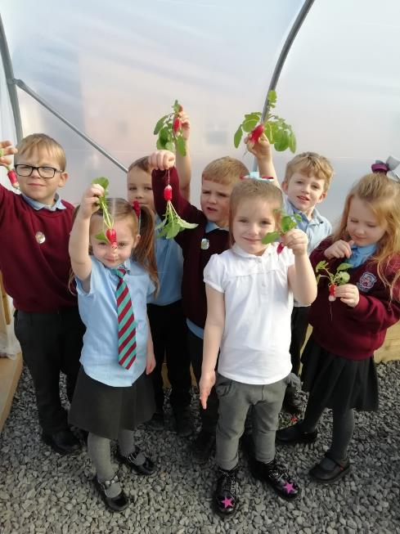
Harvesting Our Crops

Slide 5
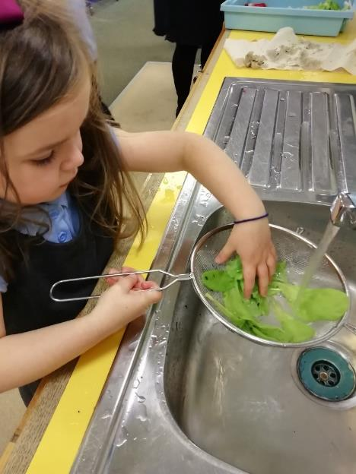
Crops Being Washed

Slide 6
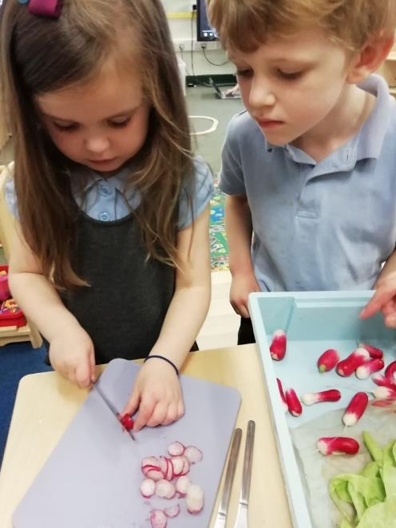
Developing Our Chopping Skills

Slide 7
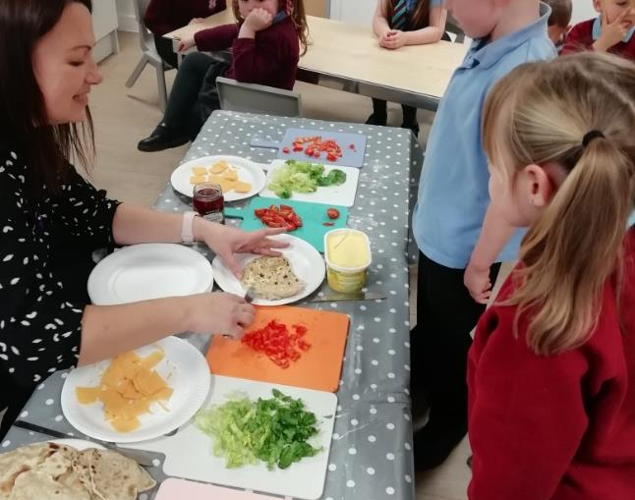
Ready to Eat!

Slide 8
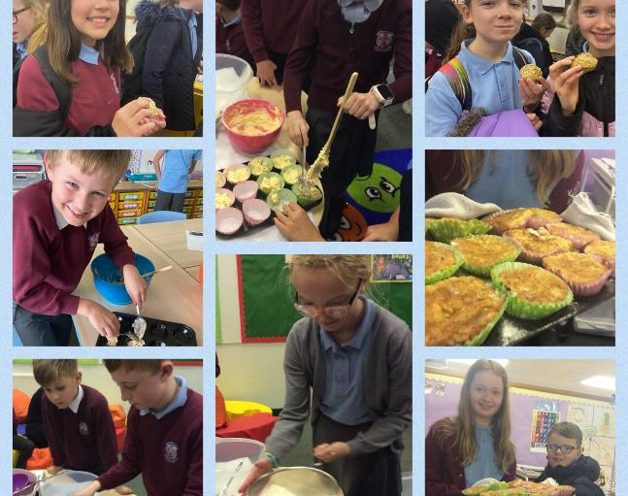
Developing Cooking Skills Across the School

Slide 9
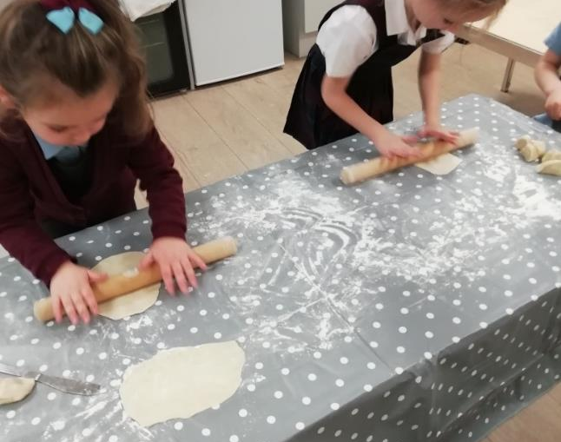
Developing our Rolling Skills

Slide 10
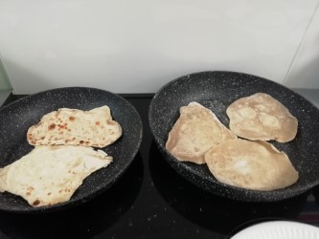
Flat Breads are Ready

Slide 11
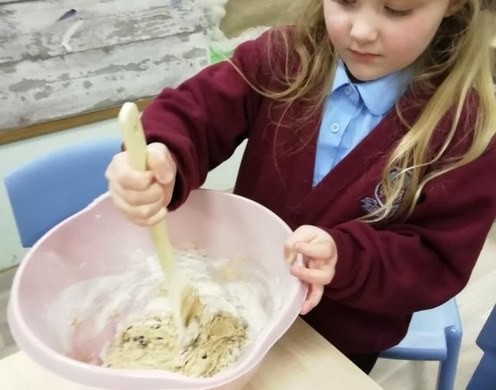
Practising our Mixing Skills

Slide 12
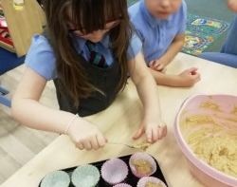
Making Muffins

Slide 13
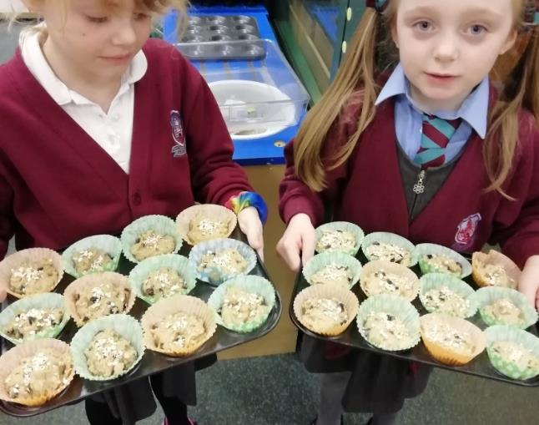
Our Muffins are Ready to Eat!

Slide 14
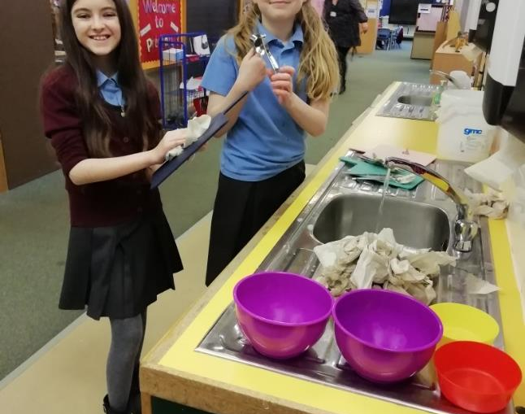
Willing Helpers to Clear Up

