Slide 1
Inclusion, Wellbeing and Equalities Framework – Rights and Equalities
Develop Your Religious Literacy Part 1 Level – Informed
@ESInclusionTeam
For Scotland's learners, with Scotland's educators
Do luchd-ionnsachaidh na h-Alba, le luchd-foghlaim Alba
Notes:
SLIDE 1:
This professional learning is pitched at an informed level and is suitable for anyone working with children, young people and adult learners in an educational context. This resource has been developed in partnership with Interfaith Scotland and Education Scotland. Information about the work of Interfaith Scotland can be found at www.interfaithscotland.org
Further information and signposts to further reading, resources and professional learning can be found in the related Information Note entitled “Develop Your Religious Literacy Part 1.”

Slide 2
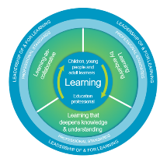
How to use this resource
Pause for Thought…
These slides can be used to facilitate professional learning in a group or whole-setting, or as a self-directed learning activity as an individual.
Facilitation notes are included at the bottom of each slide
Please do not remove or change any of the slides included.
Facilitators are welcome to add slides or activities relevant to your own setting, to support discussion and exploration of the topic. Facilitators will know their participants’ needs best.
Anyone who works in an educational setting can be a facilitator and use these slides.
For reflection or discussion activities, it is important to establish a safe space which encourages respect and honesty to ensure that everyone is able to participate.
Notes:
Slide 2
[Option to skip this slide as instructions for facilitators only. No need to read to audience]
These slides can be used to facilitate professional learning in a group or whole-setting, or as a self-directed learning activity as an individual.
Facilitation notes are included at the bottom of each slide
Please do not remove or change any of the slides included.
Facilitators are welcome to add slides or activities relevant to your own setting, to support discussion and exploration of the topic. Facilitators will know their participants’ needs best.
Anyone who works in an educational setting can be a facilitator and use these slides.
For reflection or discussion activities, it is important to establish a safe space which encourages respect and honesty to ensure that everyone is able to participate.
FACILITATION NOTES can also be found on a separate Word document on the Education Scotland Inclusion, Wellbeing and Equalities Professional Learning Framework.

Slide 3
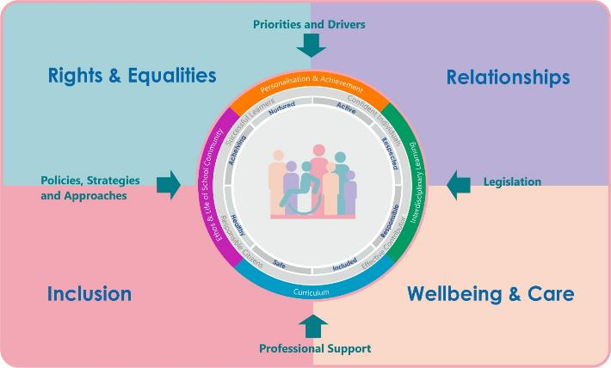
IWE Professional Learning Framework
Notes:
Slide 3
This professional learning resource comes under the Rights and Equalities theme of the Inclusion, Wellbeing and Equalities Professional Learning Framework.

Slide 4
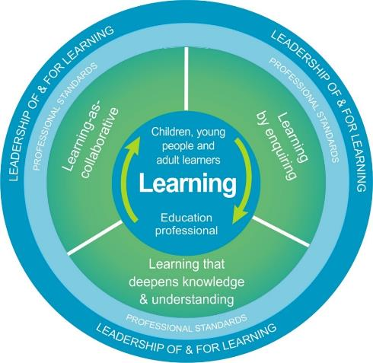
National Model for Professional Learning
This professional learning resource will support you to deepen your knowledge and understanding.
You will have the opportunity to consider how to take this learning forward on your own and with others.
The National Model of Professional Learning (education.gov.scot)
Notes:
Slide 4
This professional learning resource follows the national model for professional learning and is designed to help you gain more knowledge and have a deeper understanding of inclusion, wellbeing and equalities.
You will have the opportunity to consider how to take this learning forward on your own and with others and, on completion of the professional learning, you will be asked to consider what your next steps will be.
Please take some time to consider the reflective questions at the end of this resource
Links: The National Model of Professional Learning

Slide 5
Welcome
Pause for Thought…
This session provides an opportunity to help you develop your religious literacy by:
Considering religious discrimination and bullying.
Introducing the core beliefs of the six main faiths in the UK (Buddhism, Christianity, Hinduism, Islam, Judaism, and Sikhism).
Identifying sources of additional learning about each faith.
Helping you consider the needs of learners relating to their religious beliefs.
Notes:
Slide 5
This session provides an opportunity to:
Introduce the core beliefs of the six main faiths in the UK. These are (in alphabetical order) Buddhism, Christianity, Hinduism, Islam, Judaism, and Sikhism.
Identify sources of additional learning about each faith
Begin to consider the needs of learners relating to their religious beliefs
By religious literacy, there resources refer primarily to the ability to develop an understanding of elements of different religions, faiths and belief systems in order to meet the needs of diverse communities, promote inclusion and prevent discrimination.
Facilitator might add that the term ‘Abrahamic Faiths’ is often used to describe Judaism, Christianity and Islam because the figure of Abraham is important to all three. Similarly, but less well-known in the UK, is the term ‘Dharmic Faiths’ which describes Buddhism, Hinduism and Sikhism and recognises that there are similarities between these three faiths that developed in the Indian Subcontinent.

Slide 6
Religious Discrimination and Bullying
Pause for Thought…
What is it and what is its relevance to public bodies?
Notes:
Slide 6
Religious Discrimination and Bullying
What is it and what is its relevance for public bodies?
(ask participants if they can think of a definition for each and discuss why it is of relevance to public bodies)

Slide 7
What is religious discrimination?
Religious discrimination can include:
being treated differently because of a person’s religion, perceived religion or lack of religion or beliefs.
incidents when people make wrong assumptions about a person’s religion.
Learners, staff, families and wider community members might be at risk of experiencing religious discrimination.
Notes:
SLIDE 7
What is religious discrimination?
Religious discrimination can include:
being treated differently because of a person’s religion, perceived religion or lack of religion or beliefs.
incidents when people make wrong assumptions about a person’s religion.
Learners, staff, families and wider community members might be at risk of experiencing religious discrimination.

Slide 8
What is religious bullying?
Religious bullying can happen when people say hurtful things or actions because of a person’s religion. This can include being bullied about:
their name,
religious practices such as not eating meat or drinking alcohol,
religious clothing and symbols such as headscarf, cross or kara.
It could include trying to remove religious clothing or symbols.
It can also include being pressured into doing things that people know are against the person’s religion.
Notes:
SLIDE 8:
What is religious bullying?
Religious bullying can happen when people say hurtful things or actions because of a person’s religion. This can include being bullied about:
their name,
religious practices such as not eating meat or drinking alcohol,
religious clothing and symbols such as headscarf, cross or kara.
It could include trying to remove religious clothing or symbols.
It can also include being pressured into doing things that people know are against the person’s religion.
The following website includes excellent information and videos on religion and bullying, discrimination and stereotyping: Faith and religious bullying | Childline
Scotland’s Anti-Bullying Service, Respectme, has a range of useful resources and guidance: Home – respectme

Slide 9
What is the relevance to public bodies?
Religion and belief are a protected characteristic under the Equality Act 2010.
The Public Sector Equality Duty requires all public bodies (including many education settings) to take steps to eliminate discrimination.
The Hate Crime Strategy for Scotland 2023 protects people experiencing hate crime based on prejudice towards people based on religion or perceived religious identity.
Notes:
Slide 9:
What is the relevance to public bodies?
Religion and belief are a protected characteristic under the Equality Act 2010.
The Public Sector Equality Duty requires all public bodies (including many education settings) to take steps to eliminate discrimination.
The Hate Crime Strategy for Scotland 2023 protects people experiencing hate crime based on prejudice towards people based on religion or perceived religious identity.
To find out more about the Hate Crime for Scotland 2023 Strategy, please consider the following: 3. What is hate crime? - Hate crime strategy - gov.scot (www.gov.scot)

Slide 10
Provocation
“We get taught about how to appreciate Scotland and a lot about things in a Christian way, but I am Muslim, not Christian. I don’t get taught anything about my culture and neither does anyone in my school …. the teacher usually puts it on me to educate other people which is not fair, and it makes me feel even more like I am not included.” (Secondary school age learner)” (p.20)
Putting Learners at the Centre: Towards a Future Vision for Scottish Education (www.gov.scot)
Notes:
SLIDE 10:
Here is a quote from a secondary school age learner, taken from the website Putting Learners at the Centre: Towards a Future Vision for Scottish Education (www.gov.scot)
“We get taught about how to appreciate Scotland and a lot about things in a Christian way, but I am Muslim, not Christian. I don’t get taught anything about my culture and neither does anyone in my school …. the teacher usually puts it on me to educate other people which is not fair, and it makes me feel even more like I am not included.” (p.20)
Scotland is a society with a longstanding Christian tradition. Scotland has for many years also been home to a diversity of religions and beliefs and this diversity continues to increase. While some learners may be keen to share information about their religion and belief, we must remember that it is not their responsibility to educate others. This young person’s words reveal how it can make learners feel. We hope that this resource, and Part 2 of this resource, will equip people with some of the knowledge needed to include all learners in Scotland.

Slide 11
Core beliefs of the main faiths
Pause for Thought…
We will be exploring the six largest faiths in the UK: Buddhism, Christianity, Hinduism, Islam, Judaism, and Sikhism.
We can only cover the most basic information about each faith, please follow the links at the end to continue your learning on each one.
Remember that with any faith, two people who follow the same faith may have quite different beliefs and customs.
Religious belief and cultural attitudes & norms can be difficult to separate.
Notes:
Slide 11
Core beliefs of the main faiths
We will be exploring the six largest faiths in the UK: Buddhism, Christianity, Hinduism, Islam, Judaism, and Sikhism
We can only cover the most basic information about each faith, please follow the links at the end to continue your learning on each one
Remember that with any faith, two people who follow the same faith may have quite different beliefs and customs
Religious belief and cultural attitudes & norms can be difficult to separate
It is crucial to emphasise here how much more there is to learn about each of the faiths. It is not possible to provide comprehensive summaries in such a short resource and so the following slides should be considered as providing just the ‘headlines’ about each faith.
It is also worth noting that religious beliefs and cultural attitudes & norms can be difficult to separate. For example, many people of South Asian heritage prefer guests to take their shoes off when entering their home and may express this as part of their religion, whereas others may view it instead as a cultural feature.

Slide 12
Diversity
Linguistic
Religion / Belief
Pause for Thought…
Socioeconomic
Ethnic/Cultural/Racial
Disability
Gender/Sex
Neurodiversity
Sexual Orientation
Age
Family
Notes:
Slide 13
The features of diversity represented on the diagram have been inspired by the protected characteristics (disability, age, race, religion & belief, sex, gender reassignment, pregnancy and maternity, sexual orientation and marriage and civil partnership) from the Equality Act 2010, the non-protected characteristics that are most relevant in the context of Scottish education and groups that are protected under the Education (Additional Support for Learning) (Scotland) Act 2004.
When we take a closer look at different features of diversity – in this case religion and belief – it is important to remember that there is diversity of belief and practice both within and across religious groups. It is also worth bearing in mind that diverse people are not homogenous, we all hold unique identities and strengths, and we should not be viewed through a lens of deficit. Also remember that every person has multiple characteristics which interact and intersect with each other. For example, the experiences of a young, Muslim girl of Pakistani heritage will likely have both similarities and differences with those of an older, Muslim man of Nigerian heritage.
If in doubt about an aspect of religion and belief, consider contacting one of the religious groups in the appendix for advice and/or seek views of the religious groups which are a part of your community.

Slide 13
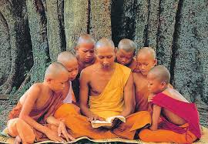
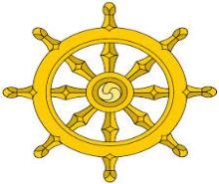
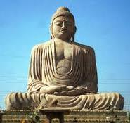
Buddhists and Buddhism
Pause for Thought…
Siddhartha Gautama, ‘the Buddha’, is the faith’s founder
Buddhism teaches the means by which anyone can achieve enlightenment – a state of profound inner peace and recognition of the connectedness of everything
Followers believe that suffering is rooted in our wants and desires
Meditation is often practised as a means of calming the mind and deepening compassion
Non-violence is a key principle, and Buddhists will typically be vegetarian/ vegan and avoid killing or harming any animal or person
Notes:
Slide 14
Buddhists and Buddhism
Siddhartha Gautama, ‘the Buddha’, is the faith’s founder
Buddhism teaches the means by which anyone can achieve enlightenment – a state of profound inner peace and recognition of the connectedness of everything
Followers believe that suffering is rooted in our wants and desires
Meditation is often practised as a means of calming the mind and deepening compassion
Non-violence is a key principle, and Buddhists will typically be vegetarian/ vegan and avoid killing or harming any animal or person
Top right image is of an adult Buddhist monk reading from a book to a group of younger monks. Buddhist monks are often recognisable by their shaved heads and yellow, orange or red robes.
The image beneath is of the symbol of Buddhism. The wheel is often used as a symbol of Buddhism because its eight spokes represent the ‘Noble eight-fold path’ which are eight rules that Buddhists seek to follow in their lives. They include ‘right speech’, for example telling the truth at all times. Another rule is ‘right livelihood’ meaning only conducting ethical work and not engaging in work that causes harm such as selling alcohol or weapons. The wheel also symbolizes the endless cycle of birth, life, death, rebirth (known as ‘Samsara’) which Buddhists seek to escape.
The image bottom right is of the Buddha, with his hands clasped in his lap in meditation.

Slide 14
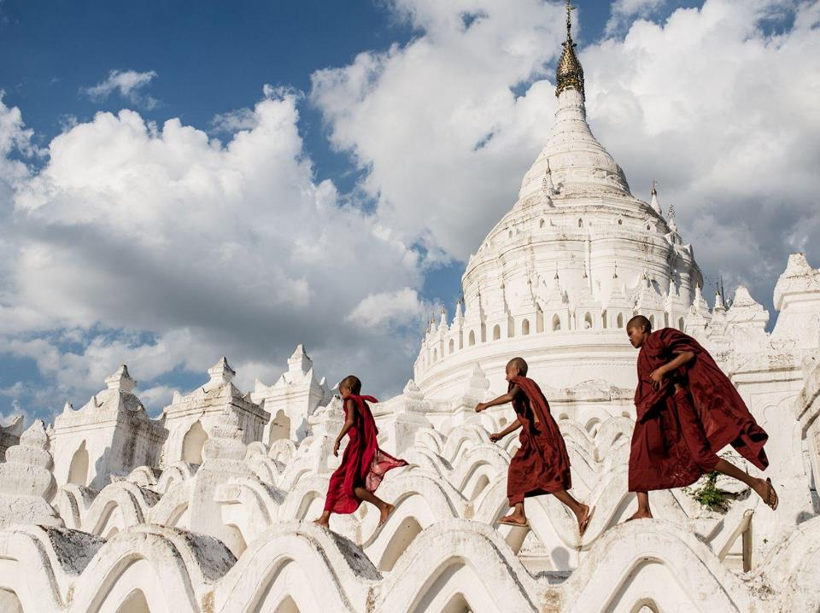
Holding onto anger is like drinking poison and expecting the other person to die
Buddha
Notes:
Slide 14
The image shows three young Buddhist monks in red robes running over the roof of a traditional Buddhist stupa.
The text reads ‘Holding onto anger is like drinking poison and expecting the other person to die’.
The intention with quoting the line from the Buddha’s teachings is to give an example of the wisdom that can be found in Buddhism. There is a similar combination of image and quotation after each faith.

Slide 15
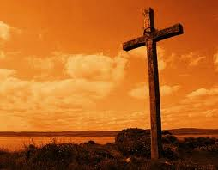
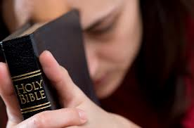
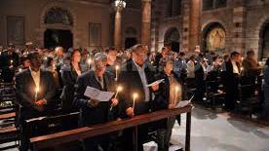
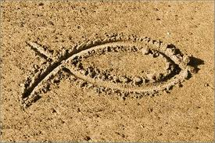
Christians and Christianity
Pe for Thought…
Christianity developed 2000 years ago in what is now Israel.
Its founder is Jesus Christ, who Christians believe to be the Son of God and the Messiah.
Christians believe in one God, with three elements: Father, Son and Holy Spirit
The holy book is the Bible (both New and Old Testaments)
The faith emphasises love for all people and Christians are encouraged to ‘love thy neighbour as thyself’
The cross is a sacred symbol commemorating Jesus’ death and resurrection and God’s forgiveness of sins
Notes:
Slide 15
Christians and Christianity
Christianity developed 2000 years ago in what is now Israel.
Its founder is Jesus Christ, who Christians believe to be the Son of God and the Messiah.
Christians believe in one God, with three elements: Father, Son and Holy Spirit
The holy book is the Bible (both New and Old Testaments)
The faith emphasises love for all people and Christians are encouraged to ‘love thy neighbour as thyself’
The cross is a sacred symbol commemorating Jesus’ death and resurrection and God’s forgiveness of sins
The top right image is of a wooden cross, representative of the cross that Jesus is believed to have been crucified upon.
The next image is of a worshipper praying while holding the Bible.
Beneath that is of the inside of a church with the congregation in worship together. The image bottom left is of the simplified fish symbol of Christianity sometimes called ‘The Jesus Fish’.
Facilitators may add that while the cross is a very widely-recognised symbol of Christianity today, the fish symbol is more ancient. It is known as Ichthys which is the Greek word for ‘fish’. In Greek, the letters ἸΧΘΥΣ (IKhThUS), form an acronym for Ἰησοῦς Χρῑστός Θεοῦ Υἱός Σωτήρ, which translates to "Jesus Christ, God's Son, Savior“. That sentence conveys the core belief of Christians – that Jesus was the son of God and saviour of humanity.
Could add that Christianity is the world’s largest religion with around 2.4 billion followers. Worldwide there are a great many different denominations of Christian with diverse practices and beliefs. These include Orthodox, Protestant, Catholic, Pentecostal etc.
In general Christians do not follow specific dietary rules, and moderate consumption of alcohol is permitted.

Slide 16
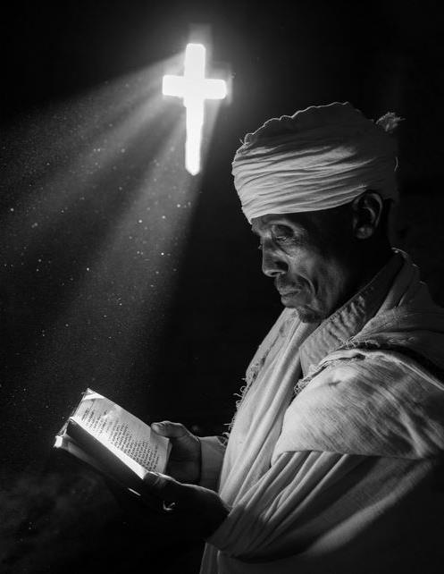
Slide 11
Let all that you do be done in Love 1 Corinthians 16:14
Notes:
Slide 16
The image shows an Ethiopian Orthodox worshipper reading from a book (presumably the Bible). Note the book is written in Ethiopic or ‘Ge’ez’ script. The light streams into the room from a cross-shaped window cut into the wall.
The text reads ‘Let all that you do be done in Love 1 Corinthians 16:14’
The Biblical verse conveys the emphasis on love in the Christian teachings.

Slide 17
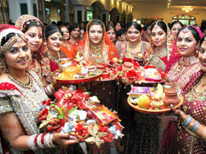
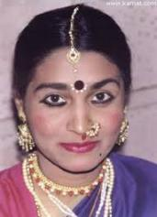
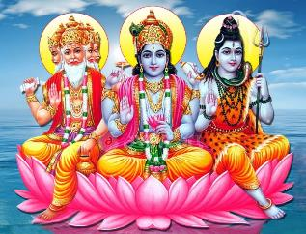
Hindus and Hinduism
Pause for Thought…
Hinduism developed many thousand years ago in India.
It has no single founder and there is wide variation of beliefs & practices among Hindus.
Hindus worship a large pantheon of gods, including Brahma, Vishnu and Shiva. Each one is considered an expression of the one God Brahman
Hindus believe in Karma: the sum of your actions influence your future fate
The soul is immortal and after death we will be reborn
Often vegetarian, Hindus are expected not eat beef
as cows are considered sacred
Notes:
Slide 17
Hindus and Hinduism
Hinduism developed many thousand years ago in India. It has no single founder and there is wide variation of beliefs & practices among Hindus.
Hindus worship a large pantheon of gods, including Brahma, Vishnu and Shiva. Each one is considered an expression of the one God Brahman
Hindus believe in Karma: the sum of your actions influence your future fate
The soul is immortal and after death we will be reborn
Often vegetarian, Hindus are expected not to eat beef as cows are considered sacred
The image top right shows a group of Hindu women in highly decorative traditional dress holding ritual objects.
The middle image is of a Hindu woman with her Bindi visible between her eyes.
The image bottom right of the slide depicts the Hindu Trimurti. Left to right they are Brahma (who represents creation & power), Vishnu (representing preservation & wisdom), Shiva (representing destruction & love). The Hindu place of worship is a Mandir.
Hindus may have shrines with divine images in their home

Slide 18
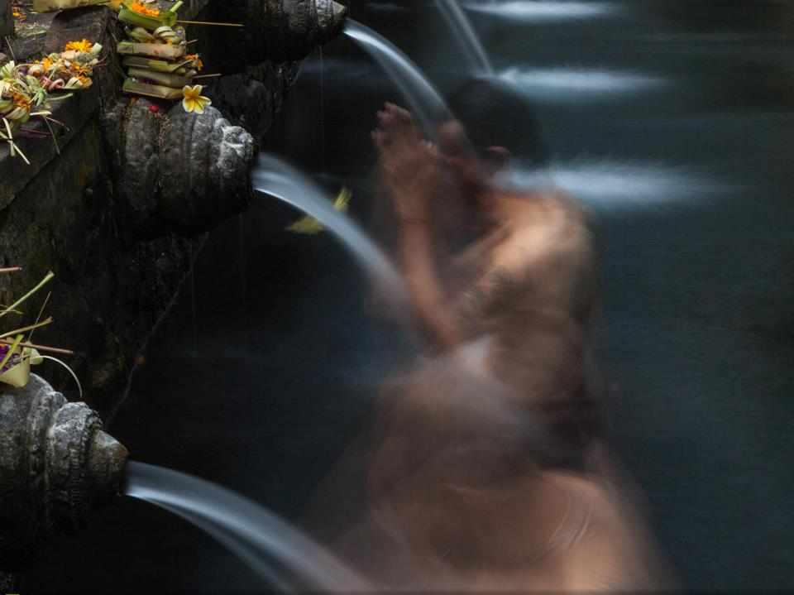
18
“One should perform karma without expecting the benefits, because sooner or later one shall definitely get the fruits. ” -The Rig Veda
Notes:
Slide 18
The image depicts a man kneeling with his hands in the prayer position, in front of a spout of water. He is likely washing himself before prayer at a temple.
The text reads ‘One should perform karma without expecting the benefits, because sooner or later one shall definitely get the fruits. -The Rig Veda’

Slide 19
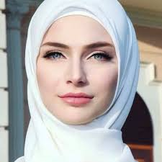
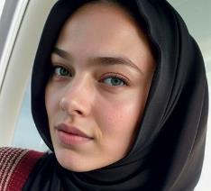
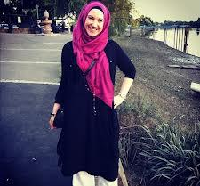
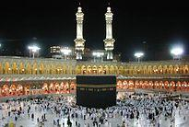
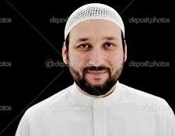
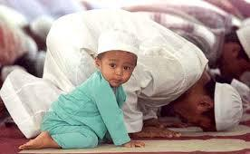
Muslims and Islam
Pause for Thought…
Islam was founded by the Prophet Muhammad. Muslims worship one God (in Arabic ‘Allah’)
The holy book is called the Quran
There are five ‘Pillars of Islam’: the declaration of faith; giving to charity; praying 5 times a day; fasting during the month of Ramadan; and the pilgrimage to Mecca
Muslims are expected not to eat pork, or other meat that is not halal
Alcohol is forbidden in Islam
Some Muslim women will wear a headscarf called a ‘hijab’
which covers the head and neck, or a ‘niqab’ which also covers the nose and mouth
Notes:
Slide 19
Muslims and Islam
Islam was founded by the prophet Muhammad. Muslims worship one God (in Arabic ‘Allah’)
The holy book is called the Quran
There are five ‘Pillars of Islam’: the declaration of faith; giving to charity; praying 5 times a day; fasting during the month of Ramadan; and the pilgrimage to Mecca
Muslims are expected not to eat pork, or other meat that is not halal
Alcohol is forbidden in Islam
Some Muslim women will wear a headscarf called a ‘hijab’ which covers the head and neck, or a ‘niqab’ which also covers the nose and mouth
The image in the top right depicts a white woman who has converted to Islam. In the Muslim tradition such people are called ‘reverts’. It is worth emphasizing that Muslim people come from a wide range of ethnic and cultural backgrounds.
The image beneath that one is of the Kaaba. It is a square black building in the centre of the courtyard of the Masjid al-Haram in Mecca which is the holiest place in Islam, and where all Muslims face towards during prayer.
Beneath that is an image of a Muslim man in traditional robes. In Scotland we may be more likely to see Muslim people wearing traditional clothing on Friday, which is the Muslim holy day.
The image bottom right is of a young Muslim boy kneeling and looking towards the viewer, while behind him adult Muslim men touch their foreheads to the carpet in prayer.
Facilitators may add that words like ‘Quran’ may be found with many different spellings because they are from the Arabic language, which uses a different script than English, and there is no single convention on how to spell Arabic words in the Latin script.
Young children are not expected to fast during Ramadan, and those who are unwell or traveling are also considered exempt. The pilgrimage to Mecca is called the Hajj and Muslim people are expected to undertake it at least once in their lifetime if possible.
Some Muslim people will avoid any physical contact with members of the opposite sex including shaking hands. If in doubt, it is best to ask if someone is comfortable shaking hands (across gender) before holding out your hand to shake.

Slide 20
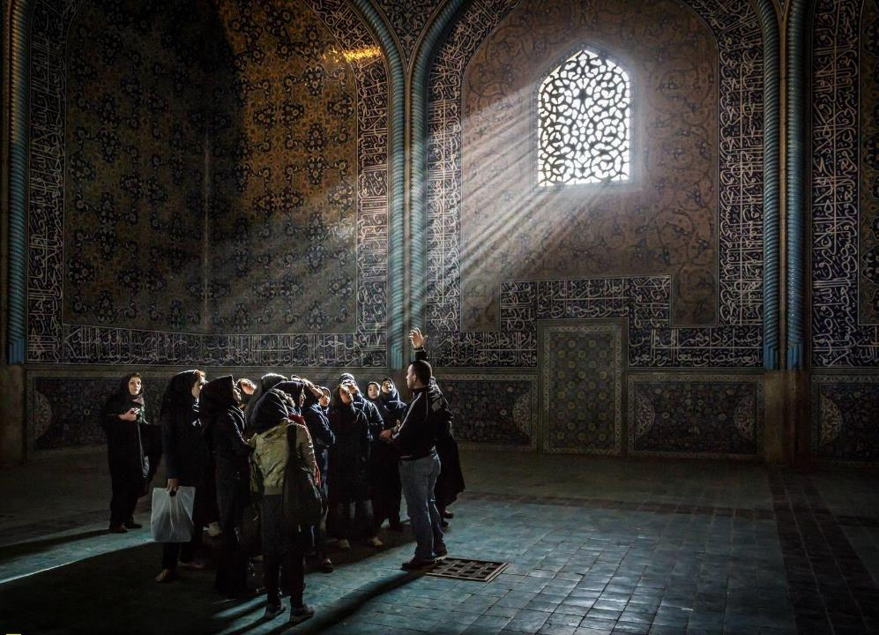
Be the flower that gives its fragrance to even the hand that crushes it
Ali Ibn Abu Talib
Notes:
Slide 20
This image shows the inside of a beautiful mosque in Esfahan in Iran. The mosque is no longer used as a place of worship but is an historical site. Note the Arabic calligraphy around the window and along the walls. We see a group of women in hijab being shown around by a tour guide.
The text reads ‘Be the flower that gives its fragrance to even the hand that crushes it. Ali Ibn Abu Talib’
The quote is from Ali Ibn Abu Talib who was the 4th Caliph (leader of the Muslim community) after the death of the Prophet Mohamed and is particularly important for Shia Muslims.

Slide 21
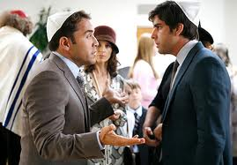
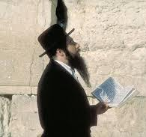
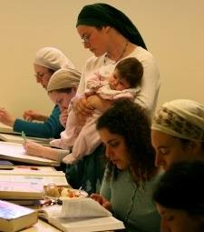
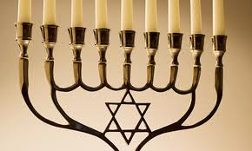
Jews and Judaism
Pause for Thought…
Jewish people believe in one God and try to live according to his Commandments. There are 613 such Mitzvot total, including the 10 Commandments.
Orthodox Jews strictly follow Jewish laws and traditions.
Non-orthodox Jews will follow some customs, but not all.
Orthodox Jews are expected to only eat kosher food
Pork is forbidden in any form
Shabbat (Sabbath): Friday evening to Saturday evening. Many Jews will not work, travel or cook during this time. Strict adherents will not answer a phone or use anything electrical during the Shabbat
Notes:
Slide 21
Jews and Judaism
Jewish people believe in one God and try to live according to his Commandments. There are 613 such ‘Mitzvot’ in total, including the 10 Commandments.
Orthodox Jews strictly follow Jewish laws and traditions.
Non-orthodox Jews will follow some customs, but not all.
Orthodox Jews will only eat kosher food
Pork is forbidden in any form
Shabbat (Sabbath): Friday evening to Saturday evening. Many Jews will not work, travel or cook during this time. Strict adherents will not answer a phone or use anything electrical during the Shabbat
The image to the right of the title shows two Jewish men wearing kippah in conversation
The image in the top right corner shows a Jewish man in traditional robes and hat reading from a text in front of the Western Wall (the last surviving wall of the Second Temple in Jerusalem).
Beneath that is an image of a group of Jewish women, most with their hair covered, studying books. One is holding a baby in her arms.
The image bottom right is of a Hanukkah menorah candelabrum with its 9 candles
Some Orthodox Jewish people (especially the Ultra-Orthodox), will avoid any physical contact with members of the opposite sex including shaking hands. If in doubt, it is best to ask if someone is comfortable shaking hands (across gender) before holding out your hand to shake.
A Jewish religious leader is a Rabbi, and the place of worship a synagogue.
Jewish people may pray three times a day – morning, afternoon and evening.

Slide 22
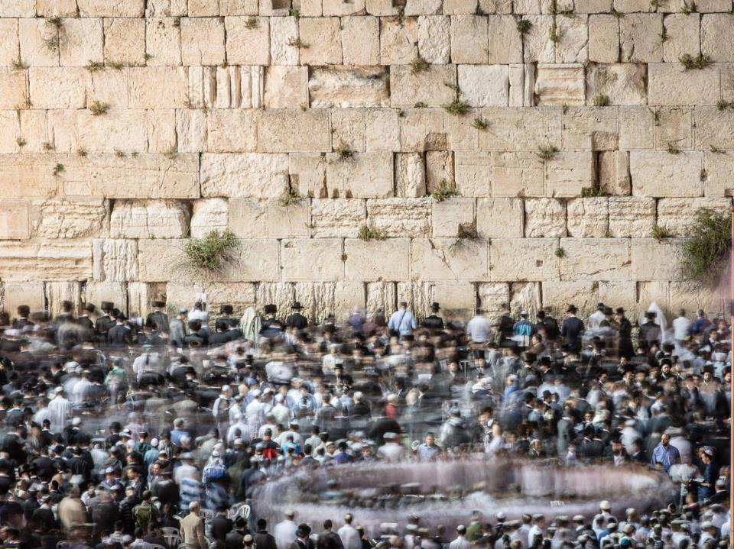
Just as love blindfolds you and you see no faults, so hate blindfolds you and you see no virtues Moshe Ben Ezra
Notes:
Slide 22
The image shows a crowd of worshipers in front of the Western Wall, the last surviving wall of the Second Temple in Jerusalem and the holiest site in Judaism. Non-Jewish people sometimes refer to it as the ‘Wailing Wall’ but it is best to avoid this term as it is not preferred by many Jewish people.
The text reads ‘Just as love blindfolds you and you see no faults, so hate blindfolds you and you see no virtues. Moshe Ben Ezra’

Slide 23
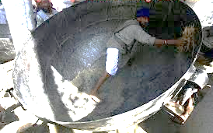
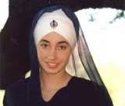
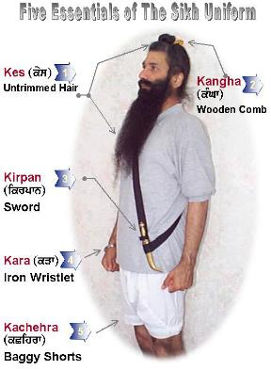
Sikhs and Sikhism
Pause for Thought…
Sikhism developed in India in the 15th Century and was founded by Guru Nanak.
Sikhs believe in one God, and equality is a core principle
Sikhs believe in charity and offer free food (called ‘Langar’) to all at their temples (called ‘Gurdwaras’)
Baptised Sikhs are expected to wear five articles of faith – the ‘five Ks’
These include not cutting your hair or beard, wearing a turban, bangle, and traditional shorts and carrying the Kirpan (a symbolic sword)
Traditionally all men have the surname Singh (meaning lion) and women have Kaur (meaning princess)
Typically, Sikhs are expected to be vegetarian and avoid alcohol and tobacco
Notes:
Slide 23
Sikhs and Sikhism
Sikhism developed in India in the 15th Century and was founded by Guru Nanak.
Sikhs believe in one God, and equality is a core principle
Sikhs believe in charity and offer free food (called ‘Langar’) to all at their temples (called ‘Gurdwaras’)
Baptised Sikhs are expected to wear five articles of faith – the ‘five Ks’
These include not cutting your hair or beard, wearing a turban, bangle, and traditional shorts and carrying the Kirpan (a symbolic sword)
Traditionally all men have the surname Singh (meaning lion) and women have Kaur (meaning princess)
Typically, Sikhs are expected to be vegetarian and avoid alcohol and tobacco
The image in the top right of the slide may not be immediately clear for viewers. It shows a man inside a very large cooking pot! The reason a pot this size is necessary is because of the Sikh tradition of Langar which involves providing food to anyone who comes to the Gurdwara at the time of one of the three meals a day. In the Harmandir Sahib (also known as the ‘Golden Temple of Amritsar’, depicted on the next slide) the community feed tens of thousands of people every day.
The two images beneath that depict a Sikh woman with the symbol of Sikhism, the Khanda, on her turban. And the Khanda itself is the symbol to the right of her.
The image in the bottom right depicts a Sikh man wearing the ‘Five Ks’ which all baptized Sikhs (regardless of gender) commit to wearing whenever possible for the rest of their lives. ‘Kes’ means that the person will not cut or trim their hair or beard (except if needed for a medical reason).

Slide 24
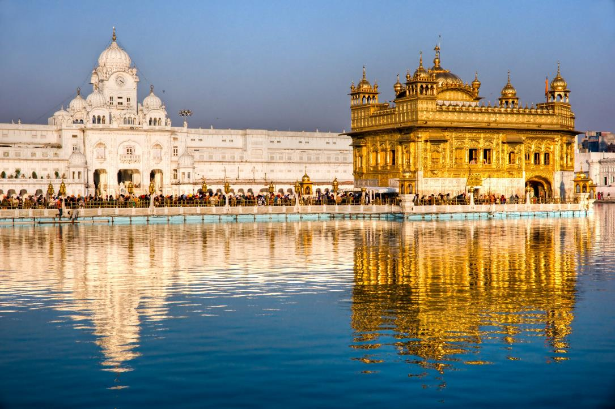
Love me when I least deserve it, because that’s when I really need it. Sri Guru Granth Sahib
Notes:
Slide 24
The image shows the Harmandir Sahib (meaning 'House of God') also known as ‘The Golden Temple of Amritsar’, the centre of the Sikh faith.
The text reads ‘Love me when I least deserve it, because that’s when I really need it. Sri Guru Granth Sahib’

Slide 25
Discussing a person’s faith and beliefs
Pause for Thought…
An approach of respectful curiosity is best.
Most problems stem from misunderstanding and assumption.
People who have been victimised for their faith may be wary about being asked about it, but if we start by saying that we are keen to meet any needs connected to their religion then typically people respond openly.
Diversity within groups: it is important to recognise both commonality and individuality. Remember that there are many different beliefs and practices among those who follow the same religion.
Telling someone that their interpretation, belief or practice is wrong because it is different from others of the same faith is never helpful.
Notes:
Slide 25
Discussing a person’s faith and beliefs
General Points
An approach of respectful curiosity is best
Most problems stem from misunderstanding and assumption
People who have been victimised for their faith may be wary about being asked about it, but if we start by saying that we are keen to meet any needs connected to their religion then typically people respond openly
Remember that there are many different beliefs and practices among those who follow the same religion
Telling someone that their interpretation/ belief is wrong because it is different from others of the same faith is never helpful
If needed, an example of the final bullet is of a non-Muslim telling a Muslim woman who wears hijab that she does not need to wear it because they know another Muslim woman who does not wear hijab. Such a comparison is unlikely to be either welcome or persuasive! Another example of unhelpful or unwelcome comments would be shaming a Jewish person for choosing to eat pork.

Slide 26
Other Practical Considerations
Pause for Thought…
Avoid asking students to explain their religion to other students. They may volunteer to share what matters most to them, but they shouldn’t be expected to summarise a whole religion to others, especially when this might cause them to feel “othered.”
Ensure you are considering the needs arising from religion and belief in the work that you do to avoid discrimination. Part 2 of this resource, entitled “Develop Your Religious Literacy Part 2,” explores needs such as diet, clothing prayer, avoiding alcohol, religious festivals and holy days.
Notes:
Slide 26
Avoid asking students to explain their religion to other students. They may volunteer to share what matters most to them, but they shouldn’t be expected to summarise a whole religion to others, especially when this might cause them to feel “othered.”
Ensure you are considering the needs arising from religion and belief in the work that you do to avoid discrimination. Part 2 of this resource, entitled “Develop Your Religious Literacy Part 2,” explores needs such as diet, clothing prayer, avoiding alcohol, religious festivals and holy days.

Slide 27
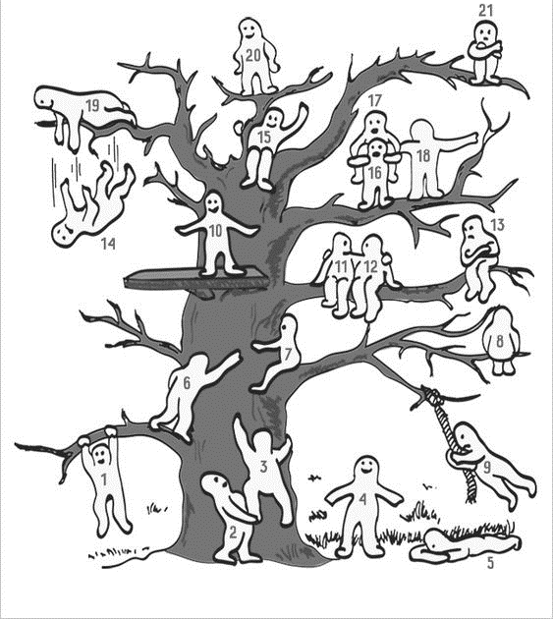
Which “blob person” best represents how you are feeling now?
Notes:
Slide 27
Today we have explored some issues which may be challenging to discuss and think about, including our own biases and harmful stereotypes. It's important that we take time to reflect and acknowledge the emotional impact having these discussions can have on us.
​
Ask participants to take a couple of minutes to look at the image on the slide and think about how they might be feeling after this session. Which “blob person” summarises their feeling most accurately? If needed, describe the image using the next a paragraph and invite participants to share if they feel comfortable.
Image representing 20 “blob people” climbing a tree with numbers on them. Number 1 is holding onto the lowest branch. Number 2 is standing at the bottom of the tree, helping Number three climb up. Number 4 is at the bottom of the tree looking up with a smile on their face. Number 6 is standing on the first branch, reaching for number 7's hand. Number 7 is sitting on the second branch. Number 10 is standing on a high and stable platform built on the tree, smiling. Numbers 11 and 12 are sitting on a high branch, holding onto each other. Number 13 is sitting on the same branch with arms folded and a sad face, looking at Numbers 11 and 12. Number 14 is falling off one of the highest branches – it looks like Number 19 pushed them. Number 15 is safely sitting on a very high branch, smiling with their arm up. Numbers 16, 17 and 18 are standing on a slightly lower branch supporting each other, with 17 piggy-backing on 16 and 18 holding onto them both. Number 19 is on the second highest branch, pushing 14 down. Number 20 looks content standing on the highest branch of the tree.

Slide 28
Reflection
From what you have learned so far, think about:
How has this made you feel?
What has this made you think about?
What one action would you like to take forward?
How can you link what you plan to do with others in your setting?
How you will know that this learning has made a difference?
Notes:
Slide 28
Participants can do this in groups.
Encourage educators to look at reflection questions and consider how they may be taken forward in enquiry.

Slide 29
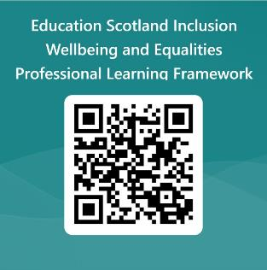
We value your feedback
Education Scotland is taking feedback on these resources so that we can continue improving our professional learning resources.
Your feedback could help us improve this resource
Please complete this short form, using the link or QR code, to let us know what you thought of it and any suggestions you have on how it could be improved
LINK: https://forms.office.com/e/J2NQUuCHji
Notes:
Slide 29: Feedback slide
Education Scotland is taking feedback on these resources so that we can continue improving our professional learning resources.
Your feedback could help us improve this resource
Please complete this short form, using the link or QR code, to let us know what you thought of it and any suggestions you have on how it could be improved

Slide 30
For Scotland's learners, with Scotland's educators
Do luchd-ionnsachaidh na h-Alba, le luchd-foghlaim Alba
Education Scotland
Denholm House
Almondvale Business Park
Almondvale Way
Livingston EH54 6GA
T +44 (0)131 244 5000
E enquiries@educationscotland.gsi.gov.uk

