Slide 1

Water Safety Lesson
Second Level

Slide 2
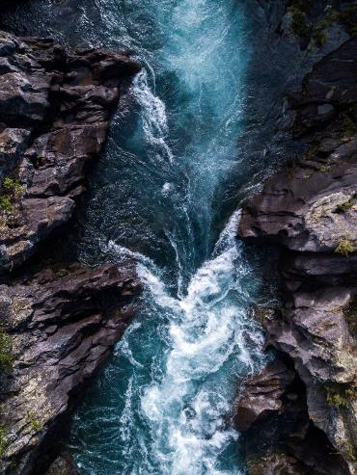

Learning
Objectives
Discuss possible dangers in or near water.
Consider how I can keep myself and others safe when in or near water.

Slide 3
Word Bank and WSS Code
Cold water
Staying safe
Weather
Dangers and hazards
Depth
Strength of water
Hidden dangers
Temperature of water
Stay close to an adult/
parent/guardian/
Keep within a safe depth
Be prepared
Emergency
Floating
Buoyancy
Treading water
Shout for help

Slide 4
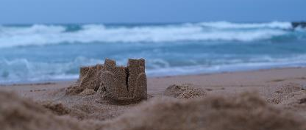
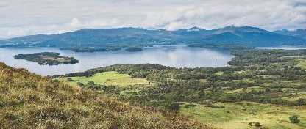
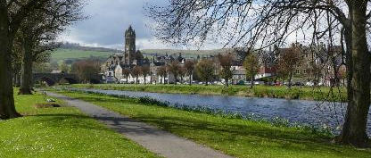
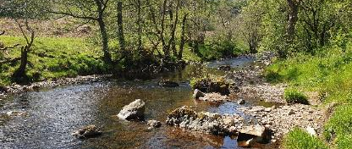
Activity 1 (Starter) Why is it important to be careful around water?
What activities do you do that are in or near water?

Slide 5
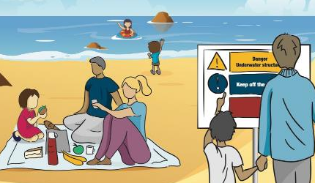
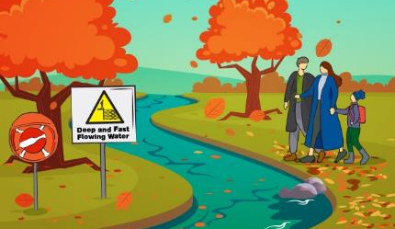
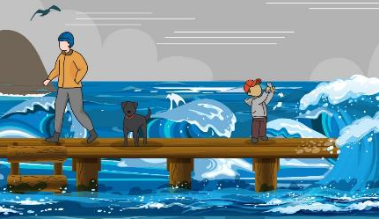
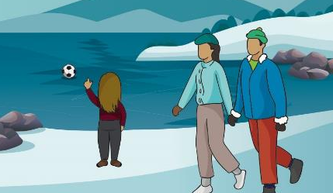

Slide 6


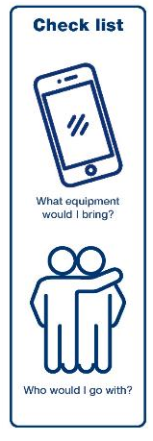

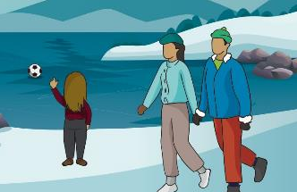
Activity 3 Stop and Think, Spot the Dangers

Slide 7
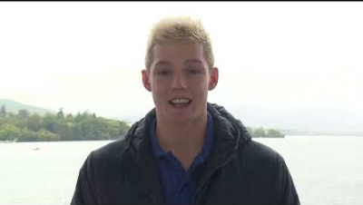
youtube.com/watch?v=LNtJmB7EK9g

Slide 8
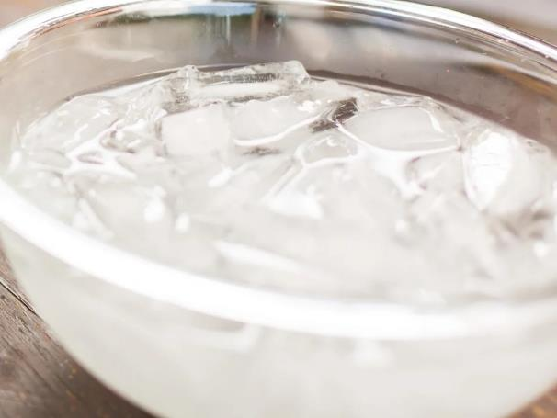

Activity 4 (Optional) Cold Water Activity

Slide 9

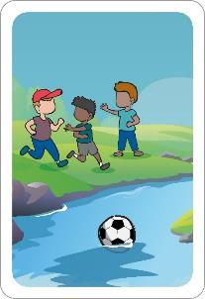

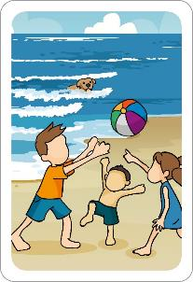
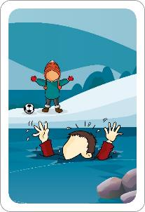
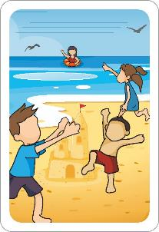
Activity 5 In an Emergency, Call 999

Slide 10
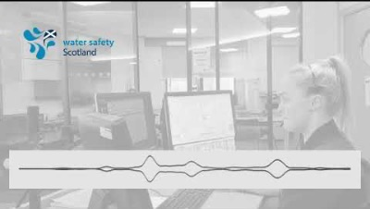
Activity 5 In an Emergency, Call 999
youtube.com/watch?v=Ma6z3Ve91qE

Slide 11

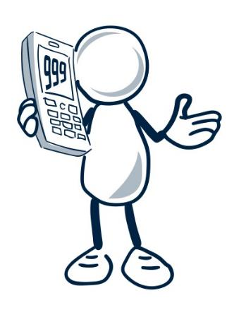

Recap - In an Emergency, Call 999
Would you have entered the water?
What could you have said to prevent him entering the water?
Why is it important to never enter the water to help someone?
What are the appropriate steps to take if someone gets into trouble in the water?

Slide 12
Plenary: Mini Quiz
Dangers are always easy to see.
The water can be very cold in Scotland, even in the summer holidays.
Planning for the weather, wearing the right clothing and
bringing equipment can make your day out safer.
Staying near a parent/guardian near water will keep me safer.
If I fall into cold water, I should float on my back like a starfish until I get used
to the temperature of the water and then shout for help or try to swim
It’s important to never go into the water to help someone – even a friend or pet.
I should dial 999 in an emergency.

Slide 13
Reflection time
Three things I learnt today.
Two things I can tell someone about water safety.
One question I still have.

