Slide 1



Hate crime and prejudice-based behaviours
Inclusion, Wellbeing and Equalities Framework
Rights and equalities: informed level
Notes:
Slide 1:
This professional learning is pitched at an informed level and is suitable for anyone working with children, young people and adult learners in an educational context. It is particularly useful for classroom teachers, classroom assistants and those working closely with young people within any educational context.
This resource has been developed with Education Scotland, YouthLink Scotland, respectme, Scotland's anti-bullying service, and the Scottish Government’s Hate Crime Strategic Partnership Group. The resource forms part of delivery of the Scottish Government’s Hate Crime Strategy, and feedback conducted to inform the strategy highlighted just how important education was in terms of tackling hatred and prejudice in Scotland.
Further information and signposts to further reading, resources and professional learning can be found in the Hate Crime and Prejudice Based Behaviours Information Note.
Anyone who works in an educational setting can be a facilitator and use these slides. For reflection or discussion activities, it is important to establish a safe space which encourages respect and honesty to ensure that everyone can participate. ​
More information on using Inclusion, Wellbeing and Equalities Framework resources is available on the education Scotland website (link on the slide)
How to use this resource:
Note to learners: If you are carrying out this professional learning as self-directed learning, please make sure you build in time for reflection and your own wellbeing. If you're learning with colleagues please plan for breaks, discussion and opportunities to check in with each other about wellbeing. If you are facilitating, please build in plenty of time for break and reflection. Consider co-developing group protocols to support a safe and respectful space.
[Option to skip the below as instructions for facilitators only. No need to read to audience]
These slides can be used to facilitate professional learning in a group or whole-setting, or as a self-directed learning activity as an individual.
Facilitation notes are included at the bottom of each slide
Please do not remove or change any of the slides included.
Facilitators are welcome to add slides or activities relevant to your own setting, to support discussion and exploration of the topic. Facilitators will know their participants’ needs best.
Anyone who works in an educational setting can be a facilitator and use these slides.
For reflection or discussion activities, it is important to establish a safe space which encourages respect and honesty to ensure that everyone is able to participate.
FACILITATION NOTES can also be found on a separate Word document on the Education Scotland Inclusion, Wellbeing and Equalities Professional Learning Framework.

Slide 2
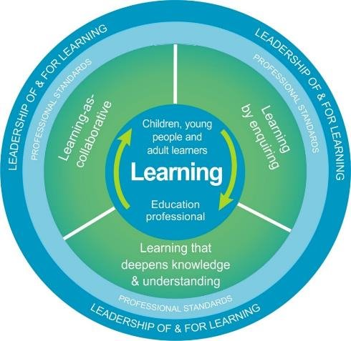
Welcome
This professional learning resource will support understanding of:
prejudice-based behaviours and hate crime in education settings
early signs of prejudice-based behaviours and hate crime
what to do when prejudice-based behaviours and hate crime occur
how to report them and support those affected
The national model of professional learning (education.gov.scot)
Notes:
This professional learning resource follows The National Model of Professional Learning and is designed to help you gain more knowledge and have a deeper understanding of inclusion, wellbeing and equalities.
You will have the opportunity to consider how to take this learning forward on your own and with others and, on completion of the professional learning, you will be asked to consider what your next steps will be.
Please take some time to consider the reflective questions at the end of this resource
This session provides an opportunity to:
Raise awareness of prejudice-based behaviours and hate crime in education settings.
Increase confidence in identifying early signs of prejudice-based behaviours and hate crime.
Develop an understanding of what to do when prejudice-based behaviours and hate crime occur, including how to report them and support those affected.

Slide 3
Diversity and intersectionality
Socioeconomic/Class
Ethnic/Cultural/Racial
Linguistic
Religion / Belief
Disability
Gender/Sex
Sexual Orientation
Neurodiversity
Age
Family
Notes:
The features of diversity represented on the diagram have been inspired by the protected characteristics (disability, age, race, religion & belief, sex, gender reassignment, pregnancy and maternity, sexual orientation and marriage and civil partnership) from the Equality Act 2010, the non-protected characteristics that are most relevant in the context of Scottish education and groups that are protected under the Education (Additional Support for Learning) (Scotland) Act 2004. ​
​
Some people will belong to or identify with more than one protected group. For some, a combination of characteristics will mean they experience hatred and prejudice in a specific way – what is referred to as intersectionality. Intersectionality can significantly impact how people experience hatred and prejudice. ​
​
Option for facilitators: To find out more about intersectionality, this 3min video What is intersectionality? (youtube.com) describes in a visual way what we mean by intersectionality. For a young person focused view, you could also consider this video on Intersectionality (youtube.com. It is important to consider intersectionality when supporting someone who has experienced a prejudice-based behaviour or hate crime, or when witnessing one taking place. ​
​
A person can be targeted due to more than one of their characteristics, for example a young person from an ethnic minority group or a disabled person who also identifies as LGBT+ could be said to have intersecting characteristics. Hate crime can also feel different for those who visibly belong to protected groups – for example, a young woman of colour from a Muslim background may hesitate to wear a hijab due to fear of being targeted by hate crime.​
​
While these are more than the characteristics that come under the Hate Crime and Public Order (Scotland) Act 2021, when developing our understanding of prejudice-based behaviours and hate crime we need to reflect on the intersectional nature of our identities. It is possible for a hate crime to be motivated by more than one characteristic but also the impact of experiencing a hate crime will differ depending on the intersectional identity of the person targeted. While other characteristics might be influencing the motivation for a hate crime, such as sex or class, for a hate crime to be committed, hate crime protected characteristics must be involved. These are shared in the next slides.

Slide 4
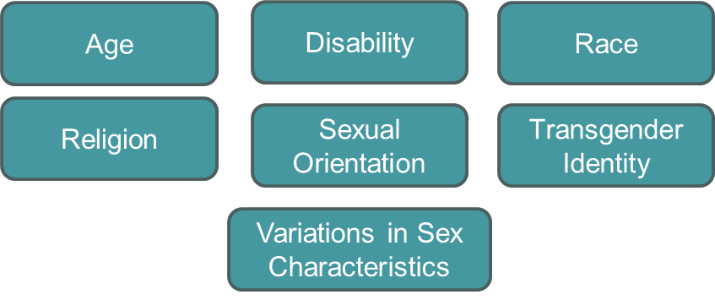
What is hate crime? ​
Hate crime describes behaviour that is both criminal and rooted in prejudice, or which is intended to stir up hatred against people by reason of them possessing or appearing to possess protected characteristics. This includes online communications. In Scotland, the Hate Crime and Public Order (Scotland) Act 2021 criminalises behaviour motivated by prejudice towards those with the following characteristics:
Under The Age of Criminal Responsibility (Scotland) Act 2019, a child under the age of 12 cannot be arrested, charged or prosecuted for a crime.
Notes:
Hate crime describes behaviour that is both criminal and rooted in prejudice, or which is intended to stir up hatred against a group of people by reason of them possessing, or appearing to possess, one of the following characteristics protected under hate crime legislation. This includes offences committed in relation to online communications. In Scotland, the Hate Crime and Public Order (Scotland) Act 2021 (‘The Act’) criminalises behaviour motivated by prejudice towards individuals based on:​
Race​
Religion or belief​
Sexual orientation​
Disability​
Transgender identity​
Age​
Variations in sex characteristics​
​
This legislation aims to address behaviour motivated by hatred or prejudice, ensuring that the law protects individuals against hate-motivated harm, both online and offline. The Act maintained prior legislative protections against offences aggravated by prejudice against disability, race, religion, sexual orientation and transgender identity, and added age.​
The Act also provided for new ‘stirring up of hatred’ offences, covering all characteristics protected in the updated legislative framework, to complement the existing offence of stirring up racial hatred that has been part of our criminal law and the law of the whole of the UK for decades.The table below shows the difference between previous legislation and the Hate Crime and Public Order Act:​
​
Previous legislation​
Hate Crime and Public Order (Scotland) Act 2021​
Stirring up of racial hatred offence – for this to be part of a criminal act the behaviour must be threatening or abusive or insulting and intended to stir up hatred against a group based on their race, colour or nationality.​
The 2021 Act created new stirring up of hatred offences for each of the following characteristics: Disability, Religion, Sexual orientation, Transgender identity, Age, Variations in sex characteristics. For this to be an offence the behaviour has to be threatening or abusive (not insulting) and the person doing it intends to stir up hatred against any of the groups above. These new offences have a higher threshold for a crime to be committed than the long-standing offence of stirring up racial hatred, which has been in place since 1986. ​
​
For racial hatred, it stays the same as before. There is a defence to all offences of stirring up hatred where a person can show the behaviour or communication of material was reasonable.​
​
The Act updated the definition of transgender identity by removing the term ‘intersexuality’ given the differences between intersex and transgender identities. For this group of people, the Act includes ‘variations in sex characteristics’ as a standalone characteristic.​
For awareness: Intersex is a term that has traditionally been used to describe individuals whose biological sex characteristics (such as chromosomes, hormone levels, or genitalia) do not fit typical definitions of male or female. It is more commonly used in medical or social discussions to describe people who have physical sex characteristics that do not align with conventional binary gender norms.​
Variations in sex characteristics is a more inclusive and precise term used in legal and human rights contexts. It encompasses a broader range of physical differences, including intersex traits, and is considered a more neutral and respectful way of describing individuals who do not fit typical male or female biological norms. ​
​
For more information on the changes to the Hate Crime legislation you can use look at an info sheet at:​
​
Hate Crime and Public Order (Scotland) Act: factsheet - gov.scot (www.gov.scot)​
​
https://www.actiononprejudice.info/wp-content/uploads/2024/05/Hate-Crime-and-Public-Order-Act-Info-Sheet-for-Youth-Workers-1.pdf​
​
It should be noted that under The Age of Criminal Responsibility (Scotland) Act 2019, a child under the age of 12 cannot be arrested, charged or prosecuted for a crime.​

Slide 5
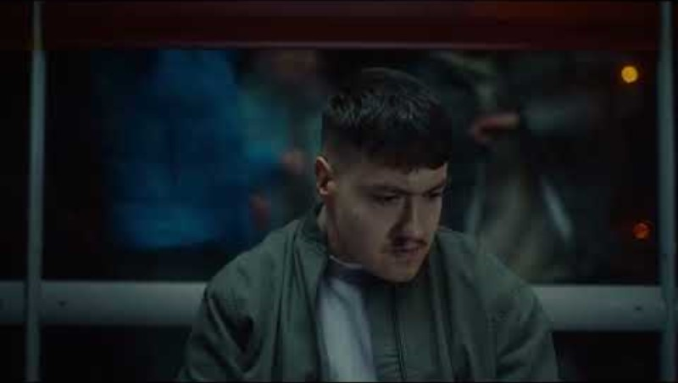
What can hate crime look like?​
Hate crimes can be verbal or physical and can include the following offences (if motivated by prejudice or intended to stir up hatred):​
threatening behaviour​
verbal abuse or insults including name-calling​
assaults​
robbery
damage to property​
encouraging others to commit hate crimes​
harassment​
online abuse on social media sites​
.
Hate crime has a hugely damaging and corrosive impact on victims, their families and communities.​
Notes:
Slide 9:
Hate crime has a hugely damaging and corrosive impact on victims, their families and communities.
When discussing what hate crime looks like, it is important to remember it includes criminal activity as well as prejudice based on identity characteristics, which can have long lasting impacts on individuals.
If you are facilitating this session with others, please be mindful of the potential experiences of participants that you may not be aware of. Taking a trauma informed approach to this work is crucial.
Hate crimes can be verbal or physical and can include the following offences (if motivated by prejudice or intended to stir up hatred):
threatening behaviour
verbal abuse or insults including name-calling
assaults
robbery
damage to property
encouraging others to commit hate crimes
harassment
online abuse on sites like Facebook or Twitter
The impact on those on the receiving end of such behaviour, whether physical, verbal, or online attacks, can be traumatic and life changing.

Slide 6


Impact of hate crime
Change in behaviour to avoid further incidents
Self-harm, eating disorders
Negative impact on education and future prospects
Financial impact due to needing to take time off
Person causing harm
Person experiencing harm
Criminal record
Converting faith to avoid future hate
Poor mental health
Potential homelessness e.g. as a result of being outed
Felt a rush from incident and escalates to more crime
Negative impact on education
Potential to go on to cause harm, e.g. revenge
Fall in with the wrong group and enters a cycle of hate
Feeling of isolation
Mental health issues, PTSD
Notes:
During the consultation phase for the Hate Crime Strategy, YouthLink Scotland held focus groups with different groups of young people. They were asked about the impacts of hate on the person experiencing harm and the impacts on the person causing harm. These are the impacts they identified in their discussions.
Person causing harm:
Negative impact on education and future prospects
Criminal record
Poor mental health
Felt a rush from incident and escalates to more crime
Fall in with the wrong group and enters a cycle of hate
Person experiencing harm:
Mental health issues, Post-Traumatic Stress Disorder
Self-harm and eating disorders
Financial impact due to needing to take time off
Negative impact on education
Converting faith to avoid future hate
Potential homelessness (e.g. as a result of being outed)
Potential to go on to cause harm (e.g. revenge)
Change in behaviour to avoid further incidents
Feelings of isolation
When considering this, the young people were able to identify more for the person harmed. These were groups of young people who were likely to have experienced hate in their lifetime, so it was naturally more difficult for them to identify impacts on someone causing harm.
There are, however, some clear similarities in relation to the impact on education and mental health. We need to remember that hate crime impacts those experiencing it, but it also has an impact on young people causing harm. When working to address the issue in education settings, it is important that all young people can access support and therefore potentially prevent future incidents.
Other impacts that were not identified by young people could include impacts on family members, community, and wider society. High profile hate crimes can cause alarm for young people who see the coverage or hear about the crime through their community. This ripple effect can result in fear especially for minoritised groups and people who hold the same protected characteristic that the victim did. In addition, the person causing harm could be vulnerable to radicalisation and taking part in further hateful behaviour.
The importance of reporting includes ensuring that the person causing harm can get support too and is given an opportunity to change their behaviour.

Slide 7
Allport scale (adapted): understanding how prejudice can harm
Murder, suicide, genocide
Physical attacks, assault, rape, criminal damage
Discrimination: in employment, education, access to housing, healthcare, services, goods
Avoidance: ignoring, excluding, physical withdrawal
Antilocution: stereotypes, verbal abuse, negative myths about people jokes and hateful opinions
Prejudice And Allport’s Scale (the-classroom.org.uk)
Notes:
The Allport Scale represents Gordon Allport’s work measuring the manifestation of prejudice in society. The scale contains 5 stages of prejudice, ranked by the increasing harm they produce.
Stereotypes and bias are a cause and a consequence of hate and inequality, where they reinforce a power imbalance between different groups by limiting opportunities and allowing discrimination. This inequality creates a foundation for the perpetuation of more stereotypes and bias. To interrupt this cycle we have to explore our own bias and create a culture where stereotypes are challenged.
On the Allport scale, we can see that stereotypes, stigma, and derogatory language (such as hate speech) make up the bottom layer of the pyramid, providing a foundation for increasingly harmful behaviours that contribute to societal violence. To prevent this progression we have to start by challenging the lower level, everyday prejudiced-based behaviours consistently.
Prejudice And Allport’s Scale (the-classroom.org.uk)

Slide 8
Bullying, prejudice-based bullying and hate crime
Bullying is face-to-face and/or online behaviour which impacts on a person’s sense of physical and emotional safety, their capacity to feel in control of their life and their ability to respond effectively to the situation they are in.
Bullying behaviour can be physical, emotional or verbal and can cause people to feel hurt, threatened, frightened and left out.
Prejudice based bullying is when bullying behaviour is motivated by prejudice, based on dislike of an individual’s actual or perceived identity and reflects wider societal trends of inequality and power.
Prejudice comes in a variety of distinct forms and prejudice-based bullying can have wide-ranging impacts on children and young people’s health and wellbeing.
A person commits a hate crime when a statutory aggravation is established in relation to an offence, under certain circumstances based on conduct and motivation.
While bullying is not itself a crime, some bullying behaviours may be - such as threatening communications or assault.
Notes:
When a prejudice-based behaviour occurs, this could also constitute bullying and, in some circumstances, a crime may also have been committed. The following definitions come from the national approach to anti-bullying, Respect for All (2024):
“Bullying is face-to-face and/or online behaviour which impacts on a person’s sense of physical and emotional safety, their capacity to feel in control of their life and their ability to respond effectively to the situation they are in.”
“The behaviour does not need to be repeated, or intended to cause harm, for it to have an impact. Bullying behaviour can be physical, emotional or verbal and can cause people to feel hurt, threatened, frightened and left out.”
Whilst there can be a number of factors which create aspects of difference amongst children and young people – for example, popularity, physicality or economic advantage – these systemic, societal and structural inequalities often support unequal relationships that can generate and intensify bullying behaviours, making certain groups more vulnerable.
Such structural inequalities can manifest themselves in prejudice based bullying. Prejudice based bullying is when bullying behaviour is motivated by prejudice, based on dislike of an individual’s actual or perceived identity and reflects wider societal trends of inequality and power. Prejudice comes in a variety of distinct forms and prejudice-based bullying can have wide-ranging impacts on children and young people’s health and wellbeing. Prejudice is escalatory by nature, can be both targeted and non-targeted, and can manifest in a variety of different ways. Not all incidents where prejudice-based behaviour occurs will be bullying incidents” (p.7)(Respect for All: The National Approach to Anti-Bullying for Scotland’s Children and Young People (www.gov.scot))
A person commits a hate crime when a statutory aggravation is established in relation to an offence, under certain circumstances based on conduct and motivation. While bullying is not itself a crime, some bullying behaviours may be - such as threatening communications or assault. Schools and settings should follow national child protection procedures in these cases, and should work closely with their education authority and colleagues in core agencies below to ensure the safety and wellbeing of children, young people, and staff:
Pastoral care staff
Senior colleagues
Youth work managers
HR colleagues
Social work
Health
Police Scotland including Campus Officers

Slide 9
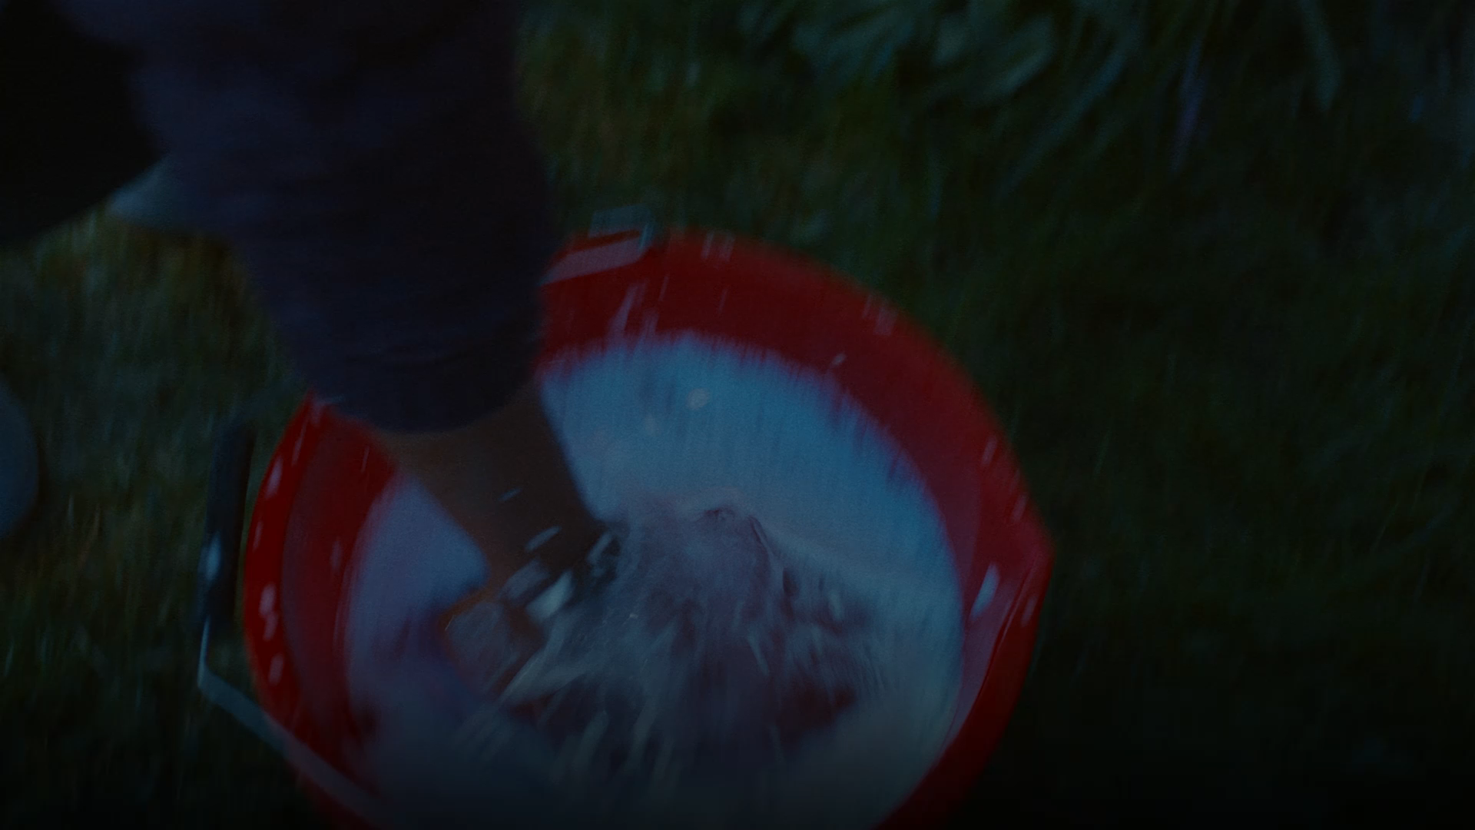
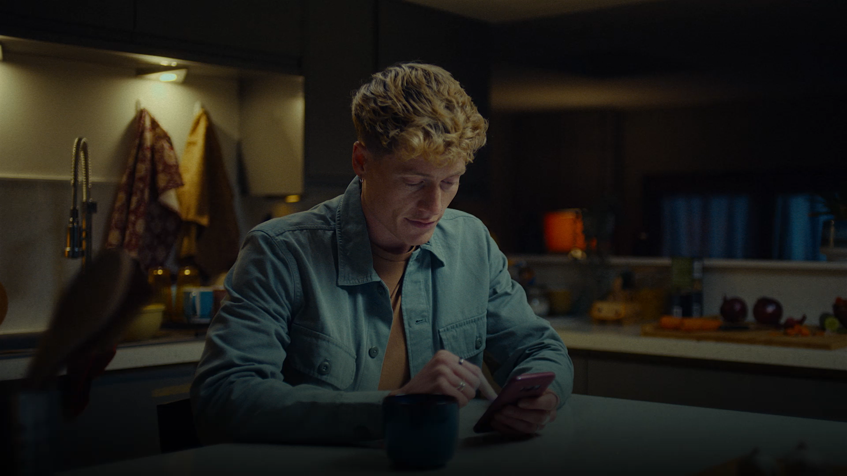
Why it is important to recognise, and report hate crime
“My daughter repeatedly asked me - ‘Mum, can I scrub off my brown, can I scrub myself white?’”
Words make our lives a living hell - YouTube
Words make me feel hated just for being me
“The words they used have had a scarring effect on me, I’ve felt very threatened and vulnerable.”
Notes:
Being able to recognise and report hate crime is crucial to making a change in society. Experiencing hate crime has a detrimental effect on physical and mental health, it can lead to increased conflict in communities and, if it goes unreported, it is as if the behaviour is acceptable and is therefore more likely to increase.
The videos (https://www.youtube.com/watch?v=PsB0R_2HFrw ;
https://www.youtube.com/watch?v=t1Im4eP-4Ug) and the quotes on this slide are from real victims of hate crime as part of the Scottish Government Hate Hurts campaign.
“The words they used have had a scarring effect on me. I’ve felt very threatened and vulnerable.”
“My daughter repeatedly asked me, “Mum, can I scrub off my brown, can I scrub myself white”?”
We can see that the words alone can have a huge impact, for example, making a young girl want to change the colour of her skin, thinking she is dirty. Reporting hate crime sends a message that all are included and valued and that the behaviour is not acceptable. A witness reporting a hate crime also helps victims see that they are not alone and that not everyone feels like their attacker does.
Hate crime is an attack on someone’s identity or perceived identity. It puts a negative label on them and can have a lifelong impact. Reporting it does not turn back time but it does help to prevent it in future.
Seemingly low level or minor events may in fact have a significant impact on the victim. Crime type alone does not necessarily dictate impact or consequences of the action. Repeated targeting of a person, whether by the same perpetrator or not, can lead to what is known as the ‘drip drip’ effect. In other words, with seemingly minor incidents, the repeated nature could affect the person’s ability to cope. Each individual will be affected differently.

Slide 10

Reflection 1
We're about halfway through, from what you have learned so far, think about:
How has this made you feel?
What has this made you think about?
What one action would you like to take forward?
How can you link what you plan to do with others in your setting?
How will you know that this learning has made a difference?
Notes:
Participants can do this in groups.
Encourage educators to look at reflection questions and consider how they may be taken forward in enquiry.

Slide 11
Staff awareness of prejudice-based behaviours and hate crime
Witnessing prejudice-based behaviours directly
Disclosure from a child or young person
Formally reported by families or via a multi-agency response
Aware of changes in behaviour that may indicate underlying concerns about a child or young person
Notes:
The types of prejudice-based behaviours staff may be required to respond to can vary significantly in nature. Educators will become aware of behaviours by:
witnessing them in school / setting
having matters disclosed to them by the student affected or those that are aware of the incident
having matters formally reported to them by families, friends or via a multi-agency response
becoming aware of changes in behaviour that may indicate underlying concerns about a child or young person
11

Slide 12

Responding sensitively to disclosure
  Reminder: Disclosures might not initially look like disclosures; a child or young person might be 'testing the water' to see if it's safe to disclose. ​
Provide safe opportunities for disclosure
Let the young person know you need to pass information on and cannot keep it a secret
Listen carefully
Reassure them that it’s not their fault
Make notes to ensure information is accurate
Reassure the young person that there are places and people that can help
Pass the disclosure on to relevant staff member straight away
Notes:
Even within a supportive environment, children and young people may find it very difficult to report behaviours. Staff should be vigilant to signs of distress or changes in behaviour which may be linked to the impact of trauma. Children and young people should be encouraged to discuss any concerns with their teacher, pastoral care team, or trusted adult within the setting.
Thinking about how children and young people might share information about prejudice-based behaviours in your setting is important. You will be the experts on this - this might be related to age and stage, Additional Support Needs, culture, understanding of consent, power balances. Reminder: Disclosures might not initially look like disclosures; a child or young person might be 'testing the water' to see if it's safe to disclose.
Provide safe opportunities for disclosure
Let the young person know you need to pass information on & cannot keep it a secret
Listen carefully
Reassure them that it’s not their fault
Make notes to ensure information is accurate
Reassure the young person that there are places and people that can help
Pass the disclosure on to relevant staff member straight away
12

Slide 13

If you witness prejudice-based behaviours
Should you witness prejudice-based behaviour, the 5Ds of Bystander Intervention can be used to help assess the situation and choose an appropriate and safe action.
Direct: step in and confront a person causing harm.
Distract: change the subject of conversation to take away the attention from the person experiencing hate.
Delegate: get help from a senior colleague.
Document: write out a statement of what happened and report the event.
Delay: check in on the person who experienced the hate at a safe time.
When selecting an action, it is important to stay safe and seek advice where needed.
Follow-up and support will need to occur alongside interventions.
Notes:
Should you witness prejudice-based behaviour, the 5Ds of Bystander Intervention (Speak Up resource) can be also used to help assess the situation and choose an appropriate and safe action.
When talking through the options for intervening it is important to remember that being safe is key to being able to successfully intervene. This should be emphasised in professional life but also when discussing intervention options with young people. It is also important to remember that prejudice-based behaviours can be displayed by young people but also other adults including colleagues, other educators or those in positions of power.
Depending on the situation, educators can seek support from a range of sources. This can include:
Pastoral care staff
Senior colleagues – Principal Teacher or DHT
HR colleagues
Police Scotland - including Campus Officers
The 5Ds of Bystander intervention as in the Speak Up resource are designed for young people to risk assess how to best safely intervene when witnessing a prejudice-based behaviour or hate crime. Here they have been adapted slightly to reflect the role of an educator. When deciding how to best intervene it’s important to consider which intervention is least likely to result in an escalation of the situation and keep you and others safe.
Direct – directly intervene and stop the incident going any further. This could include physically separating two individuals and the potential harm to oneself should be actively considered before taking this step.
Distract – this could include asking the aggressor what time it is, or about something unrelated to the incident. This takes the attention off the person experiencing harm and allows them time to walk away. The person experiencing harm could also be distracted in some situations and removed from the vicinity if it is a more group setting. Again, safety for the intervener needs to be considered before action is taken. This intervention could also be described as diffusing or de-escalating.
Delegate – this could be asking a senior colleague to intervene, in a public space this may be involving a bus driver or police officer to intervene. This could also provide a ‘safety in numbers’ feeling too. Asking for help to intervene rather than doing so alone.
Document – this is something that can be done afterwards, such as writing a statement of what happened. We do not encourage anyone to film or photograph something that is happening as this can create dangers later on, for example if a phone needs to be taken into evidence by police but the person who owns the phone is in a relationship where their phone is critical to their safety there. Documenting the incident should occur each time prejudice-based behaviour is witnessed.
Delay – this is waiting until an incident is finished to step in and could include going to the person who experienced harm afterwards and checking in, offering to support them to report the incident or calling a loved one to come help support them. This should not include taking a young person in a personal car or handing out personal details such as phone numbers.
Follow-up and support will need to occur alongside all of these interventions.

Slide 14
School reporting procedures
For school settings, please follow your own settings behaviour policy / Child Protection guidance. You should also consider completing a corporate incident form specific to your local authority if instances of hate crime occur.
Recommendations from Respect for All include:
Logging the incident formally (ideally within 3 days).
Include details of the incident, any potential underlying prejudice and impact (e.g. wellbeing concerns).
An investigation should follow, with outcomes and actions recorded on the system
For instances where staff are experiencing hate crime, please follow your settings HR policies and operational procedures. Staff have the right to report hate crime or other prejudice-based behaviour directly to their employer or the police without permission from line management.
Notes:
Depending on your setting and the incident taking place, it is important to refer to your local reporting procedures and guidance.
For youth work and CLD settings, it will be useful to reference the CLD competencies and code of ethics as well as the National Occupational Standards for Youth Work.
When doing work with young people, you may also have a group contract that has been created in partnership with the young people that can be used as a tool for reflecting on behaviours.
For school settings, please follow your local relationships and behaviour policy operational guidance which can include pastoral notes and violent incident forms. As is set out in the Scottish Government’s Respect for All guidance, it is recommended that once a bullying or prejudice-based bullying incident has been raised, this should be logged on a school or organisation’s recording system as soon as possible and ideally within three working days. This should include details of the reported incident, capturing information about the behaviour that took place, who was involved, where and when it is reported to have happened, any potential underlying prejudice, including details of any protected characteristics, and whether the impact indicates any wellbeing concerns or the need for additional support. An investigation into the incident should follow, with the recording system updated throughout the process on the outcome and any action taken as a result.
Schools should be using the following guidance to monitor and report bullying incidents: Respect for All: The National Approach to Anti-Bullying for Scotland’s Children and Young People (www.gov.scot)
Where staff are experiencing or perpetuating hate crime, you must use HR policies and guidance. This includes having the right to report hate crime directly to their employer or the police without permission from line managers.

Slide 15
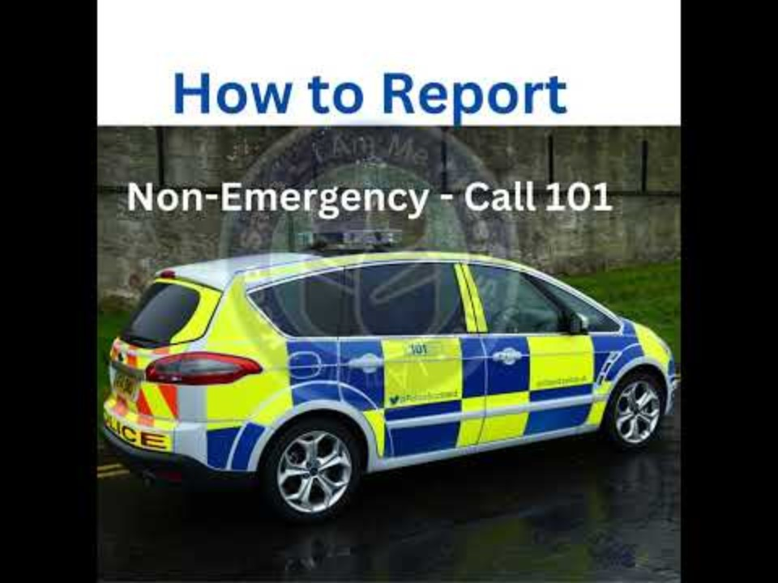
How to report a hate crime
Pause for Thought…
I am me Scotland created this video about how to report Disability Hate Crime. The guidance here can be used for any Hate Crime you experience or witness.
Reporting options:
In an emergency call Police on 999
In a non-emergency you can call Police on 101 or use the online hate crime reporting form
You can go to get support to report from third party reporting centres
Young people can report something they witness anonymously on Fearless.org
Safer Scotland offers more information
Hate Crime Information (Scotland) - YouTube
Notes:
This slide provides information on how to report a hate crime to Police Scotland. The video talks through this in detail for Disability Hate Crime but also includes how to contact Police Scotland in different accessible formats.
To note, this resource was created prior to implementation of the Hate Crime and Public Order (Scotland) Act 2021, so does not include the characteristics of age or variation in sex characteristics, however we would still encourage practitioners to utilise this resource and report in this manner.
The main ways to report to Police Scotland include:
By phoning 999 (emergency) 101 (non-emergency)
In person at any police station,
By completing a Hate Crime Reporting Form
At a Third Party Reporting Centre
Text 999 (this is for registered users only)
Contact Scotland-BSL
Keep Safe Scotland App
Young People can report what they witness anonymously at Fearless.

Slide 16




Big Questions
What about girls and young women? Does misogyny come under Hate Crime?
What sentence does a Hate Crime carry?
What about my right to Free Speech?
Will a young person get a criminal record?
Notes:
WHAT ABOUT GIRLS AND YOUNG WOMEN? DOES MISOGYNY COME UNDER HATE CRIME?
The Working Group on Misogyny and the Criminal Law recommended the creation of 'gendered' laws which specifically provide protection to women and girls.
Education settings should also refer to the Scottish Government’s guidance on Preventing and Responding to Gender Based Violence: Preventing and Responding to Gender Based Violence: A Whole School Framework (www.gov.scot)
WHAT SENTENCE DOES A HATE CRIME CARRY?
If someone is convicted of a crime involving prejudice, any punishment imposed by the court will be determined by the facts and circumstances of that case, along with consideration of any previous convictions and any mitigating factors.
More information can be accessed: Disposals and appeals | Scottish Sentencing Council
IS THIS A RISK TO FREE SPEECH? WHY CAN’T I JUST SAY WHAT I WANT TO SAY?
Hate crime legislation does not pose a risk to freedom of speech, and it does not prevent people expressing controversial, challenging or offensive views. It does not seek to stifle criticism or debate, and there are protections for freedom of expression built into the Hate Crime and Public Order (Scotland) Act 2021. The Act is compatible with the European Convention on Human Rights (ECHR), which protects everyone’s right to freedom of expression, including expressing views even if they shock, offend, or disturb others.
It is important to recognise the right to freedom of expression is not without limit and we must strike an appropriate balance between respecting freedom of expression and ensuring that victims are sufficiently protected through effective laws that protect people from the harm caused by, for example, stirring up hatred within communities.
WILL A YOUNG PERSON GET A CRIMINAL RECORD?
It is important to remember that whether something is a hate crime or not will be ultimately decided through the reporting process with Police Scotland and the Crown Office Procurator Fiscals Service. However, being able to recognize whether something could be hate related helps to call this behaviour out and make positive changes in society.
Bullying can be motivated by prejudice similar to hate crime; the distinction is when a crime has taken place, such as assault, graffiti or a breach of the peace that has been motivated by prejudice. For example, damage to property through graffiti may constitute a crime and this may be aggravated by prejudice towards a relevant characteristic. Sharing of discriminatory materials may, in some cases, constitute an offence of stirring up hatred. The Lord Advocate has issued guidelines about which category of offence will be reported to the Procurator Fiscal for consideration of prosecution.
Children who do not come within these guidelines may be referred to the Children’s Reporter or made subject to Police direct measures, depending on the circumstances. The Procurator Fiscal and the Children’s Reporter discuss cases which are subject to joint referral and the Procurator Fiscal will decide where the case is best dealt with.
The presumption should be against criminalising children and young people wherever possible unless it is in the public interest. Promoting the principles of inclusion amongst children and young people is key to preventing hate crime. Adults and children and young people can seek appropriate advice and guidance from Police Scotland if they feel a crime may have taken place.

Slide 17
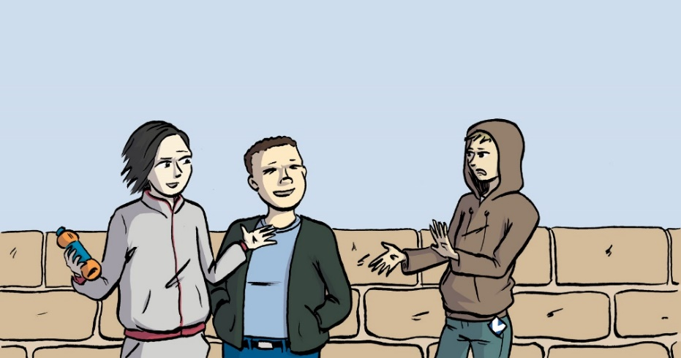
Scenario 1
You find out that Charlie, who is 15, has been called names by a group of boys because of a perceived characteristic he holds. You then overhear them threatening to beat him up.
Select one - age, disability, race, religion, sexual orientation, transgender Identity, variations in sex characteristics.
Please refer to the 5Ds - Direct, Distract, Delegate, Document, Delay.
Consider each of the bystander approaches you might take and then answer the following questions.
Which intervention felt the most natural to you?
Which intervention felt safest?
How comfortable would you feel intervening in reality?
What would help you in this position?
This activity is adapted from the Speak Up activity ‘Man on the Bus’.
Notes:
This scenario encourages participants to think about how they might use the 5Ds of bystander intervention. It is up to participants which protected characteristic they would like to focus on as this could differ depending on the young people they support.
Facilitators are welcome to include an anonymous real example from their local community for this activity.
You find out that Charlie, who is 15, has been called names by a group of boys because of a perceived characteristic he holds. You then overhear them threatening to beat him up.
PICK ONE (age, disability, race, religion, sexual orientation, transgender Identity, variations in sex characteristics).
Please refer to the 5Ds (Direct, Distract, Delegate, Document, Delay)
Consider each of the bystander approaches you might take and then answer the following questions.
Which intervention felt the most natural to you?
Which intervention felt safest?
How comfortable would you feel intervening in reality?
What would help you in this position?
Things to consider include, what is the safest option for the individual wishing to intervene, how much risk are they willing to take and what is the minimum they can do. This should also include thoughts about any other external factors that could impact what can be done, is this taking place in a school, the relationship with the young people are both potential examples of this.

Slide 18

More scenarios
Pause for Thought…
These slides include scenarios as prompts for discussion and reflection.
These scenarios are not intended to be prescriptive, but instead to demonstrate some of the ways in which prejudice-based behaviours and hate crime may present in education.
They can assist in reflection for both individual staff and school leaders to help inform and strengthen discussion around procedures in practice.
Points for consideration can be found in the notes of each slide and in the Facilitation notes.
The scenario has been adapted by two young people’s story for respectme, inspired by their lived experiences in Scottish education. You can listen to their original 6min story by clicking on the audio icon.
Notes:
Slide 22:
These slides include scenarios as prompts for discussion and reflection.
These scenarios are not intended to be prescriptive, but instead to demonstrate some of the ways in which prejudice-based behaviours and hate crime may present in education.
They can assist in reflection for both individual staff and senior leaders to help inform and strengthen discussion about settings' procedures in practice.
Points for consideration can be found in the notes of each slide and in the Facilitation notes.
The scenario has been adapted by two young people’s story for respectme, inspired by their lived experiences in Scottish education. You can listen to their original 6min story by clicking on the audio icon.

Slide 19
Scenario 3
Pause for Thought…
After a week of being called the same insults when the teachers weren’t there, Ambimbola started to feel less happy. A group of girls would think of new ways to make her feel miserable - pouring liquids in her bag, messing up her homework, pulling her hijab - even following her home when her mum wouldn’t pick her up. She tried pretending being on the phone to someone and changing her routes, but they would always find her.
Discuss and reflect:
Identify the prejudice-based behaviours experienced by Ambimbola.
What impact do they have on her?
What might be the barriers to reporting for Ambimbola?
If Ambimbola told you about her experiences, what might be your next steps?
Notes:
Scenario 2:
After a week of being called the same insults over and over again when the teachers weren’t there, she started becoming less happy. A group of girls would think of new ways to make Ambimbola feel miserable by pouring liquids in her bag, messing up with her homework, pulling her hijab, even following her home when her mum wouldn’t pick her up. She tried pretending being on the phone to someone, even changing her routes but they would always find her.
Discuss & reflect:
Identify the behaviours experienced by Ambimbola.
What impact do they have on her?
What might be the barriers to reporting for Ambimbola?
If Ambimbola told you about her experiences, what might be your next steps?
What sector might this occur in? How might things be different if it happened in another sector?
Points to consider:
Pouring liquids in Ambimbola’s bag, messing up her homework, pulling her hijab and following her home will have a negative impact on Ambimbola’s wellbeing. She is unhappy, scared, isolated, anxious and distressed. This could impact her ability to learn and feel safe at school.
Potential barriers to reporting for Ambimbola:
she might not want to cause trouble or concern for her family
she might be afraid that reporting the incidents at school and as hate crime might exacerbate the prejudice-based behaviours she experiences
she might not trust the adults in her setting to take appropriate action
To respond to these prejudice-based behaviours, a member of staff should:
Follow the 5 Ds
Support Ambimbola and ensure her needs are being prioritised in the next steps, discussing consequences for the perpetrators with her consent.
Respond to those initiating prejudice-based behaviours following the settings relationships & behaviour policy
Seek support from pastoral care, senior colleagues, youth work managers, social work, Health and Police Scotland including Campus Officers.

Slide 20
Reflection 2
From what you have learned so far, think about:
How has this made you feel?
What has this made you think about?
What one action would you like to take forward?
How can you link what you plan to do with others in your setting?
How will you know that this learning has made a difference?
Notes:
Participants can do this in groups.
Encourage educators to look at reflection questions and consider how they may be taken forward in enquiry.

Slide 21
Find out more...
Prevention
Promoting positive relationships and behaviour
Restorative Approaches and Hate Crime
LGBT inclusive education (tie.scot)
Intervention
Speak Up: 5Ds of Bystander intervention
The Digital Discourse Initiative
SACRO STOP service
Misinformation
Rumours to Riots the impact of misinformation
Misinformation and disinformation (dlwc.co.uk)
Misinformation, fake news and disinformation (BBC Teach)
General information on hate crime
Scottish Government Hate Crime Strategy
Changes in Hate Crime legislation
Crown office resources for schools
I am me learning platform
Notes:
Links to further information looking at Prevention, Intervention, Misinformation and general information about Hate Crime.
Facilitators are welcome to add links to local sources including any local authority equalities plans addressing hate crime.
There is a directory of organisations that support different communities facing hate crime on the Action on Prejudice website. https://www.actiononprejudice.info/organisation-directory/
PREVENTION
Resources to help prevent prejudice-based behaviours and hate crime on Education Scotland’s Inclusion, Wellbeing and Equalities Professional Learning Framework
No Knives Better Lives Restorative Approaches and Hate Crime Course
Promoting positive relationships and behaviour in educational settings | Resources | Education Scotland
INTERVENTION
Speak Up: 5Ds of Bystander intervention https://www.actiononprejudice.info/library/speak-up/
The Digital Discourse Initiative professional learning course aims to provide educators in Scotland with knowledge and tools to counter the effects of online hate in schools
SACRO – STOP service uses a programme which has been designed to educate and rehabilitate individuals to ensure positive, achievable and sustainable changes in attitudes and behaviours
Criminal Justice Pathway – SOLD (soldnetwork.org.uk)
MISINFORMATION
The Southport Attack: From Rumours to Riots – a resource on the impact of misinformation by Dundee International Women’s Centre
Misinformation and Disinformation resources – Dundee International Women’s Centre
Resources from BBC Teach on misinformation, fake news, and disinformation.
HATE CRIME GENERAL INFORMATION
https://www.actiononprejudice.info
Info sheet on the changes in Hate Crime legislation
https://www.copfs.gov.uk/resources/for-schools/
https://iammescotlandeducation.org.uk/
Scottish Government’s Hate Crime Strategy
Scottish Government’s Hate Crime Strategy Delivery Plan
Hate Crime and Public Order (Scotland) Act 2021 – General information note
Hate Crime and Public Order (Scotland) Act 2021 - Factsheet

Slide 22
Other resources on the Framework
The following resources on the Inclusion, Wellbeing and Equalities Professional Learning Framework can also support understanding, preventing and responding to hate crime and prejudice-based behaviours:
Bias and Inequality
Impact of Inequality
Develop your Religious Literacy: Parts 1 and 2
Mirrors and Windows: Diversity in the Curriculum
Talking about Diversity
Relational Approaches
Active Listening
Co-regulation and de-escalation
Expectations and Consequences
Notes:
Slide 4:
The following resources on the framework can also support understanding, preventing and responding to hate crime and prejudice-based behaviours:
Bias and Inequality - to help prevent hateful behaviours
Impact of Inequality - to understand the impact of hateful behaviours
Talking about Diversity - to support conversations about prejudice and diversity
Develop your Religious Literacy Parts 1 and 2 - to support an understanding and prevention of religious-based prejudice and hate
Mirrors and Windows: Diversity in the Curriculum - to prevent and address the development of prejudice through the curriculum
Relational Approaches - to support trauma-informed, restorative and solution-oriented approaches
Active Listening
Co-regulation and de-escalation - to help manage conflict between individuals
Expectations and Consequences - to help prevent hateful behaviours and crime

Slide 23
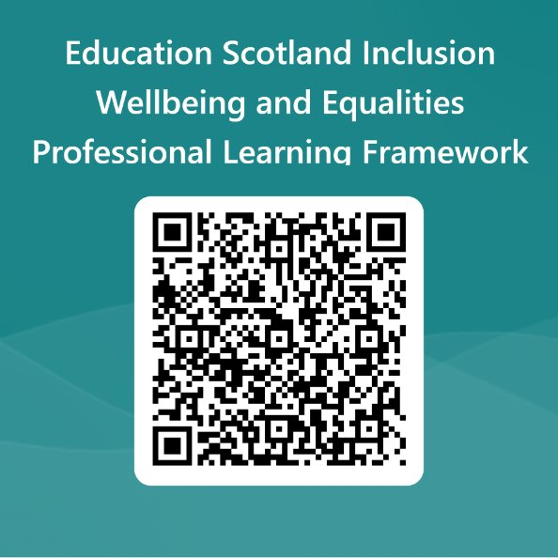
We value your feedback​
Your feedback could help us improve this resource and add to the overall value of the professional learning framework to the educational system​
Please complete this short form, using the link or QR code, to let us know what you thought of it and any suggestions you have on how it could be improved ​
Inclusion wellbeing and equalities feedback form
Notes:
Education Scotland is taking feedback on these resources so that we can continue improving our professional learning resources.
Your feedback could help us improve this resource
Please complete this short form, using the link or QR code, to let us know what you thought of it and any suggestions you have on how it could be improved: Education Scotland Inclusion Wellbeing and Equalities Professional Learning Framework (office.com)

