Slide 1
About this resource
🌟 What this session is for
This resource is designed to introduce Primary 5 learners to PIRLS 2026 on-screen assessment in a way that is positive, clear, and confidence‑building. It can be used as either an assembly or a classroom lesson, depending on what works best for your setting.
📘 What the message aims to do
Help pupils understand what PIRLS is and why they have been chosen to take part.
Build a sense of pride, purpose, and global connection.
Reassure pupils that PIRLS is not a test that they pass or fail, but is a chance for them to show how they think when they read.
Give them a simple, memorable analogy for what a study is.
Encourage a positive reading attitude as they approach the study.
🧩 What’s included
A PowerPoint presentation, with teacher guidance provided in the notes section to support delivery.
Quick, interactive vocabulary and discussion tasks to keep learners engaged.
A short video to spark curiosity and pride.
A short plenary/reflection activity to help them consolidate the message.
Optional follow‑up activities for classes who want to explore PIRLS in more depth.

Slide 2



Mission Impossible?
Imagine you were asked to find out how well Primary 5 children across the world read
Talk to your partner - what makes this so difficult? What would you need to think about?
Notes:
Suggested teacher notes:
Say: "Your mission, should you choose to accept it...is to figure out the problems. Talk to your partner - what makes this so difficult? What would you need to think about? You've got 2 minutes."
Let them discuss, then write/gather ideas on flip chart paper or on screen.
They might come up with:
Different languages - how do you compare?
Different alphabets
Some countries have lots of books, some don't
Teachers teach differently everywhere
Can't visit every school
Some children might be nervous
How do you make it fair?
Who's going to organise all of it?
How long would it take?
Say: "Look at this list. Every single problem you've just identified? Real people had to solve them. And the solution they came up with is something called PIRLS.

Slide 3
PIRLS
Notes:
As you move through the slides, say: "PIRLS stands for Progress in International Reading Literacy Study and today we are going to find out a bit more about it and why it is important for us."

Slide 4
PIRLS
Progress

Slide 5
PIRLS
Progress
in International

Slide 6
PIRLS
Progress
in International
Reading

Slide 7
PIRLS
Progress
in International
Reading
Literacy

Slide 8
PIRLS
Progress
in International
Reading
Literacy
Study

Slide 9
Key vocabulary
Notes:
The following section introduces learners to key vocabulary with a child-friendly definition and accompanying image.
Say: "But before we can learn more about PIRLS, there is some key vocabulary we need to explore."

Slide 10

Key vocabulary - research
research
Finding out information to answer a question
Notes:
Move through the slides, one at a time and have learners choral read the vocabulary and the child-friendly definition.

Slide 11

Key vocabulary - international
research
international
Involving lots of different countries around the world
Finding out information to answer a question

Slide 12

Key vocabulary - participant
research
international
participant
Involving lots of different countries around the world
Finding out information to answer a question
Someone who takes part in something

Slide 13

Key vocabulary - data
research
international
participant
data
Involving lots of different countries around the world
Facts and information collected to help us understand something
Finding out information to answer a question
Someone who takes part in something

Slide 14

Key vocabulary - compare
research
international
participant
data
compare
Involving lots of different countries around the world
Facts and information collected to help us understand something
Looking at two or more things to see what's the same and what's different
Finding out information to answer a question
Someone who takes part in something

Slide 15

Key vocabulary - study
research
international
participant
data
compare
study
Involving lots of different countries around the world
Facts and information collected to help us understand something
Looking at two or more things to see what's the same and what's different
A project where information is collected to understand something better
Finding out information to answer a question
Someone who takes part in something

Slide 16


Call my bluff 1
Call My
Bluff
The teacher collected data on how we get to school - walking, bus, or car
A. Eating a special dinner
B. Facts and information
C. The date on
the calendar
Notes:
Call My Bluff: This is a quick game to explore the vocabulary introduced.
Learners choral read the scenario and then decide upon the correct definition for the word displayed in bold.
Learners can work with a partner to decide and simply feedback by writing A, B or C on a mini-whiteboard or by voting with their hands.

Slide 17
Call my bluff 2
Call My
Bluff
Maya did some research on the solar system
A. Finding out information
B. Writing a story about space
C. creating a papier-mâché planet

Slide 18
Call my bluff 3
Call My
Bluff
The football tournament was international
C. Involving lots of different countries
A. Full of goals
B. A competition

Slide 19
Call my bluff 3
Call My
Bluff
Tom was a participant in the school sports day and won three races
A. Helper
B. Taking part
C. Watching

Slide 20
Call my bluff 4
Call My
Bluff
In reading we compared two characters in the story
A. Chose our favourite.
B. Looked at what made them the same or different
C. Drew a sketch

Slide 21
Call my bluff 5
Call My
Bluff
Scientists did a study on how much sleep children need
C. A special project
to learn more
A. Prepared for an
exam
B. Film

Slide 22

Connect it 1
A group wants to find out what breakfast foods children eat in different countries. They ask 500 children in 12 countries to fill in a form about what they had this morning.
Connect
It!
research
international
participant
data
compare
study
Notes:
‘Connect It’: a further task to help learners connect the vocabulary to real contexts…
After reading the scenario learners work together to make connections between the vocabulary and the definitions.
For example, in this scenario the participants are children, and it is international because it includes participants from 12 countries etc.

Slide 23
Connect it 2
A group wants to learn about how Primary 5 children in 62 countries learn to read. They work with schools to give children some reading activities to do online and collect the information to look at together.
Connect
It!
research
international
participant
data
compare
study
Notes:
This example outlines what PIRLS is all about.
Once learners have made the connections, explain to them that this is what PIRLS is about. Scotland will be one of the 62 countries, and they will be the participants etc.
Here, emphasise that PIRLS is an online study and that they will therefore answer questions using a digital device e.g. a laptop or computer.
Point out that some of the PIRLS texts will reflect reading digitally (e.g. web pages with hyperlinks and other multimedia features that require pupils to navigate, find information and connect ideas), while other texts, like stories, are presented on-screen in a more conventional format.

Slide 24
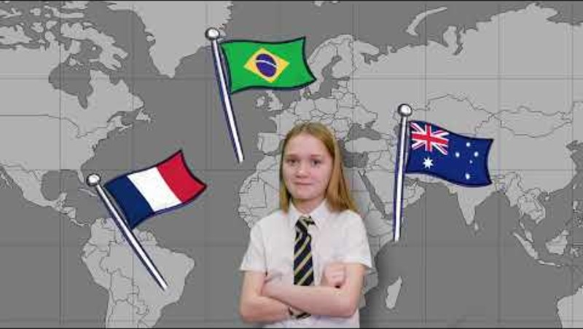
Video about PIRLS
Notes:
Watch the short video for learners https://youtu.be/oNBH5sHyW4o?list=PLcD2TdZ4bXSlHigGt_XIi0QetYn9ixFqd

Slide 25



Think
Link
Notes:
After watching the video display this slide.
Say: “Look at the three images. What links them all? Talk to your partner - what's the connection?“
After a short discussion, take ideas. The answer is PIRLS, but also could be ‘research’, ‘study’, ‘international’.
Probe: Why does that image link to PIRLS? What did the video say?

Slide 26

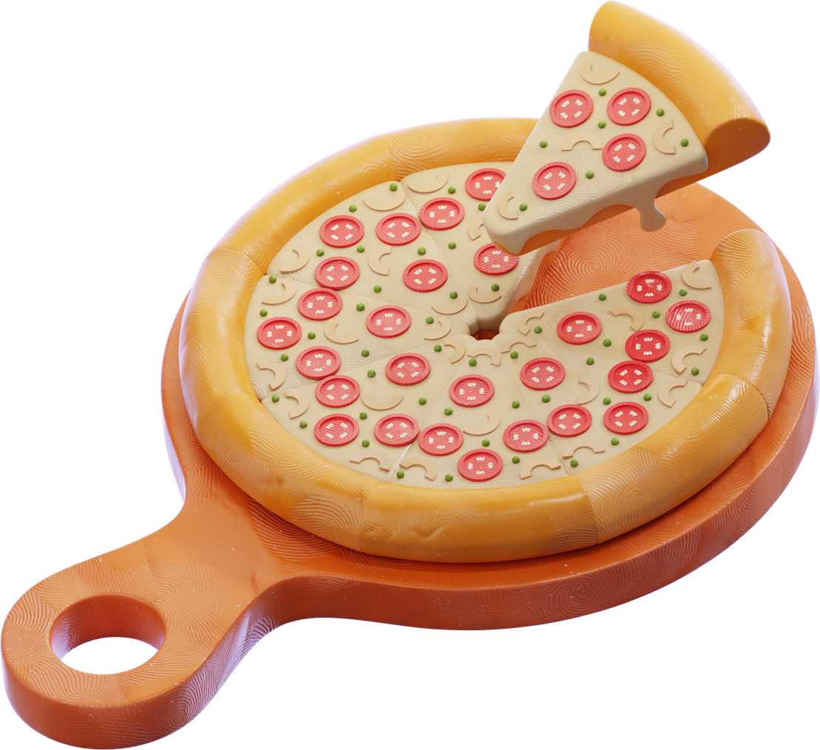
I Wonder
Why?
Notes:
Introduce the analogy of a pizza to learners.
Say:
“Imagine you’ve invented a brand‑new pizza. You think it’s delicious, but before you start selling it everywhere, you need to find out what people really think. So you invite lots of different customers to try it and tell you about their experience”.
Why collect feedback? Because everyone is different, and their opinions help you understand what’s working and what needs to change.
Some people might say, “This pizza is amazing!”
That tells you you’re on the right track.
Some might say, “I like it, but I wish it had more cheese.”
That helps you improve the recipe.
Others might say, “I can’t eat this because I need a gluten‑free or dairy‑free option.”
That shows you need different versions so everyone can enjoy it.
A few might say, “I don’t like spicy toppings.”
That helps you offer more choices.
What do you do with all that information?
You look at the results from everyone, not just one person. When you put all the feedback together, you can make smart decisions e.g.:
Add new topping choices.
Create gluten‑free or dairy‑free versions.
Adjust the recipe.
Make the pizza better for more people.

Slide 27
I Wonder
Why?
Notes:
PIRLS works the same way.
Instead of pizza, researchers are collecting information about how children read.
Your answers show what helps you understand a text.
Other children’s answers show what helps them.
When all the information is put together, adults can make reading lessons better for everyone.
Just like improving a pizza recipe, PIRLS helps improve reading education by listening to lots of different voices.

Slide 28

I wonder why 3
I Wonder
Why?
They also give everyone the same questionnaire about how they feel about reading and what they read at home.
PIRLS gives the same on-screen reading activities to children in 62 different countries
Notes:
Read the statement on the slide.
Say: “I wonder why the children are given the SAME reading activities? Talk to your partner.“
Take ideas e.g.:
To be fair.
So you can compare properly.
So the data means something.

Slide 29
I wonder why 4
I Wonder
Why?
They also give everyone the same questionnaire asking how they feel about reading and what they read at home
PIRLS gives the same on-screen reading activities to children in 62 different countries
Notes:
Now focus on the second part.
Say: “Why give a questionnaire about how you feel about reading and what you read at home? What could researchers learn from that?“
Take ideas e.g.:
Maybe children who enjoy reading more do better.
Maybe having books at home makes a difference.
Maybe some countries read more for fun than others.
It helps explain WHY some countries score higher.

Slide 30
I wonder why 5
I Wonder
Why?
The on-screen reading activities tell researchers WHAT is happening
The questionnaire helps them understand WHY. Both together give the full picture
Notes:
Explain the two parts of PIRLS e.g.:
"The reading activities that you will complete tell researchers WHAT is happening - what children are doing well and what they find challenging. The questionnaire helps them understand WHY. Both together give the full picture"

Slide 31

Think it through
Think it Through
The video said PIRLS is not a test and you don't need to practise. Why do you think they want you to know that?"
Notes:
Now look at the statement on this slide. Say: "Talk to your partner. Why is that important?“. “ Why is PIRLS called a STUDY and not a test?”
Take ideas e.g.:
So you don't worry.
Because it’s not a test of them personally, but an online study on reading achievement generally.
So that it feels more normal.
To make sure the results are an accurate reflection of pupils’ reading in each country.
So that it's fair for everyone.

Slide 32




One Thing I’m Taking With Me
Choose one reflection statement from the list
One thing I learned about PIRLS is...
One thing I’m looking forward to is...
Exchange your reflection with a partner
One attitude I’ll bring when I take part is...
Be ready to share!
Notes:
Final plenary/reflection:
Explain the task on the slide and ask learners to discuss their ideas with their partner.
For “One attitude I’ll bring when I take part is...”, pupils might think of things like:
Curiosity
Calmness
Thoughtfulness
Determination
Open‑mindedness
Patience
Learners hold up one finger, two fingers, or three fingers to show their reflection.
Ask them to share with their partner or take 3–4 quick shout‑outs.
Reinforce the message that PIRLS is about mindset, not performance.

Slide 33

EXPLORE
MORE
Notes:
Follow up activities for teachers/schools who want to dive deeper into PIRLS…

Slide 34


Where in the World?
PIRLS is a worldwide study. Children your age are taking part in lots of different countries. Let’s find out where in the world they are!
Notes:
🧠 Starter prompt
“PIRLS is a worldwide study. Children your age are taking part in lots of different countries. Let’s find out where in the world they are!”
https://www.iea.nl/studies/iea/pirls/2026
🗺️ Task (2–3 minutes)
Show a world map (on a slide or printed) and give learners a short list of participating countries. Ask them to:
Locate as many countries as they can on the map.
Point, stand, or move to show where they think each country is.
Call out what they already know about any of the places (climate, languages, landmarks, etc.).
You could choose a small, manageable set such as:
Scotland
USA
France
Saudi Arabia
South Africa
Australia
Singapore
Norway
Italy
Canada
💬 Discussion prompt:
“What do you notice about where these countries are? Are they close together? Far apart? Spread across different continents?”
This helps pupils see the global scale of PIRLS.
🌐 Connection to PIRLS
Bring it back to the purpose:
“Children in all these places will read the same stories as you. When researchers look at everyone’s answers together, they can understand how reading works around the world. You’re part of a global reading team.”

Slide 35
Do they wear uniform?
County
Detective
Your challenge is to investigate one of the countries taking part in PIRLS and uncover clues about what life is like for children your age.
What language do children speak there?
What do chlldren read - any popular books, authors, or characters?
What age do children start school?
How long is their school day?
Notes:
Country Detective activity:
Each learner/pair/group picks a country from the PIRLS list and investigates:
What language do they speak?
What's school like there -start age, school day length, uniform?
What do children read for fun there? Any popular authors or books?
How does Scotland compare?
Make it exciting: Learners could create a class "Passport" booklet. Each country they research gets a stamp.

Slide 36

30 Second Pitch
PIRLS needs a new TV advert to explain to other children what it's about. You've got 10 minutes in class to create a 30 second pitch.
Your pitch must include the following:
It helps make reading better for children across the world.
62 countries are taking part this year.
Children will read and answer questions.
It’s called a study, not a test.
Notes:
30 Second Pitch
Say: "Your job: PIRLS needs a new TV advert to explain to other kids what it's about. You've got 10 minutes in class to create a 30 second pitch."
On screen, put up the must-include:
It’s called a study, not a test.
62 countries take part.
You read and answer questions.
It helps make reading better for children everywhere.
Say: "Make it exciting. Make people want to be part of it. You'll share them with the class."

Slide 37
The PIRLS Playlist
PIRLS includes a questionnaire about what you read and how you feel about reading.
Create a class "reading playlist" - not songs, but you could include the following:
A fact I learned from a book that I’ll never forget.
A line from a poem that stuck in my head.
A book that made me laugh most.
A character I'd want as a friend.
A place from a book I'd like to visit.
Notes:
The PIRLS Playlist
Brainstorm a criteria list and ask learners to work together to create their playlists. Some ideas below:
The book that made me laugh most.
The book I couldn't put down.
A character I'd want as a friend.
A place from a book I'd visit.
A fact I learned from a book that I’ll never forget.
A real person I’d like to meet after reading about them.
A topic I want to explore more because of a book.
A non‑fiction book that changed how I see something.
A true story that inspired me.

Slide 38

Interview an Adult
Interview a parent, carer, or teacher. What might you ask them about what they remember about being in Primary 5 and their own reading experiences?
Can you remember what kind of things you read?
What book taught you something new about the world?
Do you think reading is different for children now?
What do you remember about being in P5?
Did anyone read to you at home or school?

