Slide 1

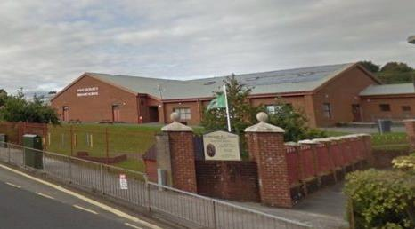

Pupil Equity Fund
St. Michael’s Primary
Dumbarton

Slide 2
Presentation outline
Set the context of West Dunbartonshire and our school
PEF funding
Early Education & Childcare Officer
Interventions and Impact
Next steps
Reflection task

Slide 3
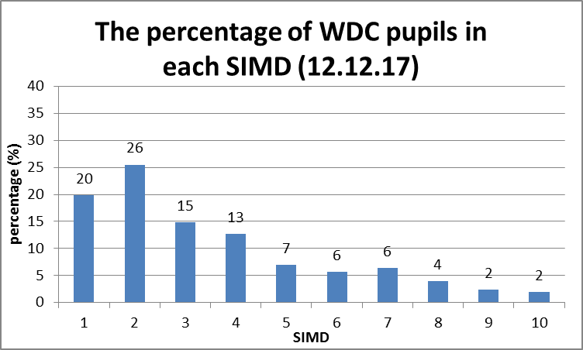
West Dunbartonshire – the context
Challenge authority
December 2017 the first inspection of the Scottish Attainment Challenge
Improvement Framework
Notes:
with a strong commitment to improving learning, raising attainment and narrowing the poverty related attainment gap

Slide 4
WDC support with PEF
Local Learning Community approach
PEF Website
Helpful guidance on recruitment
Partnership roadshow
Notes:
2 e.g. psychologist or pupil and family support workers
3 status reports and highlight reports through a website on Ourcloud
4 e.g. Tullochan Trust, Working 4 U, The Spark, Prince’s Trust, Glasgow University.
Tullochan Many of the young people we engage with are facing significant disadvantage and hardship which affects their ability to fulfil their potential.

Slide 5
St. Michael’s Context
291 pupils
12 classes
73% SIMD 1&2
39% FME
PEF £146,000
Notes:
We are on our journey to close the poverty related attainment gap. We expect progress for all learners and excellent progress for many. We want all SIMD bands represented in the excellent progress category and will target support to ensure there are no patterns of lower attainment for children in lower SIMD bands.

Slide 6
PEF Overview
Level | PEF | Cost
Early | Early Education and Childcare Officer | £25,928
First | Pupil and Family support worker | £22,910
Second | Pupil and Family support worker Psychologist appointed between learning community to work with P7 children. Tullochan Trust | £22,910 £24,000 £1,400
All Levels | Clerical assistant ( 0.2) Working 4 U Investment in Digital Technologies Experiential Learning | £4,000 £1,400 £8,000 £8,000
Cost

Slide 7
Interventions for Equity
Notes:
Joseph Rowntree Foundation
The gap between children from low income and high income household starts early. By age 5, it is 10 months in problem solving development and 13 months in vocabulary.
The Scottish Attainment Challenge and the Pupil Equity Fund.
John Swinney talked at the EIS Conference 2016 and stated that there needs to be links between health and education. How joined up is this approach???
Growing up in Scotland Survey looks at reducing the gap between the least and most disadvantaged children. Sosu and Ellis argue the need for better research and evaluation to improve policy and practice to enable a deeper understanding of how poverty affects attainment. Reducing inequality requires policies in housing, criminal justice, taxation and healthcare.
Parental socio economic background has more influence than the school attended.

Slide 8
Early Education and
Childcare Officer
Focus on Scottish Index of Multiple Deprivation (SIMD) 1& 2
Based on assessment evidence of P1
Scrutiny of data to provide targeted support
Extended to P2 and P3 at Early Level
Notes:
2 CHILD being most important (against, monthly transition meetings, their transfer of information , baseline assessments in literacy and numeracy)
1&2 children where there was a gap and identified focus groups for targeted interventions
Timetables to allow links with feeder Early Years Centre – building links in learning
NOT ALL children in deciles 1&2 need support but some children out with these deciles who did require support
Most support at P1 but targeted support also at p2 & p3
Involved in CAR
Link with nursery (already targeting support to nursery children preschool year)
Tracked progress using 5 key measures: Attendance, Attainment, Exclusion, Engagement and Participation

Slide 9
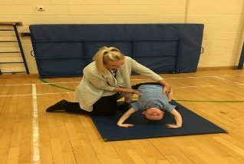
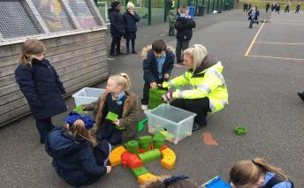
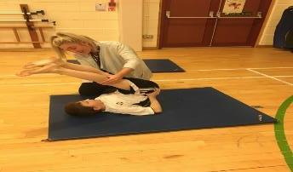
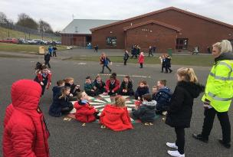

Interventions in Health and Wellbeing
Social Skills
Cognitive Skills
Curriculum for Excellence Cross Cutting Life Skills
Relationships
Personal Qualities
Notes:
Starting point
Encouraging cross cutting life skills
Homework Club, Gymnastics Club, Playground Support
IMPACT
Positive relationships built in small group and 1-1 situations
Increased engagement in afterschool clubs, improvement in approaches to play in the playground
Built relationships across h&wb, literacy, numeracy which has engaged children with a range of needs to feel welcomed and valued in the whole school environment
TARGETED SUPPORT PLANS

Slide 10
Family Learning
Collaborative Action Research (CAR)
Collaborating with feeder Early Education Childcare Centre
Does the use of interaction bags increase parental engagement?
Notes:
Parental Engagement- Effective parental involvements programmes on helping parents to use appropriate strategies to support their children's learning have a positive impact on reducing the attainment gap
CAR –
Intervention targets our P1 children and also preschool children
Professional dialogue and links
Question, Pre/post questionnaires and daily child, parental workshops
Early stages but hope to measure impact
Breaking down barriers with parents before starting school

Slide 11
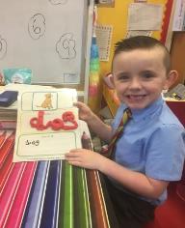
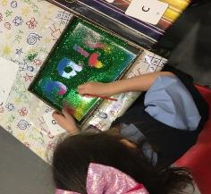
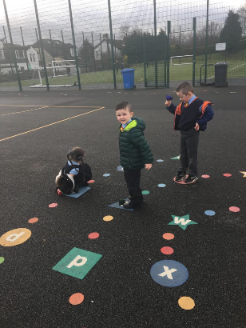
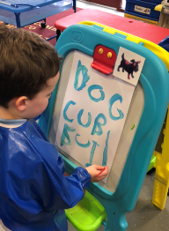
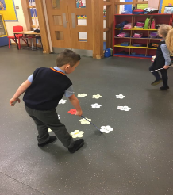

Interventions in Literacy
CLPL
Opportunities
Learning Through Play
Rhyme/
Word Aware
Notes:
Learning Through Play Approach –
Evidence of Impact – Learner 1 etc

Slide 12
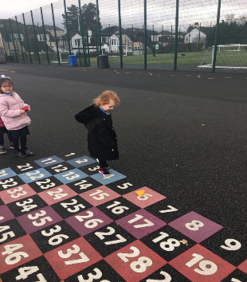
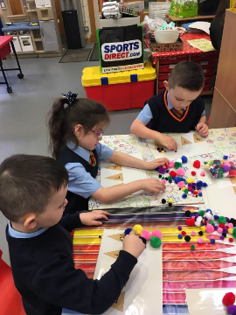
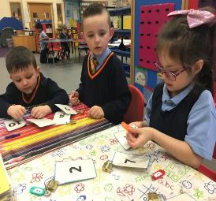
Interventions in Numeracy
Number Talk
Outdoor Learning
Learning Through Play
Notes:
IMPACT Learner 2-

Slide 13
Next Steps
Continue to engage with families
Enhance work with preschool children
Build partnerships with external agencies

Slide 14
Reflection
Please take 10 minutes to talk to the people around you to gather thoughts on what you’ve heard and compare this to your experience
Thank you and please feel free to ask any questions or get in touch
Jennifer.mulvenna2@west-dunbarton.gov.uk
01389 762038

